Slide 1
Deep Learning for Precision Segmentation of Retinal Images
Presented by:
Revanth Paineni
Sridhar Yemundla

Slide 2
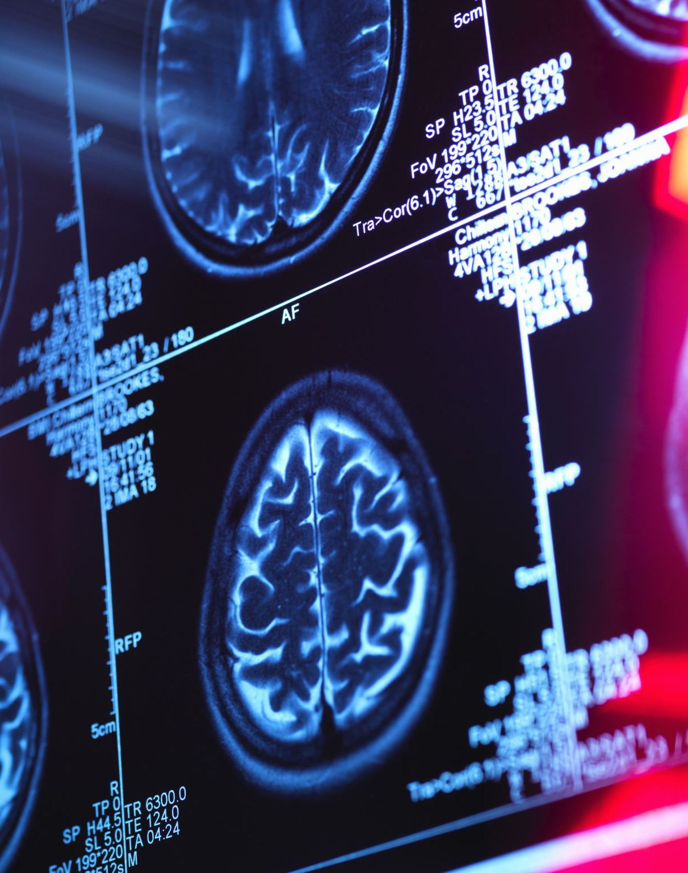
Project Overview
Objective: Develop a neural network model to segment retinal images, enhancing diagnostic processes.
Approach: Utilize state-of-the-art deep learning architectures, including hybrid Architecture,EfficientNet and MobileNet, to compare performance.
Impact: Improve accuracy and speed of retinal image analysis for medical diagnostics.

Slide 3

Data Sources
DRIVE Dataset: Digital images for vessel extraction, used for training segmentation models. DRIVE Dataset Link
High-Resolution Fundus (HRF) Image Database: Provides high-resolution images for detailed examination. HRF Database Link

Slide 4

Methodology
Preprocessing:
Image Preparation: Images resized to 256x256 pixels, normalized to range 0-1 for consistent input.
Model Architectures:
EfficientNet: As a backbone for deep feature extraction.
MobileNet: Compared for performance benchmarking.
Hybrid U-Net with Attention: Advanced architecture combining U-Net with EfficientNet, augmented by attention gates for enhanced focus on relevant image features.
Training:
Optimizer: Adam for efficient gradient descent.
Loss Function: Binary crossentropy, evaluating pixel-wise classification accuracy.
Callbacks: Model checkpoint saving and dynamic learning rate adjustments to prevent overfitting and promote convergence.

Slide 5

Evaluation Metrics
Accuracy:
Quantifies the percentage of pixels correctly segmented by the model.
Binary Crossentropy Loss:
Assesses model's precision in predicting segment boundaries against true labels.
Visualization:
Training vs. validation loss graphs displayed over epochs to indicate learning progress and diagnose model behavior (e.g., overfitting).

Slide 6
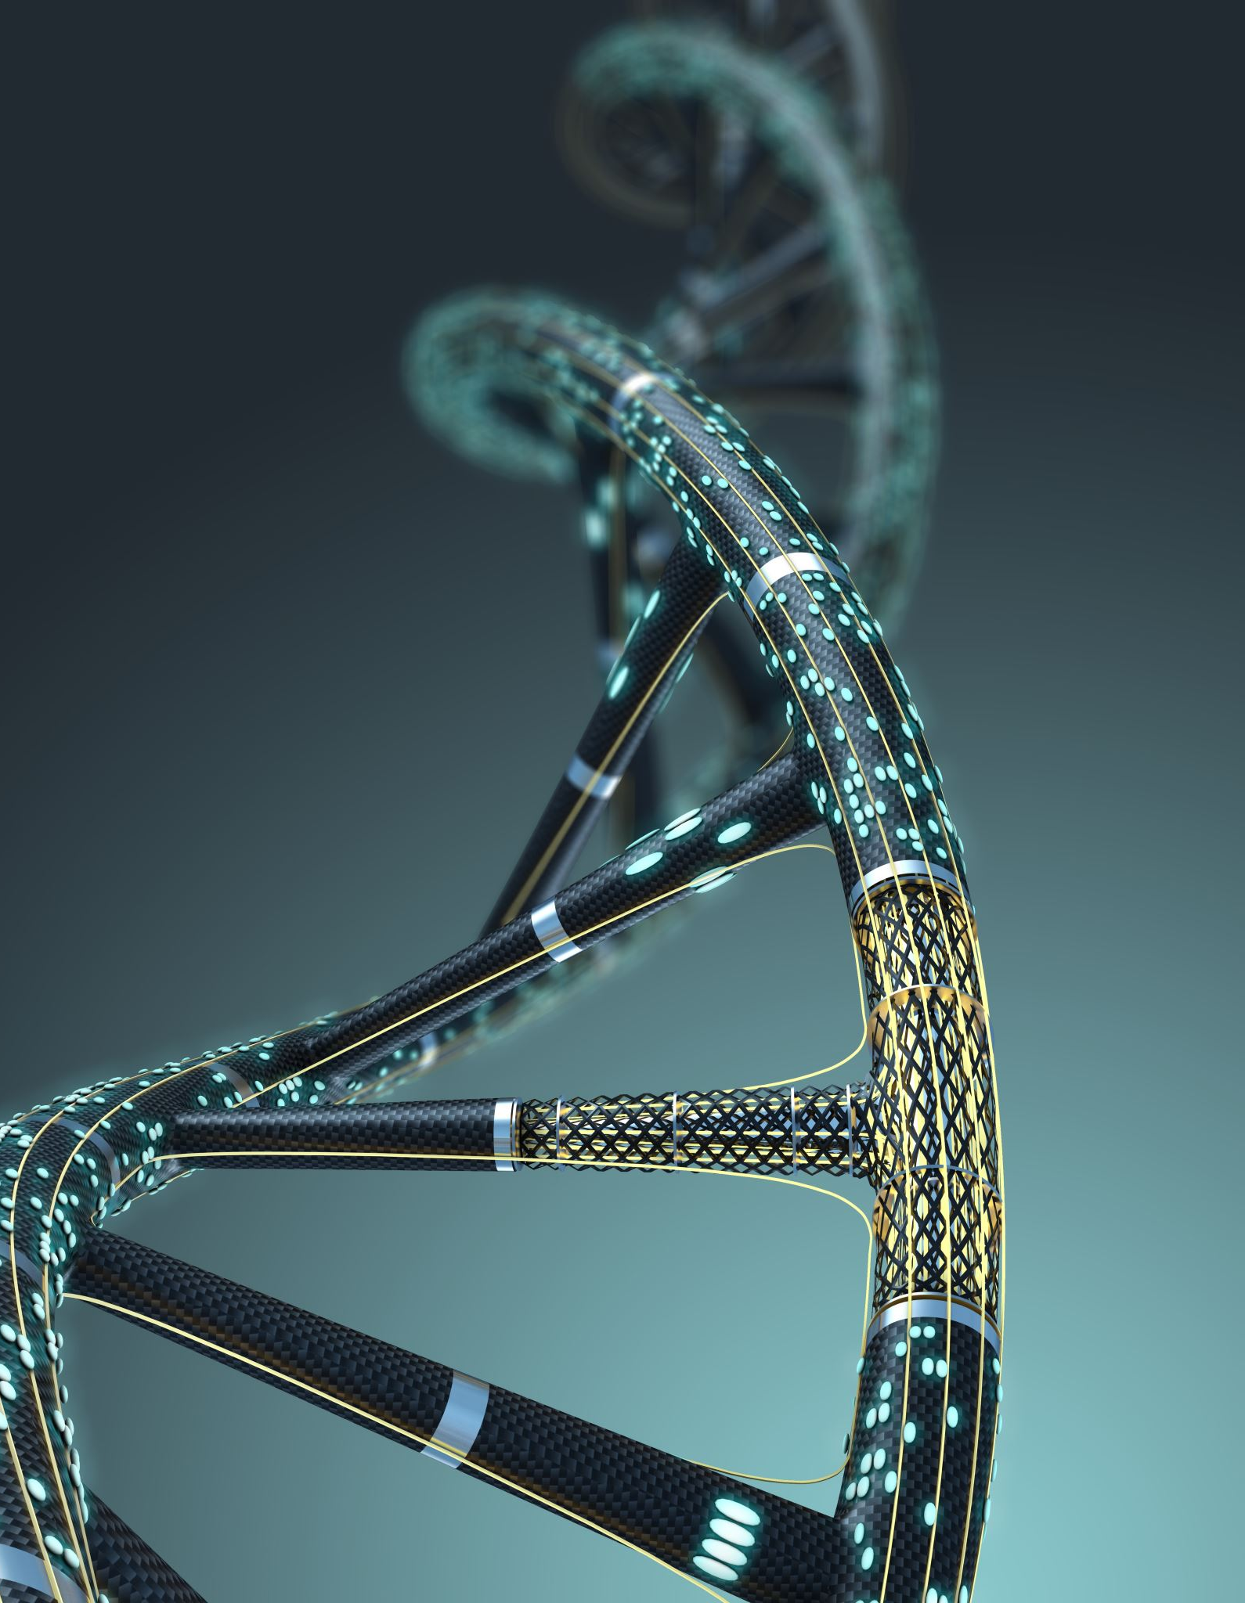
Results - Quantitative Analysis
Model Performance:
EfficientNet: Achieved 92% accuracy on the validation set.
MobileNet: Reached 92% accuracy.
Hybrid U-Net with Attention: Showcased superior segmentation precision, particularly in complex vascular structures.
Performance Summary:
The hybrid model with attention mechanism outperformed others, demonstrating its capability in handling intricate image details.

Slide 7
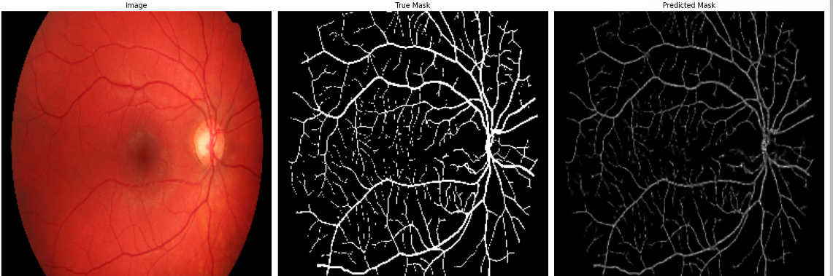
Visual Outputs - Sample Prediction
Image Displays:
Original images, true masks, and predicted masks from each model side-by-side for direct comparison.
.

Slide 8

Conclusion
Model Efficacy:
The hybrid U-Net model with an attention mechanism, using EfficientNet as a backbone, proved to be the most effective architecture for precise and detailed segmentation of retinal images.

