Slide 1
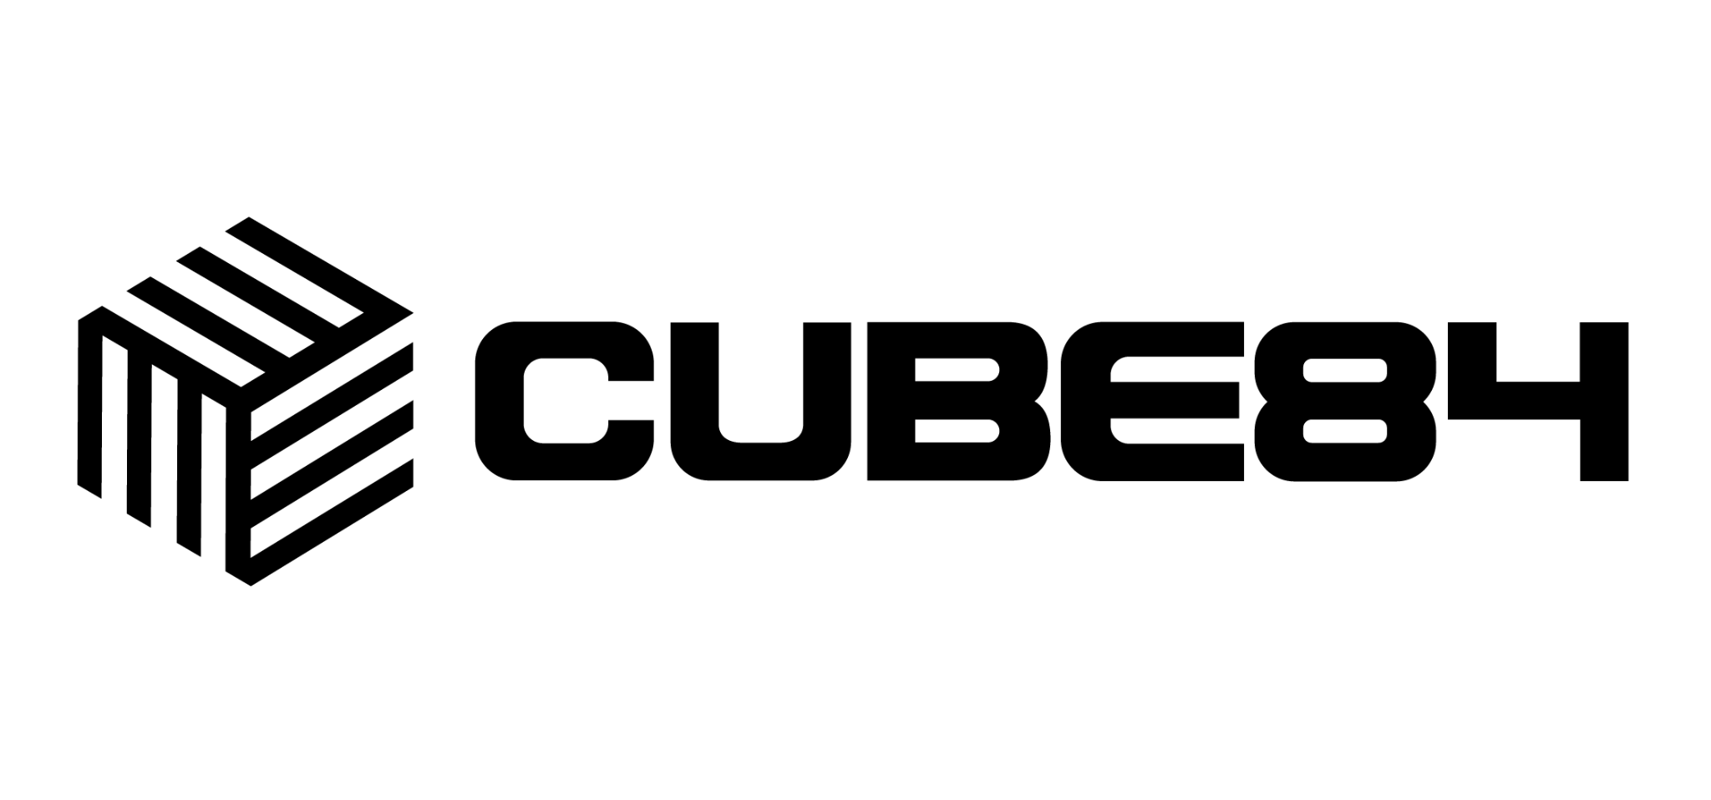

Azure DevOps to an on-prem server
Proving the connection works when traffic can only go outbound.
Internal enablement · CUBE84 · September 2026

Slide 2
The connection only runs one way
Azure DevOps cannot reach into the network. The server has to reach out.
What works
What will never work
The server opens an outbound HTTPS connection on port 443
Azure DevOps opening a connection into the network
A self hosted agent polls Azure DevOps for waiting jobs
Microsoft hosted agents reaching the server
Git fetches, artifact uploads, and test results ride the same connection
Inbound webhooks or service hooks landing on an internal endpoint
Service connections and deployment groups work the same outbound way
Any connectivity check started from the Azure DevOps side
So every test runs from the on-prem server, outward. There is nothing to click in Azure DevOps that will ever reach the box.

Slide 3
Check four things on the server first
Run these as the account the agent will use, not as your admin login.
01
Outbound 443 is open
02
Public DNS resolves
Confirm the server reaches the internet on TCP 443, directly or through a proxy. Port 22 matters only if you use Git over SSH.
The server has to resolve dev.azure.com itself. Split DNS and internal only resolvers are a common cause of failure here.
03
The clock is in sync
04
The proxy is known
Check NTP. Skew over five minutes breaks token validation and surfaces as a 401 that looks like a permissions problem.
Find out whether a proxy is mandatory and whether it needs credentials. Proxy settings and certificate stores are per user on Windows.

Slide 4
The endpoints the server has to reach
All on port 443. Test each one, not just dev.azure.com.
dev.azure.com
Core service. Also allow {org}.visualstudio.com for older redirects.
login.microsoftonline.com
Entra ID sign in and token refresh.
app.vssps.visualstudio.com
Identity and token issuance for the agent.
download.agent.dev.azure.com
Agent download and auto update. Replaces the old azureedge.net entry.
*.vsassets.io
Log, test result, and artifact blob uploads. Often the last one blocked.
pkgs.dev.azure.com
Azure Artifacts feeds. Only if the pipeline restores or publishes packages.
Allowlist by DNS name, not by IP. The underlying Azure ranges rotate, and service tags are not supported for outbound connections.

Slide 5
The agent registering is the real proof
Everything before this is preparation. This is the test that settles it.
1
2
3
4
Install and configure
Run it as a service
Watch the pool
Queue a real job
Unpack the agent on the server and run config.sh or config.cmd with the org URL and a PAT. If it completes, DNS, TLS, proxy, and auth are all working.
Start it interactively first, then install it as a service under the account it will really use.
In Agent pools the agent should show Online and stay Online for ten minutes or more.
Pin a job to that pool that publishes an artifact and test results, not one that only echoes the hostname.
An agent that flaps between Online and Offline points at a proxy idle timeout cutting the long poll, not at the agent. Downloads passing while uploads fail points at *.vsassets.io.

Slide 6
One test settles it:
the agent stays Online and a job uploads.
If Azure DevOps has to call into the network for webhooks or service hooks, outbound only will not carry it. That needs the on-prem side to poll, or a relay such as Azure Relay or Private Link.

