Slide 1
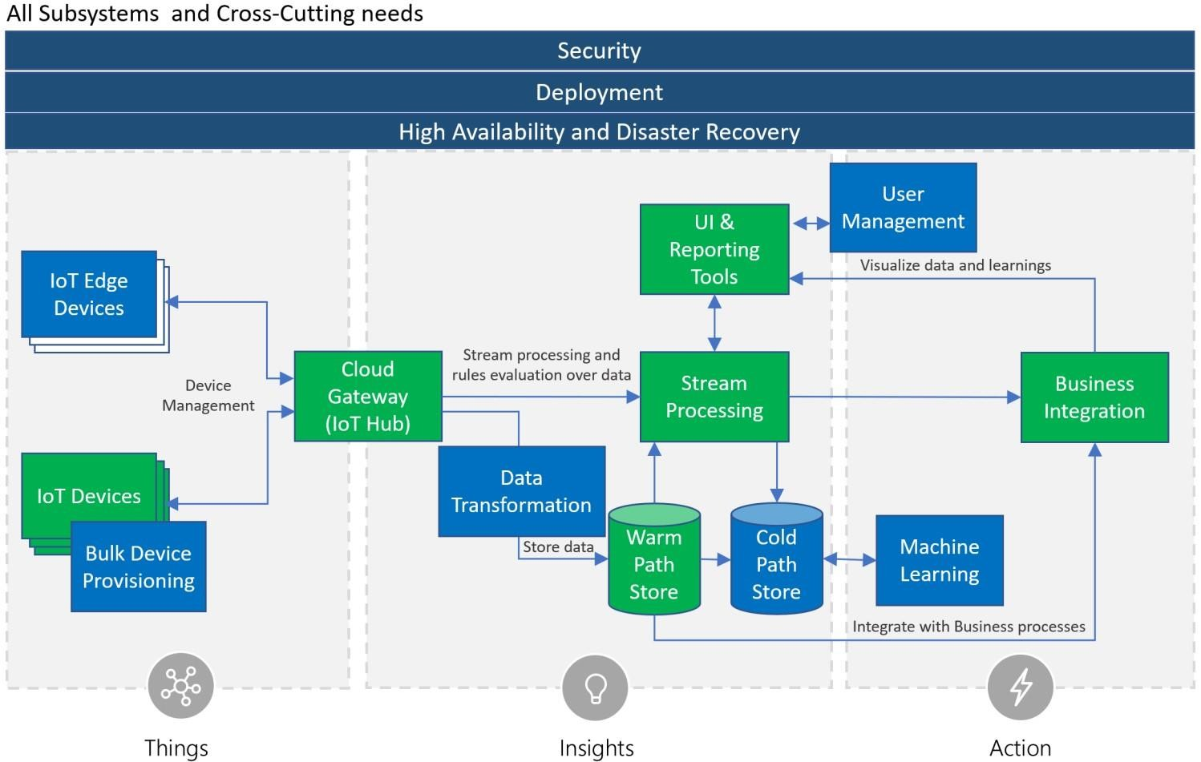
Reference Architecture

Slide 2









Wind Farm Architecture
Security
Deployment
High Availability & Disaster Recovery
Time Series Insight
Cosmo DB
Power BI
Wind Farm Simulator
Azure IOT Hub
Azure Stream Analytics
Azure Functions
Data Lake Store
Data Lake Analytic
THINGS
INSIGHT
ACTION

