Slide 1
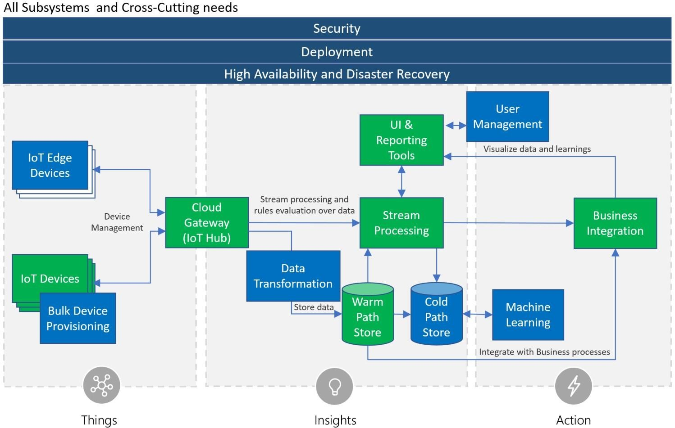
Reference Architecture

Slide 2
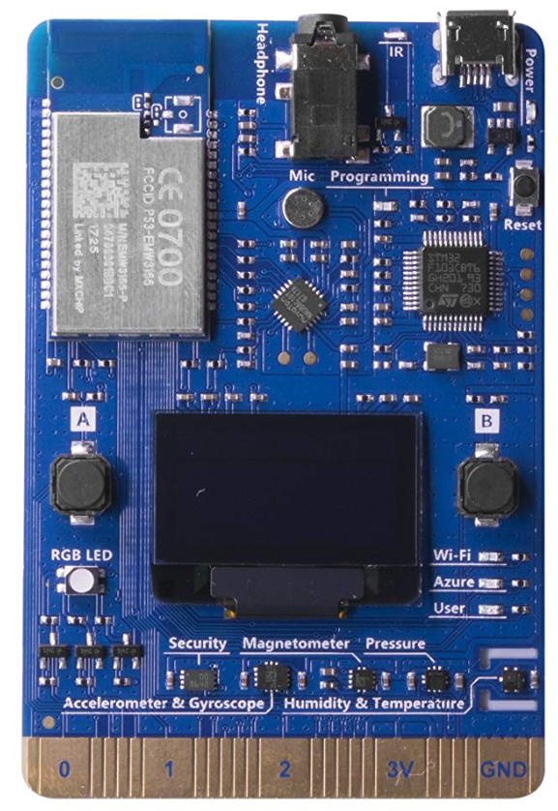


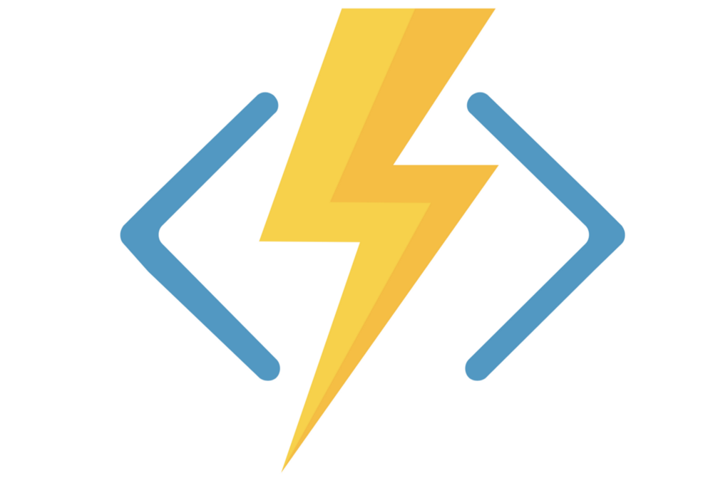


Weather Station Architecture
Security
Deployment
High Availability & Disaster Recovery
Azure IOT Hub
Azure Stream Analytics
Azure Functions
Weather station Simulator
Data Lake Store
Data Lake Analytic
THINGS
INSIGHT
ACTION

