Slide 1
Operating Systems
Moumita Patra
July-Nov 2018
Ref: Galvin, Gagne

Slide 2
General Information
Textbook:
-> Operating System Concepts 9th edition, Silberschatz, Galvin and Gagne.
Reference text books:
-> Operating Systems: Principles & Practice; Anderson and Dahlin.
-> Modern Operating Systems; Andrew S Tanenbaum.
Programming assignments will be covered in the associated lab course.
Course materials will be uploaded on moodle.

Slide 3
Introduction

Slide 4
Operating System
What is an operating system (OS)?
-> An OS is a program that manages a computer’s hardware.
-> A program that acts as an intermediary between a user of a computer and the computer hardware.

Slide 5
OS from different views
User-centric
A program that acts as an intermediary between a user of a computer and the computer hardware
Defines an interface for the user to use services provided by the system
Converts what the hardware gives to what the user wants
Can hide many details of the hardware that the user does not need to know
Can even give a very different view of the operating environment to the user than what is actually there

Slide 6
System-centric
Efficiently manages and allocates resources to users
Controls the execution of user programs and operations of I/O devices
Provides isolation/protection between different user programs

Slide 7
Operating system goals-
-> Execute user programs and make solving user problems easier
-> Make the computer system convenient to use
-> Use the computer hardware in an efficient manner
Components of a computer system:
-> hardware- provides basic computing resources
-> OS- controls and coordinates use of hardware among various applications and users
-> application programs- define ways in which the system resources are used to solve computing problems of the users
-> users- people, machines, other computers

Slide 8
Operating System Definition
No universally accepted/ completely adequate definition.
Operating systems exist because they offer a reasonable way to solve the problem of creating a usable computing system.
An approximation is that it includes everything that a vendor ships when an OS is ordered. The features may vary widely across systems.
More commonly- OS is the one program running at all times on the computer called kernel.
Two types of other programs are:
System programs- associated with the OS but not necessarily part of the kernel
Application programs- include all programs not associated with the operation of the system

Slide 9
NOTE:
Mobile operating systems often include not only a core kernel but also middleware
Middleware- a set of software frameworks that provide additional services to application developers.
Example- Both iOS and Android feature a core kernel along with middleware that supports databases, multimedia, and graphics (to name a few).

Slide 10
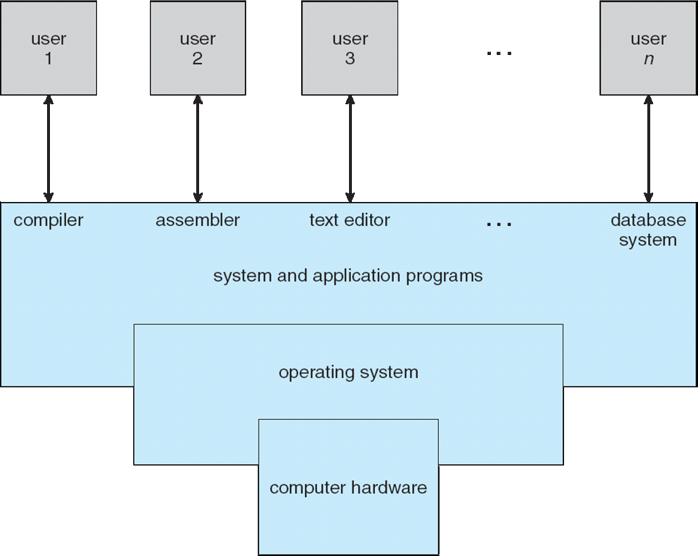
Components of a computer system

Slide 11
Computer Startup
Bootstrap program is loaded at power-up or reboot
Typically stored in ROM or EEPROM, generally known as firmware
Initializes all aspects of the system
Loads operating system kernel and starts execution

Slide 12
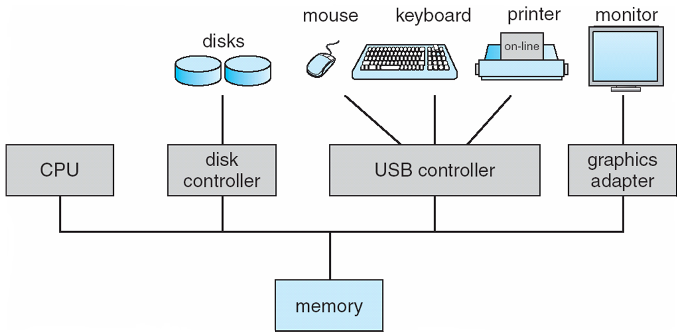
Computer System Organization

Slide 13
Computer System Operation
I/O devices and the CPU can execute concurrently
Each device controller is in charge of a particular device type
Each device controller has a local buffer
CPU moves data from/to main memory to/from local buffers
I/O is from the device to local buffer of controller
Device controller informs CPU that it has finished its operation by causing an interrupt

Slide 14

How a modern computer works
A von Neumann architecture

Slide 15
Computer System Architecture
Single and multi-processor systems
Multi-processor systems have gained importance over time
Advantages :
1. Increased throughput
2. Economy of scale
3. Increased reliability

Slide 16
Operating System Structure
One of the most important aspects of operating systems is to multiprogram.
Multiprogramming needed for efficiency
Efficient CPU and I/O utilization
Jobs are selected via job scheduling
When a program waits, OS switches to another job
Time sharing (multitasking)- CPU switches jobs frequently so that users can interact with each job while it is running, creating interactive computing.
Each user has at least one program executing in memory process
CPU scheduling needed if several jobs ready to run at the same time.

Slide 17
Types of systems
Batch systems
Multiple jobs, but only one job in memory at one time and executed (till completion) before the next one starts
Multiprogrammed batch systems
Multiple jobs in memory, CPU is multiplexed between them
Time-sharing systems
Multiple jobs in memory and on disk, CPU is multiplexed among jobs in memory, jobs swapped between disk and memory
Allows interaction with users

Slide 18
Personal Computers
-> Dedicated to single user at one time
Multiprocessing Systems
-> More than one CPU in a single machine to allocate jobs to
-> Multicore architectures
Other paraller systems, distributed systems, clusters...
-> Different types of systems with multiple CPUs/ Machines
Real time systems
-> Systems to run jobs with time guarantees
Other types
-> Embedded systems, mobiles/smartphones, ...

Slide 19
OS design depends on the type of system it is designed for
Challenges today-
Very wide variety of systems
From small embedded systems with low memory and storage to very large systems with hundreds of thousands of machines with large distributed storage
Increasing number of cores per processor and processors per machine

Slide 20
Resources managed by OS
Physical
CPU, memory, disk, I/O devices like keyboard, monitor, printer
Logical
Process, file ...

Slide 21
Operating System Operations

Slide 22
In order to ensure proper execution of the OS, it is necessary to distinguish between system code and user-defined code.
Dual-mode operation allows OS to protect itself and other system components- user mode and kernel mode
Mode bit provided by hardware
Provides ability to distinguish when system is running user mode (1) or kernel mode (0)
When the computer system is executing on behalf of a user application, the system is in user mode
When a user application requests a service from the OS (via a system call), the system must transition from user to kernel mode

Slide 23
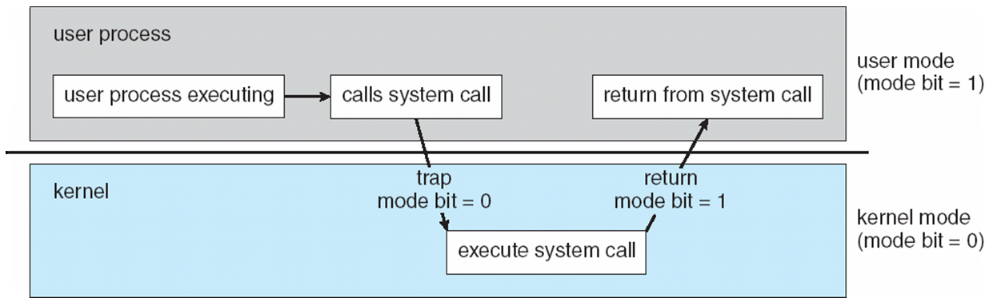

Slide 24
User-centric view
System calls- programmatic way in which a computer program requests a service from the kernel of the OS it is executed on.
Command interpreter (not strictly a part of an OS)

Slide 25
Main components of an OS
Resource-centric view
Process management
Main memory management
File management
I/O system management
Secondary storage management
Security and protection system
Networking

Slide 26
Process Management
A process is a program in execution
A process is the unit of work in a system
A system consists of a collection of processes, some of which are OS processes and rest are user processes
Needs certain resources to accomplish its task
-> CPU time, memory, files, I/O devices...
OS responsibilities
-> Process creation and deletion
-> Process suspension and resumption
-> Mechanisms for process synchronization and interprocess communication

Slide 27
Main memory management
Main memory is a large array of bytes. Each byte has its own address.
It is generally the only large storage that the CPU is able to address and access directly
For a program to be executed, it must be mapped to absolute adresses and loaded into memory
OS responsibilities-
Keep track of which parts of memory are currently being used and by whom
Decide which processes to load when memory space becomes available
Allocate and deallocate memory space as needed
Protect memory of one process from another

Slide 28
File management
To make the computer system convenient for users, the OS provides a uniform, logical view of information storage.
The OS abstracts from the physical properties of its storage devices to define a logical storage unit called the file.
OS responsibilities-
File creation, deletion, modification
Directory creation, deletion, modification
Support of primitives for manipulating files and directories
Mapping files onto secondary storage
File backup on stable (non volatile) storage media

Slide 29
I/O system management
The I/O system consists of:
A buffer-caching system
Device driver interface
Drivers for specific hardware devices

Slide 30
Secondary storage management
Most modern computer systems use disks as the principle on-line storage medium, for both programs and date
OS responsibilities
Free space management
Storage allocation
Disk scheduling

Slide 31
Security and protection system
Protection refers to a mechanism for controlling access by programs, processes, or users to both system and user resources
The protection mechanism must:
Distinguish between authorized and unauthorized usage
Specify the controls to be imposed
Provide a means of enforcement

