Slide 1
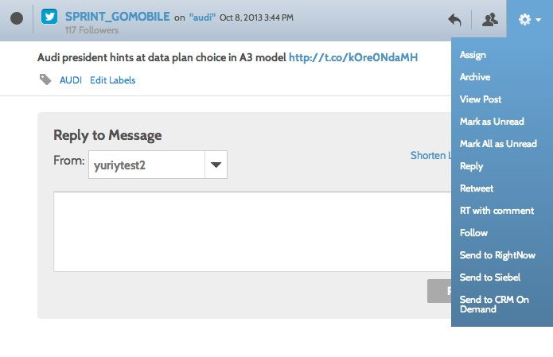
Service Request – CRM On Demand
Overview
The CRM On Demand and Social Engagement and Monitoring service request integration allows community managers to escalate a social post to CRM On Demand.
Social is becoming the predominant channel for customers to express frustration with a product or service. Since Social Engagement and Monitoring is a hub of conversation from both owned and non-owned channels, it becomes a valuable source of dialogue for Oracle's customer service systems.
Now all messages can be sent to a CRM On Demand as an incident allowing the service agent the ability to manage social interactions and provide a great customer experience.
Availability
The feature was launched in October 2013

Slide 2
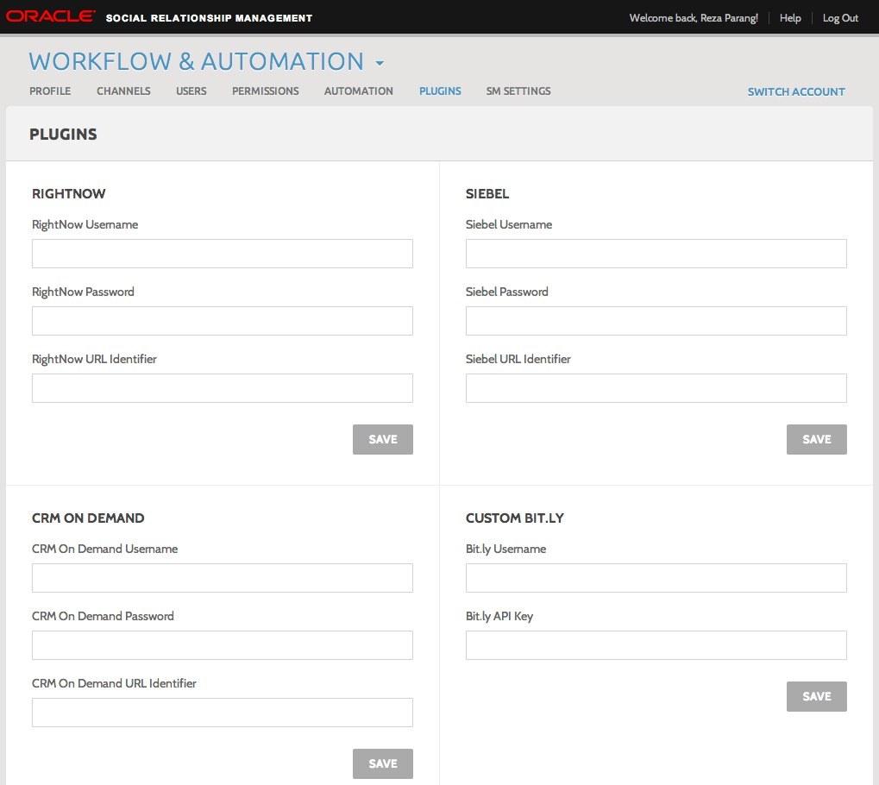
Service Request – CRM On Demand
Configure
Go to the Plugins section in Workflow and Automation. In the CRM On Demand section, provide a username, password, and endpoint URL. The "Send to CRM On Demand" option will not appear unless these are configured correctly.
To find your CRM On Demand credentials, while in CRM On Demand, search for the topic “About Oracle Social Engagement and Monitoring”.
The "Send to CRM On Demand” option will not appear if the message selected is the brand's own social property. For example, if a user is in the Brookstrut Farmers Market account and she selects a message in Engage made by the Brookstrut Farmers Market account, the option will not be there. This is because it's assumed brands will not escalate their own messages to CRM On Demand.

Slide 3
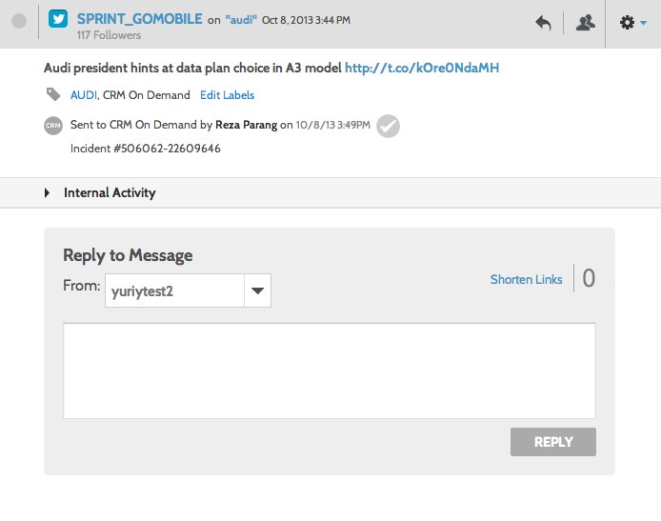
Service Request – CRM On Demand
Use
If the CRM On Demand credentials are configured correctly in the Plugins section of Engage, an option of "Send to CRM On Demand" will appear in the gear icon of a message. Selecting this option will send the message and its contents to the account configured in the Plugins section.
Once a message is sent successfully, an incident number from CRM On Demand will be returned and displayed. The message will also be labeled automatically as “CRM On Demand” as well – these messages can be accessed in the “Labels” section in the left column.
If a message fails to send, an error message will be shown.
Service requests closed within CRM On Demand must manually be closed within Engage. Next to the indication within the message is a checkmark icon. Clicking this will indicate within Engage that the service request is closed.

Slide 4
Service Request – CRM On Demand
Data Passed | Description | Source
Message ID | Internal SEM message ID | SEM
Message Link | SEM direct URL | SEM
Network Type | Facebook or Twitter network if applicable | SEM
Network Message ID | Network message ID; includes messages from listen | SEM
Topic | Facebook post, Facebook comment, tweet, or CI message | SEM
Message Body | Message content | SEM
Author ID | Network author ID | SEM
Author Name / First Name / Last Name | Author name. For Facebook, first name and last name are given in separate fields as well | SEM
Service Request ID Number | ID of the service request from CRMOD | CRMOD

