Slide 1

SEM-RightNow Integration
Ryan Teall
ryan.teall@oracle.com

Slide 2

SEM-RightNow Integration Flow (April, 2013)

Slide 3

Capture
Monitor
Engage
Global
Conversations
Setup & Real time Execution
Targeted
Results
Incident
Management
Latent
Semantic Analysis
Filtering
Listening Settings
RightNow CRM
Indicators
Sentiment
Terms
Listen
Notes:
Oracle Social Engagement and Monitoring (“SEM”), with RightNow integration path for Incident Management.

Slide 4
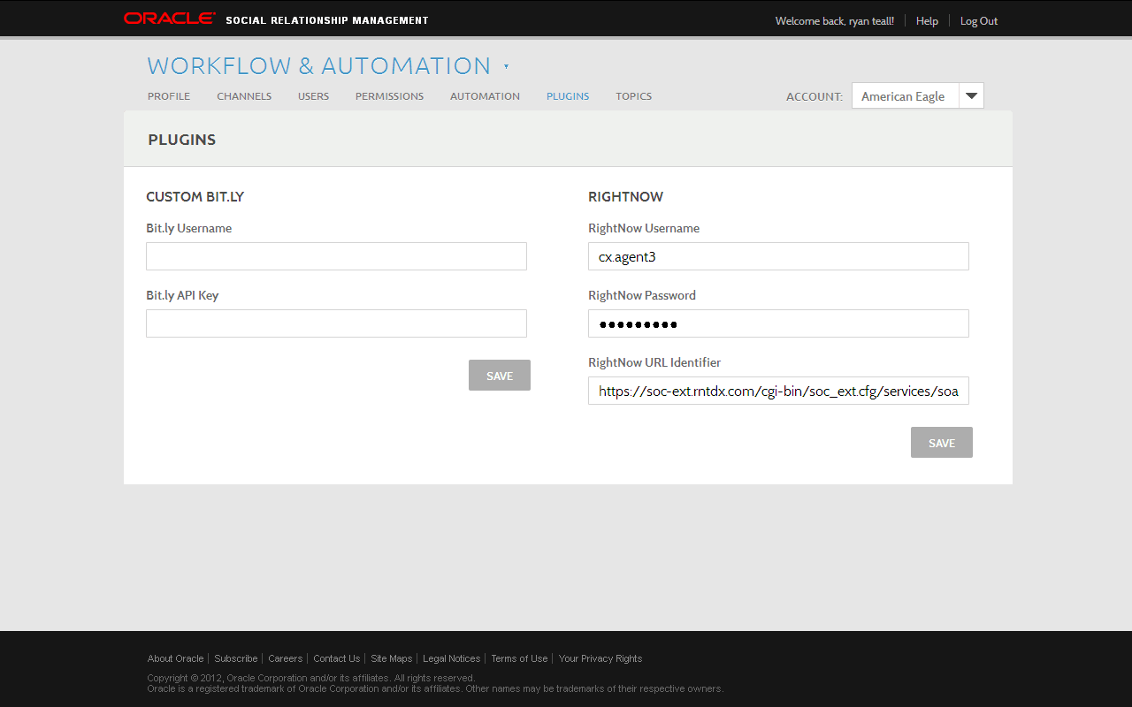
Notes:
The integration utilizes the standard RightNow Connect API, no customization is required. SEM Engage plugin for RightNow is initialized as shown here.

Slide 5
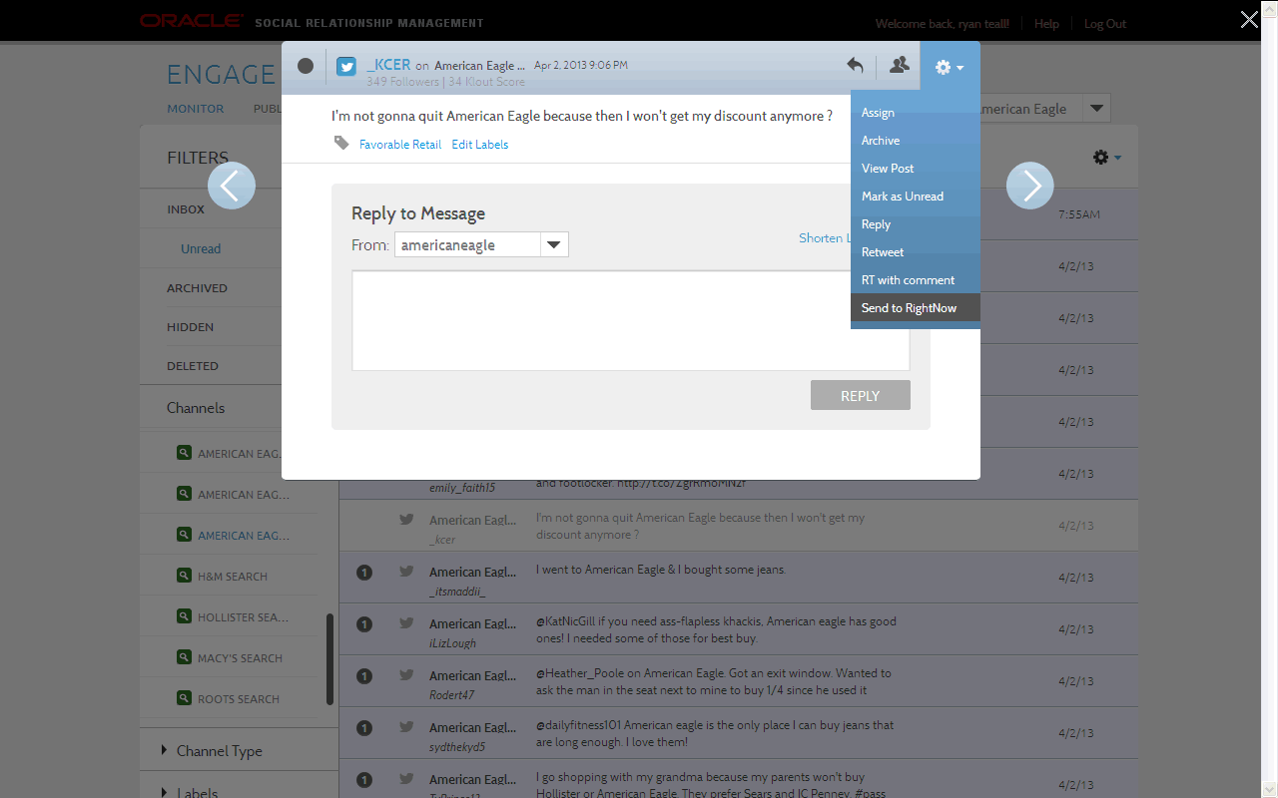
Notes:
The SEM agent is viewing a message from a Listening Topic (note the labels “Favorable” and “Retail,” which are generated by the Listening engine, and can be used for auto-assignment in Engage). The agent sends the message to RightNow via pulldown menu.

Slide 6
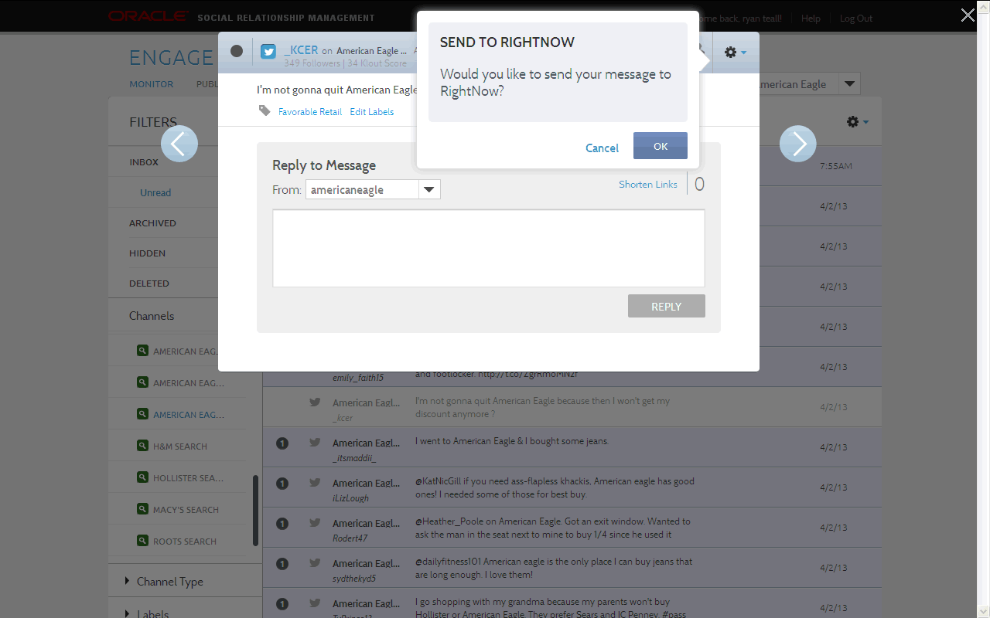

Slide 7
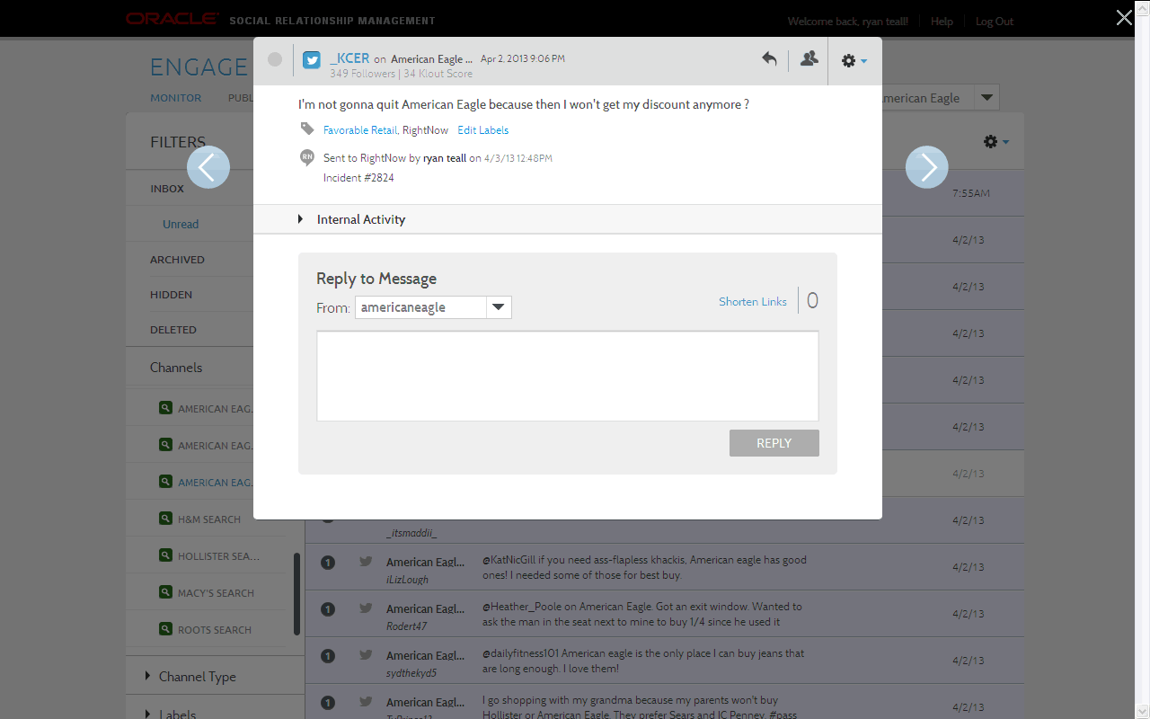
Notes:
RN confirms receipt & successful creation of an Incident by passing back an Incident Number (#2824).

Slide 8
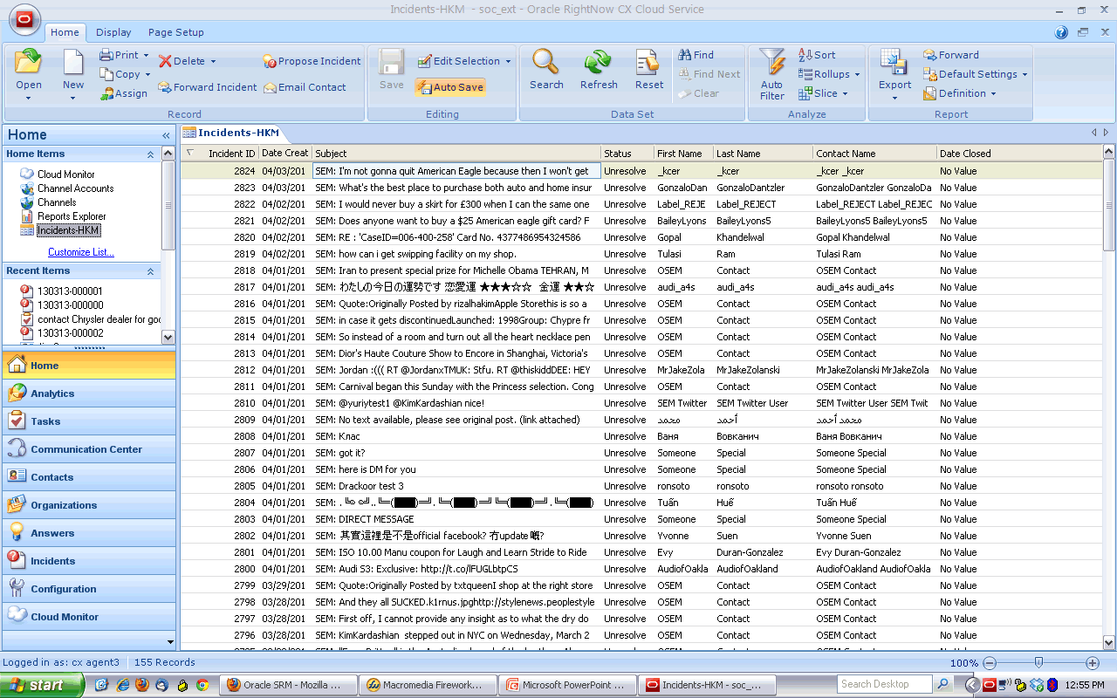
Notes:
RN user assigned to Incident #2824 sees the message from SEM.

Slide 9
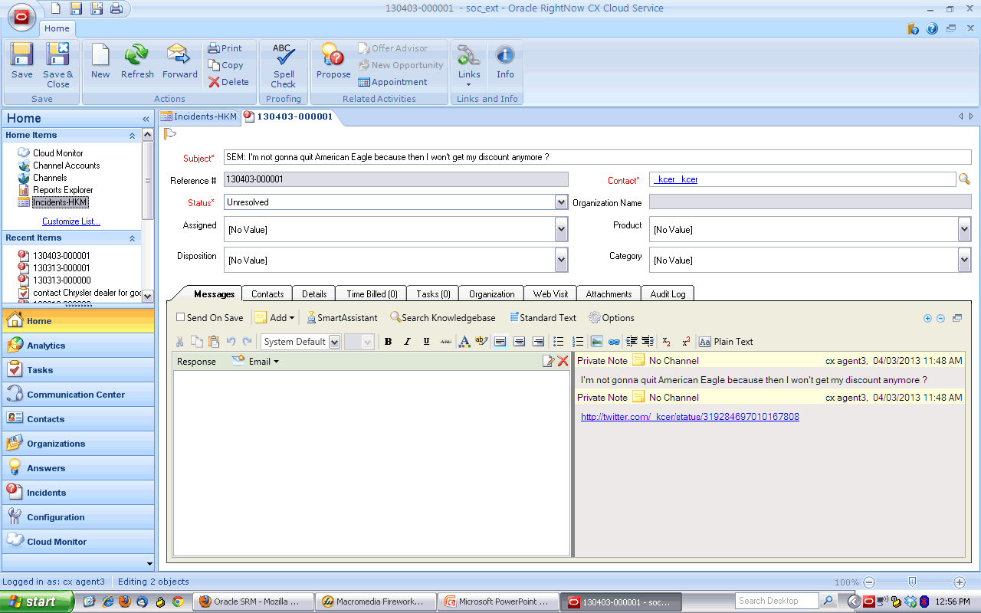
Notes:
RN user clicks into the SEM Incident—note the SEM data being pushed over in the web services call.

Slide 10
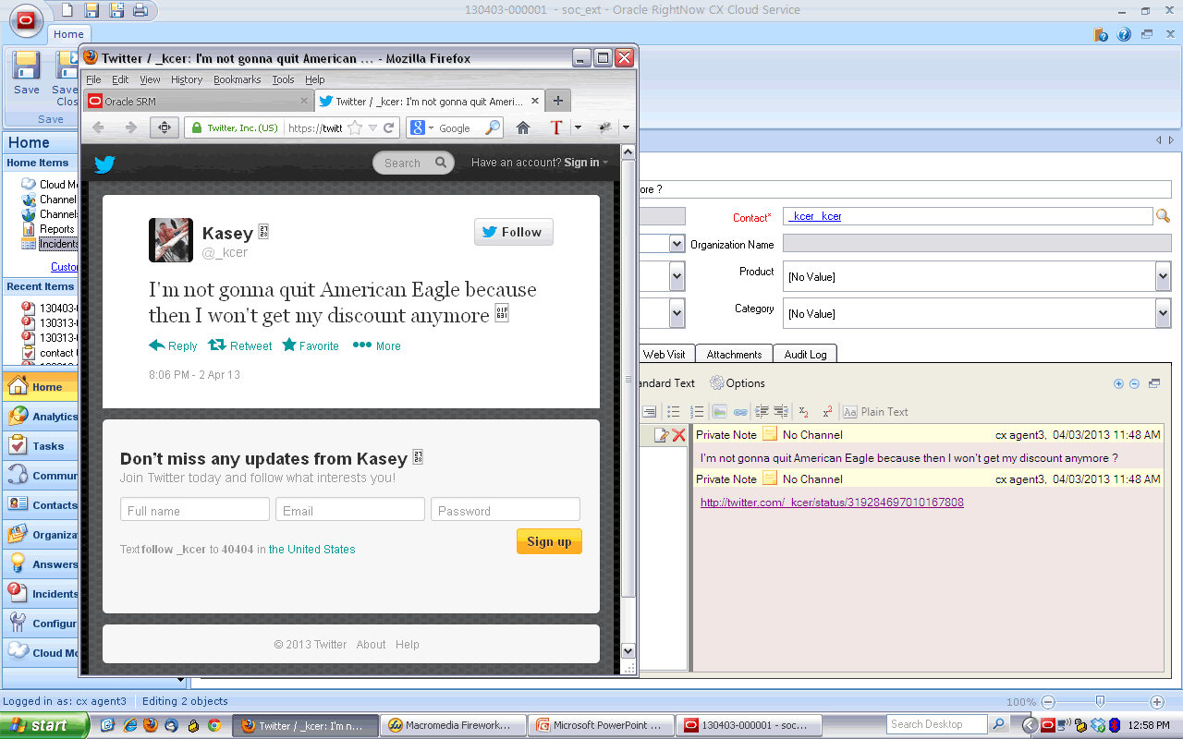
Notes:
Viewing link to verbatim Twitter content.

Slide 11
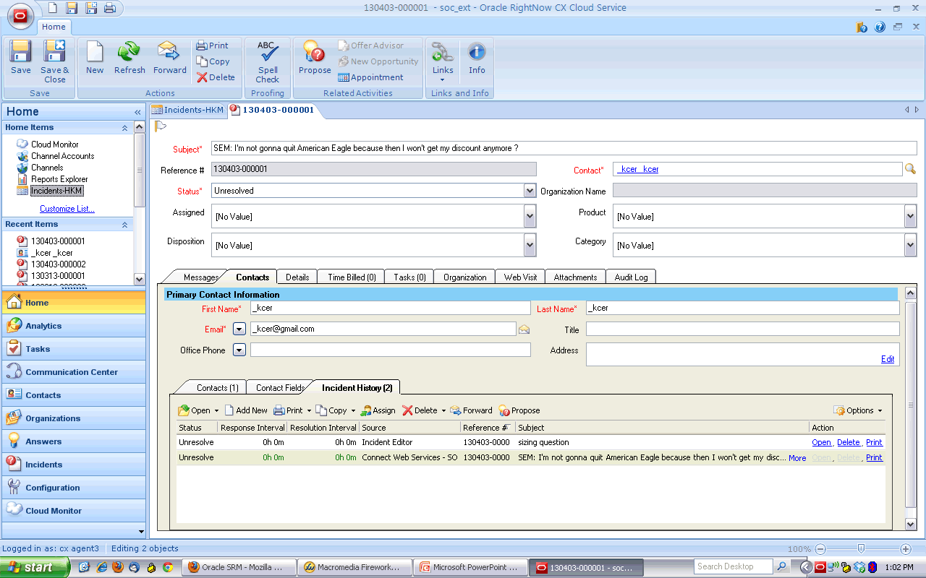
Notes:
The RN user views other unresolved Incidents linked to the “_kcer” Twitter handle.

Slide 12
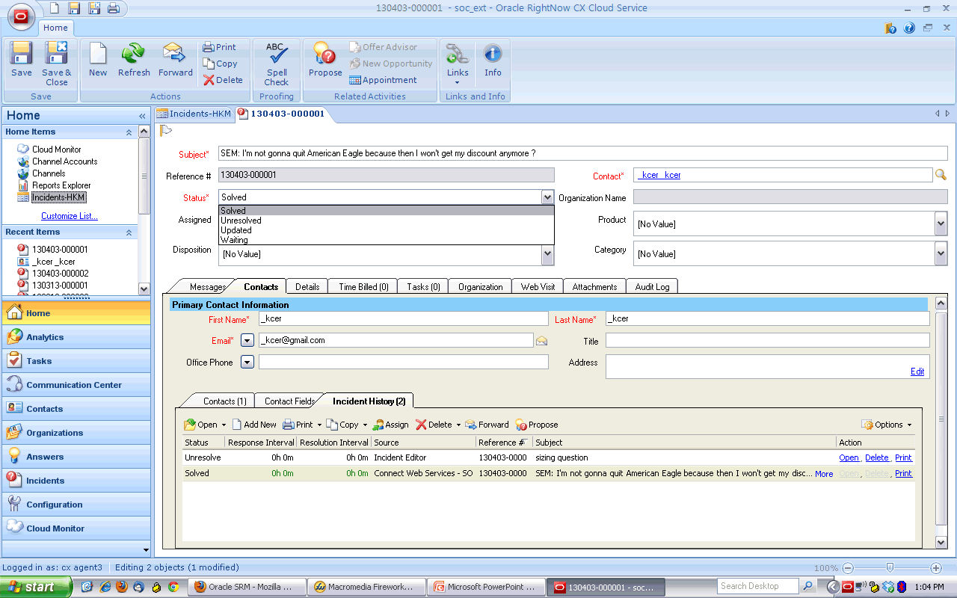
Notes:
The RN user makes an appropriate response and changes the status of the Incident to “Solved.”

Slide 13
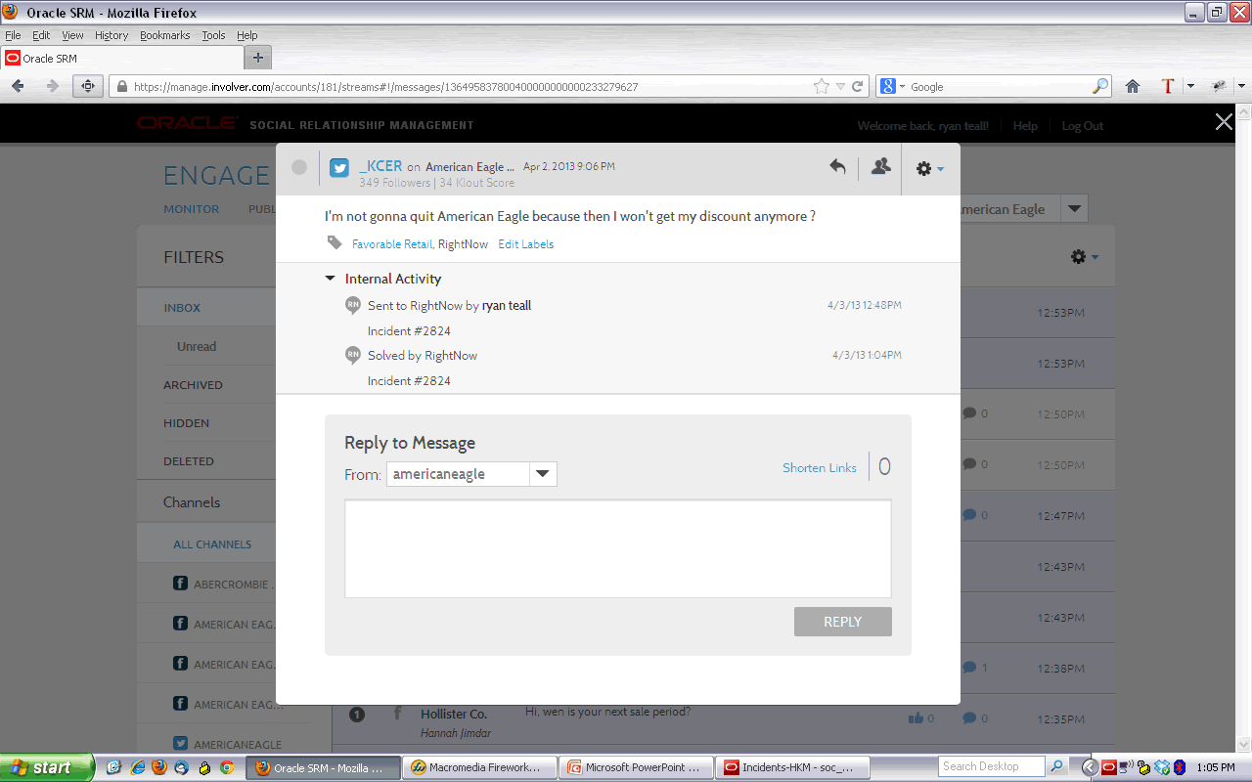
Notes:
RN notifies Engage of the status change.

