Slide 1
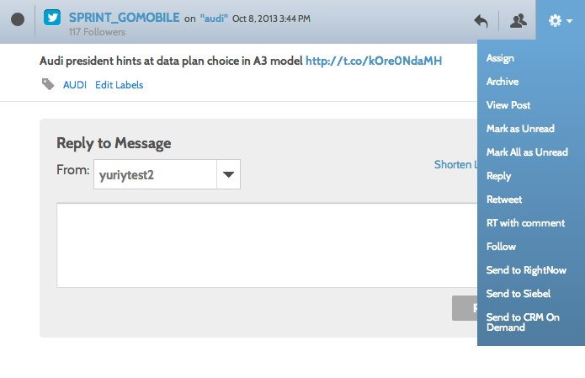
Service Request – RightNow
Overview
The RightNow and Social Engagement and Monitoring service request integration allows community managers to escalate a social post to RightNow.
Social is becoming the predominant channel for customers to express frustration with a product or service. Since Social Engagement and Monitoring is a hub of conversation from both owned and non-owned channels, it becomes a valuable source of dialogue for Oracle's customer service systems.
Now all messages can be sent to a RightNow as an incident allowing the service agent the ability to manage social interactions and provide a great customer experience.
Availability
The feature is live today.

Slide 2
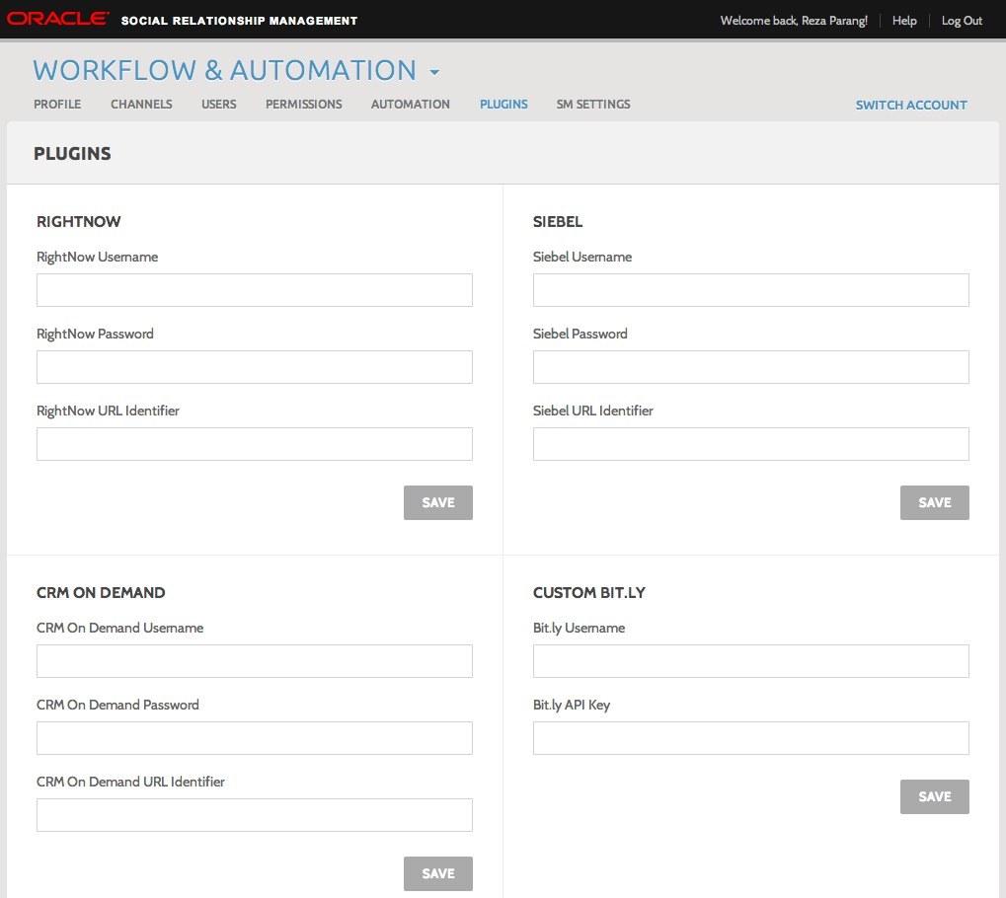
Service Request – RightNow
Configure
Go to the Plugins section in Workflow and Automation. In the RightNow section, provide a username, password, and URL identifier. The "Send to RightNow" option will not appear unless these are configured correctly.
To find your RightNow credentials, find reference in the SRM configuration document among your other RightNow help guides.
The "Send to RightNow” option will not appear if the message selected is the brand's own social property. For example, if a user is in the Brookstrut Farmers Market account and she selects a message in Engage made by the Brookstrut Farmers Market account, the option will not be there. This is because it's assumed brands will not escalate their own messages to RightNow.

Slide 3
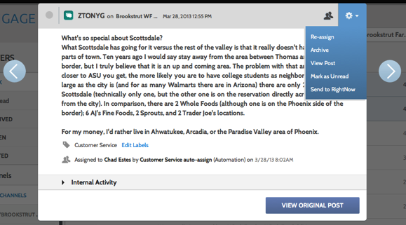
Service Request – RightNow
Use
If the RightNow credentials are configured correctly in the Plugins section of Engage, an option of "Send to RightNow" will appear in the gear icon of a message. Selecting this option will send the message and its contents to the account configured in the Plugins section.
Once a message is sent successfully, an incident number from RightNow will be returned and displayed. The message will also be labeled automatically as “RightNow” as well – these messages can be accessed in the “Labels” section in the left column.
If a message fails to send, an error message will be shown.
Service requests closed within RightNow will be indicated within Engage automatically as “closed.”

Slide 4
Service Request – RightNow
Data Passed | Description | Source
Channel Type | Facebook, Twitter, or listen channel if applicable | SEM
Email | Fake email so that a contact can be created. Example: 123.invalid@example.com | SEM
Message Body | Message content | SEM
Message Link | Social network direct URL | SEM
Author ID | Network author ID | SEM
Author Name / First Name / Last Name | Author name. For Facebook, first name and last name are given in separate fields as well | SEM
Subject | Subject name composed of message body and attachment type | SEM
Service Request ID | ID of the service request from RightNow | RightNow
Message ID | Message ID for the SEM incident from RightNow | RightNow

