Slide 1
Big Data Project
Preprocessing: Nicholas Anderson & Dipta Chandra Paul

Slide 2
Control Flow
Utilize a two pass external merge-join to sort data and add features
First pass creates stored chunks of each file (air quality and weather)
Second pass merges sorted chunks to create one sorted csv, engineered features are added during this pass as well. During this pass cardinality and variance of each column is computed
Optional third pass to apply cardinality or variance filter
Distances from facilities and roads are calculated once for each zip code (in between first and second pass of merge-join), stored in a buffer to avoid recomputing distances for each row
Create log saving which files are used, runtime, number of reads and writes, which feature are deleted/created, cardinality and variance of each feature

Slide 3
Input and Output
Input is data from data collection, plus road and shape data from data.gov
Input data volume:
27.2MB from data collection
78.9MB from data.gov (road and texas zip code shape data)
Output is a single csv containing engineered features
Output data volume 229.9MB
182.1MB for training
47.8MB for validation

Slide 4
How Spatial Impact Score is Calculated
Finds roads and facilities in radius from the zip code (this is done during distance calculation between first and second pass)
During second pass: for each row
Based on zip code find nearby facilities
Compute wind vector based on wind direction and speed
w10 and w100 are weights to determine how much of 10m vs 100m features are used
Project wind vectors onto basis vector in direction of road/facility to zip code
Scalar projections are put into Relu function (this makes it so facilities and roads which are downwind do not impact spatial impact score)
Add this value to score multiplied by decay value (Decay value is tracking how far away the facility is)

Slide 5
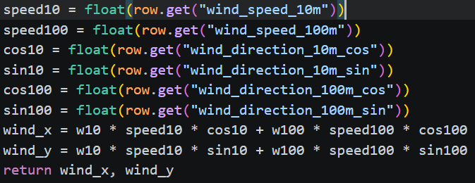
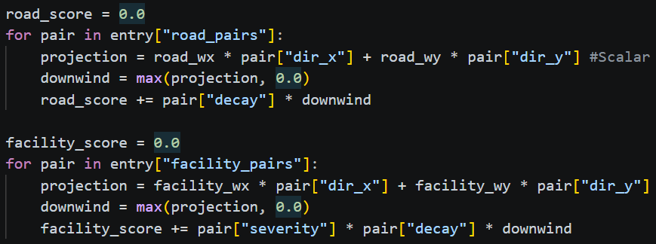
Code Snippets for Impact Score Calculation
Computing wind vector ----------------->
Adding projected values * decay value to relevant score-------->

Slide 6
Project Limitations (optional if you want to include)
- The data we worked with was not big enough, which dissuaded me from removing columns or rows to aggressively so we would have enough data to train
- While neural network training is very simple in python, creating memory-aware algorithms is as straightforward as in c++ with the easiest option being to simulate not having all data in main memory since it is the interpreters choice to either load it all or not

Slide 7
What we learned (again… optional)
Memory management in python is hard due to limited control of the interpreter
Removing redundant features is not as simple as a cardinality or variance filter due to things like covariance and features which have low variance/cardinality but otherwise increase predictive capability
When predicting future air quality, LSTMs are not always the best model, and many ML models can be very competitive.

