Slide 1
Hypothesis

Slide 2
Data Challenges
Key Challenges:
Sensor data alone may not capture enough temporal behavior
→ Need lag features to incorporate historical context
Raw features are not directly usable
Zip code → categorical (no numerical meaning)
Time/day → not inherently cyclical (23 should be close to 0)
External context (roads, factories):
Raw data has no inherent numerical meaning → Requires feature engineering to quantify impact
High dimensionality

Slide 3

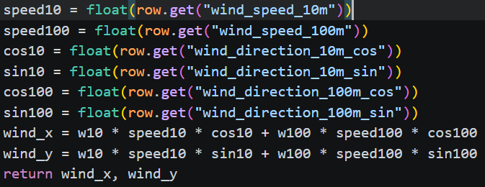
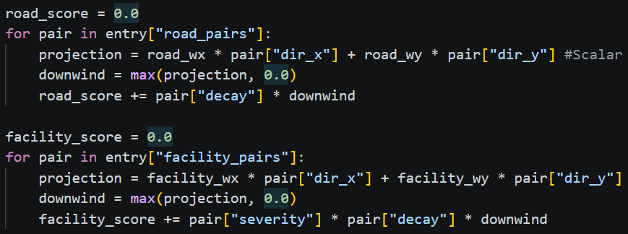
Feature Engineering
Add lag features to incorporate explicit historical context
Utilize sin/cos to capture the cyclic nature of time
Finds roads and facilities in radius from the zip code
During second pass: for each row
Based on zip code find nearby facilities
Compute wind vector based on wind direction and speed
w10 and w100 are weights to determine how much of 10m vs 100m features are used
Project wind vectors onto basis vector in direction of road/facility to zip code
Scalar projections are put into Relu function (this makes it so facilities and roads which are downwind do not impact spatial impact score)
Add this value to score multiplied by decay value (Decay value is tracking how far away the facility is)

Slide 4
Goal
Hypothesis: Combining an Autoencoder (AE) for feature compression with an LSTM for temporal modeling will improve AQI prediction accuracy.
Autoencoder → compress sensor data and preserve important structure
Why use AE?
Capture nonlinear patterns
Lower-dimensional latent representation
Better generalization → helps reduce overfitting
LSTM → captures temporal dependencies
Why use LSTM?
Captures long and short term dependencies
Learn sequential patterns
Combine AE + LSTM → should improve AQI prediction

Slide 5
Modeling Challenges (AE + LSTM)
Feature Selection
Which feature to compress in AE
AE capturing important patterns
Can only tell downstream if the AE is performing well (if the LSTM performed well)
Scaling Consistency
Which scaling method to use
Which features to scale
Data Leakage
No random selection of sequences for train/val split
Must ensure scaling is ont on validation data
Dimensionality Reduction
Once lag features added → dimensionality exploded
Model Complexity (LSTM)
Model too simple → Model too complex
Maintaining temporal and spatial consistency
Grouping by zip code then sorting by time

Slide 6
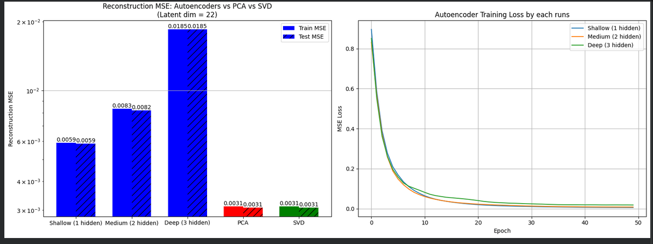
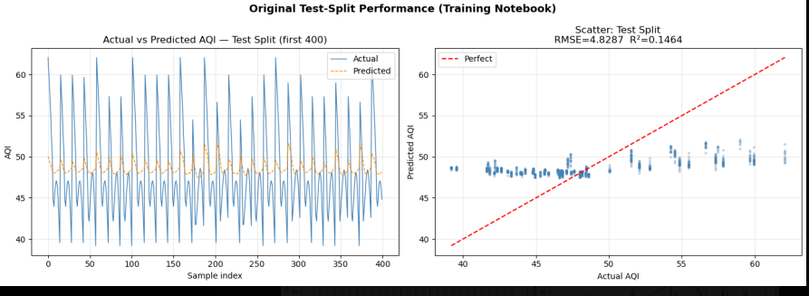
Phase 1
Results:
For our AE, we can see that PCA and SVD had better results early on in our project
For our LSTM, our model was underfitting tremendously and predicting the mean instead of learning patterns
Issues:
AE:
Suboptimal scaling method used (MinMax)
Using a linear AE, not nonlinear (did not use activation function)
Latent space was too high-D
LSTM
No lag features
Very simple model (1 layer, <64 cells)
Incorrect feature selection for compression (should not have compressed cyclic features)
Early issue of not grouping by zip code (breaks temporal and spatial structure of data)

Slide 7
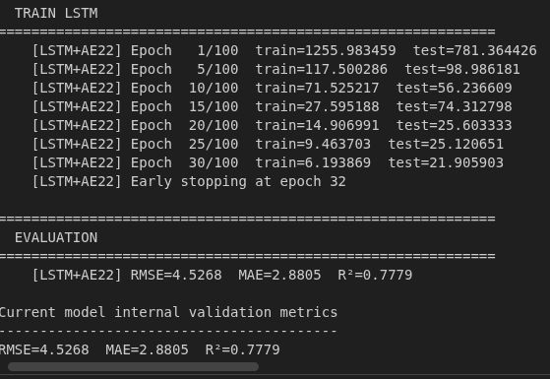
Phase 2 - Iteration 1
With a fully defined dataset, including finalized sensor selection, feature engineering strategy, and lag feature design, we could now focus on improving the models
Dimensionality exploded to ~192 features (<40 before)
Early on the iteration we tried to compress all 192 features in the AE, but our ending results were abysmal
Improvements:
Increased LSTM model complexity
Ensured proper temporal/spatial structure using groupby(), sort(), and not shuffling the train/test split
Removed train/val/test split → only train/val
Issues:
Still using MinMax scaling for AE and incorrect AE selected features (raw sensor + cyclic + binary)
24 hour lags for 6 features → LSTM dominated by lag features
Latent space too large (22 dim)
Lag features remained unscaled → AE was scaled, so LSTM priortized lag features even more
LSTM model size was huge (512 cells and 3 layers)

Slide 8
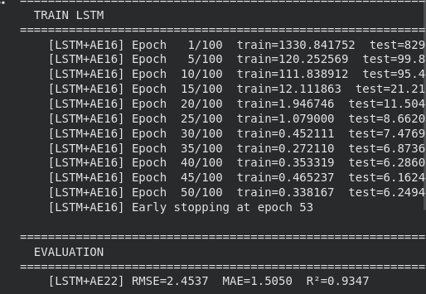
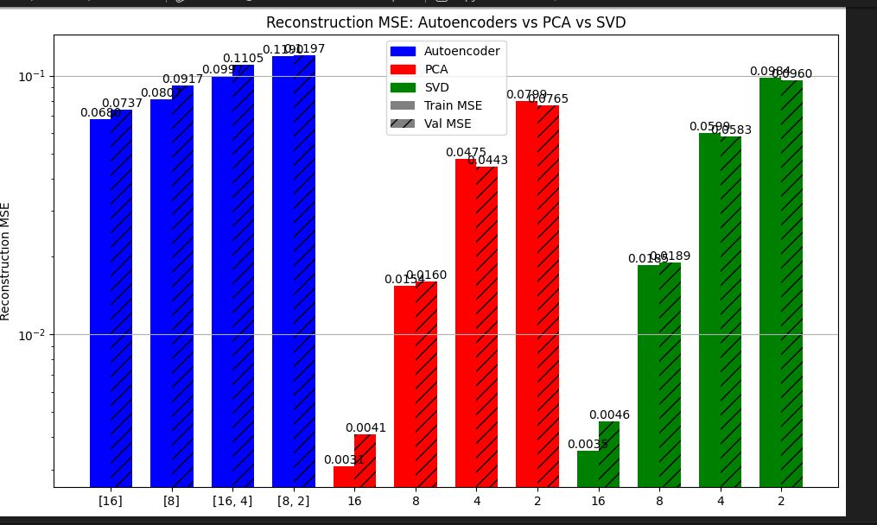
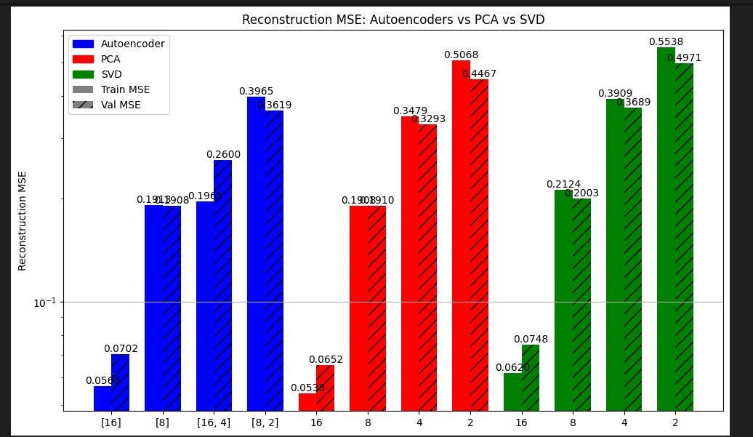
Phase 2 - Iteration 2
Improvements:
AE uses StandardScaler
Can see better reconstruction vs MinMax
Removed binary feature in compression
Feature was already engineered and scaled to directly capture meaningful patterns for the LSTM
Smaller latent space representation (22 → 16)
Outperformed PCA & SVD
Removed 2 lag features from training (wind direction sin/cos)
Low contribution to AQI prediction
Lag features scaled using same scaler as AE input
No longer dominate due to magnitude
LSTM input size (166 → 113)
Reduced dimensionality
Issues:
Very complicated to use same scaler to scale lag features as input features while also preventing data leakage
LSTM model size is still huge
AE feature selection can be improved

Slide 9
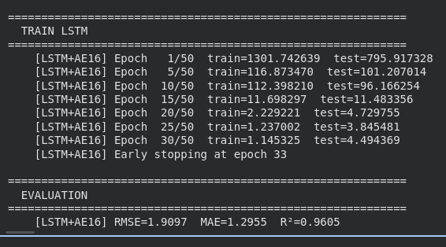
Phase 2 - Iteration 3
Improvements:
Removed wind speed lag feature
Removed due to low predictive contribution
Reduced lag windows for PM2.5 and Ozone
To 8 hours only
Removes redundant long-range dependencies
LSTM input dimension 113 → 57
Issues:
Tried to reduce AQI lag feature as well, but resulted in a poor performing model
LSTM model size is huge still (3 layers, 512 cells)
AE feature selection can be improved
Highly correlated sensor features still used

Slide 10
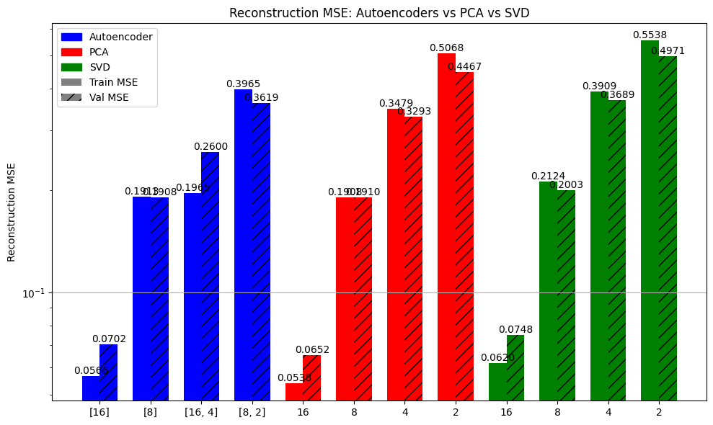
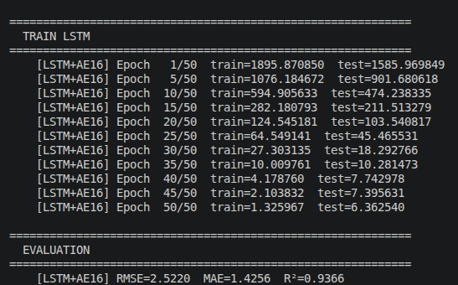
Final Model
Improvements:
Finally removed highly correlated features, low predictive features, and low variable features
With recommendations from team we were able to narrow down features even more
Removed cyclic features from AE compression
Feature was already engineered and scaled to directly capture meaningful patterns for the LSTM
Reduced latent space dimension (16 → 8)
Changed activation function for AE to LeakyReLU
Reduced size of LSTM model
From 3 layers of 512 cells → 1 layer of 96 cells

