Slide 1
Git for Non(traditional) Programmers
Roy Pardee

Slide 2
Ever seen a directory listing like this?
/my_study
/programming
/programs
pull_data.sas
pull_data2.sas
pull_data3.sas
pull_data4.sas
pull_data_final.sas
pull_data_final2.sas
pull_data_final_kill_me.sas
die_die_die.sas
die_die_die2.sas
pull_data_new.sas
Notes:
God forbid someone makes a change to an old program & updated the timestamp—now you have no idea which one is ‘current’. And maybe you’d like to see exactly what’s different about each one?
F*cking nightmare.
The cure for this ill is source code control.

Slide 3
More sales job
Or maybe you’ve seen programs with huge swaths of commented-out code, or macros with “_old” or “_dontuse” in their names?
It gets in the way.
Makes things hard to understand, and to explain.
And code is already harder to read than it is to write.
But we just can’t give that old code up, can we?
What if the new thing doesn’t work?
What if I need to see how this used to work?
My programs are like my children. My horribly, horribly deformed children.
Notes:
Disclaimer: my daughters are both lovely, and bear no resemblance to the code that I write.

Slide 4
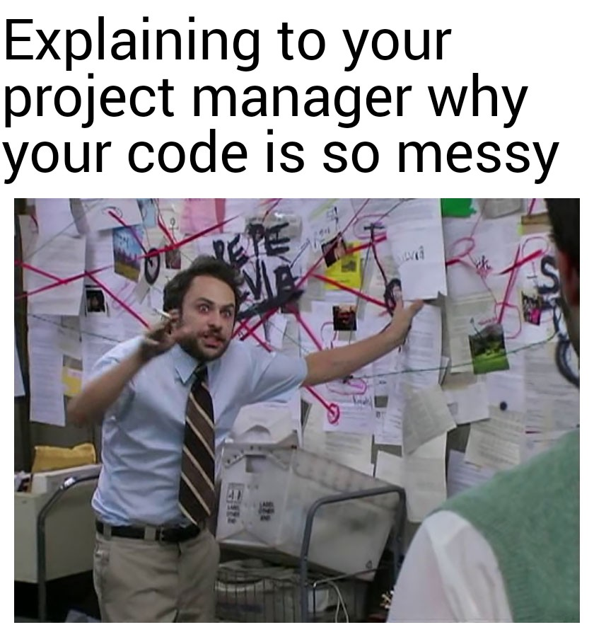
Notes:
Really this should be “explaining to your future self”.
Found on r/programmerhumor

Slide 5
What is Source Code Control?
AKA “Version Control”
Tools for storing changes to files (programs, spreadsheets, etc.) over time, so that you can
See exactly
What changed,
When it changed, and
Who changed it.
Reverse any changes that turned out to be bad
Travel back and forth in time to see how program changes affect output
It’s like winword’s “Track Changes”, except for sets of files.
In other words, it’s a big-ass “undo” button that works across files.
Notes:
I do the time-travelling all the time w/our ute job. I isolate recs that demonstrate a bug, create a dev build just from those records, see that the bug is there, then fix the code so the bug goes away & commit. That done I revert the code back to the pre-bugfixing state and run on a general purpose sampling of data & do a PROC COMPARE on the results to make sure only the things I wanted changed have changed.

Slide 6
VC Gives you the best of both worlds
You don’t have to lose your old code, but
You also don’t have to clutter up your current code.
VC is like a porch to keep my deformed kids under. Nobody has to see them but me.
End sales job.

Slide 7
What is git?
A multi-platform, free and open-source software package for doing version control.
Developed for the people working on the linux kernel.
Wildly popular.
Back in the day, a command-line nightmare experience.
Now—lovely GUI tools!
I’m going to show GitKraken
SourceTree also popular (esp. at Kaiser)
Notes:
I gave something like this talk to this group in Boston back in 2011 I think & at that time I was agnostic on which system might be best—subversion & mercurial were the other contenders. No more—git won the race.

Slide 8
What’s so great about git?
Very lightweight
Fast!
No server necessary
Installs w/out admin permissions
Attaches people’s names to changes
Easily copy just the changed files from one place to another
So good for deployment
And see exactly what’s different
And reject changes you don’t like
Really good for collaborating with external people
Notes:
open Kraken
close whichever repo opens
start new
git_demo1
note it added a readme
right-click under 'unstaged files'
create new
main.sas
right-click that--> open in default program. for me that's sublime but there's no reason it can't be SAS or whatever you're using
hdr
comment: Pulls some orders for suboxone.
lib vdw
clar
sql
create table vdw.subox_orders as
select *
from clarity.order_med
;
run
back to kraken
note 'unstaged files'
file menu -> open in file manager
note--not much different from normal stuff here--sas file, log file. the readme & .git dirs are different, but that's it.
back to kraken
stage main.sas
commit title "just getting started"
detail "a minimally functional pull of medication orders"
edit readme.md
md means markdown. it's just text really
feel free to ignore--it's just a convention.
but note the 'file changes in working directory' at the top--show those
stage readme.md
right-click the log tho--ignore that--ignore all files w/the extension .log actually
kraken made us a new file--.gitignore
again--only text
contents are pretty self explanatory
you can add other things here too
let's add *.sas7bdat
stage .gitignore
commit
So now we have 3 commits
click each one & show that it shows which files have changed.
Neat!
But let's work on our program a bit. It's right now pulling all medication orders, but we only want
ones for suboxone. Those are:
72376, 52421, 72375, 72382, 52420, 133602, 133598, 72381, 89168, 133597,
133601, 134725, 134724, 134723, 144486, 148759, 144472, 156839, 156840,
147766, 153825, 151929, 156841, 144501, 15831, 152266, 155947, 159267
add those in a where clause. run.
stage main.sas
commit "Zeroing in on suboxone orders"
Later on we notice we're getting a ton of empty columns, wasting space & time inspecting them. Lets fix that
select om.order_med_id
, om.pat_id
, om.pat_enc_csn_id
, om.ordering_date
, om.pharmacy_id
, om.medication_id
, om.sig
, om.quantity
, om.refills
, om.start_date
, om.end_date
, om.med_presc_prov_id
, om.update_date
, om.order_inst
, om.discon_user_id
, om.discon_time
, om.order_start_time
, om.order_end_time
, om.workstation_id
, om.authrzing_prov_id
, om.ord_prov_id
, om.is_pending_ord_yn
, om.med_comments
, om.refills_remaining
, om.med_dis_disp_qty
, om.order_class_c
, om.rsn_for_discon_c
, om.order_status_c
, om.ord_creatr_user_id
, om.pat_loc_id
, om.hv_discrete_dose
, om.hv_discr_freq_id
, om.hv_dose_unit_c
, om.med_route_c
kraken
view changes
stage main.sas
commit "Refined field list"
Note that I'm only using the commit summary & not the description--that's arguably bad practice, but whatevs--it's a demo. In real life, you can include as much detail as you like--include URLs to issues on your issue tracker, etc.
Now let's look at the diff view.
pick a commit
the files that were affected in that commit are listed on the right--click one.
how cool is that?
So you can see it's useful even if you're the only one ever touching this code.
It's a safety-net.
When something is minimally functional--you save the state.
And now--you can be bold.
remove dead-ends in your code that increase the burden of reading it later
try something completely different
you can always get back to your previously functional state.
it's like saving in a video game before you open the door to the boss monster
So--now imagine we have a good job that we like, and we want to share it with others. Which we did w/the Utilities repo.
go to https://github.com/kpwhri
new repo: vdw_utilities
private
github shows the tutorial page for a new empty repo, but we can ignore all but the remote
git@github.com:kpwhri/vdw_utilities.git
copy that
kraken
remotes--hit plus button
name ('private github') & paste in the remote spec
right click local -> master: set upstream
specify the name you gave when you created the remote
hit push button up top
wait for success message
refresh browser
Now code and all commits/diffs are backed up & available for download!
Forking
even better for collaboration!
you get your own copy of the repo
can make changes to your copy--test, make sure it works
then push up to your copy
then, submit a pull request!
https://github.com/kpwhri/VDW-Census
hit fork to fork into rpardee
now I'm in rpardee/VDW-Census
clone--copy
kraken--new
make trivial change
stage
commit
pussh
note # of commits on rpardee/VDW-Census
then refresh
hit create pull request

Slide 9
A few concepts
There are 3 “places” for a file to be:
working directory: where you make your edits & save, just as you would if you weren’t using VC.
The “cache”—a staging area where you load your changes, in preparation to commit them to the…
repository: the “vault” where all committed versions of all files are kept.
The staging area is what lets you combine changes in multiple files into a single unit that you can roll back from.
Kind of like an airlock.

Slide 10
File tracking is opt-in
Files can have one of a few statuses:
Untracked: git is ignoring them, will not touch them.
Modified: git is tracking the file; the version in working dir is different from the last version in the repository.
Staged: copy is added to the cache for bundling into the next commit.
Unmodified: version in the working dir = current version in the repository.

Slide 11
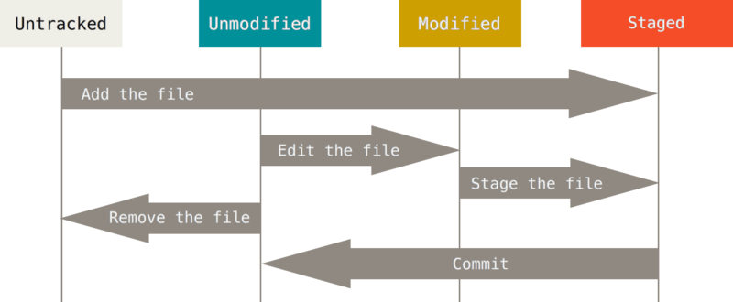
Life cycle of file statuses
Notes:
Let’s do the demo.
Source: Pro Git, by Scott Chacon. https://git-scm.com/book/en/v2/Git-Basics-Recording-Changes-to-the-Repository

Slide 12
So—useful safety net
Even if you're the only one ever touching the code.
When something is minimally functional--you save the state with a commit.
And now--you can be bold.
remove dead-ends in your code that increase the burden of reading it later
try something completely different
Re-org—consolidate all your formats in a separate ‘formats.sas’ file, say.
You can always get back to your previous functional state (all of them!)
It's like saving in a video game right before you open the door to the boss monster’s lair
BUT THERE’S MORE! Let’s share some code.

Slide 13
Excellent Code Distribution Method
Users can see the code in their browser
Very easy to make sure you have the very latest version
And to see what’s changed, who changed it, etc. etc.
Plus now the code is backed up
(Now you know what those readme.md files are about)
BUT WAIT—THERE’S MORE! Let’s Collaborate.

Slide 14
So Civilized!
The Fork is your alternate universe, if you want it.
Sometimes it’s just useful for getting a code change you want over to the author.
Makes it maximally easy for the person whose code you’ve forked.

Slide 15
Details & Caveats
KP staff can get at a KP-internal install of BitBucket (a github-workalike) at https://stash.kp.org.
Perfect for CESR code!
Git is awesome for text files, but less so for binaries.
No diff functionality.
If any bit changes, it saves a new version of the file.
Can bulk up an otherwise trim repo.

Slide 16
Thank you!

