Slide 1
Git for VDW Programmers
Roy Pardee
Notes:
Fun fact: I first gave this talk at the VIG meeting in 2011 (Boston, I think)
I still think you should use git.

Slide 2
Overview
Disclaimer
Sell you on the concept
Git
For single-programmer use
For collaboration (github/bitbucket)
Demo

Slide 3
What is Version Control?
“A system that records changes to a file or set of files over time, so you can recall specific versions later.” -Scott Chacon, Pro Git.
In other words—it’s a big-ass ‘undo’ button that works across files.
Also includes means for:
Calling out differences between versions of files (what did I/she change?)
Attaching notes to changes (why did I/she make this change?)
Managing multiple different versions of reality—bounce back and forth between versions to see what effect

Slide 4
git <> github.com
Note

Slide 5
Why should you bother?
Ever seen a directory listing like this?
/my_study
/programming
/programs
pull_data.sas
pull_data2.sas
pull_data3.sas
pull_data4.sas
pull_data_final.sas
pull_data_final2.sas
pull_data_final_kill_me.sas
die_die_die.sas
die_die_die2.sas
pull_data_new.sas
Notes:
Not pretty.

Slide 6
More sales job
Or maybe you’ve seen programs with huge swaths of commented-out code, or macros with “_old” or “_dontuse” in their names?
It gets in the way.
Makes things hard to understand, and to explain.
But we just can’t give that old code up, can we?
What if the new thing doesn’t work?
What if I need to see how this used to work?
My programs are like my children. My horribly, horribly deformed children.

Slide 7
SDMs are at particular risk for this sort of “code rot”
With project work, you usually don’t have to maintain a set of code for very long.
Project-to-project re-use is mostly about copy/paste, and then adapting to the new.
But VDW ETL programs are much longer-lived.
May have to be handed-off at some point. At the least it’s likely to need support while you’re off on vacation.
Reading code is hard. Hard enough w/out keeping false starts around.
And you may find (as I did) that once you’ve got VC in your bag of tricks, it’s useful even for project work.

Slide 8
VC Gives you the best of both worlds
You don’t have to lose your old code, but
You also don’t have to clutter up your current code.
VC is like a porch to keep my deformed kids under. Nobody has to see them but me.
End sales job.

Slide 9
What’s awesome about git
Completely file-based—no server required.
Easy to clone
A “distributed” VCS—designed to handle projects where programmers are not all on the same network.
Created by Linus Torvalds & used to maintain the linux kernel code.
Entire repositories are moved around, not just a particular version of a project. So you get the entire commit history as well as the current state.
Popular in the ruby community (which is how I became aware of it).
Exceedingly fast.
Command-liney (though there are GUIs for it)

Slide 10
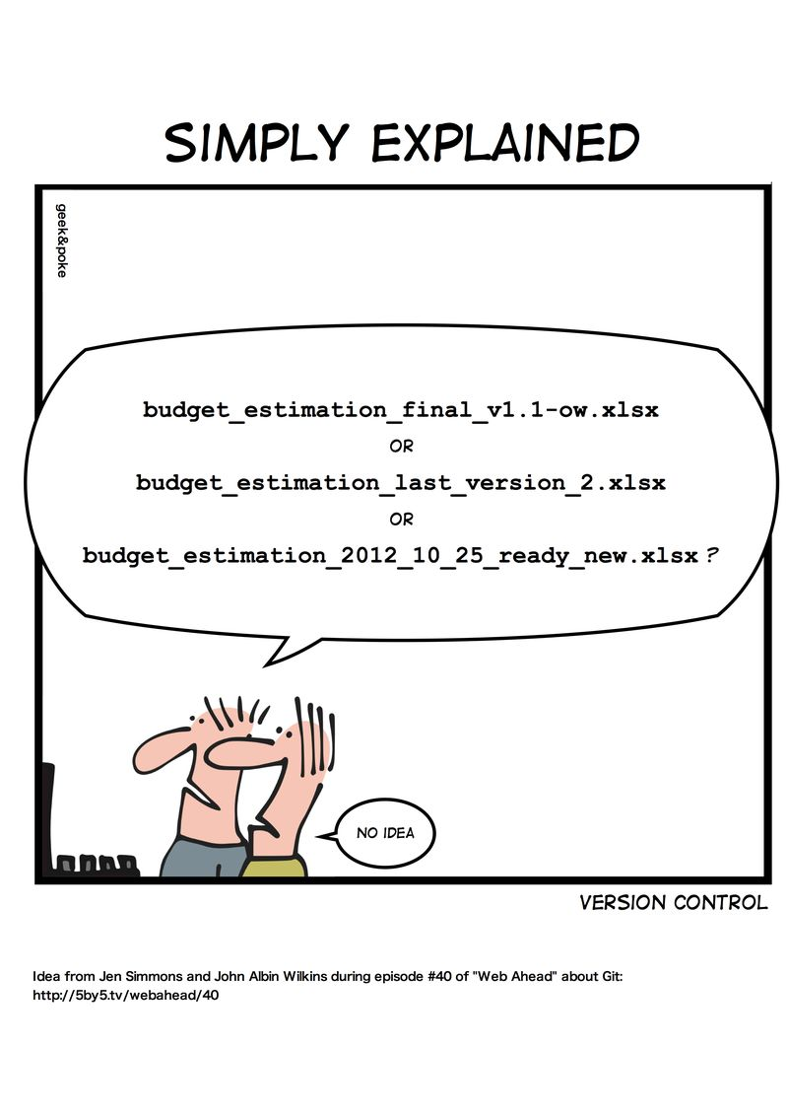
Notes:
Source: https://geek-and-poke.com/?offset=1352247302000

Slide 11
A few concepts
There are 3 “places” for a file to be:
working directory: where you make your edits & save, just as you would if you weren’t using VC.
staging area: where you stash changed files, in preparation to commit them to the…
repository: the “vault” where all versions of all files are kept.
The staging area is what lets you combine changes in multiple files into a single unit that you can roll back from.

Slide 12
File tracking is opt-in
Files can have one of a few statuses:
Untracked: git is ignoring them, will not touch them.
Modified: git is tracking the file; the version in working dir is different from current version in repository.
Staged: put into a holding area for bundling into the next commit.
Unmodified: version in the working dir = current version in the repository.

Slide 13
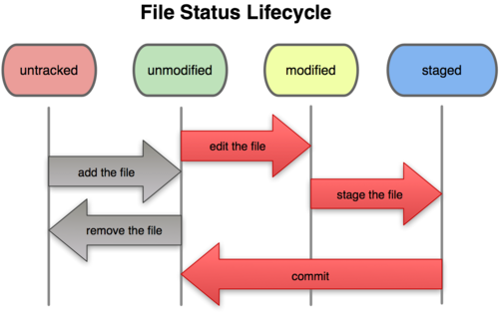
Notes:
Source: Pro Git, by Scott Chacon. http://progit.org/book/ch2-2.html
Adding an untracked file actually puts it in ‘staged’ status I believe.

Slide 14
Demo
Pssst—Roy! Refer to the cheat sheet in the slide comments.
Notes:
Demo script
mkdir -p my_study/programming/programs
cd into that
git init
notice new (master) at end of prompt--that's cue you're in a version controlled folder.
create get_cohort.sas
-------------------------
libname my_study 'blah blah blah' ;
** We want anybody enrolled on June 30th. ;
data cohort ;
set vdw.enroll ;
where '30jun2004'd between enr_start and enr_end ;
run ;
-------------------------
create formats.sas
-------------------------
proc format ;
value $gen
'F' = 'Female'
'M' = 'Male'
;
quit ;
-------------------------
git status--see--both files untracked.
git add get_cohort.sas
git status--see that one file is now staged for commit. Git will monitor this file forevermore.
git add formats.sas
git commit
git pops your favorite editor for you to hold forth on the heroic programming you just did.
change get_cohort.sas & formats.sas (change 'male' to 'boy' say; add age )
-------------------------
proc sql ;
create table my_study.cohort as
select c.mrn, d.gender
from cohort as c INNER JOIN
vdw.demog as d
on c.mrn = d.mrn
;
quit ;
-------------------------
git diff
notice you get changes reported for all files.
comparison is last committed version vs what's in working dir right now.
do git diff <<filename>> for just the changes to <<filename>>
Now we want to commit these changes--you use the same command as for adding new files to track--git add
git add .
a shortcut that says "add every file in here to the repo (changed or new)"
git commit
Now we have 2 commits--let's look at our history
git log
Notice that each commit is identified by an ugly-ass hex number--that's a SHA1 hash value.
it is possible to add a 'tag' to particular commits so you can use those to refer to a particular commit.
but the good news is that you really only need to use the first four chars of the hash to refer to a particular commit.
go back in time temporarily
- generally (git checkout <<hash>>)
undo is git checkout master
- per file (git checkout <<hash>> filename)
notice that git considers the file to be changed--you can commit this change to effectively revert just a single file.
undo is git checkout filename
go back in time permanently by reverting a commit
git revert <<hash>>
notice you get a brand new commit for the reversion--which means you can even un-do the un-do if you want.
In general, it's tough to get git to actually discard data. Not impossible, just tough.

Slide 15
Other Things git can do
Branching
create alternate realities of a project & switch back and forth between realities.
Merge changes back into the production code.
Cloning
Create a perfect copy of a repo (with all history)
Side development
Backup
Deployment
Pull/push changes between clones
Act as a subversion client.

Slide 16
Learn More
Progit.org/book
Git Immersion http://library.edgecase.com/git_immersion

