Slide 1
Data Science Analytics for HMOs: How You Can, And Why You Should
Roy Pardee
David Cronkite

Slide 2

Context: Learning Health System
The Learning Health System initiative is an explicit partnership between Research and Care Delivery aimed at cutting out the middle layers of the Research → Dissemination → Practice cycle.
Is Not Research
Aims at leveraging data to optimize care delivery
Multi-Pronged approach
So many prongs!
Medication Assisted Treatment for Opiate Use Disorder
Care Management
Care Management “ensures patients receive timely and appropriate care and supports utilization management activities.”
LHS Goal: reduce inpatient admissions by 2%
Notes:
http://incontext.ghc.org/lhs/index.html
KPWA’s Complex Case Management program “coordinates the care and services of members with multiple chronic conditions and complicated medical/social needs often resulting in the extensive use of resources. The CCM program is designed to comply with the standards set for the by the National Committee on Quality Assurance (NCQA) and is integral to the accreditation for the health plan. The RN case managers are at minimum bachelor’s level educated and are certified by the Commission for Case Management Certification (CCMC). The social work case managers are licensed independent clinical social workers (LICSW).”

Slide 3
Can We Help CM Identify Patients At Risk for Hospitalization?
LHS Decided to zero in on:
The Complex Case Management program
Patients with Diabetes, Congestive Heart Failure, or Kidney Disease
The Usual (analytical) Suspect: Johns Hopkins’ Adjusted Clinical Groups (ACGs)
Produces many useful stats, indices and scores, including especially two assessments of inpatient risk.
Task 1 was figuring out how predictive ACG’s 12-month risk of hospitalization index is in our population.
Much wrangling of data.
Side Quest: Can I learn enough Python to use it to come up with a competing (or complementary?) predictor?
Mostly an excuse to dig in to Python & its data science libraries
I was emboldened by coauthor David Cronkite, who was incredibly generous w/his time.
Notes:
https://www.hopkinsacg.org/
KPWA made a decision years ago to invest in ACGs—calculating those are part of our Enterprise production
No shade on ACGs btw—it is unquestionably useful stuff.

Slide 4
The Data
Cohort is everyone in the April 2016 ACG file, who had indication of CHF, Diabetes or Renal disease. N = 70,231
Age/Sex.
ACG’s 12-month predictor of inpatient risk.
Added a Flag for whether the person was (preventably) hospitalized over the period covered by the ACG predictions: May 2016 to April 2017.
ACG process takes the preceding 12 months worth of claims data as grist for its predictors.
Professional, Institutional, and Pharmacy claims.
But no clinical data.
Because: marketed at Insurers.
Notes:
Cohort is pretty much the same data I was gathering for the validity assessment.
Total N on that file is ~725K
Hospitalization flag was derived from claims (KPWA owns no hospitals).
By ‘preventably’ I mean, not obviously to deliver a baby, deal w/a motor vehicle (or other) accident, etc. See the %get_pop() macro in get_features.sas in get_features.sas.

Slide 5
The Data (cont)
As grist for the Python process, I would use the prior 3 months of:
All pharmacy fills (by RxCUI)
All dx codes
All px codes
All VDW lab tests, including the abnormal indicator
All BMI measures, categorized
All blood pressure measures, categorized
In the argot of Machine Learning—these are what we used as ‘features’ for the ‘model’.
Person | Date | Type | Code | Result | Comments
Patty | ::DOB:: | agegender | 60to64_F |  | Woman between ages of 60 & 64
Patty | 5/3/2016 | lab | PT:NL | 15 | Prothrombin time: normal range
Patty | 5/3/2016 | lab | INR:NL | 1.2 | International ratio: normal range
Patty | 5/3/2016 | bp | high | 130/76 | Blood pressure: high category
Patty | 6/8/2016 | Rx | 310429 |  | Furosemide 20mg tab
Patty | 6/8/2016 | Dx | Z85.820 |  | Personal history of malignant melanoma of skin
# features/person:
Median:31
IQR:55
Notes:
Look at all those ‘all’s. Note the lack of concern over the underlying medical science that might otherwise be brought to bear on this problem.
Like Click & Clack used to say: we are “unencumbered by the thought process” here.

Slide 6

Machine Learning Approach
Algorithms “learn” from the data (“features”) to make predictions.
Python’s scikit-learn library (https://scikit-learn.org) provided a wide variety of classifier algorithms for us to try.
In General:
Feed a subset of your data (“features”, “variables”) into a classifier along with the gold standard.
The classifiers “learn” to make predictions from this data.
You then sic them on a held-back subset of data.
If the predictions match your gold standard, you’ve got a good classifier.
Notes:
Dig how brute-force this is.

Slide 7
The Boogeyman: Overfitting
Even when you know what you’re doing, there’s a ton of iterating in this work.
Parameter tweaking.
Feature engineering.
Poses the risk that you will torture your models until they essentially “memorize” your training data.
Which makes for excellent predictions—on your training data.
And horrible performance in new samples.
Traditional stats hypothesis testing relies on mathematical argument.
But with data science you justify belief empirically.
You should believe my predictions because I’m demonstrating that they work.
Notes:
Ultimately, we need an answer to the question “why should I believe your predictions?”
In the olden days, you’d have to be very stingy with the amount of iterating you could do and still rely on the logic of significance testing to make the argument that your results should generalize to new samples.
(Harken back to your stats professors railing against stepwise regression. That was one of the first iterative, automated model selection techniques. The primary reason that was bad was that it involved doing waaaay too many significance tests w/out protecting the overall experiment-wise error rate.
For a representative screed against stepwise, see e.g. https://towardsdatascience.com/stopping-stepwise-why-stepwise-selection-is-bad-and-what-you-should-use-instead-90818b3f52df.)

Slide 8
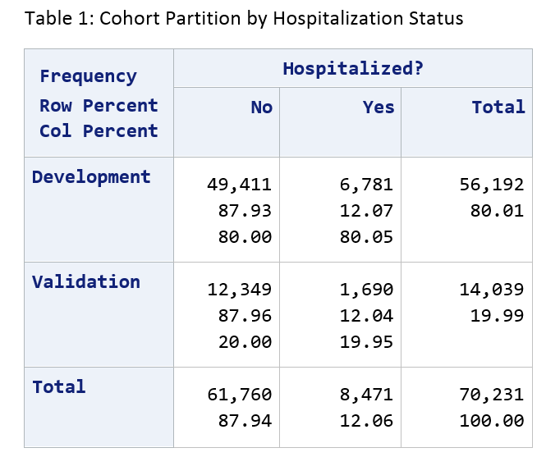
Data Science Solution: Partition Into Development and Validation Samples
Notes:
80% dev and 20% validation.
Note that 12% of our cohort has been hospitalized. These are pretty sick people.
So—dev is the playground. We can torture that for as long as we like, wreak whatever statistical malpractice we want on it. Validation is our safety net—that’s the basis of our argument later on that whatever we put together to predict in dev will be useful beyond that set of data.

Slide 9
Development Process
Read the Development data out of the database.
Split Development into two-thirds TRAIN and one-third TEST (stratified by Hospitalization status).
Train various classifiers (random forest, support vector, etc.) on TRAIN
Use those trained classifiers to predict the cases in TEST.
Evaluate performance.
If performance is unsatisfactory and we can think of something to tweak, do those tweaks and return to #1.
When done iterating (if we think we have something) evaluate classifiers in the held-back Validation data.
Notes:
Here’s the iteration I was talking about.
Note that we’re not bringing any actual clinical or even statistical knowledge to bear on this problem. This is very much a throw-it-against-the-wall-and-see-what-sticks approach.
One very nice thing about the scikit-learn libs I was able to use is that their programmatic interfaces are pretty uniform. So I was able to write a single function that accepted a generic classifier and the training/test data and would spit out predictions & statistics.
Note also that we don’t touch the validation data in this process at all. That is our ultimate backstop on overfitting—if we overfit development, validation will smack us upside the head.

Slide 10
TRAIN
Development
TEST
HOSPITALIZED
Validation

Slide 11

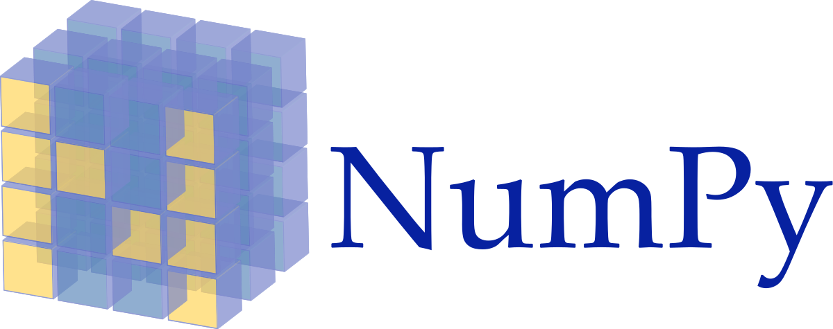

We <3 Python (Anaconda)
Open-Source Software Can Be A Harsh Mistress
Can be difficult to install
Can be difficult to connect to other things in your environment
Can be difficult to connect up to other OSS
Can be difficult to learn/use
The Anaconda distribution of Python is not difficult at all
So—come on in. The water is fine.
In particular—the APIs for the various classifiers we tried were wonderfully consistent with one another.
Notes:
https://www.anaconda.com/

Slide 12
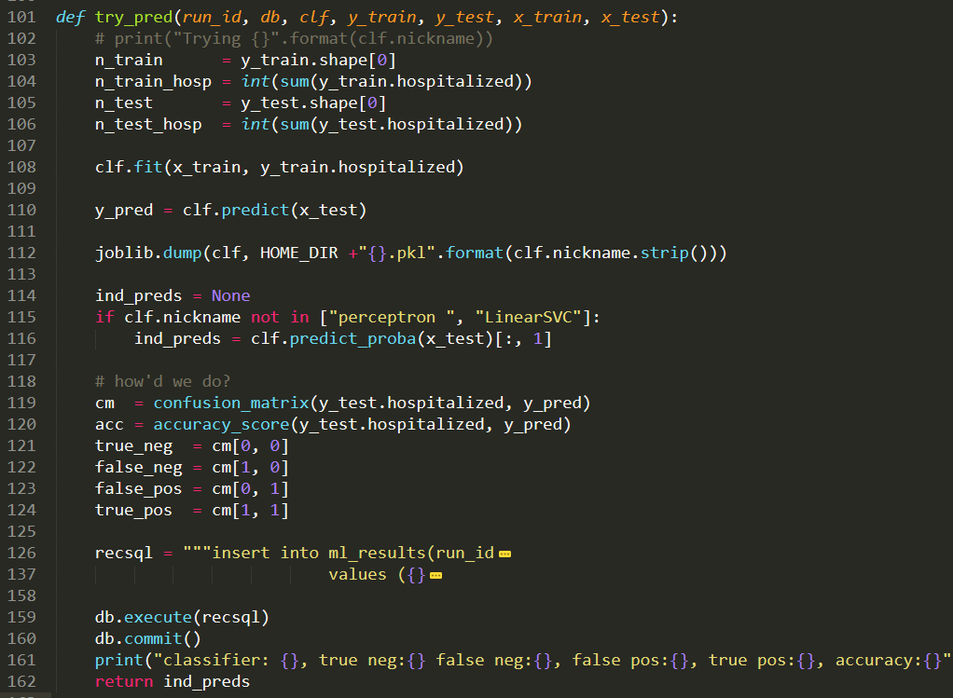
Notes:
Oh snap—code!
Here’s the generic function I wrote to put a classifier through its paces. It takes a classifier as part of the inputs, calls its .fit() and .predict() methods, and assesses/records the results.
The one difference is whether the classifier was capable of returning individual probabilities rather than just whole number will-the-or-won’t-they scores.
Note that we save the trained predictor to a file for future use on line 112 there.

Slide 13
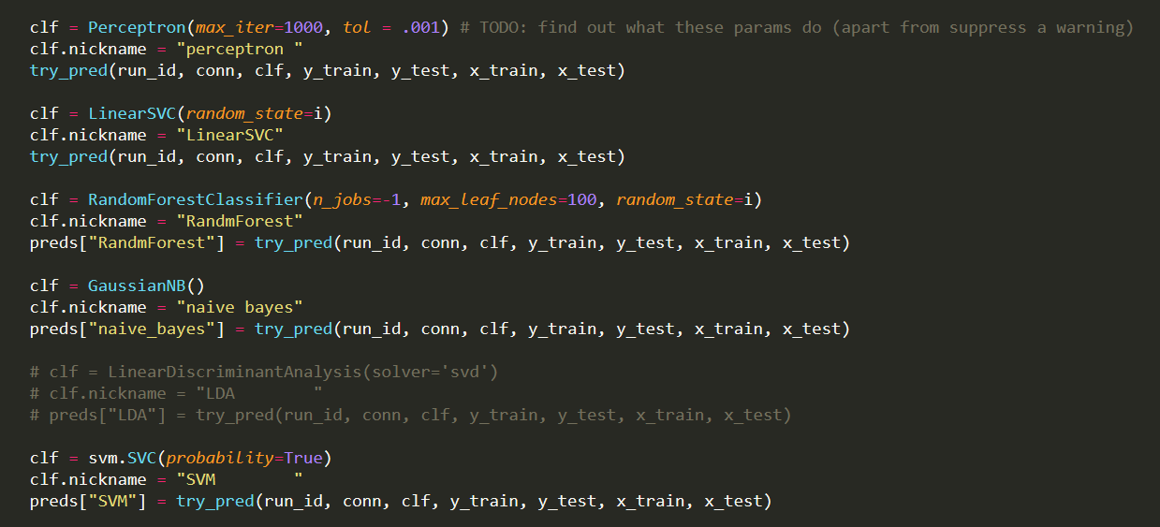
Notes:
And here’s the bit of the main function that instantiates a bunch of predictors from sklearn, and then hands them off to the aforementioned try_pred() function.
As you can tell from that TODO comment—I did not trouble myself overmuch with knowledge of the underlying statistical processes here. That pragmatic approach is part and parcel of data science, the way I think about it. If something works and you can prove it works, the soundness of the underlying math is frankly secondary.
I skipped LDA early on b/c it took a zillion years to run and the predictions were not worth that wait.

Slide 14
Script Output
Training has 37,648 people in it, 4,543 of whom have been hospitalized.
Test has 18,544 people in it, 2,238 of whom have been hospitalized.
classifier: perceptron , true neg: 14,904 false neg: 1,836, false pos: 1,402, true pos: 402, accuracy:0.83
classifier: LinearSVC , true neg: 15,217 false neg: 1,748, false pos: 1,089, true pos: 490, accuracy:0.85
classifier: RandmForest, true neg: 16,299 false neg: 2,225, false pos: 7, true pos: 13, accuracy:0.88
classifier: naive bayes, true neg: 3,655 false neg: 727, false pos: 12,651, true pos: 1,511, accuracy:0.28
classifier: SVC , true neg: 16,306 false neg: 2,238, false pos: 0, true pos: 0, accuracy:0.88
All above + individual-level predictions written back to database for posterity.
But they’re all crap!
Notes:
Note that SVC ties for top accuracy just by predicting that nobody will be hospitalized. Which is not useful and sad.
Naive Bayes has the most true positives, but at the cost of the most false positives too—by a lot. Not going to be useful either.
Soooo.. Sad face, right?
Nah!

Slide 15
Fortunately, this is a Triage problem
We can still be helpful to Care Management even if we can’t say with confidence whether any particular Patty Patient will individually be hospitalized.
CM has limited resources—they can’t engage with everyone.
But if we can help them prioritize their efforts—steer them toward a set of people who are more likely to be hospitalized than the rest, that would be a win.
So can we provide a good ranking of most-needy to least-needy?
To visualize results:
Pick a classifier and sort the cohort from most-likely-to-be-hospitalized to least-likely.
Run down the line counting the cumulative number of people who were in fact hospitalized.
Plot the number of people examined by the number of hospitalizations detected.
The faster the Y values climb, the better the predictor.

Slide 16
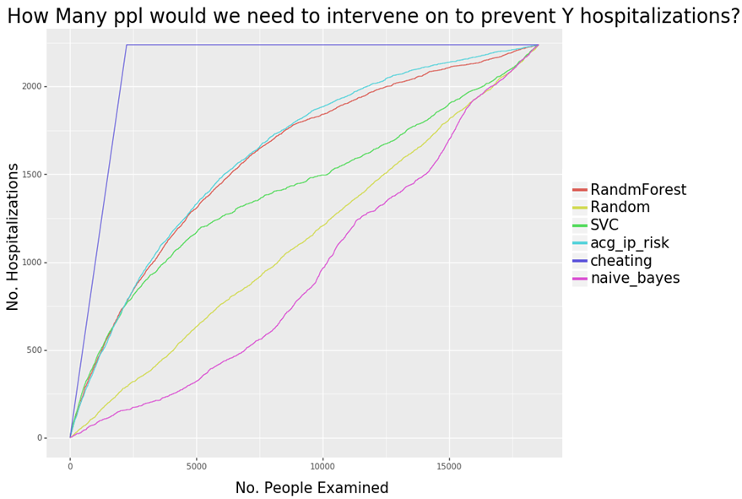
Test portion of Development Sample
Notes:
If we sort everybody based on a given classifier score, highest to lowest, and then go down the line and add up the cumulative number of people who were in fact hospitalized as we go, we can get a sense of the quality of the predictors. To the extent that a score packs the head of the line with people who were ultimately hospitalized, we should see the Y values in the following ‘number needed to treat’ (NNT) graph shoot up precipitously.
The graph answers the question ‘how many people do we have to intervene on in order to detect (and hopefully prevent) a total of Y hospitalizations?’
Couple of lines of particular interest:
The purple ‘cheating’ line is what we get if we order people by their true status—we put everyone who was in fact hospitalized up to the beginning of the line, and have godlike, perfect ‘prediction’. That represents the absolute best that any predictor could possibly do. Nobody is in that neighborhood—not even ACG.
The dull yellow-green 45-degree line in the middle is what we get if we order people randomly. That’s what we should expect to see from a complete bullshit, snake-oil predictor. Astoundingly, Naïve Bayes manages to be worse than this. Possibly I’m using it incorrectly somehow—not sure.
The turquoise line is of course ACG—that’s what we’re shooting at. It’s a pretty clear favorite over the entire range of the development sample here. Pre-2,500 people there are two candidates that give ACG a run for its money, but after that ACG pulls away.
BUT! On the left hand side of the axis, we have two candidate scores that look pretty darn good—SVC and Random Forest. That’s a pretty important part of the graph actually, because just like you don’t normally have time to page through the 2d, 3rd, 4th pages of google results that you get on a search, CM folks don’t have time to get involved with 2500 people. So we can scale back our goal again! If we can deliver say, the top 300 people most likely to be hospitalized, we’ve got a win.
So, this took a fair bit of time to get to. I started out just with coded data, used NDCs rather than RxCUIs,, tried lots of different predictors, pushed the lookback out to 3 months (I started out w/one month) and eventually elaborated things until something started to look respectable. So am I just telling myself a pretty story here? Have I overfit my data? There’s only one way to find out.

Slide 17
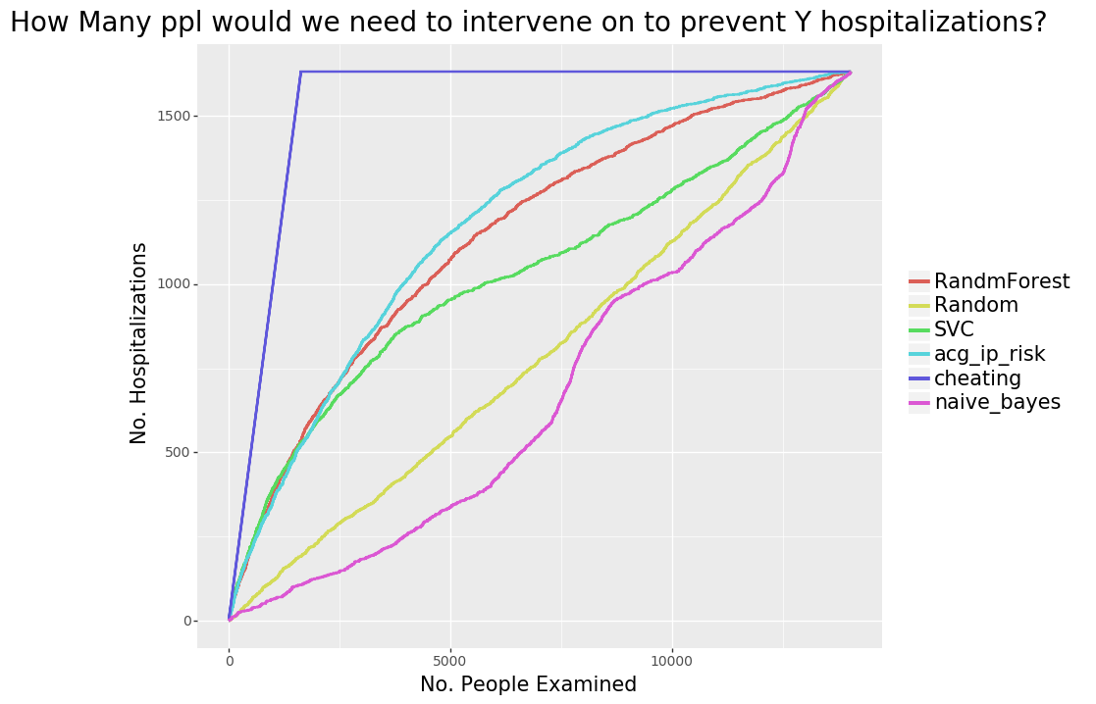
Full Validation Sample
Notes:
SCORE! Results are pretty much the same as development. If anything, random forest looks a little bit better here.

Slide 18
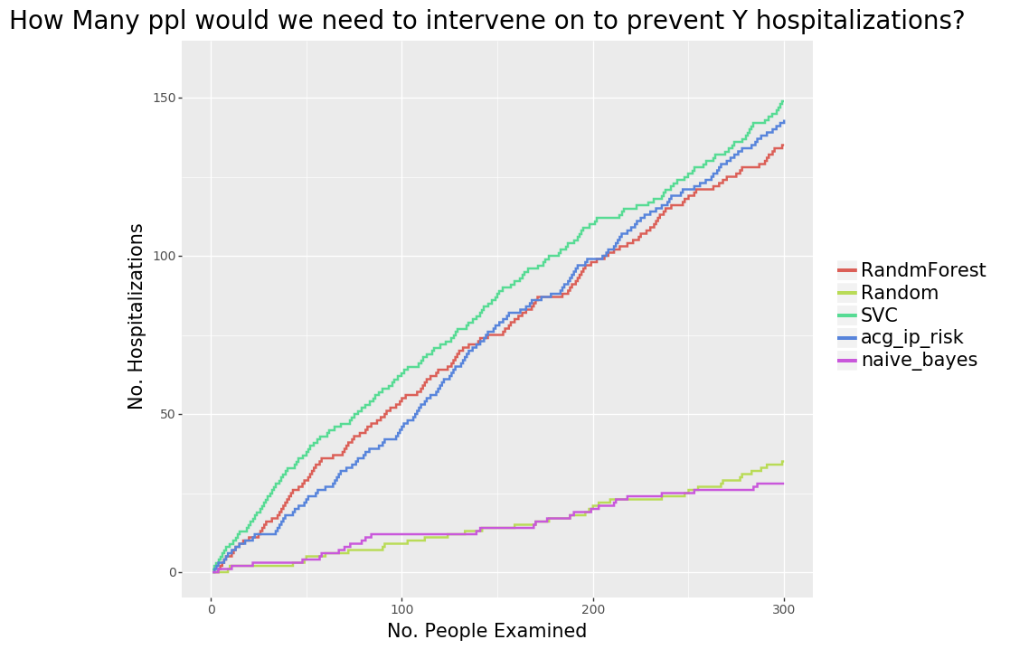
ENHANCE!
Notes:
Zooming in to x <= 300, which is much closer to the number of people that CM could actually try to engage with in a month, we can see that:
Support Vector classifier beats ACG over this whole range!
Random Forest is ahead for the first 135 people or so.
Both are worthy alternatives to ACG.
This looks like success to me, and it’s likely that we could improve this significantly from here if we spent more time/added more data.
Of the two, Random Forest is way more computationally efficient (SVC took multiple days to train unfortunately, though that’s potentially a problem that we could throw hardware at). So that one’s my favorite, even if it’s second best here.

Slide 19
Conclusions…
…and Caveats
Created a predictor just as good (for our purposes) as an expensive third party tool, using fewer months of input data.
Very little expertise, medical or otherwise.
$0 spent on software/hardware.
Python + scikit-learn very usable.
Ditto VDW Data.
No reason to operate with one hand (insurance/clinical data) tied behind our back.
Retrospective nature of the data means all claims were in.
Real world low-latency data will be spottier.
Predictions may not be as good.
Classifiers are generally Black Boxes.
Not Research, really.
Not unlocking mysteries of the underlying mechanisms here.
Notes:
Machine was Intel Core i-7 w/16GB of Ram, running 64-bit Windows 7.

Slide 20
Future Directions
Switch
from using binary feature flags to counts of feature occurrences.
to ingredient-level RxCUIs (or supplement with?)
to lower-latency sources for dx/px (other sources are already daily).
Try additional classifiers.
Tweak Parameters.
Expand population, either to additional diseases, or to the general population.
Create additional predictors for Care Managers’ ratings of success/impact.
Notes:
Unfortunately it’s not clear I’ll get to do any of this—LHS leadership was not enthusiastic about it, for reasons I still don’t understand.

Slide 21
Thank You!
https://github.com/rpardee/hcsrn_2019
roy.e.pardee@kp.org
david.j.cronkite@kp.org
Notes:
Bonus slides follow that may be useful if I get questions.

Slide 22
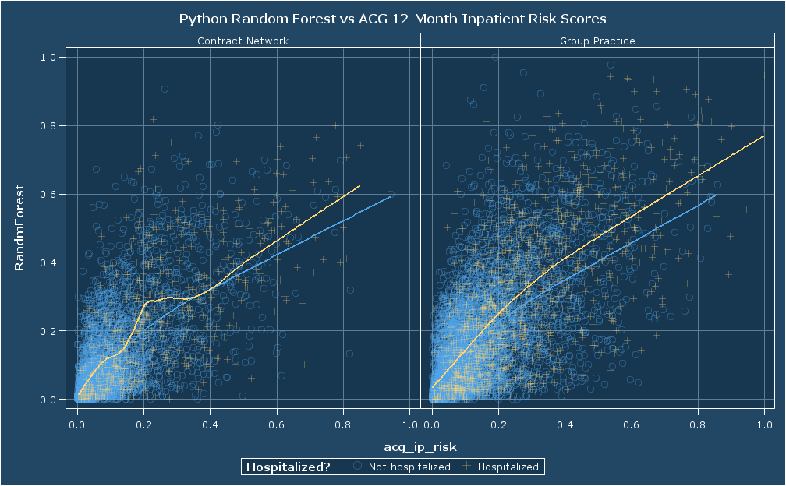
Notes:
Of possible interest—scatterplots of the RF predictors against ACG’s 12-month inpatient risk scores (both rescaled so they each take up the full range of values from 0 to 1).
It would be interesting to see NNT diagrams that were stratified by delivery system.

Slide 23
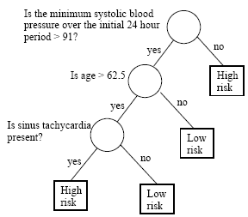
Bonus: What is a Random Forest?
A Classification Tree is a simple method for making a decision.
A Random Forest:
Creates B different bootstrapped samples from the input training data.
Creates a classification tree for each one.*
When predicting new data, it gets run through every one of the B bootstrap-generated trees.
The prediction becomes the classification reported by the majority of trees in the forest.
* The twist is that at each level of the tree, when choosing a feature to split on, only a random subset of features are considered.
Notes:
Image from https://onlinecourses.science.psu.edu/stat857/node/22/
In my case I accepted the default number of trees, which is 10. Thinking on it I should probably switch to an odd number of trees so there’s no chance of ties.

