Slide 1
Predicting Hospitalizations
The Data Science Way!

Slide 2
Context: Learning Health
The Learning Health System initiative is an explicit partnership between Research and Care Delivery aimed at cutting out the middle layers of the Research → Dissemination → Practice cycle.
Is Not Research
Aims at leveraging data to optimize care delivery
Multi-Pronged approach
So many prongs!
Medication Assisted Treatment for Opiate Use Disorder
Care Management
Care Management “ensures patients receive timely and appropriate care and supports utilization management activities.”
KP Goal: reduce inpatient admissions by 2%
Notes:
http://incontext.ghc.org/lhs/index.html

Slide 3
Can We Help CM Identify Patients At Risk for Hospitalization?
LHS Decided to zero in on:
The Complex Case Management program
Patients with Diabetes, Congestive Heart Failure, or Kidney Disease
The Usual Suspect: Johns Hopkins’ Adjusted Clinical Groups (ACGs)
Produces many useful stats, indices and scores, including especially two assessments of inpatient risk.
Task 1 was figuring out how predictive ACG’s 12-month risk of hospitalization index is in our population.
Much wrangling of data.
Side Quest: Can I learn enough Python to use it to come up with a competing (or complementary?) predictor?
Mostly an excuse to dig in to Python & its data science libraries
David Cronkite went above & beyond to help me up the Python & Analytics learning curves—THANK YOU DAVID!

Slide 4
The Data
Cohort is everyone in the April 2016 ACG file, who had indication of CHF, Diabetes or Renal disease. N = 70,231
Age/Sex
ACG’s 12-month predictor
Flag for whether the person was hospitalized between May 2016 and April 2017
ACG process takes the preceding 12 months worth of claims data as grist for its predictors.
Encounters and pharmacy claims both
But no clinical data.
Marketed at Insurers.
Notes:
Cohort is pretty much the same data I was gathering for the validity assessment.

Slide 5
The Data (cont)
As grist for the Python process, I would use the prior 3 months of:
All pharmacy fills (by RxCUI)
All dx codes
All px codes
All VDW lab tests, including the abnormal indicator
All BMI measures, categorized
All blood pressure measures, categorized
In the argot of Machine Learning—these are what we used as ‘features’ for the ‘model’.
Person | Date | Type | Code | Result | Comments
Patty | ::DOB:: | agegender | 60to64_F |  | Woman between ages of 60 & 64
Patty | 5/3/2016 | lab | PT:NL | 15 | Prothrombin time: normal range
Patty | 5/3/2016 | lab | INR:NL | 1.2 | International ratio: normal range
Patty | 5/3/2016 | bp | high | 130/76 | Blood pressure: high category
Patty | 6/8/2016 | Rx | 310429 |  | Furosemide 20mg tab
Patty | 6/8/2016 | Dx | Z85.820 |  | Personal history of malignant melanoma of skin
# features/person:
Median:31
IQR:55
Notes:
Look at all those ‘all’s. Note the lack of concern over the underlying medical science that might otherwise be brought to bear on this problem.
Like Click & Clack used to say: we are “unencumbered by the thought process” here.

Slide 6
ML Boogyman: Overfitting
Even when you know what you’re doing, there’s a ton of iterating in this work.
Parameter tweaking
Feature engineering
This poses the risk that you will torture your models until they essentially “memorize” your training data.
Which makes for excellent stats & demos—on your training data.
Which you already know the answers for.
In the olden days, you’d have to be very stingy with the amount of iterating you could do and still rely on the logic of hypothesis testing to make the argument that your results should generalize to new samples.
But nowadays we’re data rich! Just hold some data back to test generalization empirically.
Notes:
Harken back to your stats professors railing against stepwise regression. That was one of the first iterative, automated model selection techniques. The primary reason that was bad was that it involved doing waaaay too many significance tests w/out protecting the overall experiment-wise error rate.

Slide 7
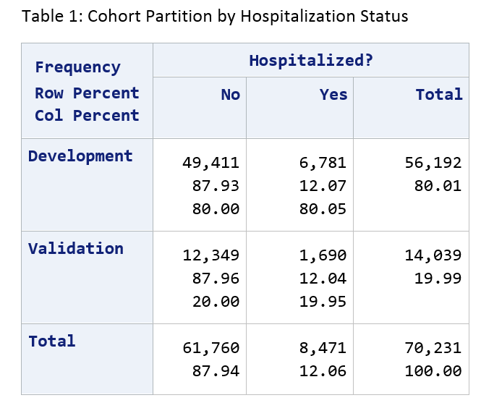
Solution: Divide into Development and Validation Portions
Notes:
80% dev and 20% validation.
Note that 12% of our cohort has been hospitalized. These are pretty sick people.
So—dev is the playground. We can torture that for as long as we like, wreak whatever statistical malpractice we want on it. Validation is our safety net—that’s the basis of our argument later on that whatever we put together to predict in dev will be useful beyond that set of data.

Slide 8
Python Time
For interacting w/SQL Server: pyodbc
For late-in-the-game manipulation: pandas
For Machine Learning: Scikit-Learn (sklearn)
naive_bayes
linear_model
model_selection
discriminant_analysis
svm
ensemble
preprocessing
externals
metrics

Slide 9
Development Process:
Read the development data out of the database.
Randomly divide it into two-thirds training and one-third test samples (stratified by Hospitalization status).
Use the training sample to ‘fit’ (train) one or more of the SKL classifiers.
Use the resulting fitted classifiers to predict the cases from the ‘test’ sample.
Evaluate performance.
If performance is unsatisfactory and we can think of something to tweak (features, classifier parameters, etc.) do those tweaks and start back at #1.
Notes:
Note that we’re not bringing any actual clinical or even statistical knowledge to bear on this problem. This is very much a throw-it-against-the-wall-and-see-what-sticks approach.
One very nice thing about the scikit-learn libs I was able to use is that their interfaces are pretty uniform. So I was able to write a single function that accepted

Slide 10
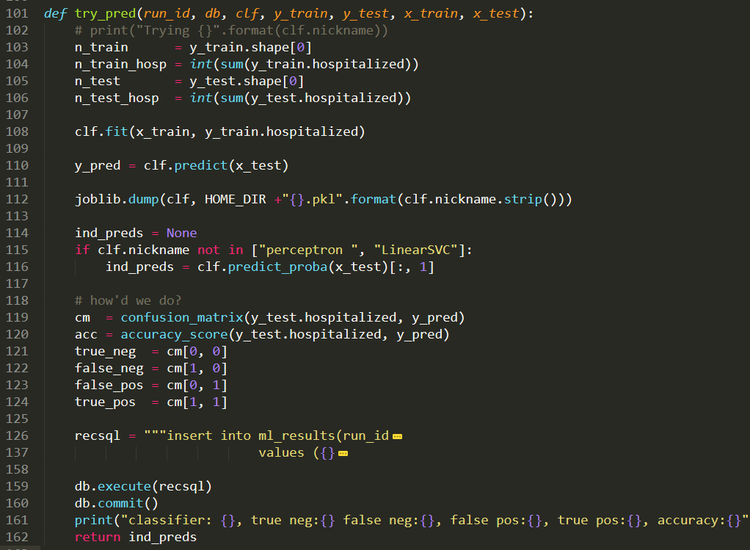
Notes:
Here’s the generic function I wrote to put a classifier through its paces. It takes a classifier as part of the inputs, calls its .fit() and .predict() methods, and assesses/records the results.
The one difference is whether the classifier was capable of returning individual probabilities rather than just whole number will-the-or-won’t-they scores.
Note that we save the trained predictor to a file for future use on line 112 there.

Slide 11
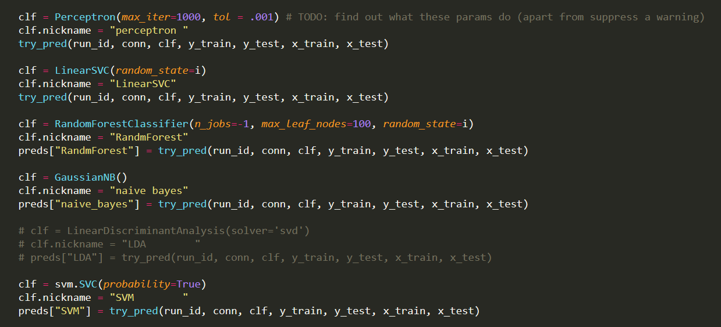
Notes:
And here’s the bit of the main function that instantiates a bunch of predictors from sklearn, and then hands them off to the aforementioned try_pred() function.
As you can tell from that TODO comment—I did not trouble myself overmuch with knowledge of the underlying statistical processes here. That pragmatic approach is part and parcel of data science, the way I think about it. If something works and you can prove it works, the soundness of the underlying math is frankly secondary.
I skipped LDA early on b/c it took a zillion years to run.

Slide 12
Script Output
Training has 37,648 people in it, 4,543 of whom have been hospitalized.
Test has 18,544 people in it, 2,238 of whom have been hospitalized.
classifier: perceptron , true neg: 14,904 false neg: 1,836, false pos: 1,402, true pos: 402, accuracy:0.83
classifier: LinearSVC , true neg: 15,217 false neg: 1,748, false pos: 1,089, true pos: 490, accuracy:0.85
classifier: RandmForest, true neg: 16,299 false neg: 2,225, false pos: 7, true pos: 13, accuracy:0.88
classifier: naive bayes, true neg: 3,655 false neg: 727, false pos: 12,651, true pos: 1,511, accuracy:0.28
classifier: SVC , true neg: 16,306 false neg: 2,238, false pos: 0, true pos: 0, accuracy:0.88
All above + individual-level predictions written back to database for posterity.
But they’re all crap!
Notes:
Note that SVC ties for top accuracy just by predicting that nobody will be hospitalized. Which is not useful and sad.
Naive Bayes has the most true positives, but at the cost of the most false positives too—by a lot. Not going to be useful either.

Slide 13
Fortunately, this is a Triage problem
We can still be helpful to Care Management even if we can’t say with confidence whether Patty Patient will individually be hospitalized.
CM has limited resources—they can’t engage with everyone.
But if we can help them prioritize their efforts—steer them toward a set of people who are more likely to be hospitalized than the rest, that would be a win.
So can we do a good ranking?
To visualize results:
Pick a classifier and sort the cohort by descending values (so—most likely to be hospitalized first).
Run down the line counting the cumulative number of people who were in fact hospitalized.
How many people do we have to go through in order to find Y people hospitalized?
The faster the Y values climb, the better the predictor.

Slide 14
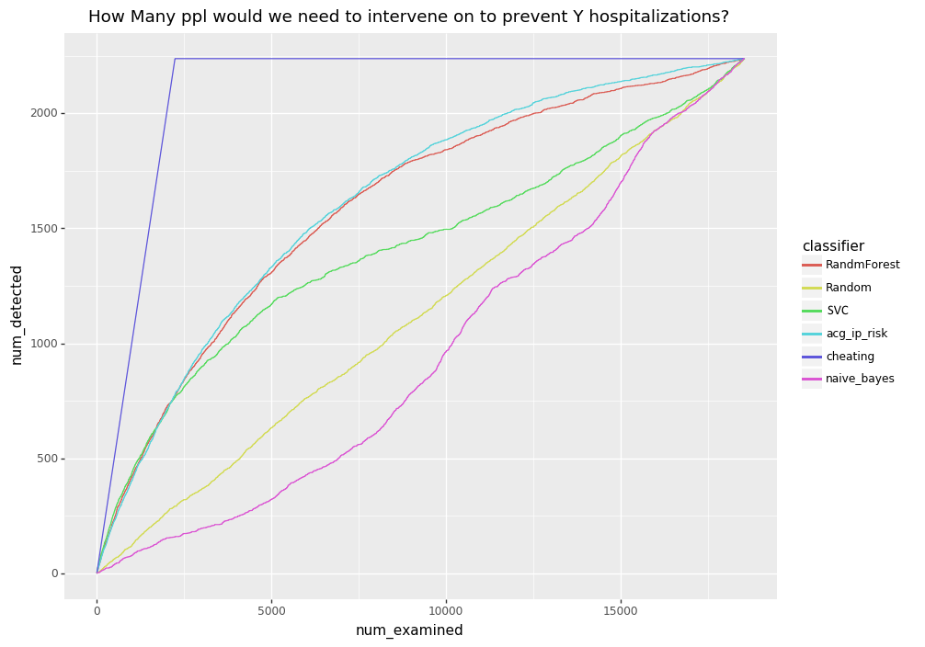
Final Development Results
Notes:
If we sort everybody based on a given classifier score, highest to lowest, and then go down the line and add up the cumulative number of people who were in fact hospitalized as we go, we can get a sense of the quality of the predictors. To the extent that a score packs the head of the line with people who were ultimately hospitalized, we should see the Y values in the following ‘number needed to treat’ (NNT) graph shoot up precipitously.
The graph answers the question ‘how many people do we have to intervene on in order to detect (and hopefully prevent) a total of Y hospitalizations?’
Couple of lines of particular interest:
The purple ‘cheating’ line is what we get if we order people by their true status—we put everyone who was in fact hospitalized up to the beginning of the line, and have godlike, perfect ‘prediction’. That represents the absolute best that any predictor could possibly do. Nobody is in that neighborhood—not even ACG.
The dull yellow-green 45-degree line in the middle is what we get if we order people randomly. That’s what we should expect to see from a complete bullshit, snake-oil predictor. Astoundingly, Naïve Bayes manages to be worse than this. Possibly I’m using it incorrectly somehow—not sure.
The turquoise line is of course ACG—that’s what we’re shooting at. It’s a pretty clear favorite over the entire range of the development sample here. Pre-2,500 people there are two candidates that give ACG a run for its money, but after that ACG pulls away.
BUT! On the left hand side of the axis, we have two candidate scores that look pretty darn good—SVC and Random Forest. That’s a pretty important part of the graph actually, because just like you don’t normally have time to page through the 2d, 3rd, 4th pages of google results that you get on a search, CM folks don’t have time to get involved with 2500 people. So we can scale back our goal again! If we can deliver say, the top 300 people most likely to be hospitalized, we’ve got a win.
So, this took a fair bit of time to get to. I started out just with coded data, used NDCs rather than RxCUIs,, tried lots of different predictors, pushed the lookback out to 3 months (I started out w/one month) and eventually elaborated things until something started to look respectable. So am I just telling myself a pretty story here? Have I overfit my data? There’s only one way to find out.

Slide 15
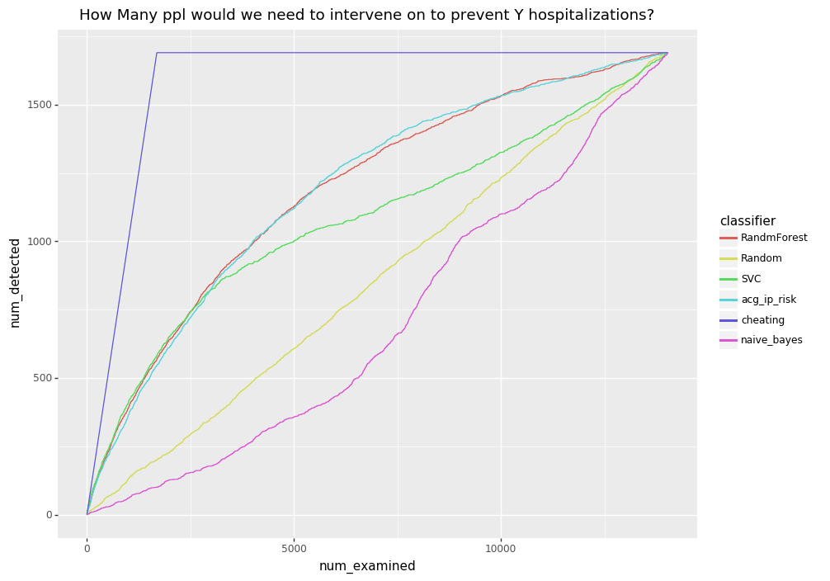
Validation Results
Notes:
SCORE! Results are pretty much the same as development. If anything, random forest looks a little bit better here.

Slide 16
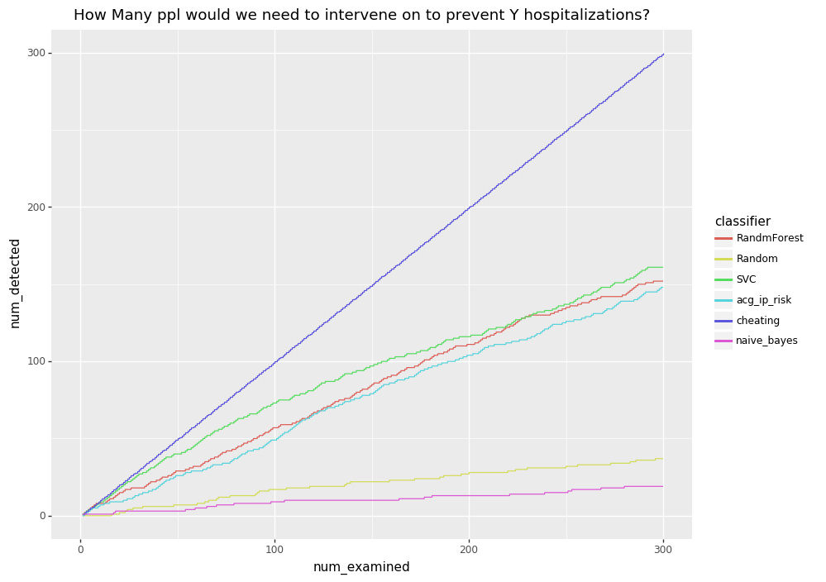
ENHANCE!
Notes:
Zooming in to x <= 300, which is much closer to the number of people that CM could actually try to engage with in a month, we can see that Random Forest and SVC are both a tad better than ACG. Of these two, Random Forest is way more computationally efficient (SVC took multiple days to train unfortunately, though that’s potentially a problem that we could throw hardware at). So that one’s my favorite, even if it’s second best here.

Slide 17
Conclusions and Caveats
This is fun!
We can create our own predictive processes without too much trouble.
As an HMO, we have both clinical and insurance data—and we should use both!
3rd party tools tend to be marketed to either insurers or providers, and so focus on only one type of data.
Here we were able to create a predictor just as good (for our purposes) as an expensive third party tool, using fewer months of lookback data.
But are the hospitalizations in fact preventable?
We don’t know for either score.
Even if RF predictions are comparable to ACGs overall, it may be that RF is great for Group Practice enrollees, but not Contracted Network enrollees (where we are much more like an insurance co.).

Slide 18
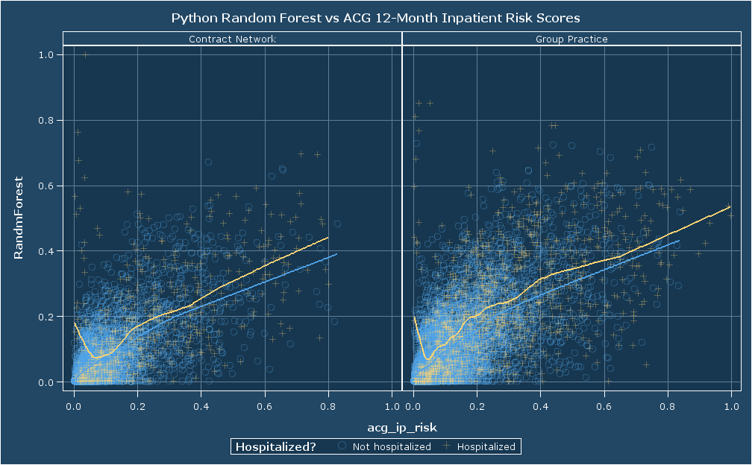
BUT—maybe not
Notes:
These scatterplots look pretty similar. Note especially the hook on the loess line toward the left in the Hospitalized group, where the ACG assessed the risk as low but RF disagreed—lots of orange crosses there. That suggests that the RF predictor is keying in on something that the ACG algorithm doesn’t pay attention to. The fact that both groups feature this hook suggests that it is not just clinical data, which should be sparse in the CN group.
Tyler raised the excellent point that the low-acg/high-RF points may have been hospitalized due to pregnancy or injury, which aren’t preventable, and which ACG explicitly ignores. Even more reason to pursue a version that does a similar exclusion.

Slide 19
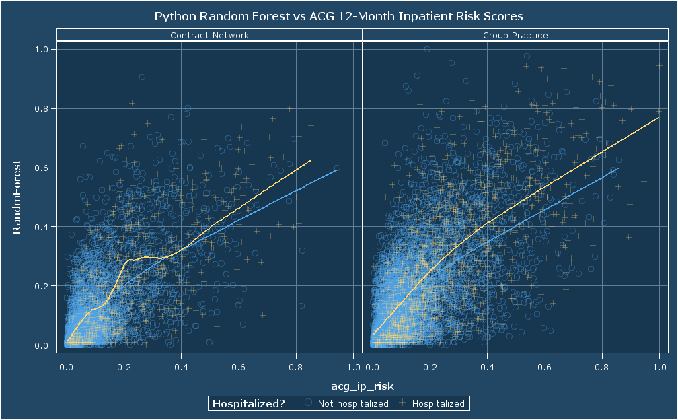
Notes:
Looks like Tyler was right. A much-later run using the same DRG exclusions that ACG uses to ignore non-preventable hospitalizations ditches those low-ACG/high-RF ‘hooks’ in the plots.
It would be interesting to see NNT diagrams that were stratified by delivery system.

Slide 20
Future Directions
Exclude known non-preventable hospitalizations (e.g., deliveries; injuries).
Switch to the ingredient-level RxCUIs, which Geoff just made available.
Switch to lower-latency data for dx/px (other sources are already daily).
Try additional classifiers.
Investigate which particular features are important/actually used by the RF—narrow in on just the features that are predictive.
Expand population, either to additional diseases, or to the general population.
Try to enhance predicted outcome by factoring in (somehow?) Care Managers’ ratings of how useful they thought they were to improving a patient’s life.
Notes:
Note that it’s unclear I’ll get the chance to do any of this. I sent an e-mail to the PI & biostatistician letting them know what I’d found, but they have not seemed enthusiastic about getting into this. My hope is that the DI article that David & I wrote, and this and other (HCSRN) presentations will whet our (and our sister orgs’) appetite for this kind of work.

Slide 21
Thanks!

Slide 22
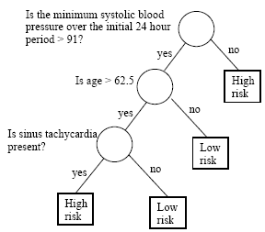
Bonus: What is a Random Forest?
A Classification Tree is a simple method for making a decision.
A Random Forest:
Creates B different bootstrapped samples from the input training data.
Creates a classification tree for each one.*
When predicting new data, it gets run through every one of the B bootstrap-generated trees.
The prediction becomes the classification reported by the majority of trees in the forest.
* The twist is that at each level of the tree, when choosing a feature to split on, only a random subset of features are considered.
Notes:
Image from https://onlinecourses.science.psu.edu/stat857/node/22/
In my case I accepted the default number of trees, which is 10. Thinking on it I should probably switch to an odd number of trees so there’s no chance of ties.

