Slide 1
Visualizing VDW Lab Results Data
Why You Should, And How You Can—Easily!
Roy Pardee
HMORN Annual Meeting 16-April-2013

Slide 2
Call The Waaaambulance
Lab is hard. It requires more substantive clinical expertise to do well than probably any other VDW data area.
Primary reason: no applicable national coding standard.
LOINC effort didn’t get underway until 1994.
By then GH (and other sites?) had been using its own idiosyncratic coding system for six years.
Even now LOINC is honored more in the breach than the observance.
Result: Uneducated fools like me have to try and interpret what clinically-trained people mean when they say e.g., “glycated hemoglobin” results.
Notes:
I’m going to whine at you a little.
And the poor researchers are at my mercy. (Have I mentioned I was a psych major?)

Slide 3

Notes:
Just flash this for a few seconds

Slide 4
Feigning Competence
A good Lab data programmer knows:
How often they should see a given test type in their data—and how the popularity of a test waxes/wanes over time.
When differently-described/coded result types are in fact the same thing (and vice-versa)
What the results should look like.
Character values like ‘Pos’, ‘Negative’, or numeric values?
If numeric:
What units should be attached?
What should distributions look like?
Users of the data will often need to know these things too.
The Boogeyman: What if I’m including inappropriate result records?
Notes:
What would a good lab programmer know?

Slide 5
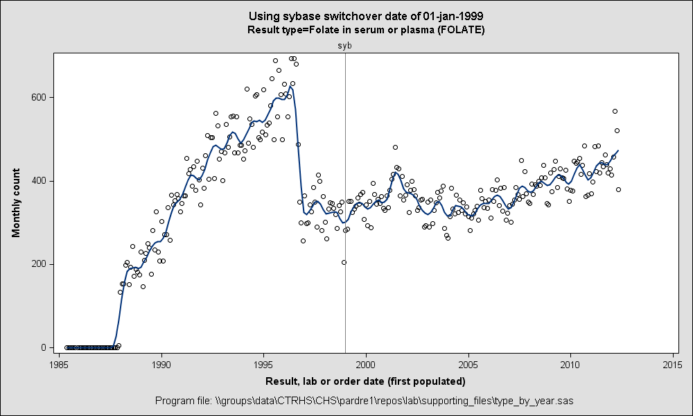
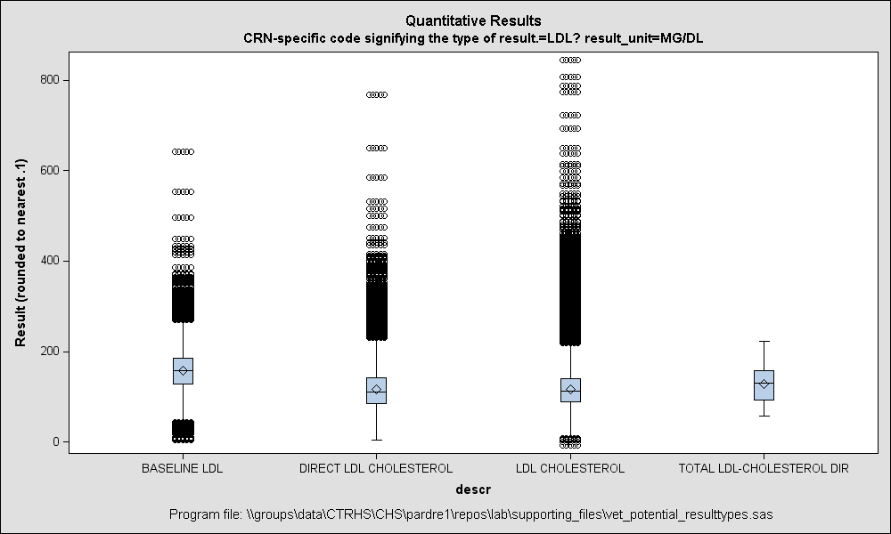
Picture > 1,000 Words
Surely the best way to develop the familiarity (and still have time left to attend to one’s other responsibilities) is to generate & study graphs of the data.
So I did that. For each of our 100 different TEST_TYPEs.
100 of these
Notes:
It’s a cliché because it’s true.
Because I wanted to see these for all of our result types, I made these graphs with by-processing (BY TEST_TYPE ;). So I would get 100 line-graphs, followed by 100 boxplots, followed by 100 barcharts, etc.

Slide 6
It Scrolls When It’s Told, Or Else It Gets The Hose
The problem with reviewing so many graphs is that the different graphs for any given result type are scattered over a huge document.
Boxplots showing value distributions by unit gave no info on relative frequencies of those units.
Lineplots of tests over time not informative on which local codes are contributing most of the results.
Scrolling back and forth to get the gestalt without being distracted by other test types was too much to ask of my meager attention span.
What I really wanted was a one-page “report-card” type display for each test type.
Notes:
(The title is a riff on a quote from The Silence of The Lambs.)
In the bad-old-days of PROC GREPLAY, I would not have even bothered trying to put a compound graph together. But nowadays we have a much better choice.

Slide 7
%SGDESIGN—My Hero!
New in SAS v9.2.
A GUI tool for creating templates for compound graphs.
Drag-and-drop your way to graphical excellence!
Define a lib pointing at the data you want to graph (or data w/the same structure) and then invoke %sgdesign.
When you’re done, either save the result off into a separate .sgd file, or select View → Code and copy/paste result into your program.
Use that with PROC SGRENDER or SGDESIGN to create new instances of your compound graph.
Notes:
But hooray—SAS now has new, modern graphics capabilities, including a template designer with a graphical user interface.

Slide 8
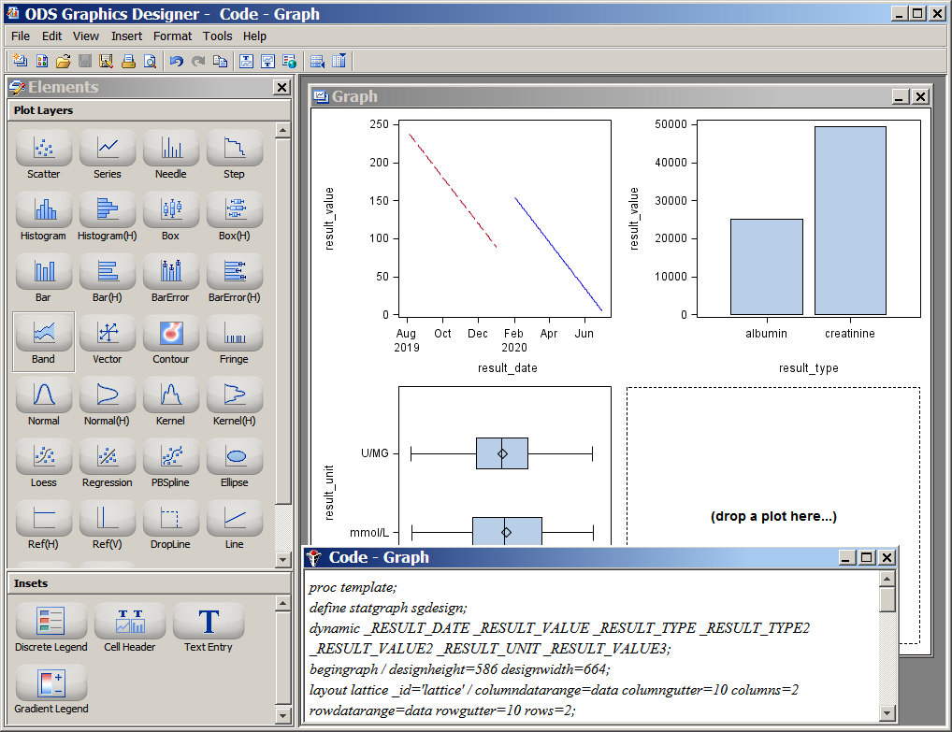

Slide 9
Enter vdw_lab_graphs.sas
Written as a distributable VDW Program + SGD template file.
Efficient!
Gathers statistics for all result types into a hash object in a single pass through the dataset.
Empirically checks for numericality of result values, and reads numeric values into a numeric variable.
Attaches dates to results, regardless of which of the date vars are actually populated for a given result.
Inserts a placeholder value for missing units and result values.
Notes:
When I discovered that I was off to the races—wrote a new program to produce a one-per-result-type report card.
Let’s take a look!

Slide 10
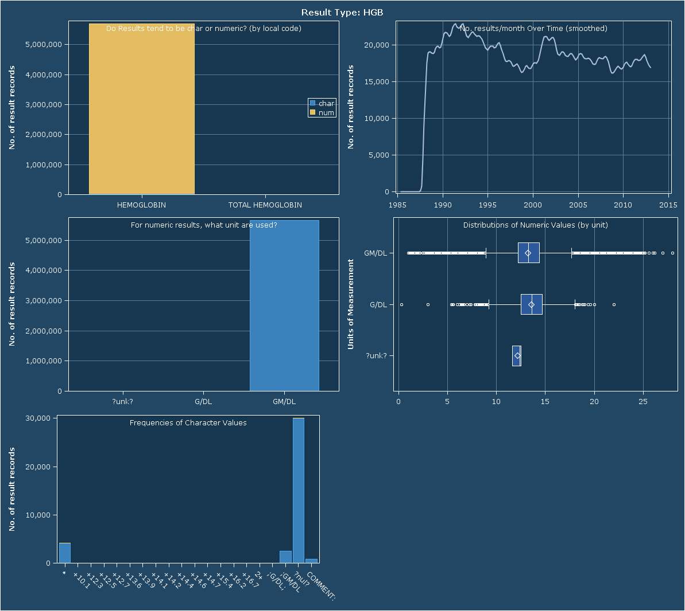
Notes:
HGB = Hemoglobin in blood
Things to notice here:
First graph shows result type by local code. For us we only use 2 different local codes (result descriptions) to signify HGB results (one of which makes negligible contribution). The vast majority of the values are numeric like we would expect, but there are some character-looking values as well (or else the legend wouldn’t have an entry for char). You can tell from the scale of the y-axis here that we have > 5 million HGB records in our file.
The second graph shows monthly counts of result records over the entire extent of the file. Here we see that we’ve had pretty high, and relatively steady counts over the entire extent of our file (1988 to present). Note that this line is actually a loess-smoother, which in my experience tends to show the true volume of results over time better than a simple series plot.
The third graph shows the units attached to those results determined to be numeric. Here too there’s a single strong mode of GM/DL—G/DL and ‘?unk?’ (which is the placeholder value inserted when null units are found) make no significant contribution to the total # of HGB result records.
The fourth graph shows the distributions of the numeric values, again by result unit. Looking at the fairly uniform distributions across the 3 values, it’s tempting to think about changing them all to GM/DL.
The final graph shows what the apparently non-numeric values look like. Bear in mind the scale of the y-axis, lest you overestimate the extent of the problem. The vast majority of these records seem to be unresulted—the result values are simply null. Now that we have decided to remove these from the lab results dataset, these show that I have some work to do getting rid of them. It’s likely that once I do a fair chunk of the null unit records will also be jettisoned. Note also the smattering of values w/plus signs + a numeric value—those are either values that I need to look into to see if I can simply ignore the +s & parse them out in creating the file, or rather signify something that should be preserved (e.g., it may mean modifier should be set to ‘>’). Then again—seeing that these values don’t merit actual bars even on a graph w/max(y) = 30k, it’d be hard to cry over simply discarding those records.

Slide 11
Punch List
Use long names to identify result types, not just TEST_TYPE values.
Can we put reference information in the 6th location (e.g., expected units & normal range)?
Add counts by local code to #results/month graph (or replace total?)
Include a unified legend for local code values depicted in the lower two bar graphs.
Table of contents to allow users to jump right to result types of interest.

Slide 12
SGD Sneakiness
%SGDESIGN gui does not expose all the functionality of the SG template language.
For applications that read all data from a single dataset, you can copy/edit the code from the code view & then reference the template in a call to SGRENDER.
But apps that use > 1 dset (like this) have to use the SGD file, which is a binary.
The Big Secret: SGDs are actually .zip files, containing an XML file w/the text of the template code.
So—change extension; unzip; edit XML file; rezip; change extension back; done!
That’s what I did to switch from lattice layout to gridded layout.

Slide 13
Download it Today!
The program (and these slides, and sample output) are all available on github:
http://github.com/rpardee/lab-graphs
Please send me feedback at pardee.r@ghc.org
Thank you!

