Slide 1
How To Write a VDW Program
A Primer for Programmers on Multi-Site Studies
Roy Pardee

Slide 2

Join our cult!
The VDW is a shared delusion.
No single person can touch the whole thing—it’s spread out over 18+ HMORN sites.
It changes sometimes—specs and of course implementations.
There is no single person editing the specs!
Our tool for synchronizing our conceptions of the VDW files is the documentation on the portal.
It’s very important for you to read our promotional literature.
Notes:
This is actually a profound concept.
…and by that I mean our website—the CRN Portal

Slide 3
How Does the VDW Work?
HMORN VOC Workgroups devise specs.
Sites wrangle their indigenous data into the those specs. (The hard part!)
The actual names & locations of the VDW datasets are given in a well-known set of standard macro variables (“the standard vars”).
The end result is an environment where you can count on what datasets / variables will be available & what their contents are.
Notes:
Your local SDM enjoys sophisticated coffee and/or alcoholic beverages.

Slide 4
For Example
The StdVars.sas file defines the VDW-standard macro variables.
%include "\\server\share\crn\vdw\StdVars.sas" ;
** Find everyone enrolled on 30-jun-1997 ;
data my_people ;
set &_vdw_enroll ;
where '30jun1997'd between enr_start and enr_end ;
run ;
A standard macro var referring to the Enrollment file
Variables from the Enrollment file standard.
Variables from the Enrollment file standard.
Notes:
The simplest VDW program ever.

Slide 5
The Standard Variables
Site Identifiers:
&_SiteName (e.g., “Kaiser Permanente Colorado”)
&_SiteAbbr (e.g., “KPNW”)
&_SiteCode (e.g. “01”)
Datasets:
&_vdw_enroll, &_vdw_rx
Utility:
&lowest_count: gives the lowest acceptable counts for releasable aggregate data w/out full IRB review (at sites that allow such things).
Notes:
There are a couple of others that are not really end-user-useful. See this page for details:
It should go without saying that you shouldn’t redefine these variables in your VDW program.

Slide 6
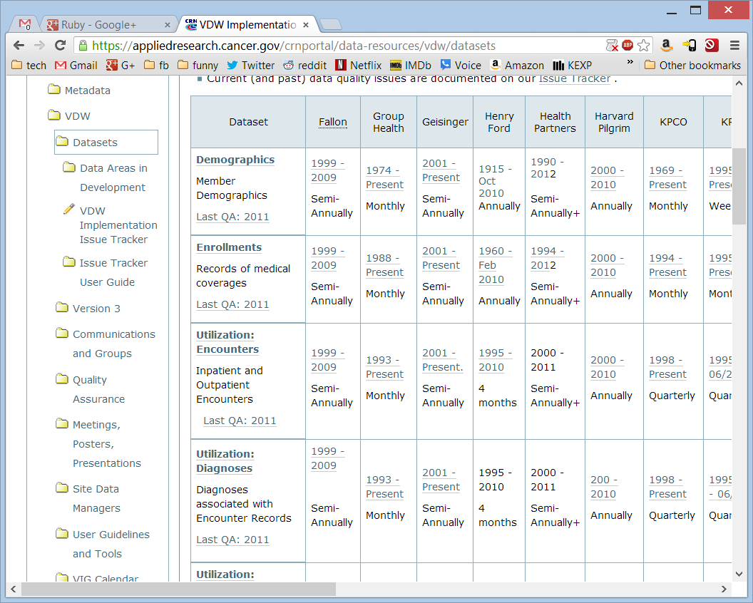
Bookmark This!
Click for detailed spec
Date Range; Click for Implementation Details
Data Quality Issues
HMORN-wide QA Report
Update frequency
Notes:
Click the Dataset name links for the specs.
If the cell contents are a link, the destination page gives details on the implementation at that site.
his is centrally maintained, so each Site Data Manager can update it to reflect changes (this sample material is almost certainly out of date).

Slide 7
How to develop a VDW program
Familiarize yourself w/the specs
Formulate the question
Check for relevant data quality issues
Decide on desired outputs
Write your program
Write up a Workplan
Beta test at a site or 3
Bugfix
Inflict on remaining sites
Bugfix
Collect data

Slide 8
1: Familiarize yourself with the data structures
The specs sometimes get copied around <cough>datawiki</cough> but the authoritative versions are on the CRN Web Portal:
https://appliedresearch.cancer.gov/crnportal
Overview is at Data Resources → VDW → Datasets
That is your entry point to VDW Documentation generally.
Notes:
Your local SDM can set you up with access if you don’t already have it.
Now that leadership of the VDW has moved from CRN to HMORN, we would like to transition off the CRN website, but for the foreseeable future that’s where we are.

Slide 9
2: Formulate The Question
Arguably even more important for a VDW project, as the potential time waste is multiplied by the number of people involved.
Not too soon to start coding against local data—generate output for your site to give your Investigator “something to shoot at.”
Consider also mocking up multi-site versions of your output, to cut down on the “Oh. That’s not what I meant.” factor.
Notes:
And these are people it would be tough to buy beer for…

Slide 10
3: Check The Issue Tracker
Check the relevant sites and dataset implementations for outstanding issues, to see if any affect the information you need.
Be sure to expand the ‘Filter Issues’ formlet at the top of the page.
If there are any, let the site programmer know about them, and contact the relevant SDM to:
get an updated ETA on a fix
see if there are recommended workarounds.
Notes:
https://appliedresearch.cancer.gov/crnportal/data-resources/vdw/datasets/vdw-implementation-issue-tracker

Slide 11
4: Decide on outputs
What do you want back from the sites?
SAS datasets (recommended!)
Log files (recommended!)
ODS Output (HTML, RTF, etc.)
Obviously, requesting summary data alone (even in dataset format) is much easier to approve than individual-level data.
Plan for an iterative process—consider automating collation of results from the sites.
We’ve got a macro to help w/that (more later).
Notes:
You do not want to hand-wrangle output from multiple sites into a single set of collated output. You’re a programmer—write a program to do it for you. ;-)

Slide 12
5: Develop and Debug your program
Program defensively where you reasonably can (e.g., if gender in (‘m’, ‘M’))
KEEP. Don’t DROP.
Make things easy on the Sites
Use the new packaging convention.
Put content needing site edits up high in the program, clearly delineated by comments.
Eliminate log warnings as much as possible; document the unavoidable ones.
Use the variables defined in StdVars.sas to make code portable.
Make things easy on yourself
Use already written macros and code snippets
Notes:
Err on the side of explicitness—so KEEP specific lists of vars you want. That way you’ll be much less likely to get your sites’ extra, off-spec vars (which you almost certainly don’t want and have in some cases tainted files w/PHI and gotten people in trouble.

Slide 13
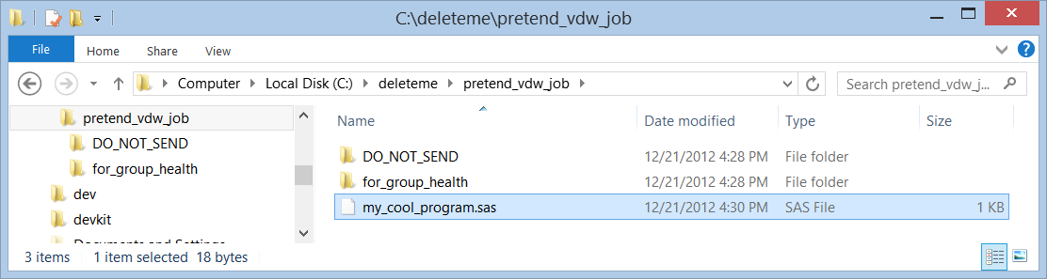
The new packaging convention
Credit to CESR: Gwyn Saylor
CESR convention is overly complicated IMHO, but the kernel of the idea is genius:
Distribute your program, all associated dependencies (supporting dsets & programs) as a standalone zip file,
Which includes a subdirectory structure to hold output reports and data.

Slide 14
The Joy
All your users have to do is:
Unzip the archive someplace.
Edit the main SAS program to add:
StdVars.sas reference
A reference to the location of the main unzip folder. (I call this &root).
From there, you can:
%include any supporting programs.
Set libs to root, “to-stay” and “to-go” locations you know exist b/c the folders are baked into your zip.
Optionally, PROC PRINTTO the log output to the “to-go” folder.

Slide 15
A Note on Developing Code Lists
Frequently the toughest part of writing data pull programs.
Particularly tough in multi-site programming, due to site variation in coding patterns.
Particularly tough with NDCs.
Note that EverNDC is site-specific at each site.
Enlist the help of your beta testers (and the larger group of SDMs) if possible.
Make it easy for site staff to eyeball results for sanity-checks.
Notes:
Jeff Brown’s shop has said that they are willing to help generate NDC lists.

Slide 16
6: Write Up A Workplan
A formal request document accompanying your program(s), describing:
Who is making the request.
The project it fits under.
What VDW data sources are necessary to fulfill it.
Which bits of output you want back.
Which sites you would like to respond.
Use the CRN Web Portal for this if possible, as it gives good visibility & allows easy updating.
Eliminates the “is this the latest version?” problem.
We’ve got a template workplan on the Portal.
Notes:
Template workplan:
https://appliedresearch.cancer.gov/crnportal/data-resources/vdw/template-workplan
Sample:
https://appliedresearch.cancer.gov/crnportal/data-resources/vdw/quality-assurance/qa-programs/2012-qa/enroll-demog-workplan

Slide 17
7: Send ‘beta’ program to your test sites
Start right out using the portal to distribute.
Upload it as a ‘file item’.
Use ‘Categorization’ tab of edit view to make the workplan a ‘related item’ of the file, and vice versa so there are easy links between them.
I like to use comments on the File item to document the changes I make.
Expect additional bugs to appear as each additional site runs your program.
Bugfix until it runs successfully at all test sites.
Notes:
Sample file item:
https://appliedresearch.cancer.gov/crnportal/data-resources/vdw/quality-assurance/qa-programs/2012-qa/vdw_enroll_demog_qa.zip/view

Slide 18
8: Distribute the now-tested program to remaining sites
Expect this too to be an iterative process.
Don’t be too disappointed if there are still some yet-undetected programming errors that come to light.

Slide 19
9: Collect Your Data
I tend to encourage site programmers to use whatever transfer utilities/websites they are comfortable with.
Encourage site programmers to use the PHI checklist and %detect_phi macros.
Use website-borne workplan to publicly document who has/has not submitted data.
The ‘public’ visibility creates a kind of naughty-and-nice list.
It also gives a single authoritative source for information on who has/has not yet responded.

Slide 20
Politics
Default to treating people like they're doing you a favor.
Make your code as easy to run as possible.
Fix all reported bugs, even for tiny things that won’t merit an official re-distribution & re-run (since there’s a good chance you’ll be running the code again for other problems).
Be gracious.
Always assume the fault is with your code first.
But if you do find a bug in one of your sites’ implementations, please see the Issue Tracker User Guide for the reporting process.
Notes:
Issue tracker user guide:
https://appliedresearch.cancer.gov/crnportal/data-resources/vdw/datasets/issue-tracker-user-guide

Slide 21
Specific Programming Tips
Expect the unexpected
Include an ‘Other’ category in your formats.
Prepare for missing values in any non-key variable.
Use CLASSDATA datasets with PROC TABULATE to control output.
Cut down on data volumes as early as possible.
Keep only the vars you need.
Hit the smaller dsets first where possible.
Notes:
Have mercy on the Californias.

Slide 22
Specific Programming Tips
Modularize
Macros, or even separate programs.
When bugs are fixed, sometimes you only need to re-run a portion of the program.
Allow for interim datasets.
Good for debugging.
Sometimes useful for subsequent work (e.g., feasibility run followed by funded study).
But:
Delete them before creating them at each step. (See %RemoveDSet() macro).
Do a complete run-through before sending your program off-site.
Notes:
Delete output datasets as the first step in your macro/program, so that you don’t get fooled about what’s working & what isn’t by old datasets left over by prior runs.

Slide 23
The Standard Macros
There’s a whole separate webinar on this, but quick plug:
In the course of writing VDW programs, we have come up with a series of tested, reusable SAS macros to use as building blocks for new programs.
They are easily %include-ed into your program.
%include vdw_macs ;
Full Details on the CRN Portal.

Slide 24
Tips For Collating Output
Request output in SAS datasets.
Give the dsets you want back distinct, predictable names that signify their purpose—for example:
Start the name with &_SiteAbbr
End the name with something like “_for_my_site”
Indicate the content in the middle of the name.
E.g.: kpnw_obesity_inventory_FOR_GH
Notes:
Couple of reasons for this. First, it makes programmatic collation easier (as you’ll see on the next couple of slides). It should also make it clear which datasets you want from the sites, and make them stand out from any other interim datasets you maybe shouldn’t have.

Slide 25
Collating Output (cont.)
Distinct names let you dump everybody’s submissions into a single folder, so you can see at a glance who submitted data when.
They also allow you to programmatically manipulate those datasets, which can be a real time-saver.
Notes:
Because chances are you are going to have to produce that output multiple times as more sites chime in.

Slide 26
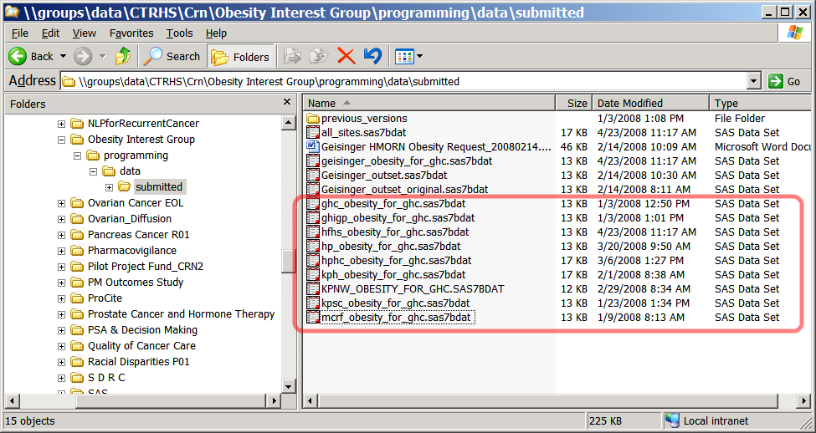
Collating Output (cont.)

Slide 27
Automate collation with %stack_datasets()
InLib: The location of the site-submitted datasets.
Nom: The base name of the individual datasets.
OutLib: Where you want the collated data.
Output dsets look just like the input, w/an additional SITE variable.
%include vdw_macs ;
libname sub "//server/project/programming/data/from_sites" ;
libname d "//server/project/programming/data" ;
%stack_datasets(inlib = sub, nom = obesity_for_ghc, outset = d) ;

Slide 28
Getting Help: Sources
VDW User listserv
VDW Operations Committee Leads: Tyler Ross & Dan Ng
The CRN Web Portal.
Your Local Site Data Managers, Bill, Gene and Roy.

Slide 29
Roy’s General Programming Prejudices
While developing, use dsoptions=“note2err”, as it protects against:
Type coercion.
Uninitialized variables.
Park lengthy code lists off in separate text files & read them in to your main program with INFILE.
Make dstep/proc boundaries explicit with quit or run statements.
No magic numbers—use macro vars as named constants, to make your intention clear.
Drop dsets as soon as you are done with them.
Run in batch (clean environment; clean log)

Slide 30
Roy’s Prejudices (continued)
Check your logs.
Code around WARNINGs—a WARNING should be a true cause for concern.
Do the Ns in each dataset make sense?
Consider using a log-checking program.
Label things
Datasets:
why does this dset exist?
what’s inside it?
to whom should questions be directed?
Variables:
Again—why does it exist?
Give context (e.g., age as of what date?)
Code (via comments):
What’s your goal?
How are you getting there? (high-level)
What approaches did you try and reject?

