Slide 1
Enroll/Demog/Lang WG
HCSRN VDW Implementation Group (Virtual)
October 2023

Slide 2
Overview
Thank-yous
Top-level results
Miscellaneous Observations
Discussion: Non-Self-Reported Race/Ethnicity

Slide 3
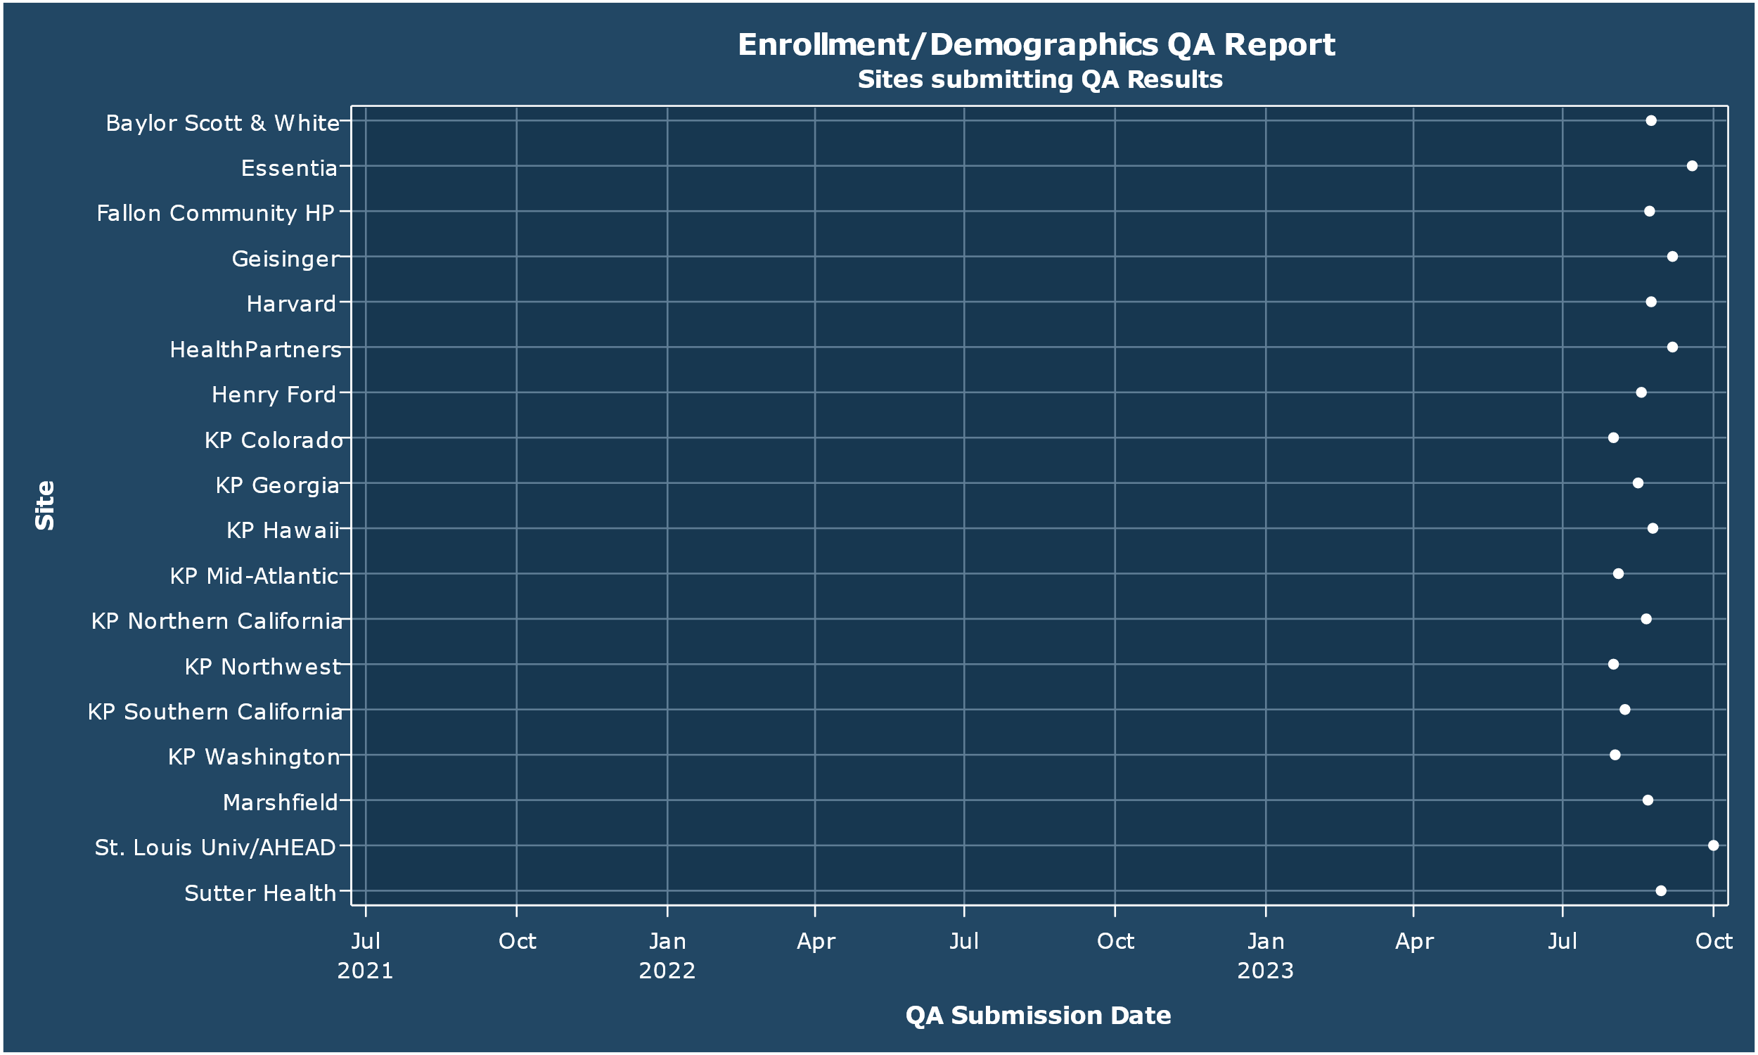
As always—you guys rock
Notes:
Thank you thank you thank you!

Slide 4
Most Not-Passed Checks
QA Check | Warn Threshold | Fail Threshold | Fails | Warnings | Passes | Percent of Sites Passing
Plan type(s) known? | 2% | 4% | 4 | 0 | 0 | 0%
Do enrollment periods overlap? | 0% | 0% | 1 | 0 | 0 | 0%
Duplicated MRNs in demog? | N/A | N/A | 1 | 0 | 0 | 0%
Notes:
This is I believe the fewest failed/warned checks ever. So—the state of Enrollment is strong!

Slide 5
The Dirty Laundry
Site | Table | Check | Result | No. recs offending | Pct. recs offending | Issue Status (if logged)
Baylor Scott & White | Enrollments | Do enrollment periods overlap? | fail | 25,035 | . | In Progress
 | Demographics | Duplicated MRNs in demog? | fail | 3,570 | 0.14 | In Progress
Geisinger | Enrollments | Plan type(s) known? | fail | 1,776,732 | 17.61 | NOT YET LOGGED
Harvard | Enrollments | Plan type(s) known? | fail | 885,445 | 5.10 | NOT YET LOGGED
KP Northern California | Enrollments | Plan type(s) known? | fail | 30,761,877 | 33.81 | Not Fixable
Marshfield | Enrollments | Plan type(s) known? | fail | 3,664,977 | 72.34 | In Progress
Notes:
Note that there has been a marked improvement in the number of recs causing BSW’s fails here, which I find really encouraging.
Note also that the ‘issue status’ links here won’t work, alas. We will have to see if we can come up with a substitute issue tracker somehow.

Slide 6
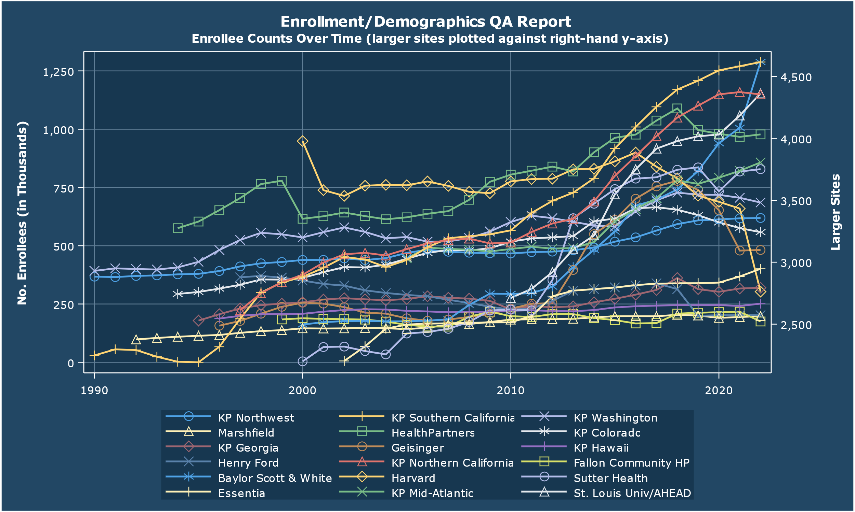
BSW and SLU are growing
Notes:
This is a bit tough to read given that the CAs are plotted separately, but it’s interesting (and nice) to see the steep positive slopes on the last bit of their lines. BSW had more than 1.25M enrollees in 2022, and SLU looks to be around 1.1M.
On the whole across the HCSRN we have 18M enrollees.

Slide 7
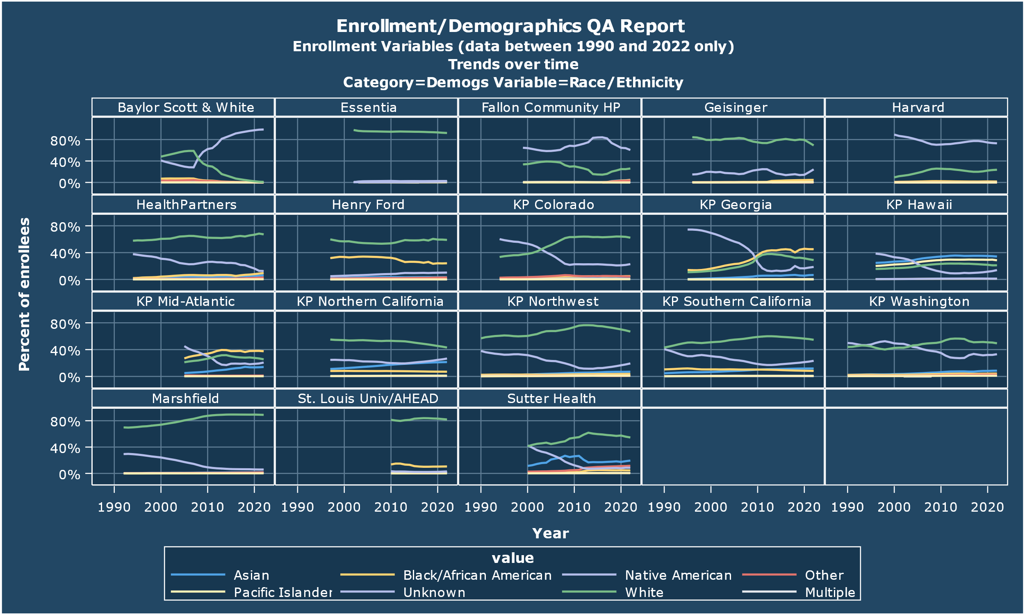
Enrollee Race Differences
Notes:
Essentia & SLU seem to be our “whitest” sites, while right here at KP Mid-Atlantic looks to have the highest proportion of African-American enrollees. KP Hawaii has the most Asian enrollees

Slide 8
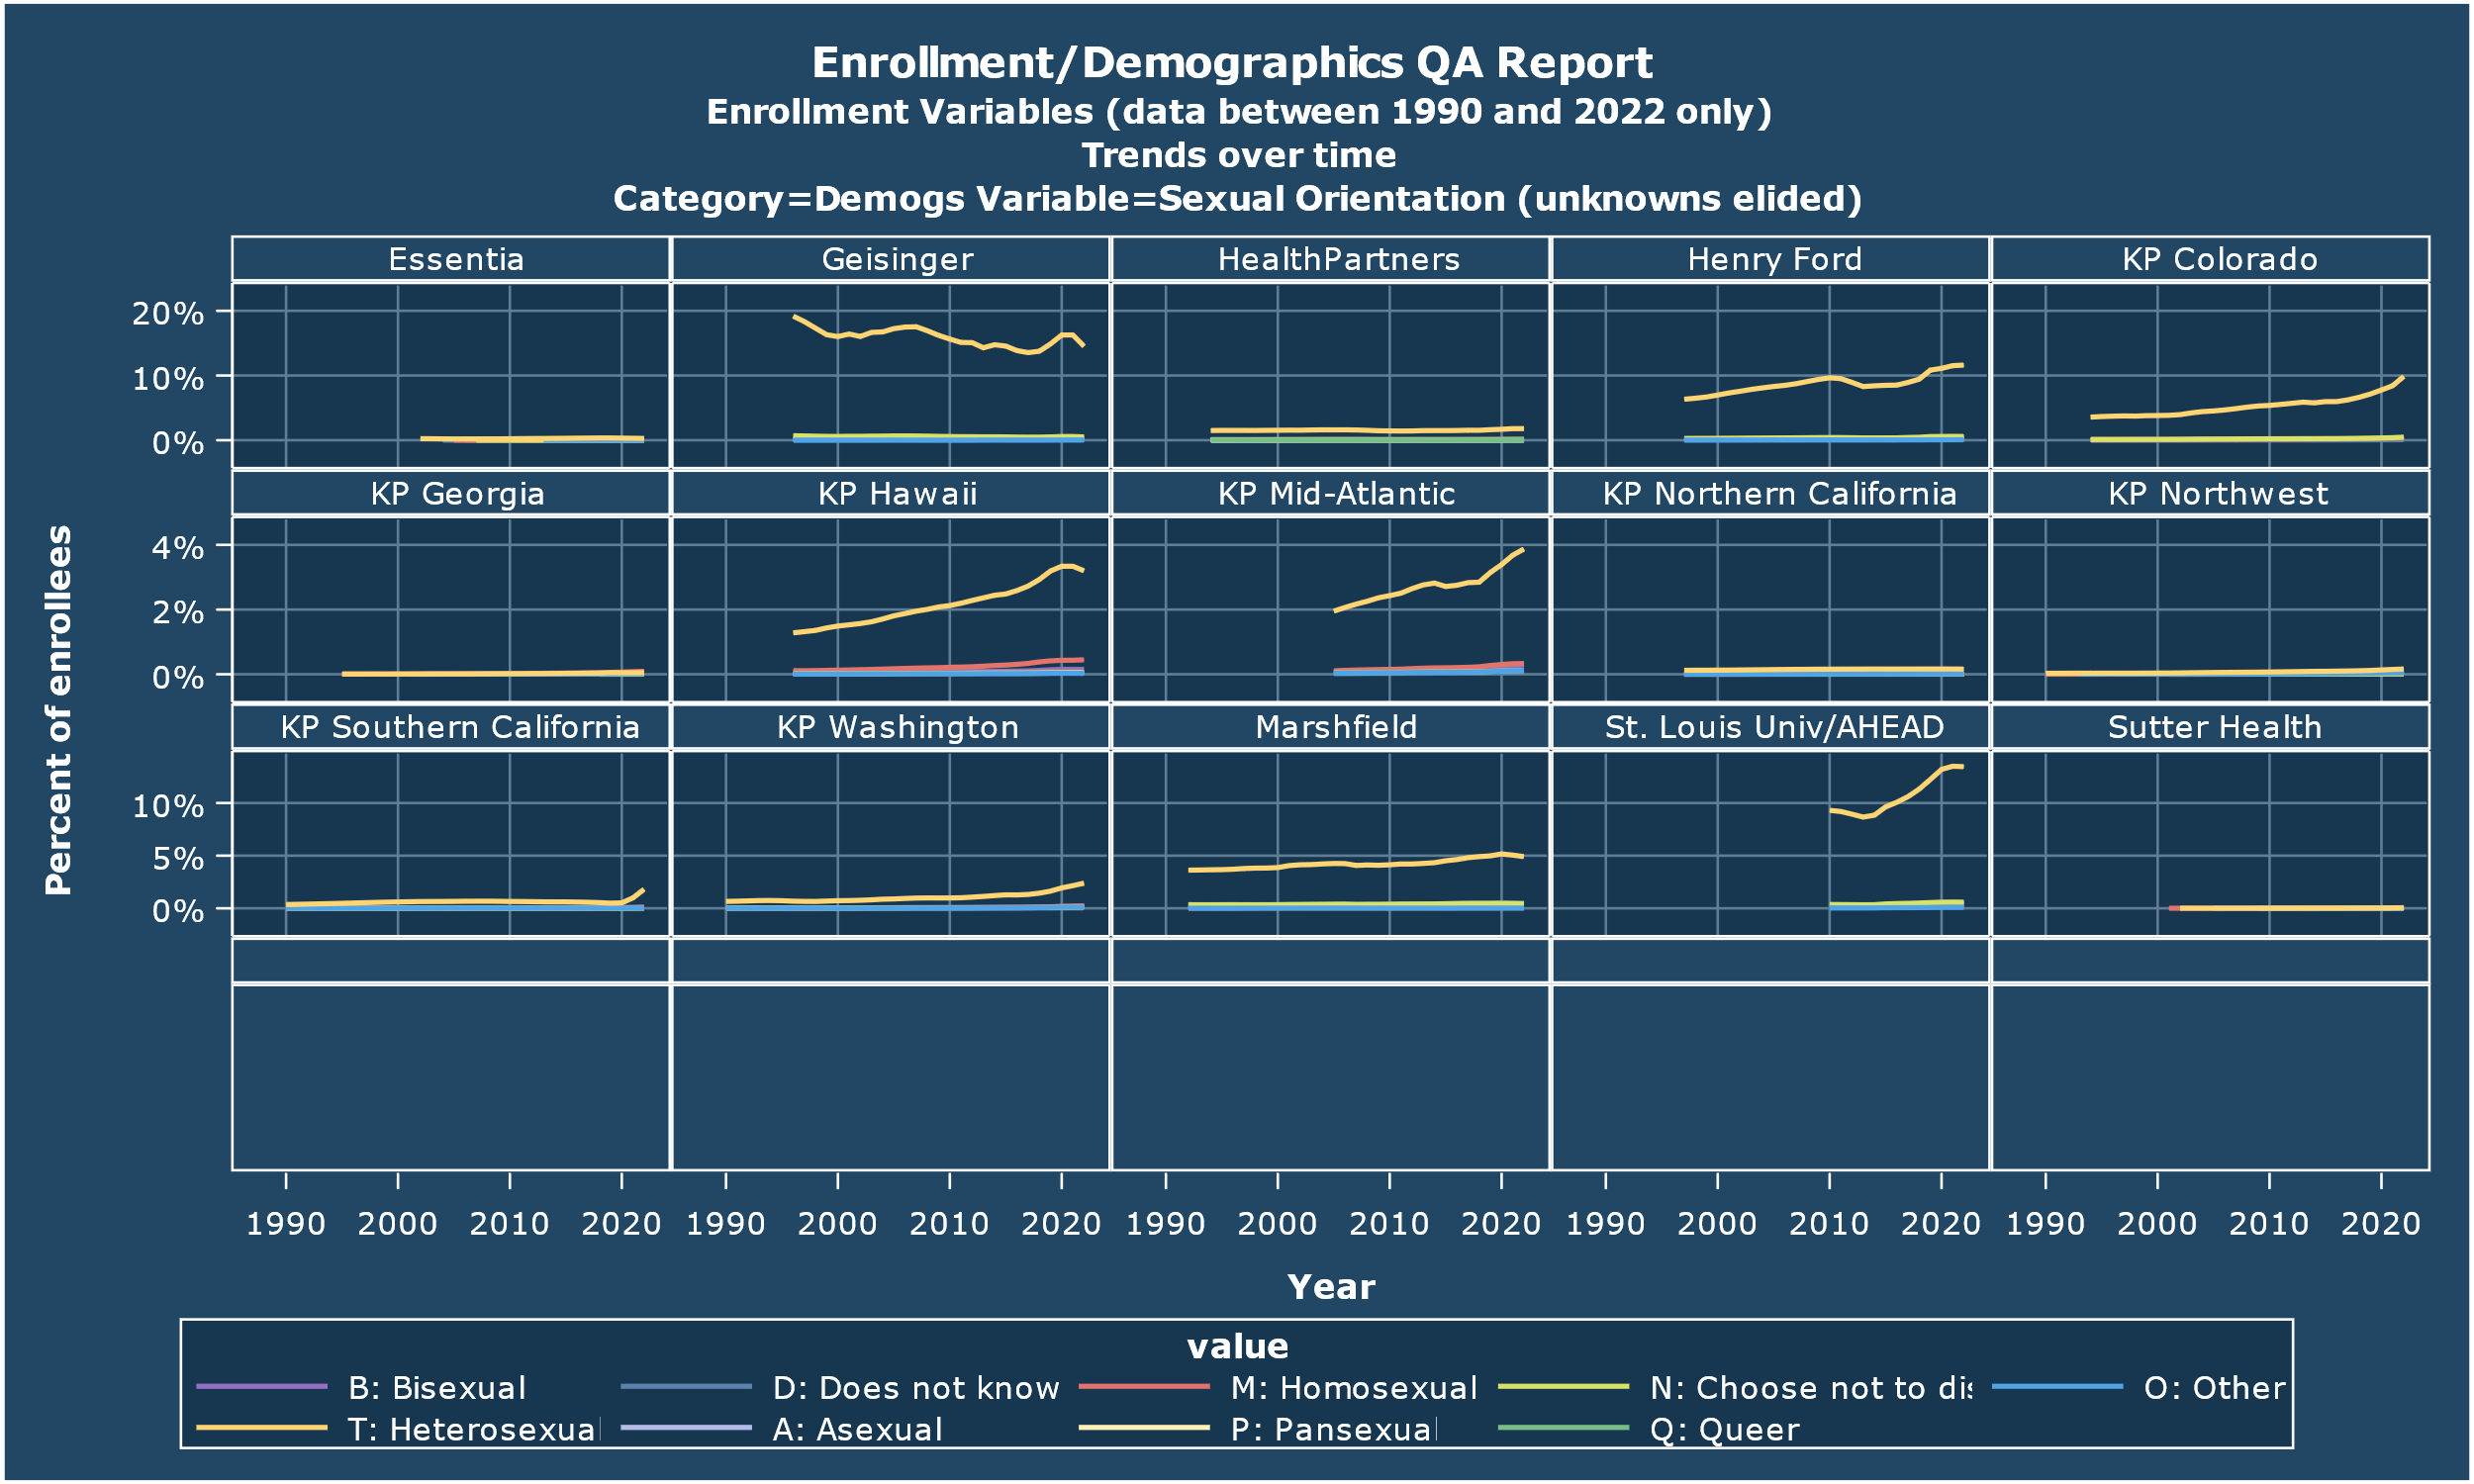
Sexual Orientation
Notes:
Geisinger & SLU are out front in collecting sexual orientation data on their enrollees. Among the KPs that have any data, Colorado and Hawaii both stick out.

Slide 9
New ‘Population Characteristics’ Report
Had been manually compiled by VOC Staff(?) in order to help with grant writing
Was woefully out of date
Before she left Reesa asked what I could put together just using the submitted QA data.
Lost:
Deprivation Index stats
‘Continuously enrolled’ stats
Gained:
Data Year
Population Basis
My intention is to keep this up-to-date as part of the regular QA process.
(This is me asking forgiveness for re-purposing data & inviting comment/objection.)

Slide 10
HCSRN Population Characteristics (2018 Data)
 | BSW | EIRH | GHS | HFHS | HPHC | HPI | KPCO | KPGA | KPHI | KPMA | KPNC | KPNW | KPSC | KPWA | MCRF | MPCI | PAMF
Total population all US sites: 19610847
Total Membership | 240993 | 316427 | 567556 | 87472 | 953718 | 1315621 | 770842 | 429002 | 285632 | 929087 | 4629906 | 686643 | 5064638 | 850863 | 212110 | 301793 | 1968544
Continuously enrolled* | 179540 | 307567 | 417154 | 72164 | 704798 | 1039341 | 588923 | 323039 | 223650 | 701461 | 3907641 | 541761 | 4097292 | 651761 | 180107 | 249671 | 309061
% Continuous coverage | 74.5% | 97.2% | 73.5% | 82.5% | 73.9% | 79.0% | 76.4% | 75.3% | 78.3% | 75.5% | 84.4% | 78.9% | 80.9% | 76.6% | 84.9% | 82.7% | 15.7%
Age
0 to 19 | 23.7% | 24.3% | 28.9% | 17.2% | 21.5% | 27.1% | 20.0% | 19.8% | 21.3% | 18.7% | 22.2% | 20.9% | 23.5% | 16.0% | 24.0% | 21.6% | 19.4%
20 to 39 | 25.2% | 22.9% | 21.9% | 20.9% | 27.5% | 28.0% | 24.1% | 27.1% | 26.1% | 24.3% | 27.3% | 25.9% | 27.6% | 25.0% | 19.0% | 25.4% | 13.3%
40-64 | 33.9% | 31.5% | 30.8% | 36.7% | 43.9% | 36.3% | 36.4% | 42.7% | 35.4% | 34.5% | 34.5% | 35.1% | 33.6% | 40.7% | 33.0% | 34.1% | 31.9%
65+ | 17.2% | 21.4% | 18.4% | 25.3% | 7.0% | 8.6% | 19.5% | 10.4% | 17.2% | 22.5% | 15.9% | 18.1% | 15.3% | 17.5% | 24.0% | 18.9% | 35.4%
Youth
0 to 5 | 5.4% | 7.6% | 8.5% | 3.6% | 5.2% | 7.6% | 4.8% | 4.1% | 5.5% | 4.6% | 5.9% | 5.3% | 6.0% | 3.8% | 6.0% | 6.2% | 9.9%
6 to 11 | 7.1% | 7.1% | 9.1% | 4.7% | 6.2% | 8.3% | 6.1% | 5.5% | 6.7% | 5.5% | 6.9% | 6.3% | 7.1% | 4.7% | 7.7% | 6.5% | 4.5%
12 to 17 | 8.4% | 7.2% | 8.9% | 6.2% | 7.5% | 8.5% | 6.8% | 7.2% | 6.8% | 6.3% | 7.2% | 6.9% | 7.7% | 5.4% | 8.1% | 6.6% | 4.2%
Gender
Female | 55.9% | 55.4% | 53.5% | 57.0% | 51.4% | 52.2% | 52.7% | 54.4% | 50.8% | 53.5% | 51.5% | 52.0% | 51.6% | 53.6% | 52.9% | 56.4% | 60.0%
Insurance
Commercial | 31.2% | NA | 14.6% | 77.5% | 97.9% | 70.3% | 57.0% | 66.1% | 67.7% | 75.6% | 73.3% | 72.6% | 70.3% | 66.5% | 36.5% | 61.3% | 41.8%
Medicaid | 0 |  | 42.7% | 0.0% | 0.0% | 16.4% | 7.6% | 0.0% | 14.7% | 0.9% | 7.3% | 8.4% | 10.2% | 0.5% | 38.3% | 22.5% | 3.9%
Medicare | 10.9% |  | 20.3% | 22.5% | 2.1% | 5.3% | 20.6% | 11.3% | 17.3% | 23.6% | 19.0% | 19.1% | 13.2% | 18.8% | 21.8% | 14.7% | 36.6%
Self-pay | 0.0% |  | 0.0% | 0.0% | 0.0% | 1.7% | 12.7% | 22.1% | 0.4% | 0.0% | 0.0% | 0.0% | 6.3% | 14.3% | 3.3% | 0.0% | 0.5%
Other | 57.8% |  | 22.4% | 0.0% | 16.0% | 6.3% | 2.1% | 0.4% | 0.0% | 0.0% | 0.4% | 0.0% | 0.0% | 0.0% | 0.0% | 1.5% | 17.2%
Census
Lower neighborhood income (<25K) | NA | 1.9% | NA | 6.8% | 0.9% | 1.3% | 0.6% | 1.9% | 0.6% | 1.0% | 1.2% | 0.4% | 1.1% | 1.2% | 0.5% | 1.0% | NA
Lower neighborhood education (<25% college) | NA | 62.6% | NA | 51.9% | 27.7% | 34.2% | 25.5% | 40.1% | 47.1% | 26.1% | 37.5% | 39.4% | 53.5% | 38.8% | 17.8% | 27.2% | NA
Race
Asian | 0.2% | 0.6% | 0.9% | 4.6% | 0.8% | 3.9% | 3.4% | 6.7% | 34.4% | 11.1% | 19.8% | 6.3% | 10.8% | 7.0% | 1.6% | 3.9% | 16.0%
Black or African American | 2.4% | 1.8% | 3.8% | 29.8% | 1.4% | 6.1% | 4.2% | 39.9% | 0.9% | 42.3% | 6.9% | 3.3% | 8.2% | 3.1% | 0.7% | 3.3% | 3.4%
Native Hawaiian/Pacific Islander | 0.0% | 0.2% | 0.5% | 0.1% | 0.0% | 0.2% | 0.3% | 0.1% | 26.9% | 0.3% | 1.0% | 0.9% | 0.8% | 0.9% | 0.2% | 0.1% | 0.4%
American Indian/Alaskan Native | 0.0% | 2.4% | 0.1% | 0.4% | 0.1% | 0.6% | 0.6% | 0.3% | 1.0% | 0.5% | 0.5% | 0.8% | 0.3% | 0.9% | 0.5% | 0.9% | 0.3%
Multiple or Other | 1.4% | 0.0% | 0.1% | 1.8% | 0.0% | 0.5% | 3.2% | 0.1% | 0.0% | 1.0% | 0.0% | 0.4% | 0.0% | 0.9% | 0.7% | 0.0% | 2.3%
Unknown | 67.8% | 1.0% | 22.6% | 9.3% | 81.2% | 38.3% | 13.3% | 16.6% | 8.5% | 5.3% | 7.3% | 8.4% | 7.3% | 37.3% | 8.6% | 25.0% | 9.0%
White | 25.3% | 93.0% | 72.0% | 51.9% | 15.7% | 48.0% | 58.4% | 32.1% | 21.4% | 30.1% | 43.8% | 71.6% | 32.1% | 46.2% | 87.8% | 66.7% | 55.9%
Ethnicity
Hispanic | 2.9% | 1.1% | 5.2% | 2.1% | 0.9% | 2.4% | 16.6% | 4.2% | 6.8% | 9.6% | 20.7% | 8.4% | 40.5% | 3.7% | 3.0% | 5.3% | 12.7%
Non-Hispanic | 28.6% | 98.3% | 69.8% | 85.6% | 18.2% | 32.8% | 68.5% | 0.00% | 84.9% | 21.3% | 0.0% | 26.1 | 44.1% | 58.8% | 90.6% | 54.5% | 76.3%
Unknown | 68.5% | 0.6% | 25.0% | 12.3% | 81.0% | 64.8% | 14.9% | 95.8% | 8.3% | 69.1% | 79.3% | 65.5 | 15.3% | 37.5% | 6.4% | 40.2% | 10.9%

Slide 11
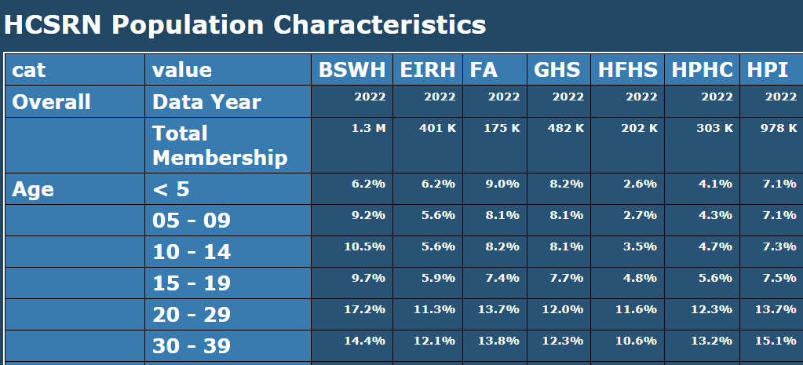
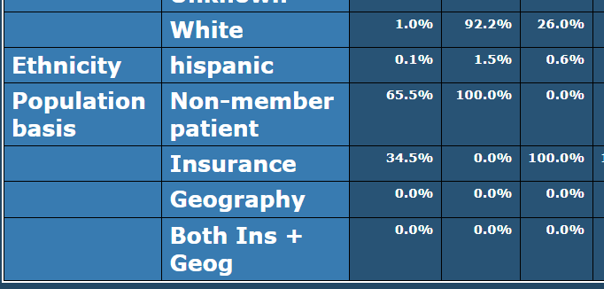
New Version

Slide 12
Discussion: Is It Time to let go of non-self-reported (NSR) Race data?
Investigators (at least at KPWA) seem convinced that our race/ethnicity data is (all) self-reported.
Which is actually about 77% true.
Death certificate data is our largest source of NSR race/eth data
I’m considering hiving off the NSR information into a separate set of variables
Karen Coleman & Don McCarthy did a fantastic presentation on their local Race/Ethnicity data mart at the last E/D workgroup meeting.
I’m very curious to hear what you all are doing with your implementations.
Notes:
One issue that came up during KPSC’s talk is how much faith to have in the proposition that EMR-borne R/E data is in fact self-reported. I believe most everyplace it is supposed to be as a matter of policy, and the boogeyman is “what if users are screwing around?”. I don’t want to dismiss that concern, but IMHO it is secondary for me, because I have a non-trivial amount of data that I positively know is NSR—death certs.

Slide 13
Thank You!
roy.e.pardee@kp.org

