Slide 1
Enrollment / Demographics / Language
Investigator Lead: Mark Hornbrook
Technical Lead: Roy Pardee

Slide 2
Overview
Datasets
Demographics
Patient Languages
Enrollment
The QA
Checks
Results
Report
The New Capture Variables

Slide 3
Demographics
Serves 2 important purposes
Holds demographic information!
Sex
Date of Birth
Race & Hispanic Ethnicity (as available)
Serves as lookup table for MRNs
MRNs must be unique
MRNs must never be null
Any MRN appearing in any other VDW file should appear in demographics (within tolerance)
So you will occasionally find missing values in birth_date, sex, etc.
Notes:
Note that the reverse of that last point is not true—an MRN appearing in Demog is no guarantee that the implementing site has say, rx fills or lab results or encounters for that person.

Slide 4
Demographics Specification
Variable Name | Definition | Type(Len) | Values
MRN | Medical record number is the unique patient identifier within a site and should never leave the site | char(*) | Unique to each patient at each site
BIRTH_DATE | The person's date of birth | num(4) | SAS Date
GENDER | The person's gender and/or sex; if both gender and sex are known, this variable should hold gender | char(1) | M = Male F = Female O = Other including transgendered U = Unknown
RACE1 - RACE5 | The person's race. Preference is for self-reported; please see comment 1 for recording multiple race values | char(2) | HP = Native Hawaiian / Pacific Islander IN = American Indian / Alaskan Native AS = Asian BA = Black or African American WH = White MU = Multiple races with particular unknown OT = Other, values that do not fit well in any other value UN = Unknown or Not Reported
HISPANIC | Whether the person is of Hispanic origin / ethnicity | char(1) | Y = Yes N = No U = Unknown
NEEDS_INTERPRETER | Whether the person needs an interpreter to communicate with an English-only speaker | char(1) | Y = Yes N = No U = Unknown
Notes:
There are 5 race variables in order to account for multi-racial information.

Slide 5
Patient Languages
Language info was originally in the Demographics table.
Split out around 2012 in order to accommodate > 1 language per person.
Uses ISO-639-2 spec to code language.
There is one record per person per known language.
So—only populated where language is known.

Slide 6
Patient Languages Specification
Variable Name | Definition | Type | Values
MRN | Medical record number is the unique patient identifier within a site and should never leave the site | char(*) | Unique to each patient at each site
LANG_ISO | A code signifying the language. | char(3) | As defined by ISO-639-2 or 'unk' for unknown Note that value set is lowercase
LANG_USAGE | How the person uses this language. | char(1) | S = Spoken/signed W = Written B = Both spoken and written U = Unknown
LANG_PRIMARY | For spoken languages, whether this is the person's primary spoken language. | char(1) | Y = Yes N = No U = Unknown
Notes:
That ISO spec can be found here: http://www.loc.gov/standards/iso639-2/langhome.html
One unfortunate thing about that particular ISO standard—it has a single entry for “Chinese”, even though that arguably isn’t a language (it should probably be Mandarin, Cantonese, etc.). This, despite having an entry for Klingon (seriously).

Slide 7
Enrollment
Generally the means by which we define Populations for “Population-Based” research.
Sets out the people and time periods over which they are “at risk” for appearing in other VDW files—e.g., get sick, have prescriptions, etc.
Historically, derived from insurance data at member sites.
So—in addition to being able to say who was sick/got care, we can say who stayed healthy (or stayed home anyway).
More recently broadened to accommodate Nonmember Patients—people who get some portion of their treatment from the implementing site, but who have no insurance relationship with it.
HCSRN Orgs are increasingly diverse—we now have both Provider-Only and Insurer-Only members.
Notes:
When this spec originated, the set of organizations expected to implement it were all HMOs, or had significant HMO components.

Slide 8
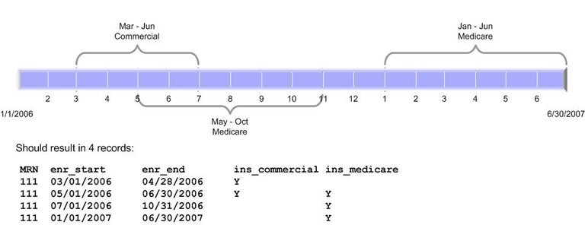
Enroll has a start/stop structure
Basically, MRN, dates + variables describing the Person/Period.
Add as many records as necessary to document aspects of the person/period, but
Records must not overlap.

Slide 9
Enroll Variables are Mostly Flags
Insurance type (commercial, self-funded, etc.) flags
Plan type (HMO, POS, etc.) flags
Drug coverage
All take values of [Y]es, [N]o, [U]nknown or [E]xternal.
‘External’ means ‘Yes, but provided by someone other than the implementing org’.

Slide 10
Non-Flags
Primary Care Provider & Clinic
Enrollment Basis gives the reason this person/period is in the file.
Has implications for whether we expect to have a full medical record in VDW.
Values:
[I]nsurance—person was insured by the implementing org during this period.
[G]eography—person lived in a geography in which the implementing org had a monopoly on medical care.
[B]oth Insurance + Geography
Non-Member [P]atient—person received some portion of care from implementing org.

Slide 11
New Data Capture Problem Flags
Spec change approved 2015.
Allow sites to document known issues with capture of various types of data, if there any.
Values are one of:
[N]o, there are no known problems with capture for this person/period.
Yes, there are [K]nown problems with capture for this person/period.
[X] Not implemented.
WHERE incomplete_outpt_rx <> ‘K’ ;
Optional
at last eval, 8 of 15 responding sites had substantive implementations of 1 or more flags.
Evaluation Report Available on the portal.
Notes:
These are more to the point than enrollment_basis in terms of defining populations.

Slide 12
Quality Assurance
Request Sent out Annually (though I accept submissions at any time).
Combination of objective checks and descriptives.
Collated Multi-Site Report Available on the portal.
Frequently useful for characterizing site data for grant applications.
See also, this blog post.

Slide 13
Objective Checks
All 3 Files
All named variables exist and are the proper type (no tolerance)
For those vars with an enumerated domain of permissible values, only those values exist in the file (warn at > 2% off-spec, fail at > 5%)
Demographics
MRN is unique
All MRNs in Enrollment appear in Demog (warn at > 2%, fail at > 4%)
Enrollment
Enr_end must fall after enr_start. Zero tolerance.
Enr_end must not be in the future. Warn at 1%, fail at 3%.
Periods must not overlap—for any given MRN and date, there must be at most 1 record embracing the date. (no tolerance)
At least one of the plan type flags (which say whether the person/period was enrolled in a PPO, HMO, etc.) must be set. Warn at 2% and fail at 4%.
Ditto for the insurance type flags (e.g., commercial, medicare/caid, etc.).
If any of the Medicare part insurance flags are set, the general Medicare insurance flag must be set. Zero tolerance.
No period prior to 2006 should have the Medicare Part D flag set. 1% warn, 2% fail.
If the Part D flag is set, the drugcov flag must also be set.
If the high-deductible health plan flag is set, either the commercial or the private-pay flag must also be set.
If any of the incomplete_* variable values is 'X' (not implemented) then all values must be 'X'.
Language
(MRN, Language) must be unique.
Notes:
Let’s look at some samples from the QA descriptives.

Slide 14
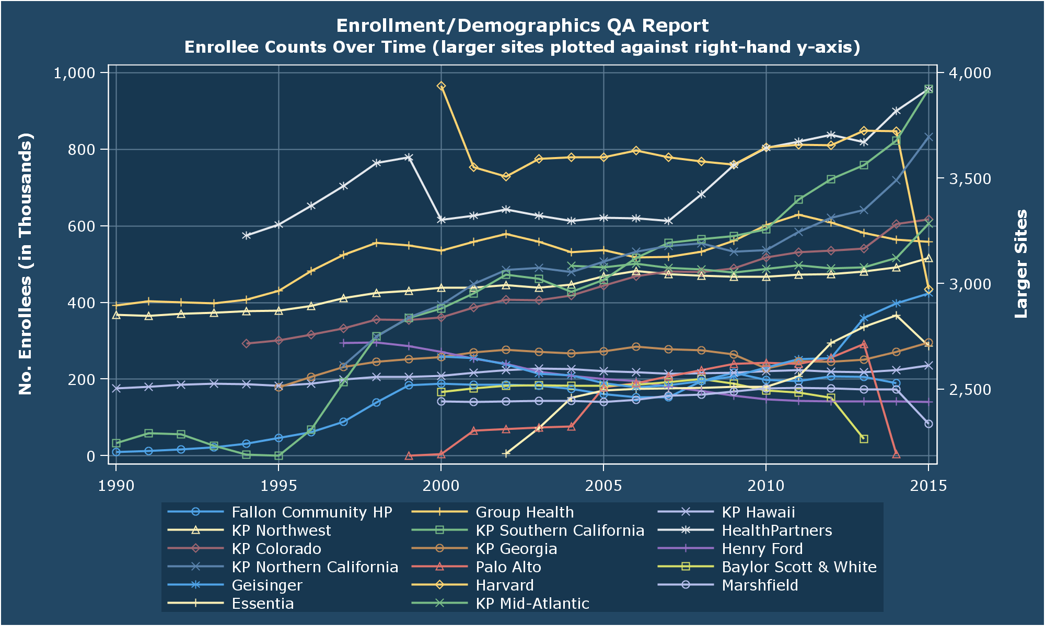
QA Report Highlights
Notes:
Counts of enrollees over time.

Slide 15
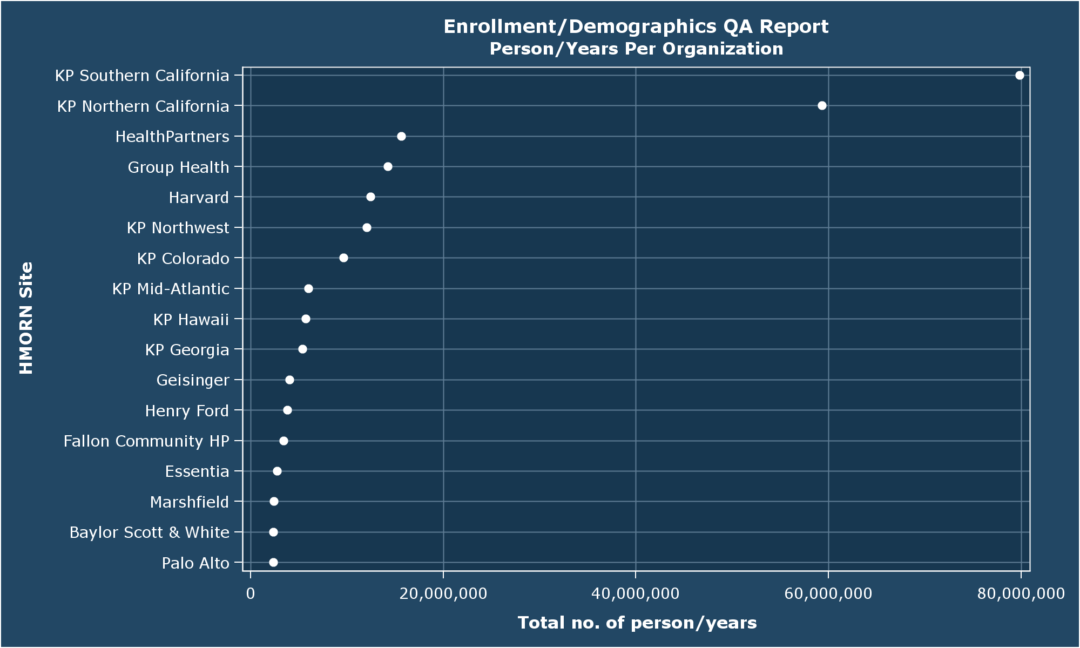
Total Person/Years

Slide 16
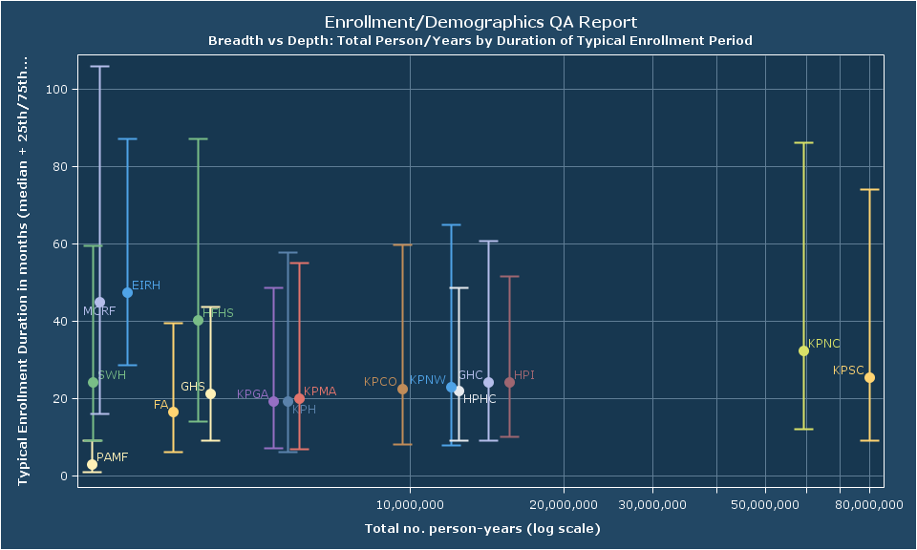
…by average duration

Slide 17
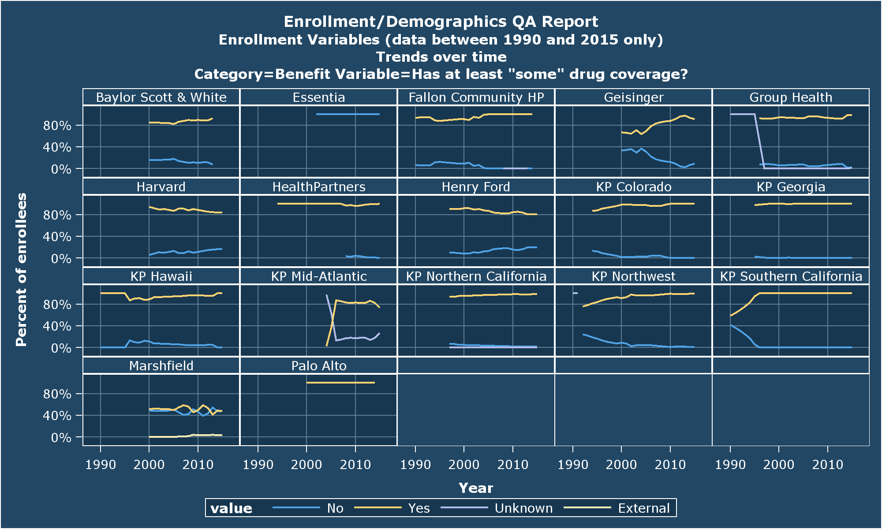
Proportion With Drug Coverage

Slide 18
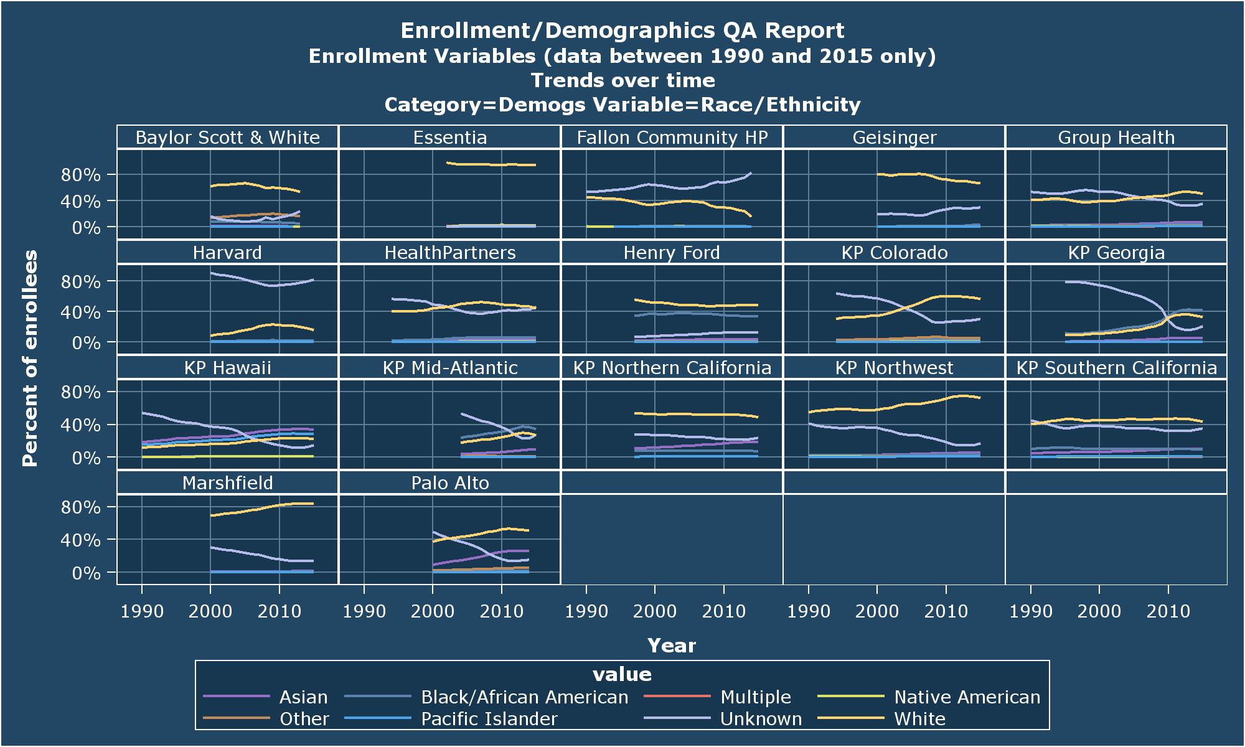
Race

Slide 19
Completeness Flag Evaluation
For each month from &start_year to &end_year:
Enumerate set of enrollees with coverage that month
taking note of their values on the relevant incomplete_: var
Count number of ‘events’ (that is records in the relevant file) happening to those people.
Divide the count from #2 by the count from #1.
Result is a per-enrollee rate for each month, for each found value of the incomplete_: var.
Plot rates over time by site.
Notes:
I elided any month/incompleteness-category for which there were fewer than 200 enrollees.

Slide 20
Pharmacy Capture
Notes:
We start with the strongest implementation. Note that not every site is on every graph b/c some sites haven’t implemented the substantive dataset whose capture is being described.
Essentia have all-zero rates because they don’t yet have a pharmacy file.
What we’re looking for here (and seeing!) is a nice clean separation between the yellow and blue series’, at sites with substantive implementations of the incomplete_outpt_rx flag. The silver-grey series are the sites that haven’t done a substantive implementation, and are instructive for comparisons.
Couple of things to notice here, which will set us up for the other five graphs.
The rates of not-suspected-incomplete (NSI) and not-implemented (NI) are generally pretty consistent across sites. The tendency for these seems to be between .5 and 1 monthly fills per enrollee.
Contrast that with the suspected-incomplete (SI) lines—those are fairly consistently < .5.
Marshfield has particularly good information on who they don’t get fill data for, signified by their SI line being right at zero for most of the period.
Compare that with many other sites, where, while the blue SI lines are discriminably lower than the yellow-orange NSI lines, they are not in fact zero. So it’s almost never the case that we know that we get absolutely no fill data on people, we just expect (correctly it seems) that we have less fill information for these members.

Slide 21
Lab Result capture
Notes:
This too looks pretty reasonable. Here again we see very decent separation between the SI and NSI rates at most every site, and reasonably uniform rates overall. I’m particularly struck by the similarity of the plots in the third row, plus maybe Hawaii and Georgia. It looks like there’s a slight secular trend at these sites for more tests per enrollee.
I love that Marshfield has all-NSI values on this variable—that shows a good understanding of the intent behind the variable and confidence in their data capture.
Geisinger sticks out a bit here by having high rates of lab fills for everyone. They pull the y-axis up a bit, which compresses the variability visible at sites with lower overall rates. That hurts KP Northwest the most I think, as there isn’t much “daylight” visible between their NSI and SI series’.
In general though, like the previous graph, I think this makes the point pretty strongly that applications that need complete lab data would do well to heed the information in this flag.

Slide 22
Hypothetical
Patient ID | Ethnicity
1111 | Hispanic
2222 | Ashkenazi
3333 | Pashtun
4444 | Slovak
5555 | Hispanic
6666 | Sephardic
7777 | Scandinavian
8888 | Basque
Imagine a source of patient Ethnicity information like the table at left.
One record per patient only—so no way to indicate e.g., “I’m Bengali and Hispanic”
VDW Demographics takes note of Hispanic ethnicity only.
What would you have us put down for the value of Hispanic for the patients at left?
[U]nknown whether they are Hispanic, or
[N]ot Hispanic?

Slide 23
Prejudices
VDW is a shared delusion.
Nobody has ever seen it, or could ever see it.
The specs are a shared point of reference—crucially important, but are just the tip of the iceberg—implementations are the rest.
Both specs and implementations change over time, so expertise has a half-life.
The specs are a means for allocating blame.
When a program fails, whose fault is it?

