Slide 1

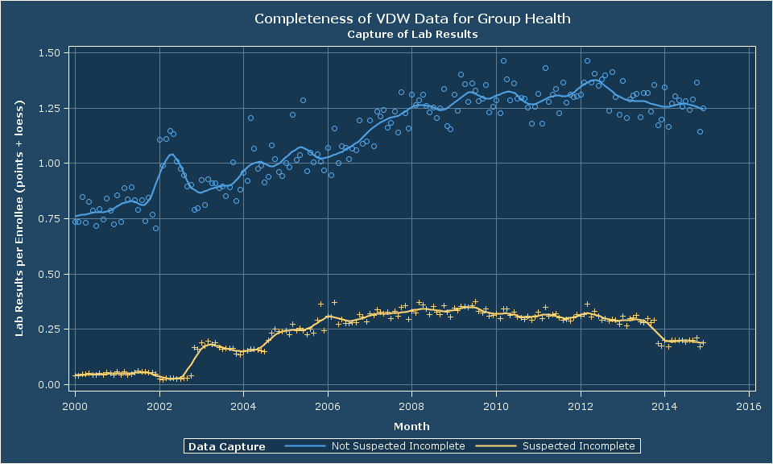
VDW Data Completeness Re(capture)d: Are You Getting The Whole Story?
Roy Pardee JD MA¹; Don Bachman MS²; Mark C. Hornbrook PhD²; Catherine Cleveland²; Priyam Mathur MS³; Dan Ng MBA⁴; Susan Aumer PhD PMP⁵; William Harding BS⁶; Celia Jordan BS⁷; Jeremey Meier BS⁸; Carmen Wong MBA⁹; Brian Hoch BS¹⁰
¹Group Health Research Institute ²Kaiser Permanente Center for Health Research, ³Meyers Primary Care Institute ⁴Kaiser Permanente Division Of Research ⁵HealthPartners Institute for Education ⁶Kaiser Permanente Institute for Health Research ⁷MidAtlantic Permanente Research Institute ⁸Essentia Institute of Rural Health ⁹Kaiser Permanente Center for Health Research, Hawaii ¹⁰Marshfield Clinic Research Foundation
Introduction
The New Variables (cont)
Results
Discussion
Completeness of data capture is often crucial for HCSRN research
Bachman et al.'s 2014 investigation found serious problems with implementations of the then-existing enrollment flag for incomplete capture
VDW Implementation Group quickly approved a spec change aimed at improving our description of data capture of VDW cohorts
This poster describes the new variables and their early implementations
Implementation of the new flags is optional.
Thus far 8 sites have implemented (7 are shown here).
A value of ‘N’ is not an assertion that capture is complete.
All ‘N’ means is that the implementing site does not know of a reason why capture should be incomplete.
Pharmacy
Tumor
Population-based research often requires drawing conclusions from data that aren’t there. For example:
If this patient had ever had phenothiazines, we would have a record of it in our data.
She has no such record.
Therefore, she is a suitable control for our study of phenothiazine exposure.
These inferences are only valid if we have complete data.
We can either eliminate all people with problematic capture of any sort from VDW, or give studies the ability to tailor their samples to their needs.
Outpatient pharmacy flag is the most consistently well-implemented flag of the six. Clear separation between SI and NSI rates..
For tumor, two of the four sites with SI values show excellent separation overall.
Lab Results
EMR Data
Evaluation Method
Calculate monthly per-person rates of relevant data records, broken out by the whether capture is suspected incomplete (SI) or not suspected incomplete (NSI). For example:
The New Variables
The lab results flag is similarly well implemented at the sites. Note that Marshfield clinic has no enrollees whose lab data capture is suspect.
Six sites have SI values on EMR data (here signified by social history data). Implementations are all good post-2010. KPCO and KPNC are excellent overall.
Conclusion
Variable Name | Definition | Valid Values
incomplete_outpt_rx | Is outpatient pharmacy fill data suspected to be incomplete for this person/period? | K: There are known reasons to suspect capture is incomplete. N: No—there is no known reason to suspect capture is incomplete. X: This Variable Not implemented.
incomplete_outpt_enc | Is outpatient encounter data suspected to be incomplete for this person/period?
incomplete_inpt_enc | Is inpatient encounter data suspected to be incomplete for this person/period?
incomplete_emr | Is electronic medical record data (e.g., social history, vital signs, etc.) suspected to be incomplete for this person/period?
incomplete_tumor | Is tumor data suspected to be incomplete for this person/period?
incomplete_lab | Is lab results data suspected to be incomplete for this person/period?
Month | Rx Flag | N People | N Fills | Rate
April 2013 | SI | 44,556 | 8,860 | 0.20
April 2013 | NSI | 537,247 | 547,339 | 1.02
May 2013 | SI | 45,413 | 9,332 | 0.21
May 2013 | NSI | 536,633 | 546,005 | 1.02
Inpatient Stays
Outpatient Encounters
Just like our health systems, VDW needs to be a "learning" system, and adapt to negative findings.
In this case, we went from finding to new spec in nine months, and implementations in twelve.
While there is considerable variation in implementation quality, the new variables are demonstrably better than the old single-flag approach.
Plot rates over time by site.
Best implementations show discernible differences in rates.
The inpatient flag implementations are less uniformly high quality. Of the four sites with SI values 2 show good separation overall, and a third starts to get good around 2010.
Here we have four sites with SI values, two of which have good separation from the NSI rates.

