Slide 1
Enroll / Demog / Lang
HMORN VIG 2015 Annual Meeting

Slide 2
Overview
Incomplete_* variables implementation
Progress—are we ready to rev the official spec?
Discussion—how did you guys handle implementation?
QA In-Depth
Results
To-Do/Future Directions
Feedback?

Slide 3
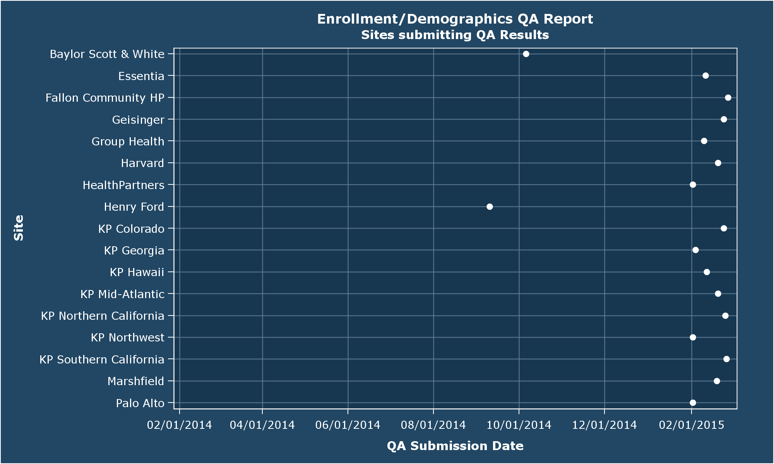
You guys rock
Notes:
Since pretty much this whole presentation is predicated on the last round of QA, let’s talk about who we’re talking about.
Last year’s mid-year QA was the first time we had usable output from all 17 sites. We didn’t get quite every site this time, but we do have younger-than-six-months-old data from every site, which is a first. Next time I hope to report updated output from every site.
A THOUSAND THANKS TO ALL OF YOU WHO RESPONDED.
The full QA report has been uploaded to the HMORN portal here:
http://hmoresearchnetwork.org/share/page/site/VDW/documentlibrary?file=Enroll-Demog-Language%20QA%20Report#filter=path%7C%2FQA%2Fenrollment_demographics
As always, I’m happy to take resubmissions at any time!

Slide 4
Incomplete_ var implementations

Slide 5
Rough Timeline
“Foundational Issues” presentation outlines the population denominator problem at the mid-year meeting in 2009.
Outside_utilization proposal approved as part of V3 in Austin.
Spring 2014: Don presents his empirical review of out_ute. Not pretty.
Change Proposal Presented at the Mid-Year last October.
Did not go down smoothly.
Not actually approved until December VIG call.
Implementation goal: 1-feb-2015
ambitious, but token implementation should be easy, right?
QA program (with added relevant checks/descriptives) sent out in early February.
Notes:
I expected to see Group Health all alone in this—am incredibly gratified to see that other sites are making use of it.

Slide 6
Progress
15 Sites demonstrated through QA that they
Have removed outside_utilization.¹
Have added the six new incomplete_* variables.
We are definitely ready to revise the official spec.
Furthermore, nine sites actually have substantive implementations on one or more of these variables.
Notes:
1. KPGA actually renamed their variable.

Slide 7
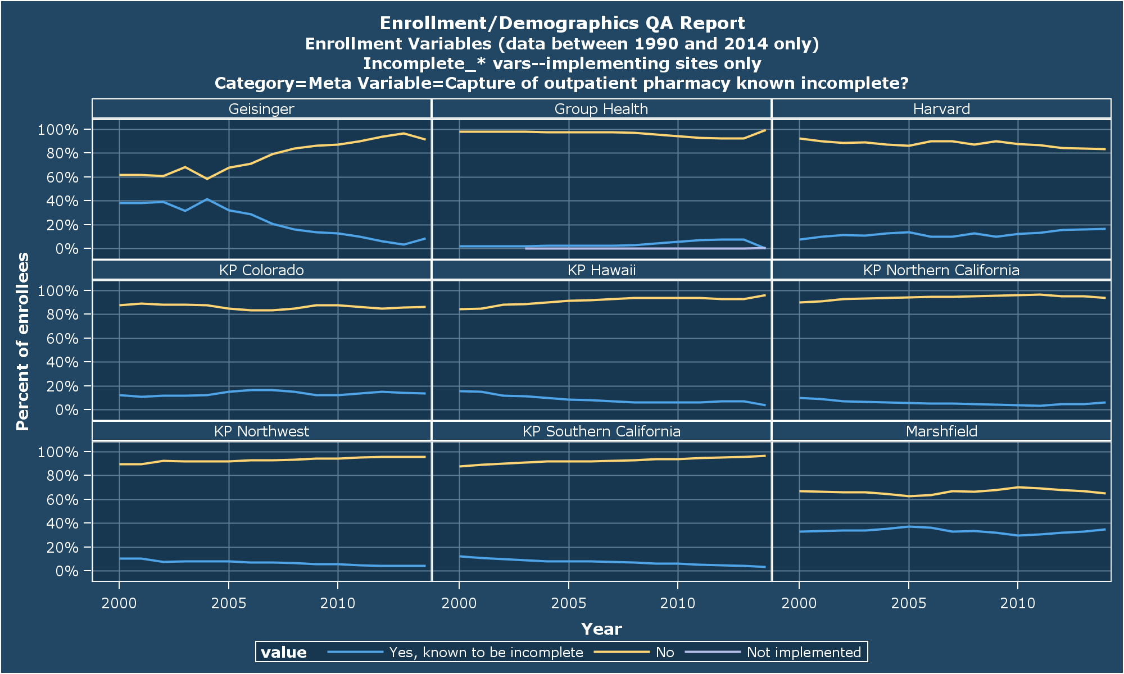
Outpatient Rx Fills

Slide 8
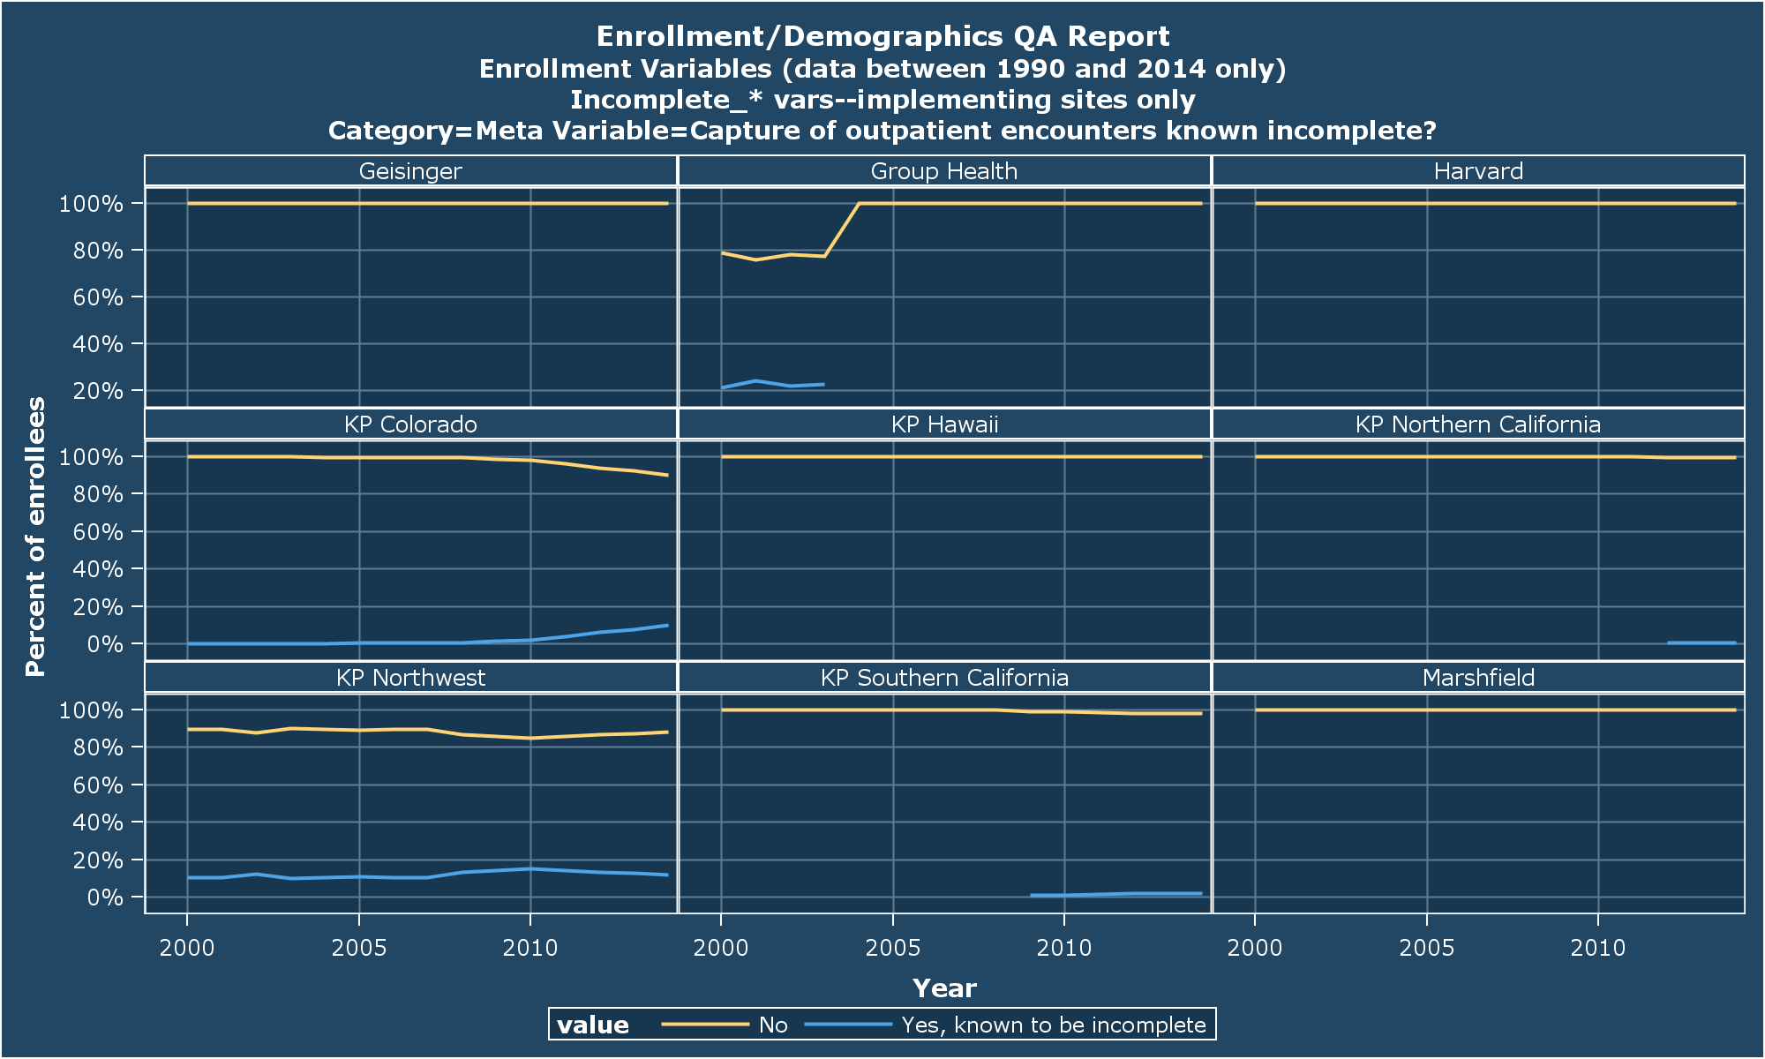
Outpatient Encounters

Slide 9

Inpatient Encounters
Notes:
Looks like all 9 sites implemented this identically to the outpatient encounter flag. It may be that we don’t really need both vars, all told.

Slide 10
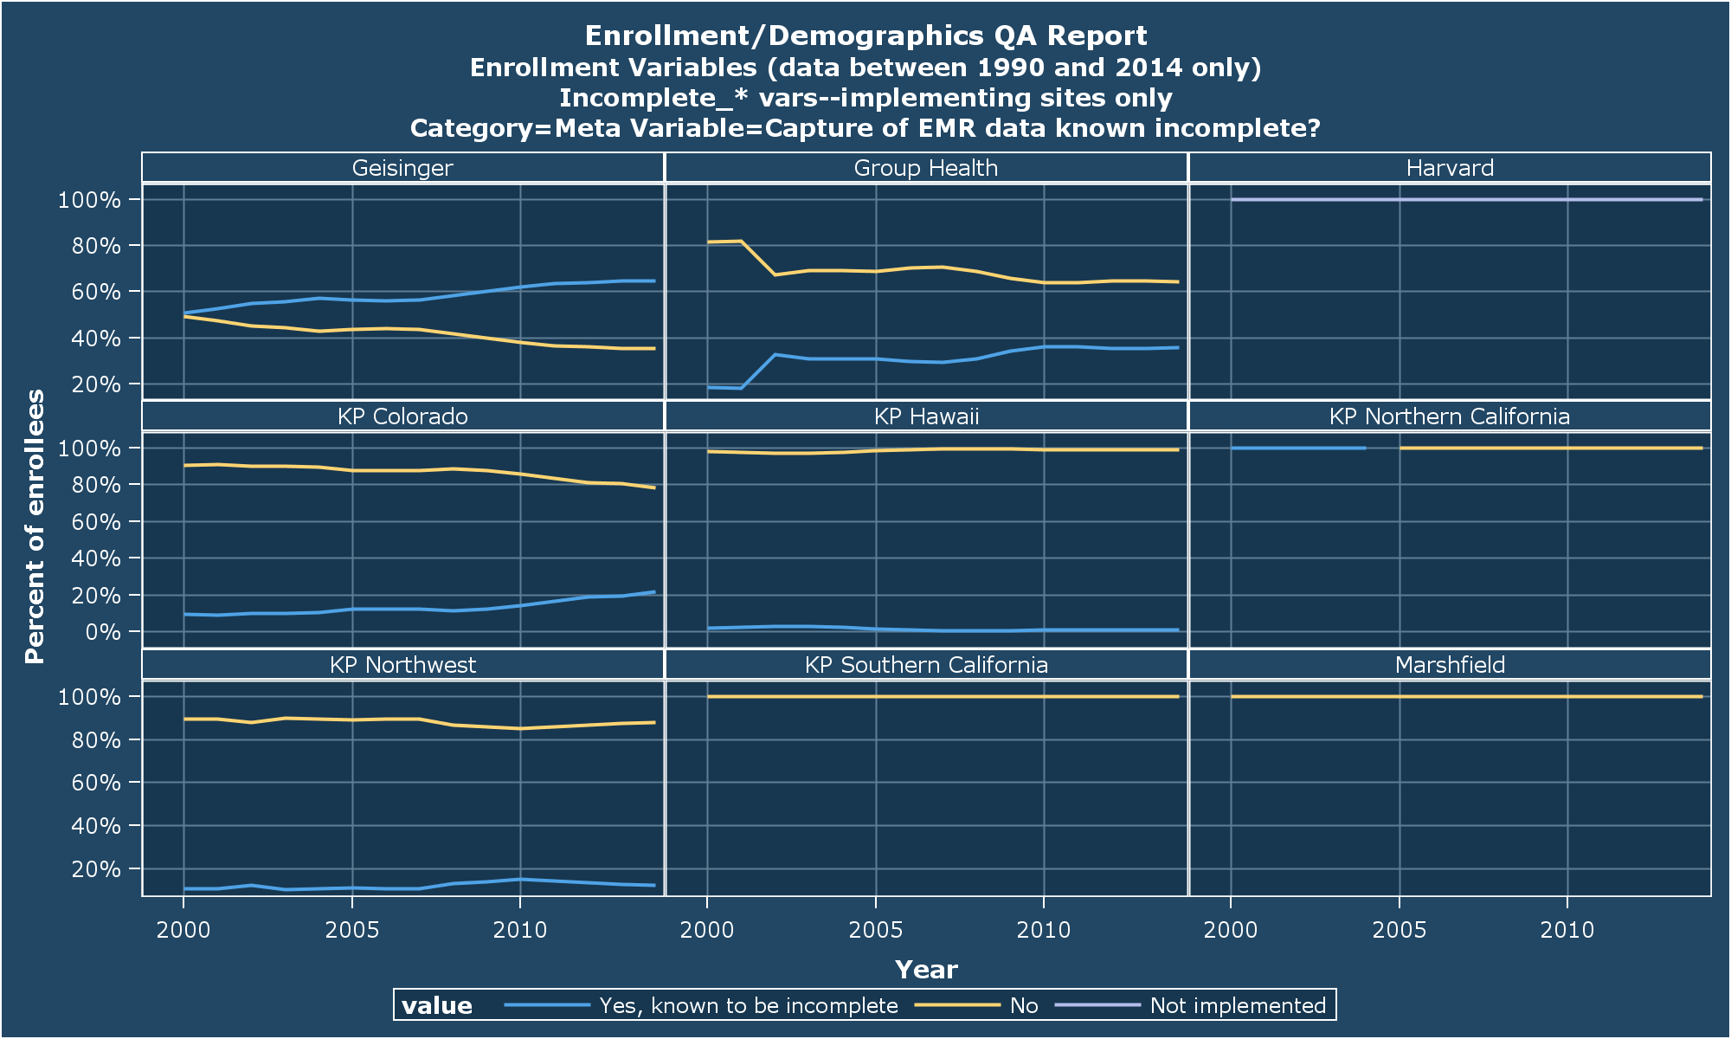
EMR
Notes:
Harvard hasn’t implemented this b/c (if I understand correctly) they don’t have routine access to their EMR data (can get it onesey-twosey for projects).
KPNC’s pattern seems most intuitive to me (assuming we all implemented EMRs sometime after 2000, which may not be the case everywhere). I have ambitions of taking our rollout schedule into account (we rolled out from 2003 to 2005, clinic-by-clinic).

Slide 11
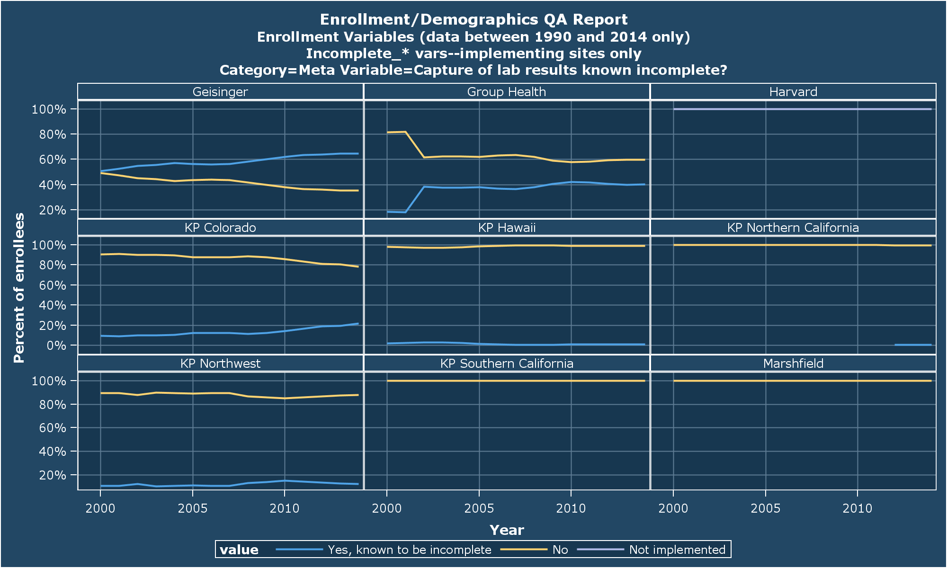
Lab Results
Notes:
Very similar implementations here, though not quite the same. At GHC, our capture of data for labs resulted in one of our labs was good even prior to our Epic rollout.

Slide 12
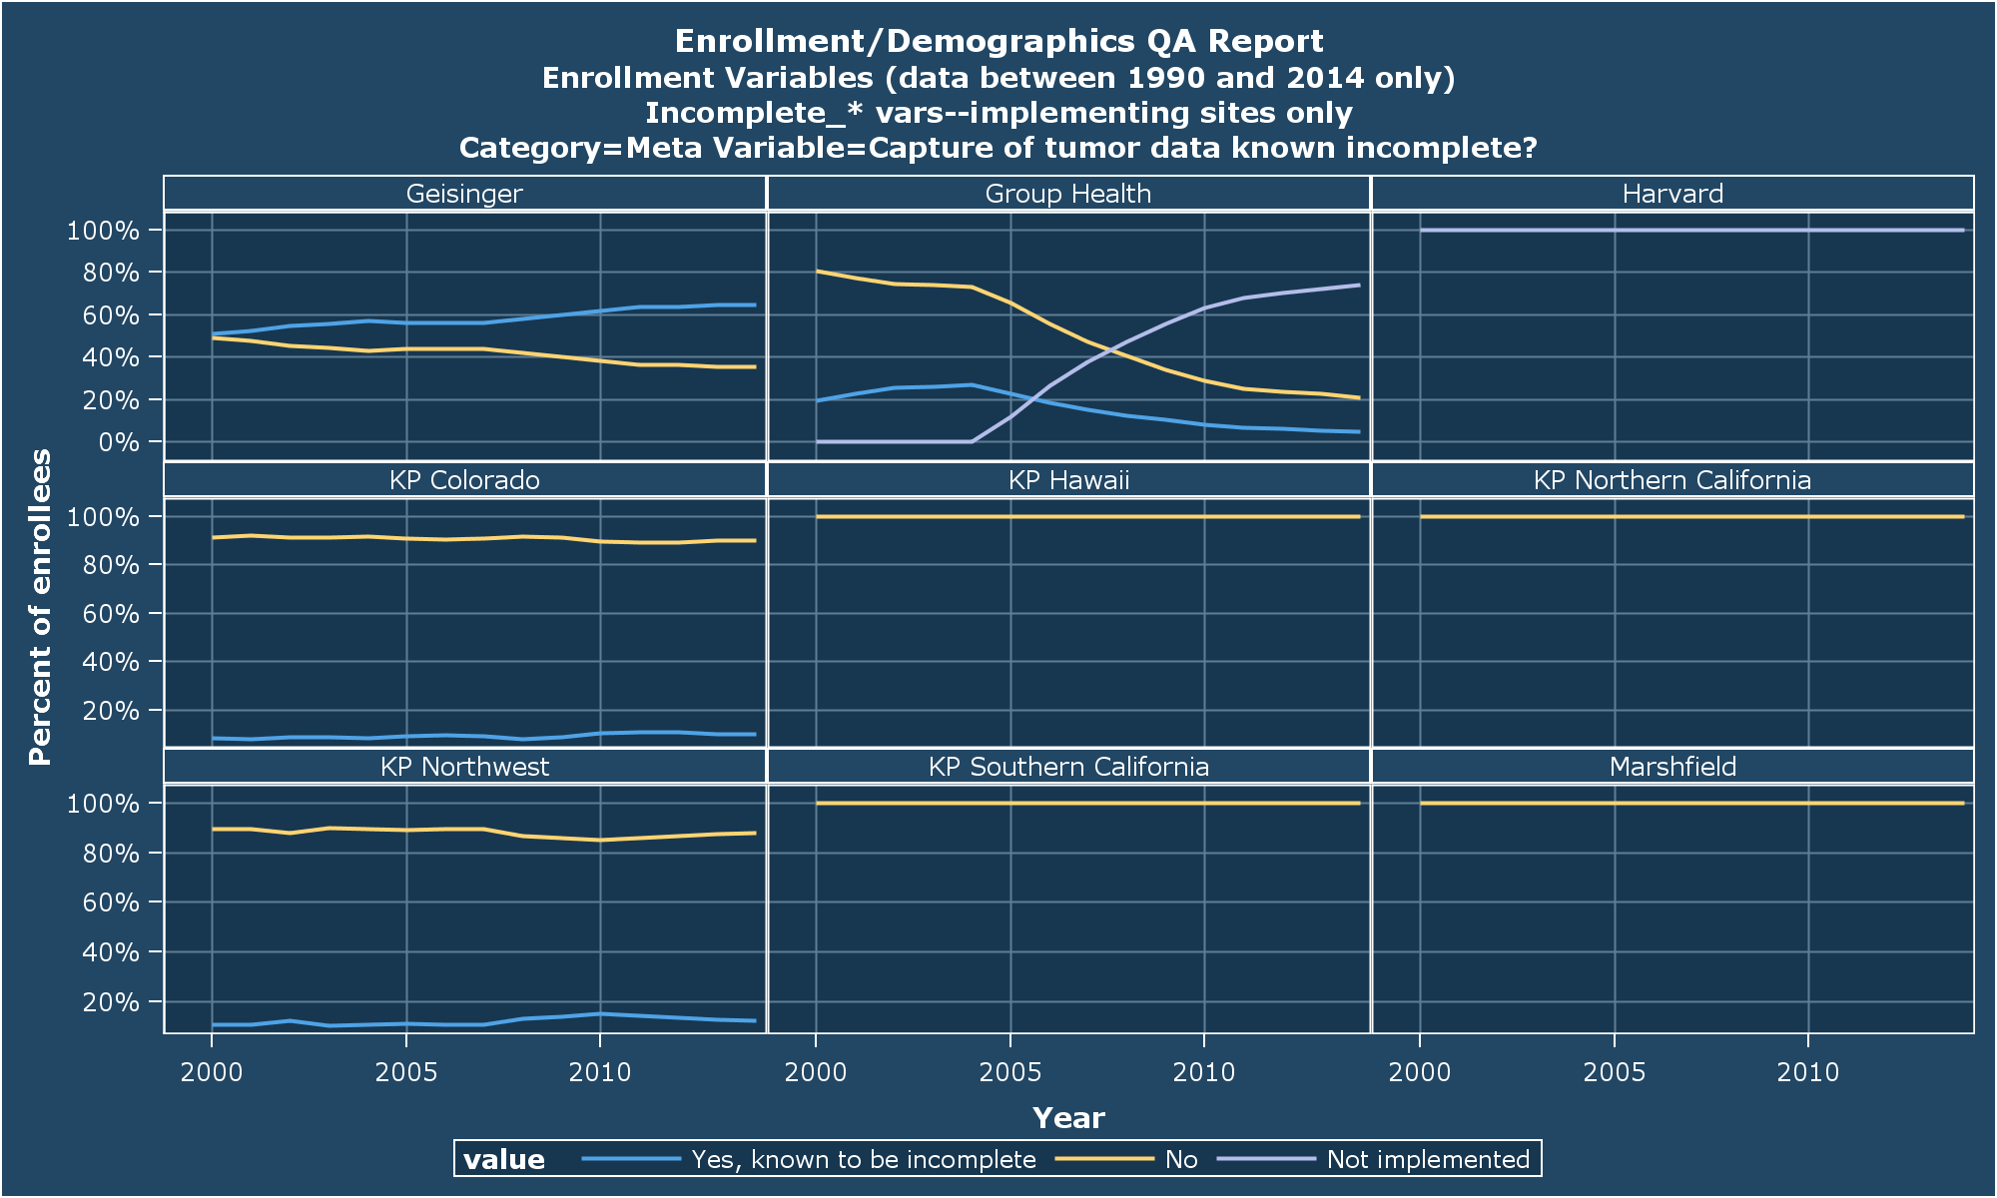
Tumor
Notes:
Once again, you guys rock.

Slide 13
Questions for Implementers
What were your considerations in implementing (e.g., plan types, geography, etc.)?
Did you (or could you still) add new data to VDW that you had been holding back to shield users from complexity?
Have you looked at data rates to validate your implementation?
Are you happy with your current implementation, or do you think it needs more work?
How difficult was the work?
Notes:
Let’s take some time to share best practices here…

Slide 14
QA In-depth

Slide 15
Most Not-Passed Checks
QA Check | Warn Threshold | Fail Threshold | Site Fail | Site Warnings | Site Passes | Percent of Sites Passing
Plan type(s) known? | 2% | 4% | 4 | 3 | 10 | 59%
Do enrollment periods overlap? | 0% | 0% | 5 | 0 | 12 | 71%
Start/end agreement | 0% | 0% | 4 | 0 | 13 | 76%
Medicare Part D agrees with drugcov? | 0% | 0% | 3 | 0 | 14 | 82%
Insurance type(s) known? | 2% | 4% | 2 | 0 | 15 | 88%
incomplete_tumor: if any value = X, then ALL values must = X | 0% | 0% | 1 | 0 | 14 | 93%
incomplete_outpt_rx: if any value = X, then ALL values must = X | 0% | 0% | 1 | 0 | 14 | 93%
Primary_language has been removed from demog. | N/A | N/A | 1 | 0 | 15 | 94%
Are all vars in the spec in the dataset & of proper type? | N/A | N/A | 1 | 0 | 16 | 94%
Valid values: lang_iso | 2% | 5% | 1 | 0 | 16 | 94%
Notes:
These are the objective checks that most often tripped warnings or failures.
Of these, the most concerning to me is the overlapping periods check. Two sites have only nominal violations (e.g., 5 records overlap at KPSC) but 3 sites have multiple thousands of recs (Henry Ford has > 100k overlapping records). Start/stop agreement would be next. Here too, two sites have only nominal violations (e.g., 4 recs at Essentia).
The two fails on incomplete_tumor/outpt_rx are at GHC. I hope to fix these before the end of April.

Slide 16
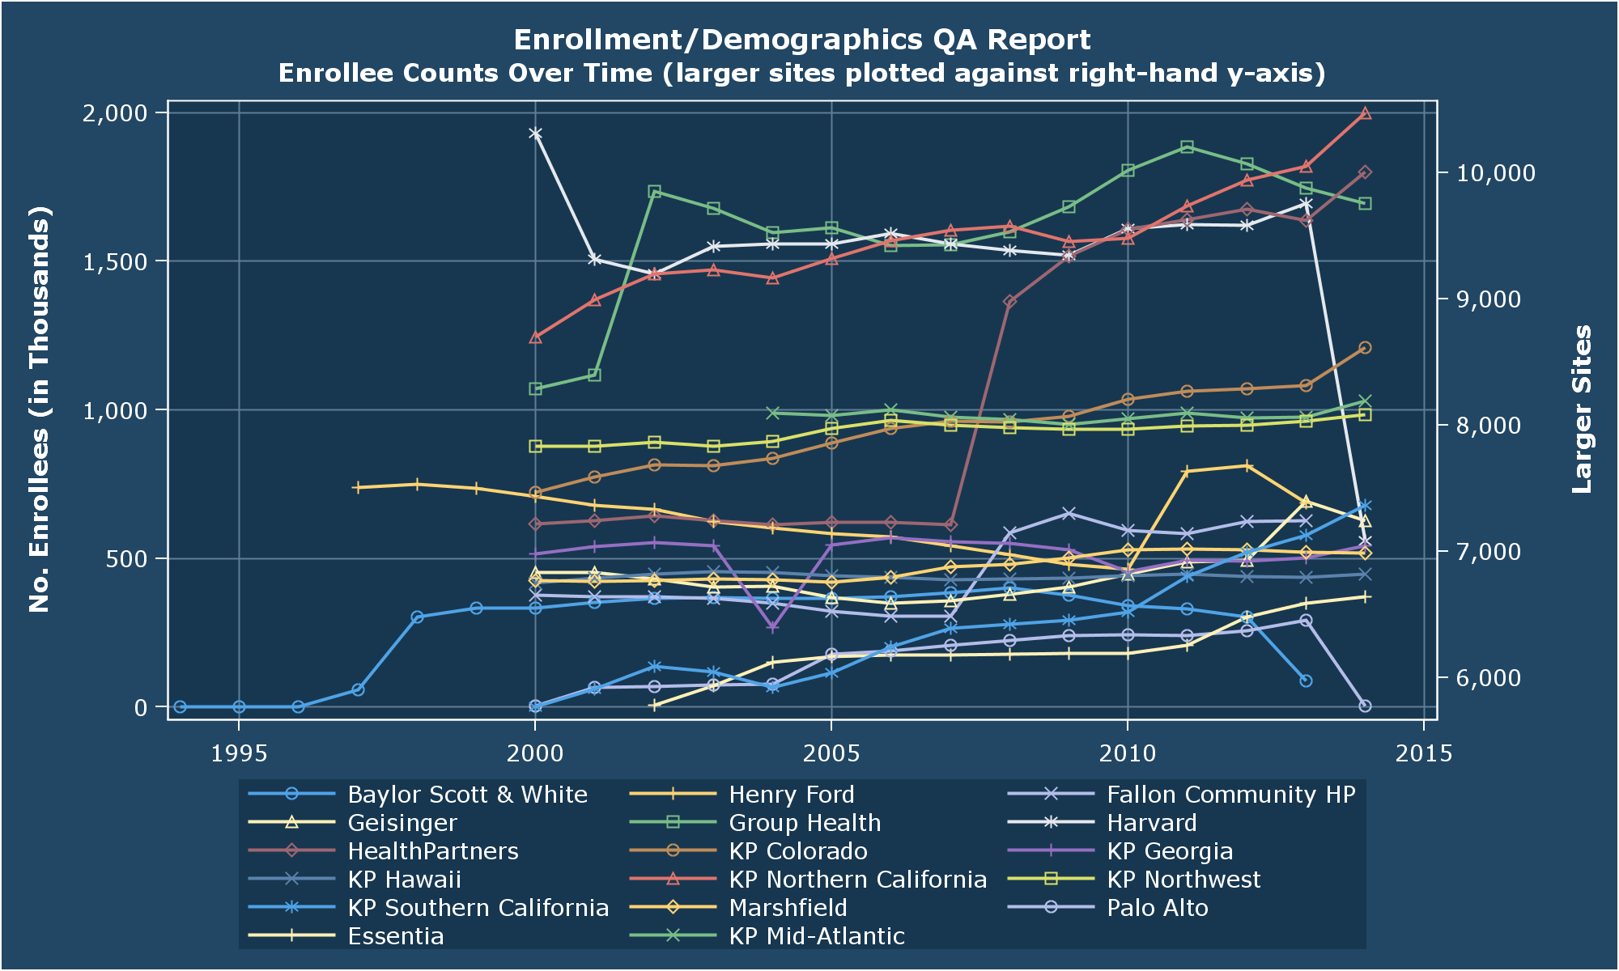
Enrollee Counts
Notes:
Note that one of the changes I made to the QA program had the unfortunate result of limiting enrollment counts to 2000->forward (so the only two sites with pre-2000 enrollment here are the two who did not run the latest QA). I will be fixing that.

Slide 17
Nearly 175 Million Person/Years
HMORN Site | Total no. of person/years
Baylor Scott & White | 2,720,741
Essentia | 2,517,771
Fallon Community HP | 2,607,093
Geisinger | 3,379,077
Group Health | 8,418,025
Harvard | 11,440,334
HealthPartners | 10,603,753
Henry Ford | 5,095,495
KP Colorado | 7,074,934
KP Georgia | 3,962,069
KP Hawaii | 3,297,348
KP Mid-Atlantic | 5,403,794
KP Northern California | 47,430,288
KP Northwest | 6,961,269
KP Southern California | 48,031,958
Marshfield | 2,359,280
Palo Alto | 2,365,034
 | 173,668,265
Notes:
The 2000->forward bug affecting the prior graph also affects this. So this count went down (it was 220 mil at the mid-year).

Slide 18
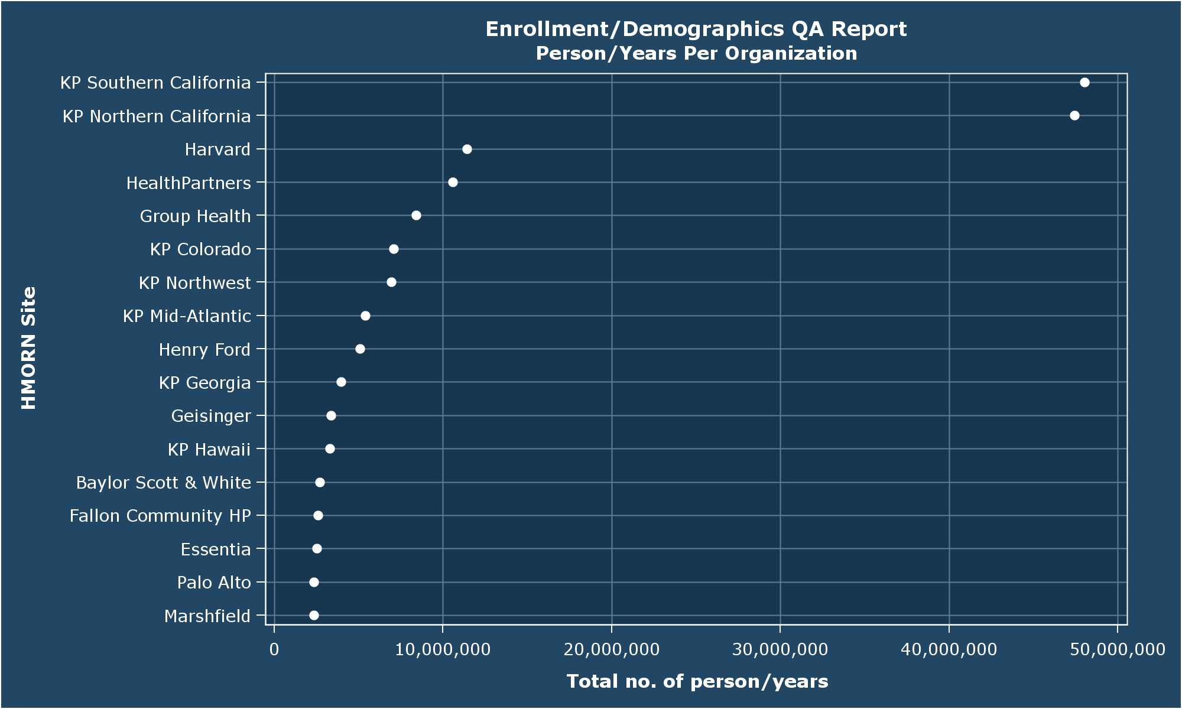
55% of which happened in the Golden State
Notes:
Lest any of us get too chuffed, it’s no secret that most of us are (collectively) the tail to California’s dog.
Southern Cal had more pre-2000 enrollment than Northern, and so they’re more penalized here.

Slide 19
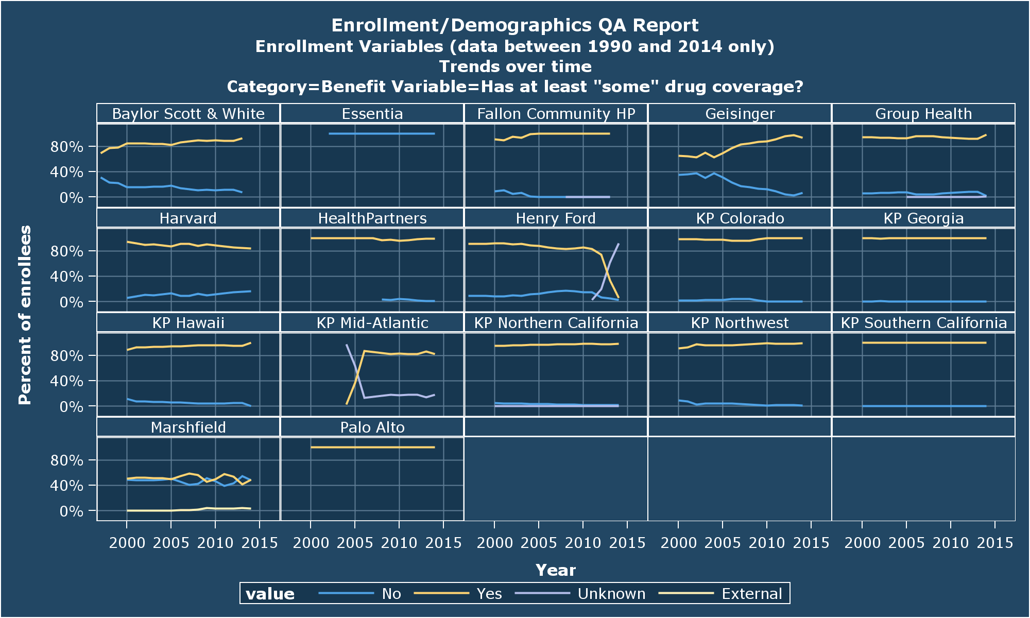
Drug Coverage
Notes:
Marshfield is using the new ‘external’ value for this.

Slide 20
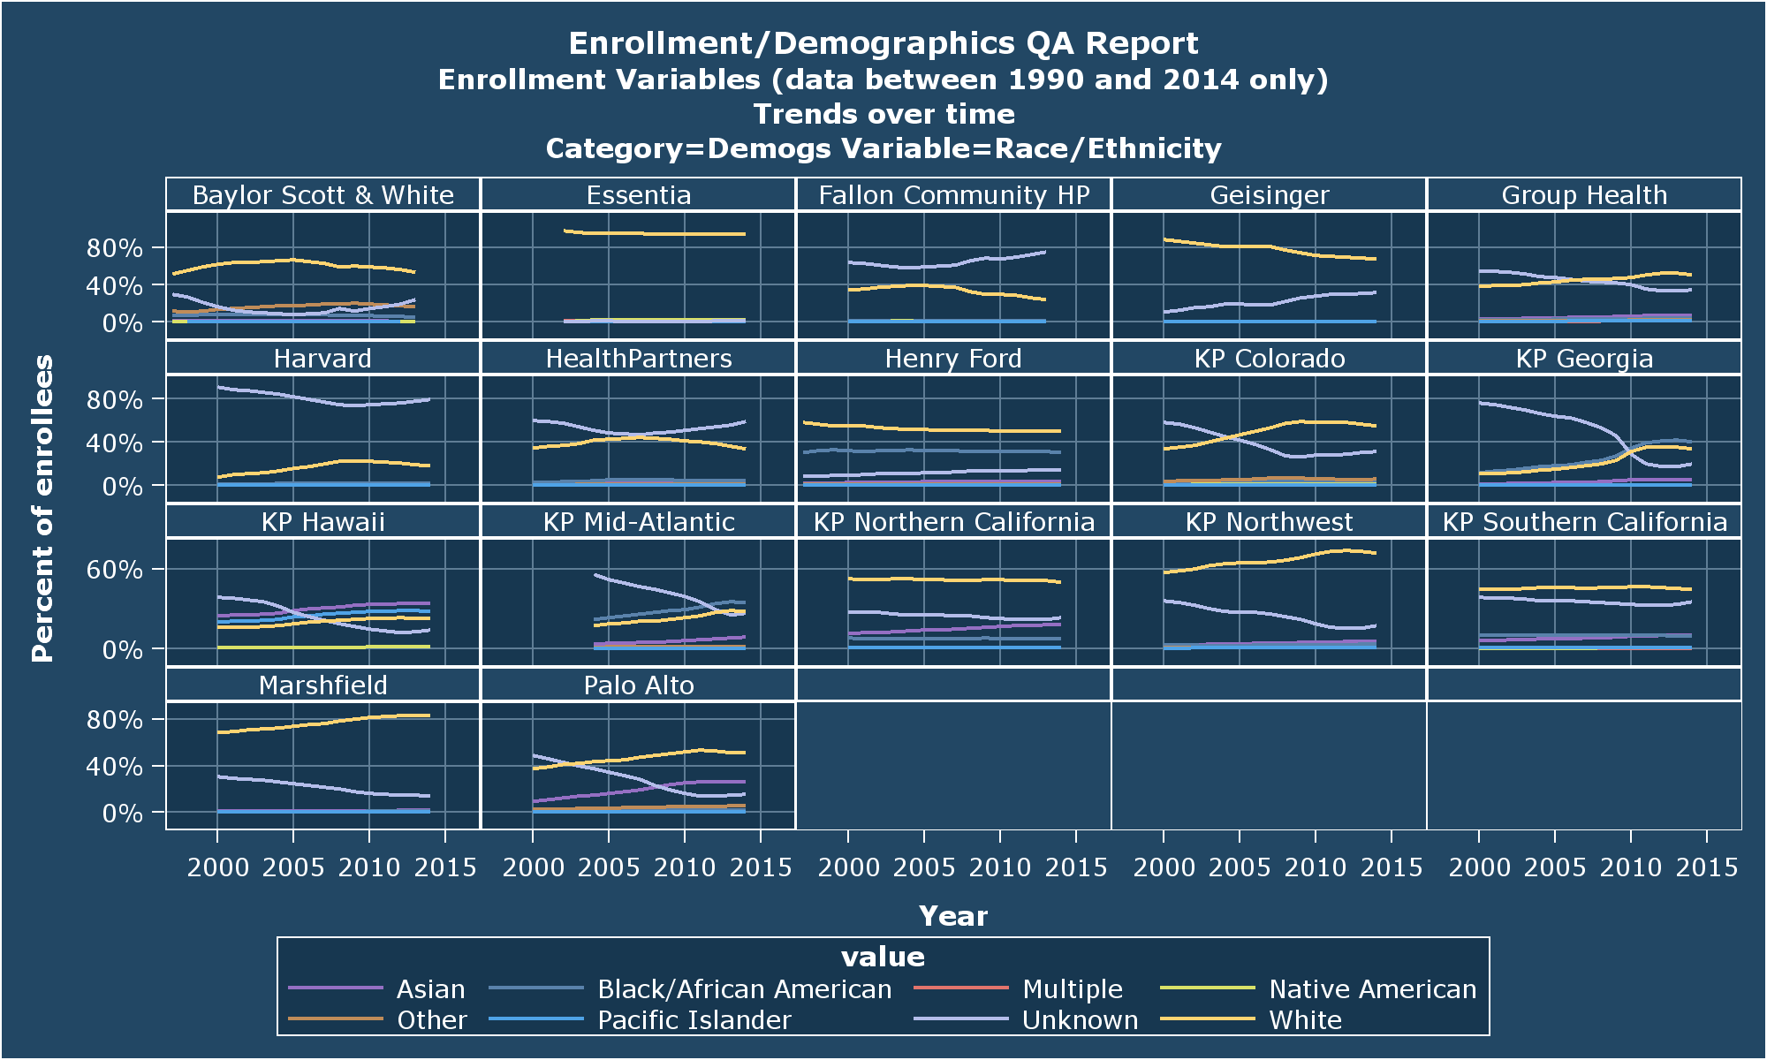
Race
Notes:
Unknowns continue to decline almost everywhere (precipitously at KPGA!).
BSW has a significant number of ‘other’ race values.
Hawaii is the only site where White is 3rd most common (after Asian & Pacific Islander).
KPMA, KPG & Henry Ford all havesignificant proportions of African American enrollees (KPGA has a majority of AA enrollees).

Slide 21
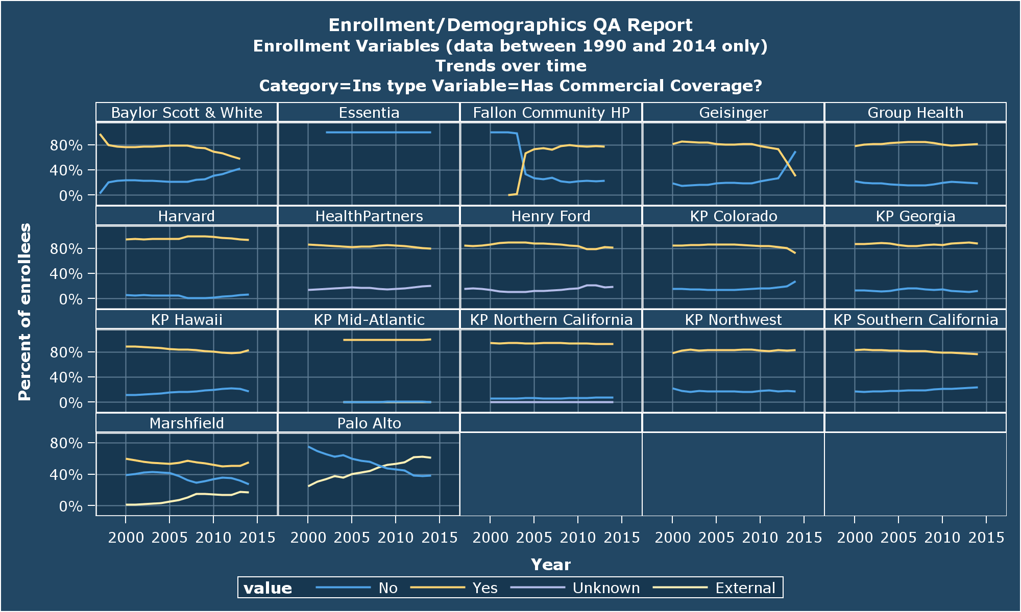
Commercial Coverage
Notes:
Marshfield & Palo Alto are both using the new(is) ‘External’ value here.
Still some variability on sites’ willingness/ability to use ‘No’ values.

Slide 22
QA To-Do:s
Distribute separate code that will depict record counts by the incomplete flag variables.
Not really QA, just an aid to implementation at this point.
Describe distributions of enrollment lengths.
Make person/year dotplot a scatterplot against median period length.
Add the December -> January enrollee count by insurance type.
Anything else?

