Slide 1

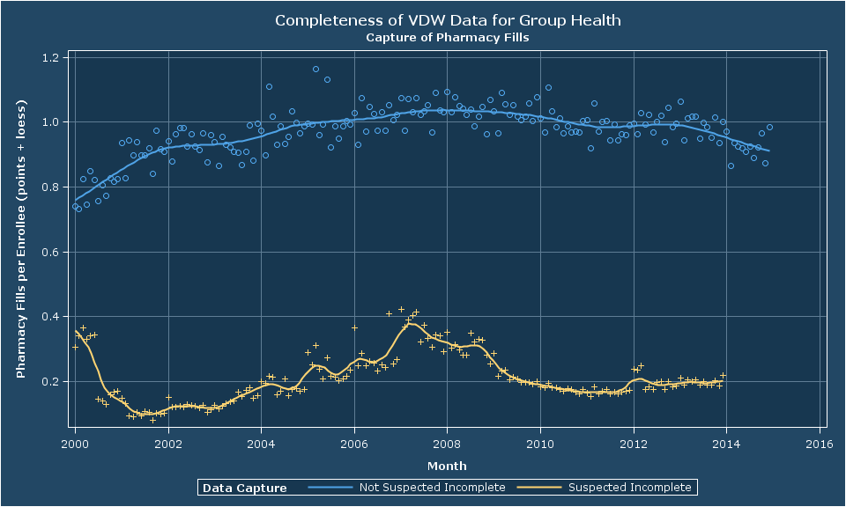
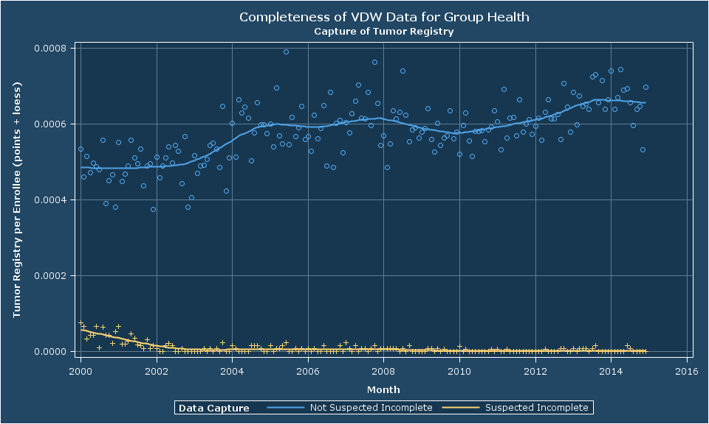
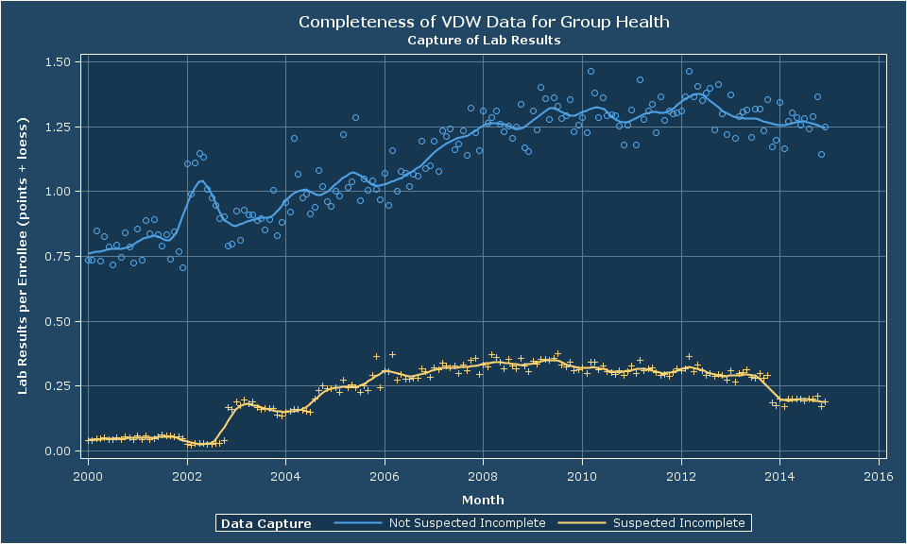
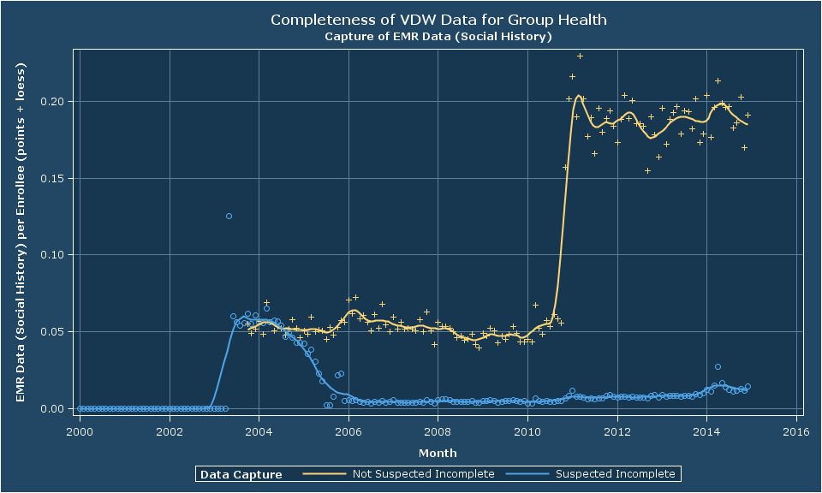
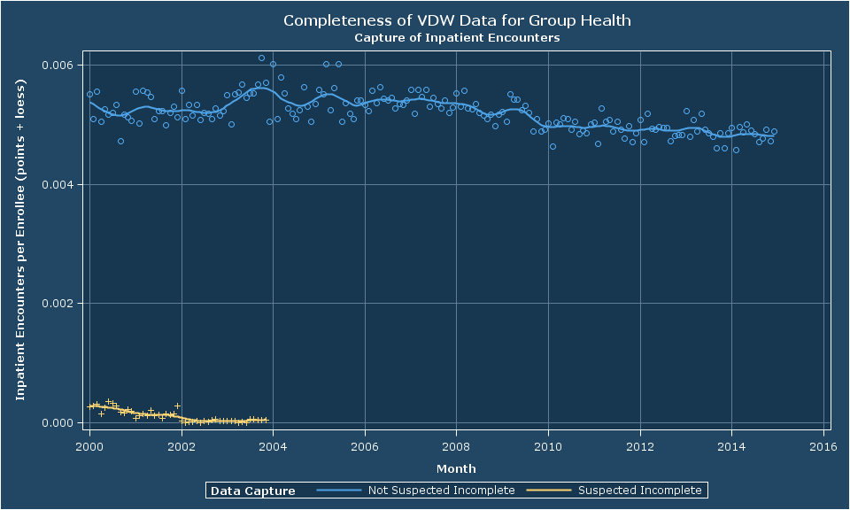
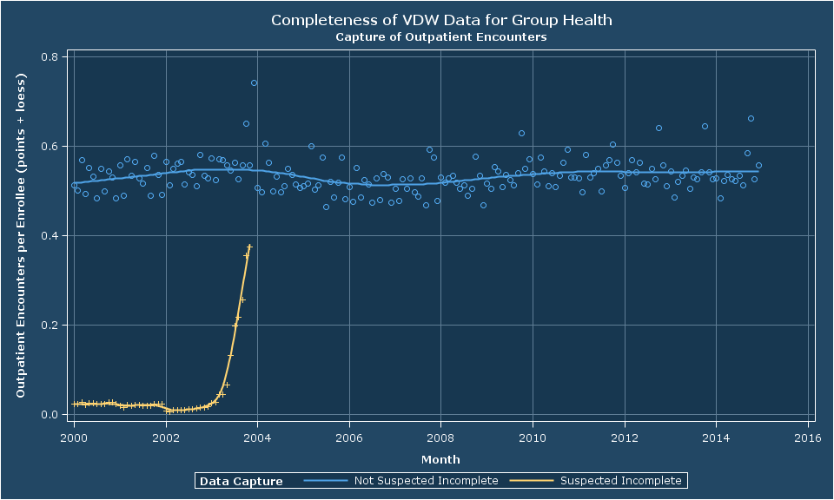
Known Unknowns: Flagging Incomplete Data Capture in VDW Enrollment
Author: Roy Pardee, JD MA
Group Health Research Institute
Introduction
Evaluation Method
Implementation & Results
Summary
HMO-based research generally gets us the best of two data worlds. We have:
The depth-of-detail of a healthcare provider, and
The completeness-of-information of a health insurer.
Nevertheless, we do have some data “blind spots”—conditions under which we know our capture of particular types of data are incomplete.
In December of 2014 the VDW Implementation Group adopted a set of 6 enrollment variables for flagging these periods.
After implementing these flags at Group Health, we looked to see how well our results tracked actual data capture.
For each month and flag variable:
Enumerate the set of people enrolled in that month, in both the suspected-incomplete (SI) and not-suspected-incomplete (NSI) groups.
Count the number of records in the relevant file (e.g., rx fills for incomplete_outpt_rx) for each enrolled person.
Compute rates by dividing the second number by the first number.
If implementation is good, rates for the SI group will be discernibly lower than those for NSI.
The logic of population-based research often relies on being able to draw conclusions from the data that isn’t there. For example:
If this patient had ever taken a phenothiazine drug, we would have a record of it in our data.
She has no such record.
Therefore, she is a suitable control for our case:control study of the effects of phenothiazines.
These inferences are only valid if we have complete data. We have the great luxury of very often having complete data. But not always.
Pharmacy implementation is based on drug benefits and (prior to 2004) Medicare status.
Tumor implementation is based on county of residence.
The Variables
Conclusion
Table 1: The New Flag Variables
Table 2: Excerpt of Pharmacy Evaluation Data
Variable Name | Definition | Valid Values
incomplete_outpt_rx | Is outpatient pharmacy fill data suspected to be incomplete for this person/period? | K: There are known reasons to suspect capture is incomplete. N: No—there is no known reason to suspect capture is incomplete. X: This Variable Not implemented.
incomplete_outpt_enc | Is outpatient encounter data suspected to be incomplete for this person/period?
incomplete_inpt_enc | Is inpatient encounter data suspected to be incomplete for this person/period?
incomplete_emr | Is electronic medical record data (e.g., social history, vital signs, etc.) suspected to be incomplete for this person/period?
incomplete_tumor | Is tumor data suspected to be incomplete for this person/period?
incomplete_lab | Is lab results data suspected to be incomplete for this person/period?
Month | Condition | N Enrollees | N Rx Recs | Rate
April 2013 | SI | 44,556 | 8,860 | 0.20
April 2013 | NSI | 537,247 | 547,339 | 1.02
May 2013 | SI | 45,413 | 9,332 | 0.21
May 2013 | NSI | 536,633 | 546,005 | 1.02
June 2013 | SI | 45,800 | 8,654 | 0.19
June 2013 | NSI | 536,619 | 510,137 | 0.95
Lab implementation is based on Group Practice Division and EWA vs. WWA. Most of the SI result data comes from EWA.
EMR (here indicated by Social History records) implementation is based on Group Practice Division Status.
The new flag variables allow us to expose this crucial information in an easy-to-use form, without needing to invoke (and explain) concepts like “Group Practice Division” to our partners.
Our implementations are generally high quality, discriminating very well between groups with demonstrably different rates of data capture.
These variables are a valuable addition to our enrollment data.
Inpatient Encounters is based on MainNet and date.
Like Inpatient, Outpatient encounters are based on MainNet and date.

