Slide 1

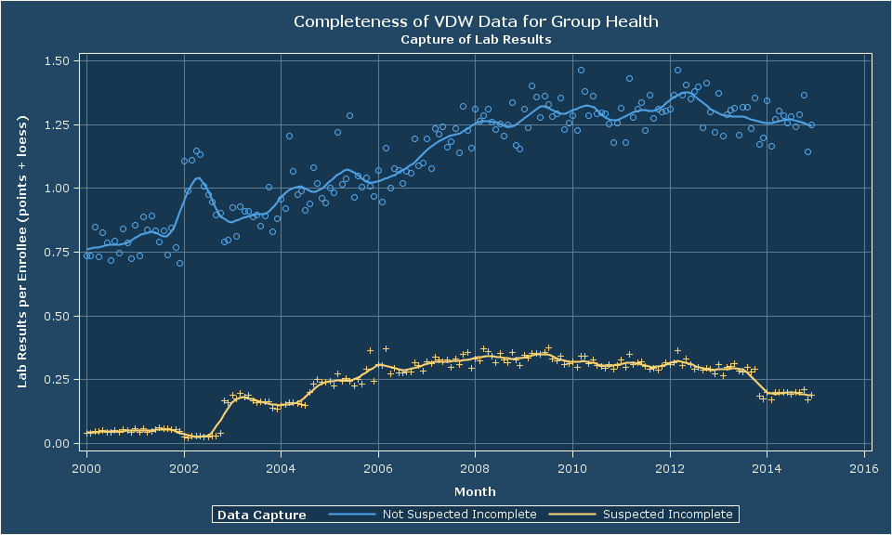
The Learning Healthcare (Data) System: VDW Data Capture Revisited
Roy Pardee, JD MA¹; Don Bachman, MS²; Mark Hornbrook, PhD²; Catherine Cleveland²; Priyam Mathur, MS³; Dan Ng, MBA⁴; Susan Aumer, PhD PMP⁵; William Harding, BS⁶; Celia Jordan, BS BA⁷; Jeremey Meier, BS⁸; Carmen Wong, MBA⁹; Brian Hoch, BS¹⁰
¹Group Health Research Institute ²The Center for Health Research, Kaiser Permanente Northwest ³Meyers Primary Care Institute ⁴Division Of Research, Kaiser Permanente Northern California ⁵HealthPartners Institute for Education ⁶Institute for Health Research, Kaiser Permanente Colorado ⁷MidAtlantic Permanente Research Institute ⁸Essentia Institute of Rural Health ⁹The Center for Health Research, Kaiser Permanente Hawaii ¹⁰Marshfield Clinic Research Foundation
and Research
Introduction
The New Variables (cont)
Implementation & Results
Discussion
At the 2014 Annual Meeting, Bachman et al. presented an excellent investigation into VDW enrollment’s OUTSIDE_UTILIZATION field, which purported to flag periods of suspect capture of either pharmacy or encounter data.
That investigation revealed serious problems with the flag, calling its usefulness into question.
Taking this to heart, the VDW Implementation Group approved spec changes removing this field, and adding a suite of six new flags, which allow sites to express any cautions they may have about capture of specific types of data.
These flags are assigned by local VDW analysts on the basis of their knowledge of data capture limitations at their site for identifiable subgroups of patients.
Implementation of the new flags is essentially optional—sites must have the fields in the table, but can opt to use the ‘X’ value to signify no substantive implementation.
In practical terms, we recommend interpreting Xs the same as Ns.
Thus far 8 sites have implemented (7 are shown here).
A value of ‘N’ is not an assertion that capture is complete. All ‘N’ means is that the implementing site does not know of a reason why capture should be incomplete.
As the VDW and its processes mature and we turn to more sophisticated quality assurance investigations, it is crucial that we respond effectively to negative findings. Just like our health care systems, we need to learn from our data.
The VDW Operations Committee was able to go from negative finding to new spec in something like six months, and actual implementations in less than a year. For a large, increasingly divers and largely unfunded group, this is an excellent pace.
The outpatient pharmacy flag is the most consistently well-implemented flag of the six. Very clear separation between the SI and NSI values.
For tumor, two of the four sites with SI values show excellent separation overall.
Evaluation Method
After numerous HCSRN sites implemented these flags, the Enrollment workgroup put out an evaluation program which calculated monthly per-member rates of the number of relevant records (e.g., lab results for incomplete_lab) for each value of each flag.
We then produced by-site plots of these rates over time, to allow for quick evaluation and cross-site comparisons.
In general, we should expect to see higher rates of records for enrollees for whom the relevant flag is set to N than those with Y values.
Non-implementing sites’ rates are illustrative for comparison.
Conclusion
The New Variables
The lab results flag is similarly well implemented at the sites. Note that Marshfield clinic has no enrollees whose lab data capture is suspect.
Six sites have SI values on EMR data (here signified by social history data). Implementations are all good post-2010. KPCO and KPNC are excellent overall.
On balance, the new flags stand to improve the quality of data-based research in the HCSRN. Projects needing to define populations-at-risk of exposure to particular pharmacy fills, tumors, or lab result values, for example, would do well to use the new flags to screen out people whose exposures may not be completely captured.
The Enrollment/
Variable Name | Definition | Valid Values
incomplete_outpt_rx | Is outpatient pharmacy fill data suspected to be incomplete for this person/period? | K: There are known reasons to suspect capture is incomplete. N: No—there is no known reason to suspect capture is incomplete. X: This Variable Not implemented.
incomplete_outpt_enc | Is outpatient encounter data suspected to be incomplete for this person/period?
incomplete_inpt_enc | Is inpatient encounter data suspected to be incomplete for this person/period?
incomplete_emr | Is electronic medical record data (e.g., social history, vital signs, etc.) suspected to be incomplete for this person/period?
incomplete_tumor | Is tumor data suspected to be incomplete for this person/period?
incomplete_lab | Is lab results data suspected to be incomplete for this person/period?
The inpatient flag implementations are less uniformly high quality. Of the four sites with SI values 2 show good separation overall, and a third starts to get good around 2010.
Here we have four sites with SI values, two of which have good separation from the NSI rates.

Slide 2
The Learning Healthcare (Data) System: VDW Data Capture Revisited
Roy Pardee, JD MA¹; Don Bachman, MS²; Mark Hornbrook, PhD²; Catherine Cleveland²; Priyam Mathur, MS³; Dan Ng, MBA⁴; Susan Aumer, PhD PMP⁵; William Harding, BS⁶; Celia Jordan, BS BA⁷; Jeremey Meier, BS⁸; Carmen Wong, MBA⁹; Brian Hoch, BS¹⁰
¹Group Health Research Institute ²The Center for Health Research, Kaiser Permanente Northwest ³Meyers Primary Care Institute ⁴Division Of Research, Kaiser Permanente Northern California ⁵HealthPartners Institute for Education ⁶Institute for Health Research, Kaiser Permanente Colorado ⁷MidAtlantic Permanente Research Institute ⁸Essentia Institute of Rural Health ⁹The Center for Health Research, Kaiser Permanente Hawaii ¹⁰Marshfield Clinic Research Foundation
and Research
Introduction
The New Variables (cont)
Implementation & Results
Discussion
At the 2014 Annual Meeting, Bachman et al. presented an excellent investigation into VDW enrollment’s OUTSIDE_UTILIZATION field, which purported to flag periods of suspect capture of either pharmacy or encounter data.
That investigation revealed serious problems with the flag, calling its usefulness into question.
Taking this to heart, the VDW Implementation Group approved spec changes removing this field, and adding a suite of six new flags, which allow sites to express any cautions they may have about capture of specific types of data.
These flags are assigned by local VDW analysts on the basis of their knowledge of data capture limitations at their site for identifiable subgroups of patients.
Implementation of the new flags is essentially optional—sites must have the fields in the table, but can opt to use the ‘X’ value to signify no substantive implementation.
In practical terms, we recommend interpreting Xs the same as Ns.
Thus far 8 sites have implemented (7 are shown here).
A value of ‘N’ is not an assertion that capture is complete. All ‘N’ means is that the implementing site does not know of a reason why capture should be incomplete.
As the VDW and its processes mature and we turn to more sophisticated quality assurance investigations, it is crucial that we respond effectively to negative findings. Just like our health care systems, we need to learn from our data.
The VDW Operations Committee was able to go from negative finding to new spec in something like six months, and actual implementations in less than a year. For a large, increasingly diverse and largely unfunded group, this is an excellent pace.
The outpatient pharmacy flag is the most consistently well-implemented flag of the six. Very clear separation between the SI and NSI values.
For tumor, two of the four sites with SI values show excellent separation overall.
Evaluation Method
After numerous HCSRN sites implemented these flags, the Enrollment workgroup put out an evaluation program which calculated monthly per-member rates of the number of relevant records (e.g., lab results for incomplete_lab) for each value of each flag.
We then produced by-site plots of these rates over time, to allow for quick evaluation and cross-site comparisons.
In general, we should expect to see higher rates of records for enrollees for whom the relevant flag is set to N than those with Y values.
Non-implementing sites’ rates are illustrative for comparison.
Conclusion
The New Variables
The lab results flag is similarly well implemented at the sites. Note that Marshfield clinic has no enrollees whose lab data capture is suspect.
Six sites have SI values on EMR data (here signified by social history data). Implementations are all good post-2010. KPCO and KPNC are excellent overall.
On balance, the new flags stand to improve the quality of data-based research in the HCSRN. Projects needing to define populations-at-risk of exposure to particular pharmacy fills, tumors, or lab result values, for example, would do well to use the new flags to screen out people whose exposures may not be completely captured.
The Enrollment/Demographics workgroup will fold this work into our standard QA package (generally run annually) to monitor implementation quality on these new variables.
Variable Name | Definition | Valid Values
incomplete_outpt_rx | Is outpatient pharmacy fill data suspected to be incomplete for this person/period? | K: There are known reasons to suspect capture is incomplete. N: No—there is no known reason to suspect capture is incomplete. X: This Variable Not implemented.
incomplete_outpt_enc | Is outpatient encounter data suspected to be incomplete for this person/period?
incomplete_inpt_enc | Is inpatient encounter data suspected to be incomplete for this person/period?
incomplete_emr | Is electronic medical record data (e.g., social history, vital signs, etc.) suspected to be incomplete for this person/period?
incomplete_tumor | Is tumor data suspected to be incomplete for this person/period?
incomplete_lab | Is lab results data suspected to be incomplete for this person/period?
The inpatient flag implementations are less uniformly high quality. Of the four sites with SI values 2 show good separation overall, and a third starts to get good around 2010.
Here we have four sites with SI values, two of which have good separation from the NSI rates.

