Slide 1


Caloric & Macro
Nutritional Tracker & Calculator

Slide 2
Humber College
Caloric + Macro Nutritional Calculator
Joshua Esemogie n01470636 Pelumi Owoshagba n01574587
Kirill Tsybulka n01561393 Roger Paredes n01602284
May – Aug 2024

Slide 3




1. Team Introduction
Joshua Esemogie, Tech Lead
Pelumi Owoshagba, Developer, Tester
Roger Paredes, Developer
Kirill Tsybulka, Developer
3

Slide 4


2. Introduction
Purpose: To engage users, guide them, and support them in their fitness journey.
Goal: Fill a crucial gap in the fitness and nutrition market by offering accurate, personalized, and actionable nutritional guidance.
4

Slide 5
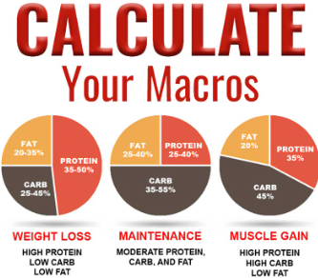
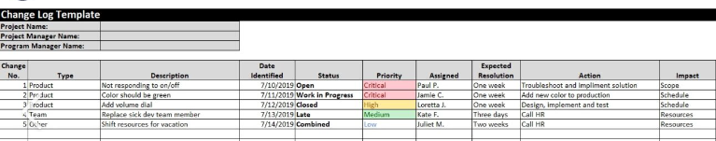
3. Project Description
Caloric + Macro Nutritional Calculator:
Based on individual customer needs.
Users input their stats: weight, height, age, activity level, and desired objective.
Provides required calories and macro nutritional distribution to achieve their objective.
Optional Features:
User accounts for logging progress.
Progress tracking over time
5

Slide 6

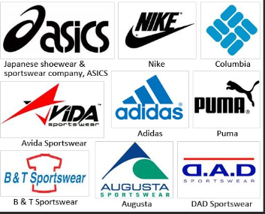

4. Project Business Case
Ideal For
Gyms
Protein supplement companies
Sports brands
Monetization
Initial Phase: Standalone project with ad revenue.
Future Potential: Can be sold or licensed.
6

Slide 7


5. Project Business Case: Consumer Demand
Market Insights
High Demand: Increasing prioritization of health and wellness.
Challenges: Many individuals lack accurate information and personalized guidance
7

Slide 8
6. Project Business Case: Target Audience
Who Will Benefit
Primary Users: Fitness enthusiasts, athletes, and individuals focused on health.
Professionals: Personal trainers, nutritionists, and fitness industry professionals
8

Slide 9
7. Project Business Case: Competitive Advantage
Unique Selling Points
Personalization: Accurate recommendations tailored to individual needs.
User Experience: Intuitive interface and easy-to-use features.
Progress Tracking: Optional feature for enhanced engagement.
Continuous Improvement: Regular updates based on user feedback and advances in fitness and nutrition.
9

Slide 10
8. Project Business Case: Monetization Strategy
Revenue Generation
Partnerships: Collaborate with fitness or food brands for advertising or affiliate marketing.
Advertising: Implement Google Ads and Network Ads once user base is established.
10

Slide 11
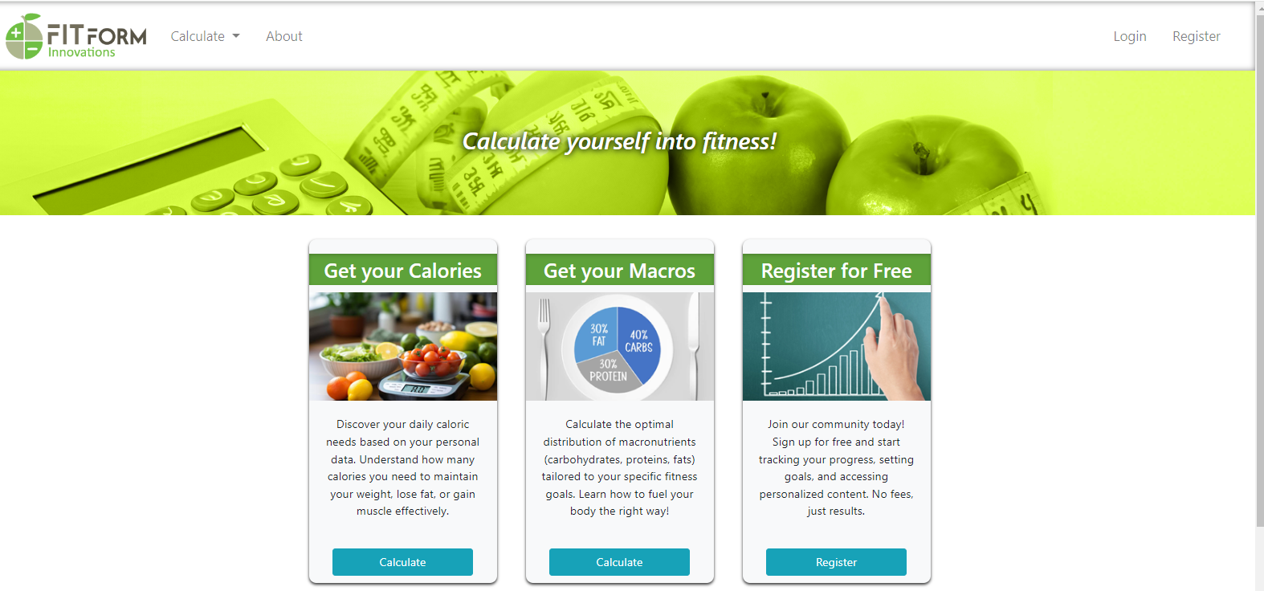
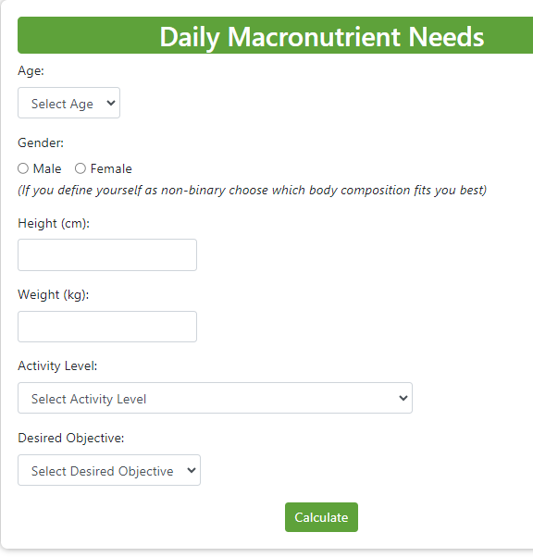
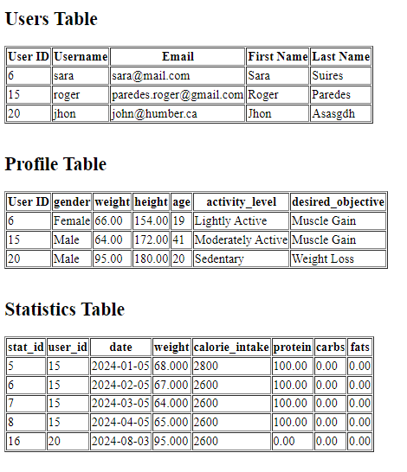
9. Demonstration
Live Demo
11

Slide 12
10. Future Opportunities
Potential for Sale
Value Proposition: Engage customers and build loyalty.
Scalability: Can be expanded or integrated with other fitness and nutrition services.
Investment: Highlight the benefits for potential buyers or investors.
12

Slide 13
11. Conclusion
Recap
Summary of the project's purpose, features, and business case.
Emphasize the competitive advantages and monetization strategies.
Call to Action
Invite questions and discussions.
Provide contact information for further inquiries or partnerships
.
13

Slide 14
Questions?

Slide 15
Thank you!

