Slide 1
Rudy Parra
DEEP DIVE IOT BOOTCAMP · COHORT 20
Senior Electrical Lab Technician, GridFlow
Lead Software Developer, Pii Energy
Founder & Board Member, NM Tech Talks
Deep Dive IoT alum, 2023 · therudyparra.com
Notes:
Open warm. "Three years ago this fall, I was sitting in those exact chairs, in this exact bootcamp." That is literally true: Deep Dive IoT, Oct to Dec 2023. Introduce yourself fast and get to the story. Do not read the slide, they can see it. Mention Jamie and Zuyva by name and thank them for the invite.

Slide 2
I sat in this exact bootcamp in 2023
START HERE
Deep Dive IoT, Oct to Dec 2023
Four months later
400+ hours of C++, circuits, soldering, clean room work, and lab automation. Finished my A.A.S. in CIS the same month.
IoT & Software Developer at Telemetry Insight. Bench-testing well controllers and shipping BLE features. First real IoT paycheck.
Notes:
This is the slide that matters most to them. Be honest about what was hard. Tell one specific story: a project that broke, a week you doubted it, the moment something clicked. They need to hear that the person on stage struggled too. The Telemetry Insight job is your proof that this bootcamp leads somewhere: April 2024, four months after you finished. Keep it to two minutes.

Slide 3
A research lab, not a tech job
BEFORE THE BOOTCAMP
National Solar Observatory, 2020
Lockheed Martin, 2023
Coe College, 2023
Image Creation Developer on the DevOps team. Built and debugged Windows and Linux OS images for cloud and on-prem.
Led a team across four NSF glass physics projects. Melted glass at 1300°C, ran XAFS and Raman, presented two posters.
Sole first author on solar spectroscopy research. Found that sunspot area drives the H-alpha line shape. NASA and NSF funded.
None of this was an IoT job. All of it taught me to take a messy physical system and figure out what it was actually doing.
Notes:
Point: the non-linear path is the point. Solar physics, OS imaging, and glass research have nothing in common on paper. What they share is measurement, debugging, and patience with systems that lie to you. That transfers directly to IoT. The Lockheed stint was Jan to May 2023, remote; Coe was that summer; then the bootcamp that fall. One year, three totally different things.

Slide 4
GridFlow
DAY JOB, PART ONE
Senior Electrical Lab Technician, working on vanadium redox flow batteries for long duration storage.
What a flow battery is
What I do
Why it matters
Liquid electrolyte in tanks instead of solid cells. Scale the tanks, scale the hours of storage.
ESP32 and Particle Photon firmware in C++. Current, voltage, temp, and GPS sensors over BLE and Wi-Fi. Python on the DAQ side.
Commercial energy resiliency. Keeping the lights on when the grid cannot.
Notes:
Keep this concrete. The "What I do" card is basically their curriculum: ESP32, C++, BLE, sensors. Say that out loud. "This is the stuff you are learning right now, and I use it every single day." Mention the IoT safety monitoring devices and custom PCBs you have built. Lab work is very much a tech job.

Slide 5
Pii Energy
DAY JOB, PART TWO
Lead Software Developer on the Edge 2000, a plug-in solar and battery system for regular people. Launched Pi Day 2025. Featured in PV Magazine.
This is IoT
The stack
The hard part
Hardware in someone's house, reporting state every minute, controlled from an app.
Device telemetry into AWS: API Gateway in front of Lambda. Room-level outlet control and overcurrent detection in the app.
Not the code. Making it simple enough that nobody needs an electrician to use it.
Notes:
This is the slide most relevant to an IoT class. Slow down here. If you can show the app on your phone, do it. Talk about a real bug: a device that dropped off the network, bad timestamps, a sensor reading that made no sense. They will remember the war story, not the architecture.

Slide 6
Nobody hired me for the thing I studied
Solar physics did not lead to solar hardware on purpose. The bootcamp did not teach me flow batteries. Every job I have came from being curious out loud and knowing somebody.
Build things. Show people. Say yes to the room.
Notes:
This is your thesis. Say it plainly and let it sit for a beat. If you only get one idea across today, make it this one. Tie it back to how you got the GridFlow job and the Pii role specifically.

Slide 7
I build community on purpose
THE OTHER HALF OF THE JOB
NM Tech Talks
Techqueria NM
Q-STEM
Founder and board member. I run marketing, and I co-organize the Tech Access track at TechFest.
Chapter Director. Latinx professionals in tech, here in New Mexico.
Founder. A meetup for LGBTQ+ people working in STEM.
Showing up to these rooms is how I met almost everyone who later helped me.
Notes:
Tell them the practical version: a meetup is a low-stakes way to meet hiring managers without applying to anything. Invite them personally to the next Techqueria or NMTT event. Being invited by name is what actually gets someone to show up.

Slide 8

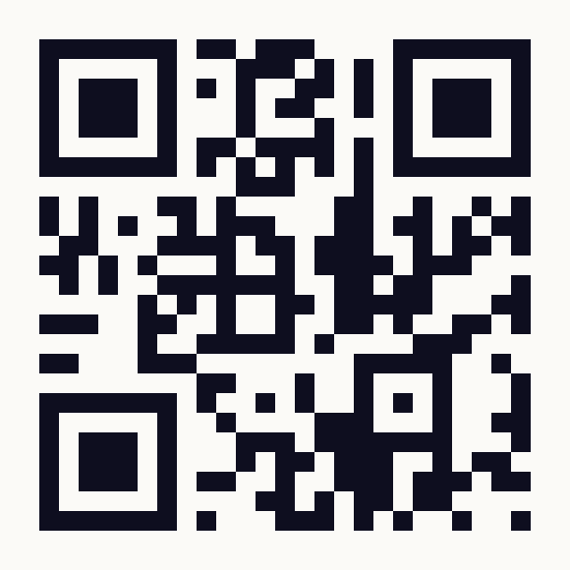
TechFest
NM TECHTALKS PRESENTS
@ Innovation District
Albuquerque, NM
October 29 to 30, 2026
Free and open to the public. 100+ speakers across five tracks and three venues.
Thursday 10/29, Main Library · Tech Access track
Career panels all day, plus free résumé reviews from 3:45pm with people who actually hire. Built for you.
nmtechfest.com
Notes:
Close the pitch here. Point at the QR code and give them ten seconds to scan it right now, in the room. Tell them to come Thursday specifically. The résumé tables are the single most useful thing for a bootcamp student: RESPEC, Pacific Fusion, Indeed, CAI, and NM Workforce Solutions will all be there. Tell them to bring a printed résumé, and that you will personally be there and will introduce them to people.

Slide 9
Questions, and then find me
Reach me
Do this week
therudyparra.com
LinkedIn: Rudy Parra
[EMAIL]
Register for TechFest. Come Thursday. Bring a printed résumé and say hi to me.
I mean the "find me" part. Connect with me today while you still remember, not in six months when you need something.
Notes:
Leave real time for questions, at least ten minutes. Expect: how did you get the GridFlow job, did the bootcamp get you hired, what should I learn next, is the degree worth it. Answer honestly. Add your email to the slide before you present, or just say it out loud and ask them to connect on LinkedIn right there in the room.

