Slide 1

Document Layout Analysis: Layout LM
Riten Patel

Slide 2
History

Slide 3
Timeline of papers and month/year

Slide 4
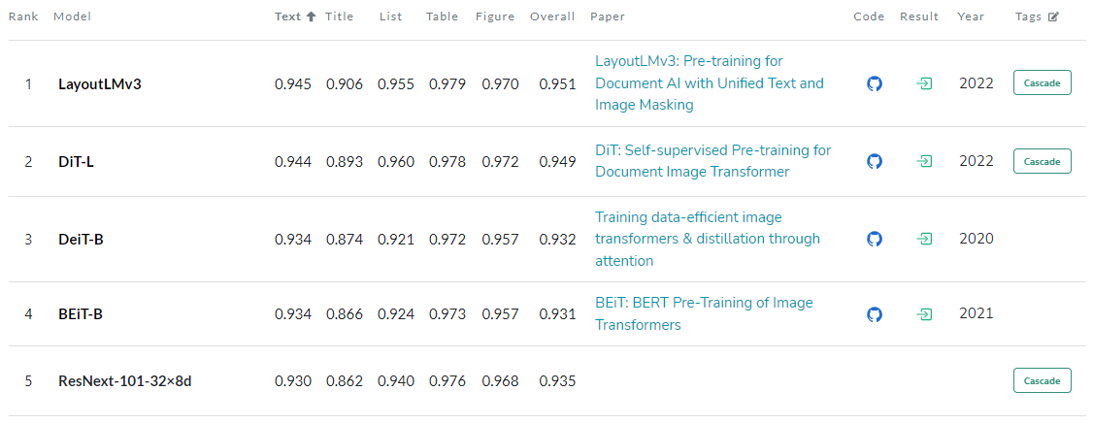
Benchmarks

Slide 5
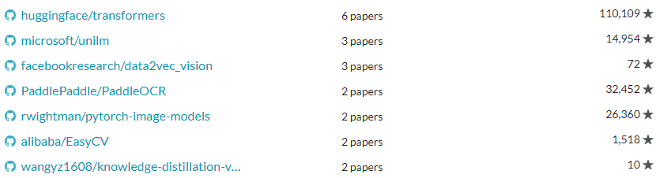
Popular Libraries
Library Num Papers Github Stars

Slide 6
Purpose

Slide 7
Applications

Slide 8
Method

Slide 9
References
https://paperswithcode.com/task/document-layout-analysis/latest

