Slide 1

CardioGuard
Explainable Heart Disease Risk Classification with a Tuned Stacking Ensemble
SMLC (UX25CS635A) — Supervised Machine Learning Classification Mini Project
Rahul Patidar
SRN: PES1PGE25DS049 · 1st Semester, M.Tech (Data Science & Artificial Intelligence) · PES University
Under the guidance of: Dr. Shylaja S. Sharath, HOD, Dept. of CSE, PES University

Slide 2



Problem & Motivation
Heart disease is one of the leading causes of death worldwide. Clinicians assess risk by combining many measurements — age, cholesterol, blood pressure, ECG results — a process that is manual, inconsistent, and hard to scale for early screening.
Why it matters
#1
cause of death globally is cardiovascular disease (WHO)
Predict
Binary classification: heart disease present (1) vs. absent (0) from 13 standard clinical features.
13
Validate rigorously
Leak-proof pipeline, stratified splits, cross-validated hyperparameter tuning, held-out test set.
clinical features used per patient in this study
Explain
302
Every prediction is accompanied by the clinical factors driving it — not a black box.
unique, de-duplicated patient records (UCI Cleveland)
CardioGuard — SMLC Mini Project
2

Slide 3

Dataset Overview
UCI Cleveland Heart Disease dataset — the classic benchmark used across published heart-disease-classification research.
13 clinical features, 3 groups
Class balance (after de-duplication, n = 302)
Continuous (6)
age, trestbps, chol, thalach, oldpeak, ca → StandardScaler
Binary (3)
sex, fbs, exang → passthrough (already 0/1)
Nominal categorical (4)
cp, restecg, slope, thal → One-Hot Encoded
80 / 20 stratified split
Train: 241 patients | Test: 61 patients (never touched during tuning)
Data-quality note: cp / restecg / slope / thal codes are inconsistently documented across public mirrors — modelled purely as nominal categories, with no assumed clinical ordering.
CardioGuard — SMLC Mini Project
3

Slide 4




Methodology & Pipeline
A leak-proof scikit-learn Pipeline: preprocessing is fit only on the training fold, for every model and every CV split.
1
2
3
4
→
→
→
Preprocess
Tune 6 models
Stack ensemble
Explain & deploy
ColumnTransformer: scale / passthrough / one-hot
GridSearchCV, 5-fold stratified CV, optimize ROC-AUC
Combine tuned base learners → Logistic Regression meta-learner
Permutation importance + SHAP; single joblib Pipeline
Base learners tuned: Logistic Regression · K-Nearest Neighbors · Decision Tree · Random Forest · SVM (RBF) · Gradient Boosting
Novelty: (1) hyperparameter-tuned Stacking Ensemble selected purely by cross-validated ROC-AUC (never by peeking at the test set); (2) dual explainability — global permutation importance + exact per-patient SHAP values; (3) single deployable Pipeline object shipped to an interactive UI.
CardioGuard — SMLC Mini Project
4

Slide 5
Tuned Baseline Model Comparison
5-fold cross-validated ROC-AUC (training set) vs. held-out test ROC-AUC, after GridSearchCV tuning
Takeaways
• Logistic Regression leads on CV ROC-AUC (0.896) — the linear signal in this feature set is strong.
• SVM (RBF) generalizes best on the untouched test set (ROC-AUC 0.918).
• Decision Tree is weakest and most test-CV gap prone — a single tree overfits small tabular data.
• No single model dominates both views → motivates stacking multiple tuned learners.
CardioGuard — SMLC Mini Project
5

Slide 6
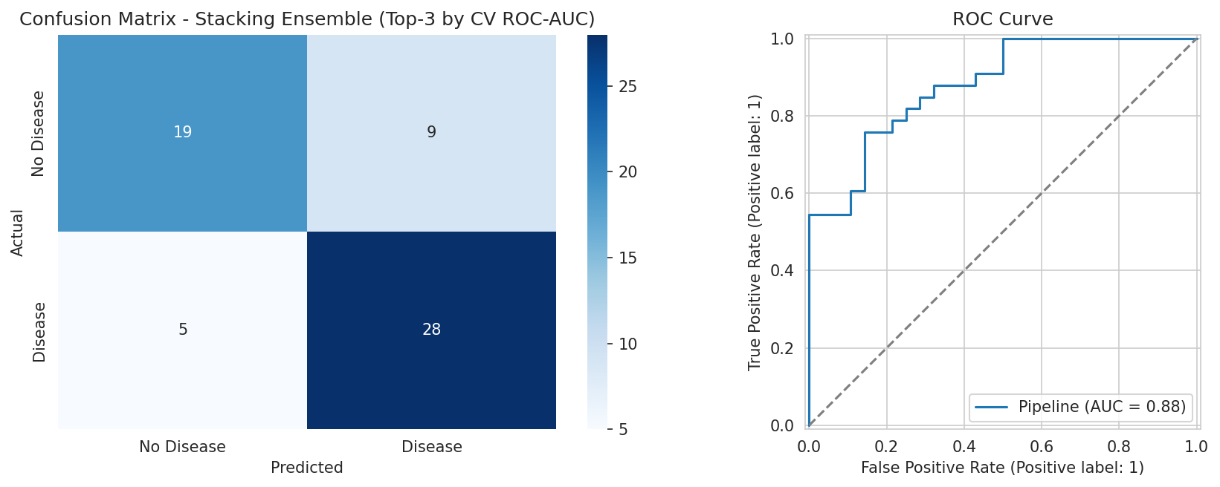
Stacking Ensemble — Final Results
Selected combination: Logistic Regression + Random Forest + Gradient Boosting, LR meta-learner (chosen by CV ROC-AUC alone)
0.898
0.881
77.0%
0.800
CV ROC-AUC
Test ROC-AUC
Test Accuracy
Test F1
Sanity check
Majority-class baseline: 54.1%
Model test accuracy: 77.0%
On two real held-out patients, predicted risk was 9.6% (confirmed no disease) vs. 91.3% (confirmed disease).
Per-class (test set): No Disease — precision 0.79, recall 0.68, F1 0.73 Disease — precision 0.76, recall 0.85, F1 0.80
CardioGuard — SMLC Mini Project
6

Slide 7
Explainability: Why the Model Decided
Two complementary techniques give both a global and a per-patient view of the model's reasoning
Global — Permutation Importance
Local — Per-Patient SHAP Values
shap.TreeExplainer on the tuned Random Forest component gives fast, exact SHAP values — used as a stand-in for the deployed stacking ensemble.
ca and thal (major vessels colored, thalassemia result) dominate global importance — consistent with known cardiology risk markers. For each patient, the dashboard surfaces the top 4–5 SHAP factors pushing predicted risk up or down — e.g. ⬆️ thal pushes risk UP (SHAP = +0.18).
CardioGuard — SMLC Mini Project
7

Slide 8

Interactive Clinical Risk Dashboard
The trained Pipeline is shipped to two live front-ends sharing one artifact
HIGH RISK
Predicted probability: 91.3%
❤️ CardioGuard Risk Calculator
Streamlit web app — app.py
Age
Top factor: ⬆️ thal pushes risk UP (SHAP = +0.183)
55
Resting BP
130 mm Hg
Also available: ipywidgets dashboard embedded directly in the notebook for a self-contained, no-server live demo (Section 11).
Cholesterol
240 mg/dl
Max Heart Rate
150
Predict Risk
One shared artifact: cardioguard_pipeline.pkl + cardioguard_explainer.pkl, loaded by both front-ends — no risk of a scaler/model mismatch at inference time.
CardioGuard — SMLC Mini Project
8

Slide 9

Conclusion & Future Work
Summary
Limitations & Future Work
• Tuned Stacking Ensemble (LR + RF + GB) selected purely by CV ROC-AUC — 0.898 CV, 0.881 held-out test ROC-AUC.
• Modest dataset (302 patients) — a larger, more diverse cohort would tighten confidence in test-set numbers.
• 77.0% test accuracy, comfortably beating the 54.1% majority-class baseline.
• SHAP currently explains the Random Forest component; a full KernelExplainer on the ensemble would be exact but slower.
• Dual explainability (permutation + SHAP) and a shared, single deployable Pipeline power two live UIs.
• Add probability calibration and external validation on a second clinical site before any real-world use.
Not a medical device — educational demonstration only.
Rahul Patidar | PES1PGE25DS049 | PES University
Under the guidance of Dr. Shylaja S. Sharath, HOD, Dept. of CSE, PES University

