Slide 1
SER 502 - Final Project Presentation
Reported by: Team 4
Rohith Bellapu (rbellapu)
Rushikesh Vinod Patil (rpatil29)
3. Aakanksha Jain (ajain251)
4. Naheer Fatima (nnolas33)
5. Vamsi Kolapalli (vkolapal)

Slide 2
This language is designed by taking an inspiration from the Java programming language.
Orange
Overview

Slide 3
Key Features of Orange
The declaration of variables in the language supports three data types:
1. int
2. String
3. Boolean
Provides support for arithmetic operators such as addition(+), subtraction(-), multiplication(*) and division(/).
Provides support for Logical operations such as AND, OR and NOT.
Provides support for looping structures such as if-else, for loop, for in range and while loop.
Provides support for Relational operations such as ==, >, <, <=, >=.
Provides support for Assignment operator which assigns the identifier with a value.
Provides support for ternary operator such as ? :

Slide 4
SYNTAX
SYNTAX
Declaration of variables:
Print statement
print(“hello world”)
int num = 10
string str = “Hello world”
Boolean boolVal = true

Slide 5
SYNTAX
SYNTAX
For loop structure:
for (i = 0; i <= 10; i++){
print(i)
}
While loop structure:
while (i<= 10) {
print(i);
i = i – 2
}
If-else structure:
if (n > 1)
{
print(“n is greater than 1”)
} else{
print(“n is less than 1”)
}
For in range loop structure:
for i in range(10) {
print(i)
}

Slide 6
Flowchart:
Flowchart:
Source file
ANTLR4
Visitor
Evaluator

Slide 7
Grammar
Grammar of the language
The basic structure of the grammar :
program: statement_list; statement_list: statement (OP_SEMICOLON statement)*; statement: print | expression | assignment | conditional | loop;
assignment : (data_type)? IDENTIFIER OP_ASSIGN (literal | expression); #assignment statement definition
print: ‘print’’(‘print_argument_list’)’; #Printing statement
print_argument_list: IDENTIFIER (',' print_argument_list)? | literal (',' print_argument_list)? | ; conditional: 'if' '(' expression ')' '{' statement_list '}' ( 'else' '{' statement_list '}’)?; #condition
#Loop statements
loop: traditional_for_loop | traditional_while_loop | range_for_loop; traditional_for_loop: 'for' '(' data_type IDENTIFIER OP_ASSIGN expression_term OP_SEMICOLON comparison_expression OP_SEMICOLON expression ')' '{' statement_list '}'; traditional_while_loop: 'while' '(' expression ')' '{' statement_list '}'; range_for_loop: 'for' IDENTIFIER 'in' 'range' '(' range ')' '{' statement_list '}';

Slide 8
Grammar
Grammar of the language
range: INTEGER_L ',' INTEGER_L; expression: boolean_expression | numeric_expression | comparison_expression | ternary_expression ; boolean_expression: expression_term (OP_LOGICAL_AND | OP_LOGICAL_OR) expression_term | OP_LOGICAL_NOT expression_term | expression_term; comparison_expression: expression_term (OP_EQUALS | OP_GREATER | OP_SMALLER | OP_GREATER_EQUALS | OP_SMALLER_EQUALS) expression_term | expression_term; numeric_expression: expression_term | '(' numeric_expression ')' | numeric_expression (OP_ADD|OP_SUB) numeric_expression | numeric_expression (OP_MUL|OP_DIV) numeric_expression | numeric_expression (OP_SUCCESSOR | OP_PREDECESSOR) ;
string_expression: string_term (OP_ADD string_term)*; #String concatenation string_term: STRING_L | IDENTIFIER; ternary_expression: comparison_expression OP_TERNARY_TRUE expression OP_TERNARY_FALSE expression; expression_term : IDENTIFIER | literal | BOOLEAN_FALSE | BOOLEAN_TRUE;

Slide 9
Grammar
Grammar of the language
literal : INTEGER_L | BOOLEAN_L | string_expression; data_type : 'int' | 'boolean' | 'string'; BOOLEAN_L : BOOLEAN_FALSE | BOOLEAN_TRUE; INTEGER_L: DIGIT+; STRING_L: '"' .*? '"'; DIGIT : [0-9] | [1-9][0-9]+; BOOLEAN_TRUE : 'true' ; BOOLEAN_FALSE : 'false' ; /* ASSIGNMENT OPERATOR DEFINITION */ OP_ASSIGN : '=';

Slide 10
Grammar
Grammar of the language
/* ARITHMETIC OPERATOR DEFINTIONS */ //OP_SET_ARITHMETIC : OP_ADD | OP_SUB | OP_MUL | OP_DIV; OP_ADD : '+'; OP_SUB : '-'; OP_MUL : '*'; OP_DIV : '/'; OP_SUCCESSOR : '++'; OP_PREDECESSOR : '--'; /* RELATIONAL OPERATOR DEFINITIONS */ //OP_SET_RELATIONAL : OP_EQUALS | OP_SMALLER | OP_GREATER | OP_SMALLER_EQUALS | OP_GREATER_EQUALS; OP_EQUALS : '=='; OP_SMALLER : '<'; OP_GREATER : '>'; OP_SMALLER_EQUALS : '<='; OP_GREATER_EQUALS : '>=';

Slide 11
Grammar
Grammar of the language
/* LOGICAL OPERATOR DEFINITIONS */ OP_LOGICAL_AND : '&&'; OP_LOGICAL_OR : '||'; OP_LOGICAL_NOT : '!'; OP_TERNARY_TRUE : '?' ; OP_TERNARY_FALSE : ':' ; OP_SEMICOLON : ';'; IDENTIFIER : [a-zA-Z_][a-zA-Z0-9_]*; WS: ('\t' | '\r' | '\n')-> skip;

Slide 12
ANTLR stands for Another Tool For Language Recognition, which is a parser generator that takes in a grammar as input and produces source code as output. It is a versatile tool that can be used to read, process, execute, or translate structured text or binary files.
Interpreter
ANTLR4
The ANTLR parser generates an abstract syntax tree (AST) that can be traversed using a tree listener implementation. This allows us to create recursive descent parsers for the parsing technique we used.
The .g4 files produced by ANTLR are highly organized, easy to read, and concise. They are designed to handle various edge cases and provide excellent error reporting.
ANTLR also generates well-tested and reliable lexer, parser, interpreter, and visitor classes automatically. Additionally, ANTLR ensures portability when switching target languages, eliminating the need to re-implement algorithms.
Sources: ANTLR documentation.

Slide 13
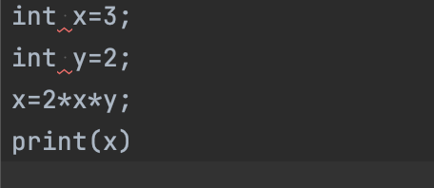
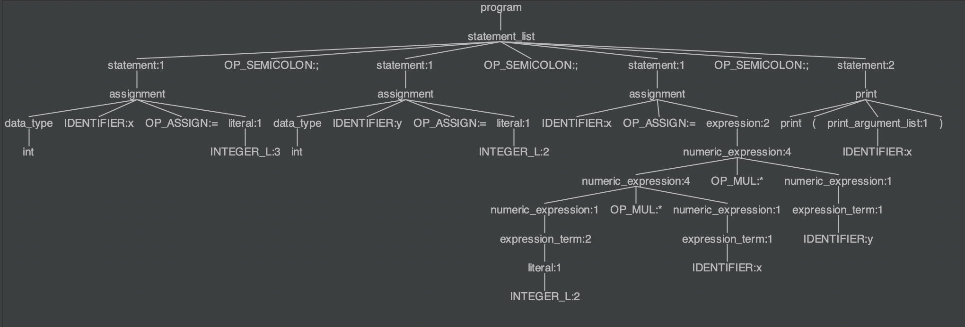
Parse Tree
Parse Tree

Slide 14
Programming Language
Java is a popular programming language choice due to its strong type checking, automatic garbage collection, and efficient execution. It is considered semantically safe and supports generalization, security, and extensibility. In Java, all methods must be called through a class or object, ensuring a high level of reliability and maintainability.
In the context of ANTLR4, Java allows for the extension of the visitor base class.
JAVA
MyOrangeVisitor extends OrangeBaseVisitor<Object>
Our evaluator functions are written in
MyOrangeVisitor.java class

Slide 15
Data Structures
List
private final List<SemanticError> semanticErrorList;
(This captures all the semantic errors that arises upon execution of the code.)
HashMap
private final Map<String, Variable> variableMap;
(This stores the identifier and variable in the form of key-value pairs)

Slide 16
The evaluation is done in the MyOrangeVisitor.java ﬁle
Runtime
The functions implemented for semantic evaluation are as shown below:
T visitStatement_list(OrangeParser.Statement_listContext ctx);
T visitStatement(OrangeParser.StatementContext ctx);
T visitAssignment(OrangeParser.AssignmentContext ctx);
T visitPrint(OrangeParser.PrintContext ctx);
T visitPrint_argument_list(OrangeParser.Print_argument_listContext ctx);
T visitConditional(OrangeParser.ConditionalContext ctx);
T visitLoop(OrangeParser.LoopContext ctx);
T visitTraditional_for_loop(OrangeParser.Traditional_for_loopContext ctx);
T visitTraditional_while_loop(OrangeParser.Traditional_while_loopContext ctx);
T visitRange_for_loop(OrangeParser.Range_for_loopContext ctx);
T visitRange(OrangeParser.RangeContext ctx);
T visitExpression(OrangeParser.ExpressionContext ctx);
T visitBoolean_expression(OrangeParser.Boolean_expressionContext ctx);
T visitComparison_expression(OrangeParser.Comparison_expressionContext ctx);
T visitNumeric_expression(OrangeParser.Numeric_expressionContext ctx);
T visitString_expression(OrangeParser.String_expressionContext ctx);
T visitString_term(OrangeParser.String_termContext ctx);
T visitTernary_expression(OrangeParser.Ternary_expressionContext ctx);
T visitExpression_term(OrangeParser.Expression_termContext ctx);
T visitLiteral(OrangeParser.LiteralContext ctx);
T visitData_type(OrangeParser.Data_typeContext ctx);
Evaluator

Slide 17
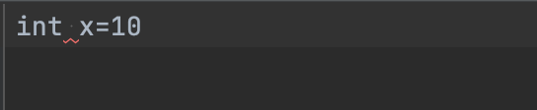
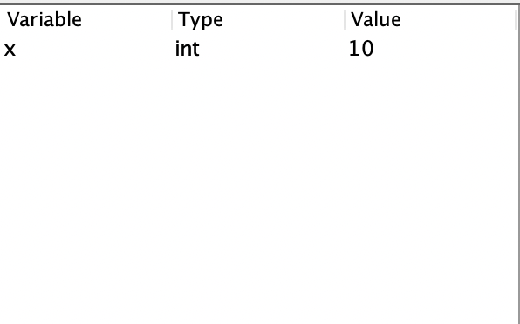
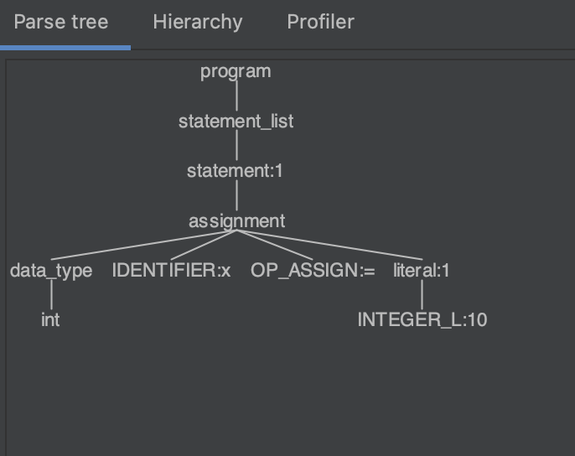
Run Time Flow
Run Time Flow

Slide 18
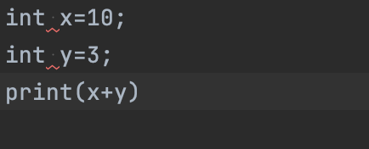
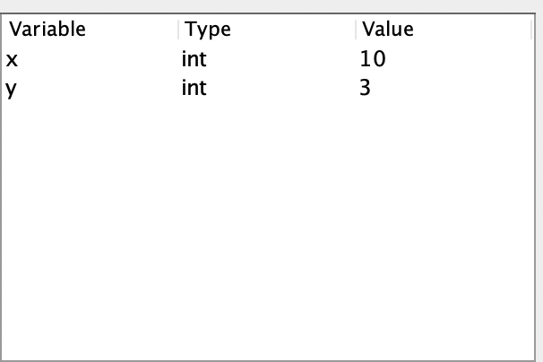
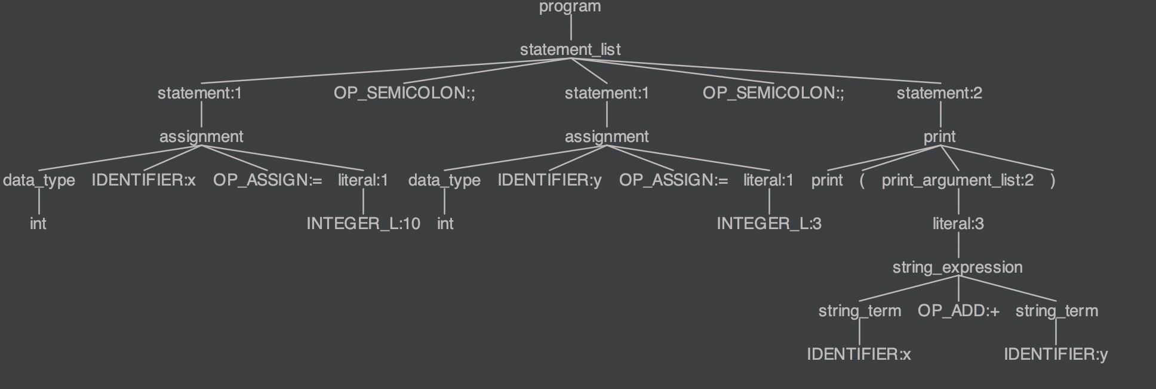
Run Time Flow (Continue)
Run Time Flow(Continue)

Slide 19
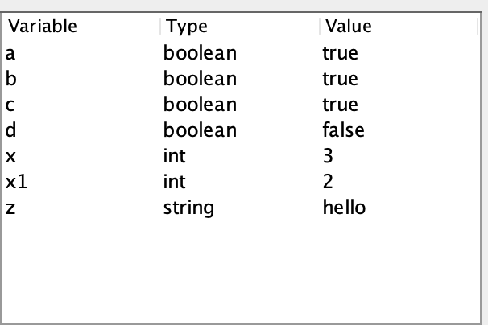
Sample Test Cases
Sample Test Cases
TEST CASE 1:
Output
int x = 3;
int x1 = 2;
string z = "hello";
boolean a = true;
boolean b = true;
boolean c = true;
boolean d = !true;
print(x)

Slide 20
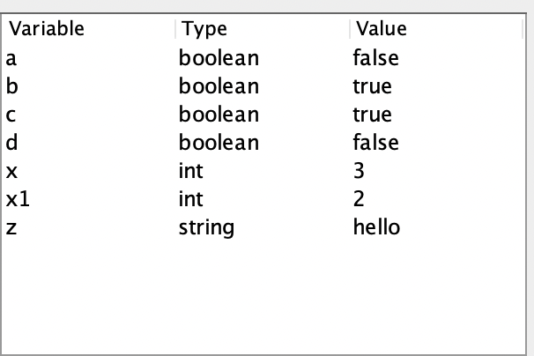
Sample Test Cases
Sample Test Cases
TEST CASE 2:
Output
int x = 3;
int x1 = 2;
string z = "hello";
boolean a = true && false;
boolean b = true || false;
boolean c = true;
boolean d = !true

Slide 21
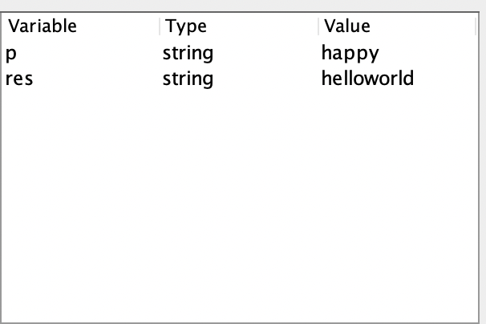
Sample Test Cases
Sample Test Cases
TEST CASE 3:
Output
string res = "hello" + "world";
print(res);
string p = "happy";
print(p)

Slide 22
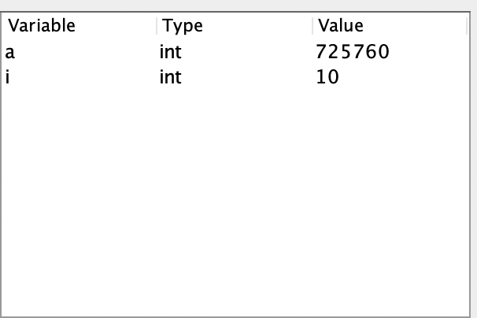
Sample Test Cases
Sample Test Cases
TEST CASE 4:
Output
int i=1;
int a=2;
print("Output of for :");
for(int j=1;j<3;j++){print(j)};
print(" Output for while is :");
while(i<10)
{
print(i);
a=a*i;
i=i+1
}
print(a)

Slide 23
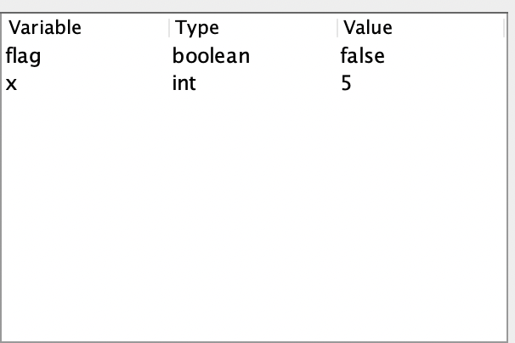
Sample Test Cases
Sample Test Cases
TEST CASE 5:
Output
int x=3;
boolean flag = false;
x = flag ? 1:2;
if(flag)
{
x=10
}
else
{
x=5
};
print(x)

Slide 24
Thank You
- Team 4,Orange

