Slide 1
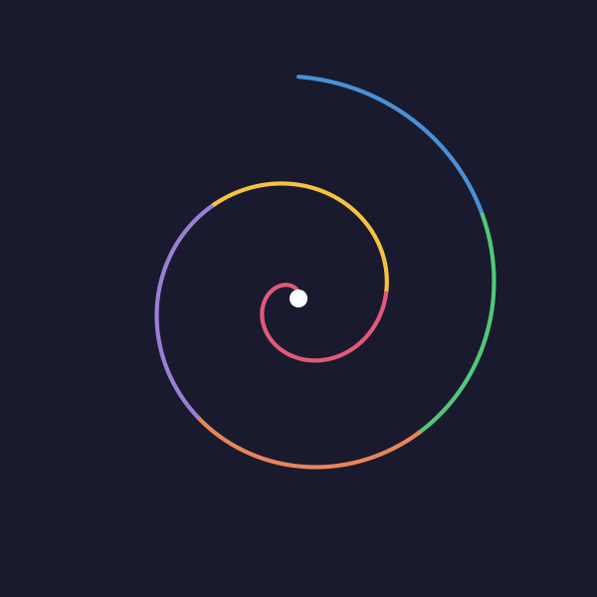
Research Agora
61 Open-Source AI Skills for ML Research
Built by a researcher, for researchers.
1 / 9

Slide 2
The Problem
Researchers use ChatGPT for everything.
But there are no verified, reusable workflows.
Citation hallucinations pass peer review.
We need infrastructure — not just chat.
2 / 9

Slide 3
Research Agora
A skills marketplace for ML research.
61 public skills · 6 plugins · MIT license
One install command. Works today.
3 / 9

Slide 4
What You Can Do
▸ /paper-review
Simulate a skeptical reviewer
▸ /paper-references
Catch hallucinated citations
▸ /proof-auditor
Verify mathematical proofs
▸ /claim-auditor
Audit evidence for every claim
▸ /paper-introduction
Draft compelling intros
4 / 9

Slide 5
Verified, Not Vibes
Every verification skill ships with a benchmark.
L1 Code-verified
L2 Reproducible experiment
L3 Paper evidence
L4 Citation support
L5 Logical argument
L6 Assertion (no evidence)
You can measure skill quality.
5 / 9

Slide 6
Works Everywhere
Claude Code (native)
Cursor (.mdc rules)
Gemini CLI
GitHub Copilot
Conversion tool included.
No vendor lock-in.
6 / 9

Slide 7
Benchmarked
HALLMARK citation benchmark
F1-H: 0.908
Quarterly refresh.
Open leaderboard.
Measure before you trust.
7 / 9

Slide 8
P-AGI Workshop @ ICLR 2026
“Skills, Benchmarks, and Verification Are What AI-Assisted Research Needs”
Test-driven research:
Define verification criteria
BEFORE delegating to AI.
8 / 9

Slide 9
Get Started
Browse:
rpatrik96.github.io/research-agora
Install:
/plugin marketplace add rpatrik96/research-agora
Contribute:
github.com/rpatrik96/research-agora
Save this post ↓ · Link in comments
9 / 9

