Slide 1



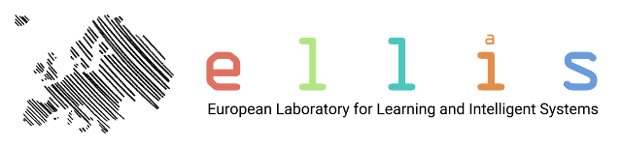



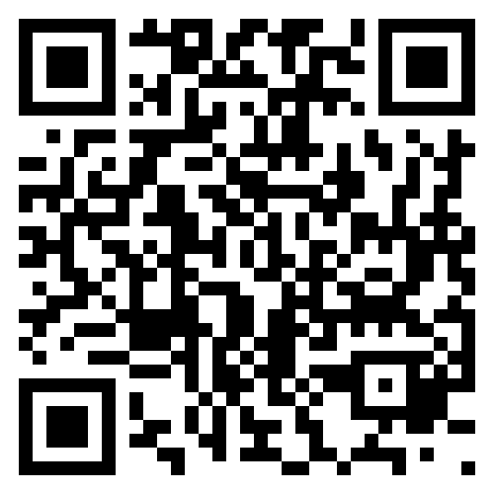

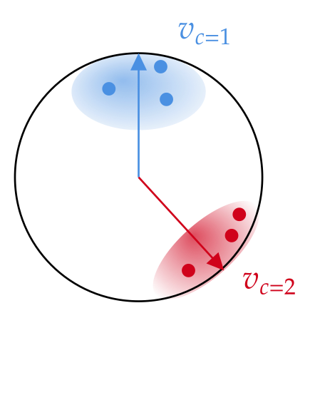
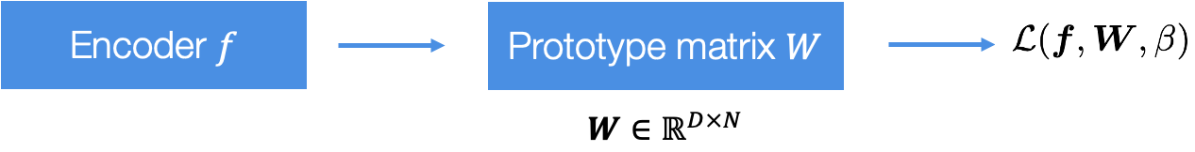
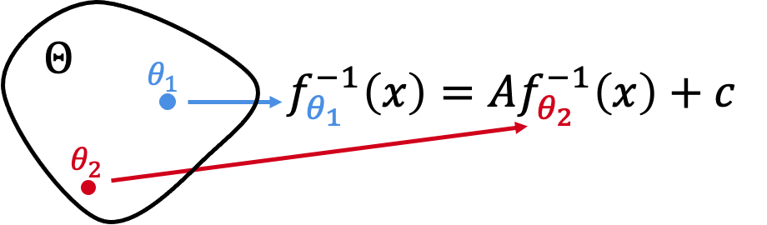
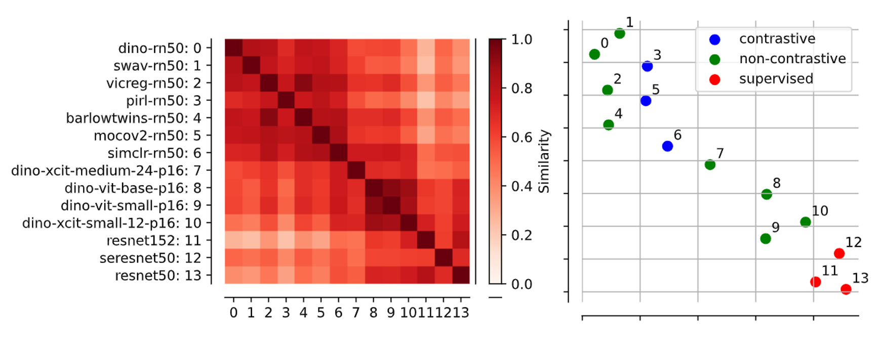
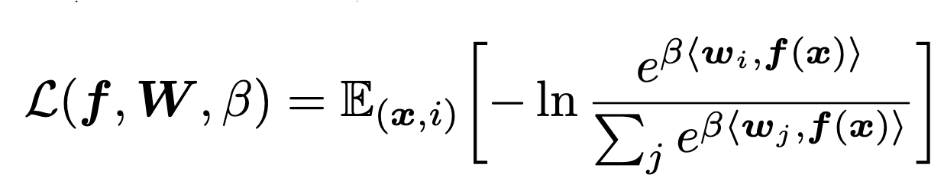
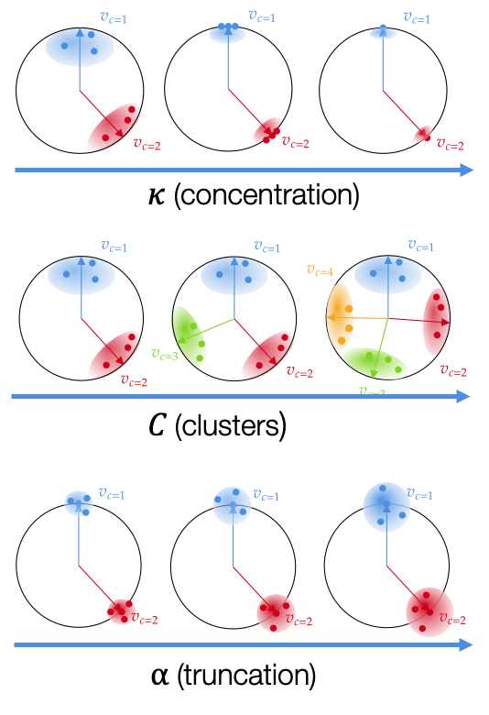
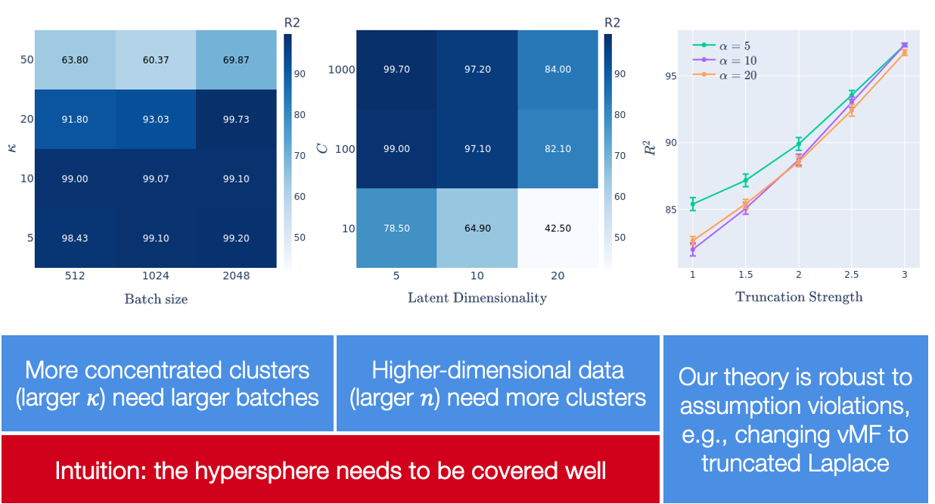
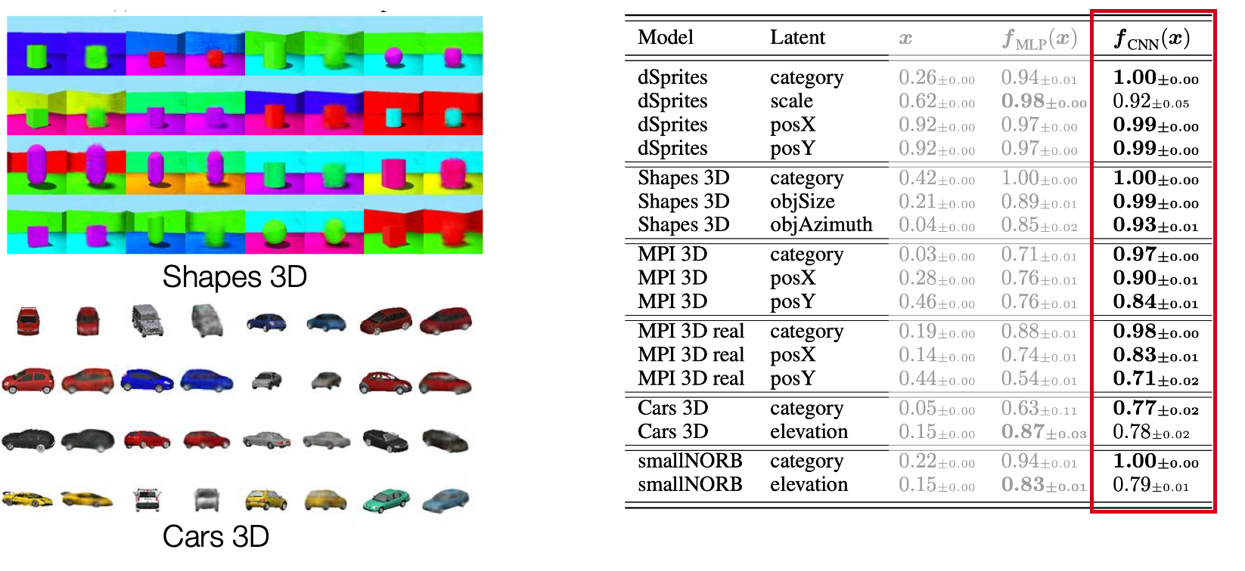
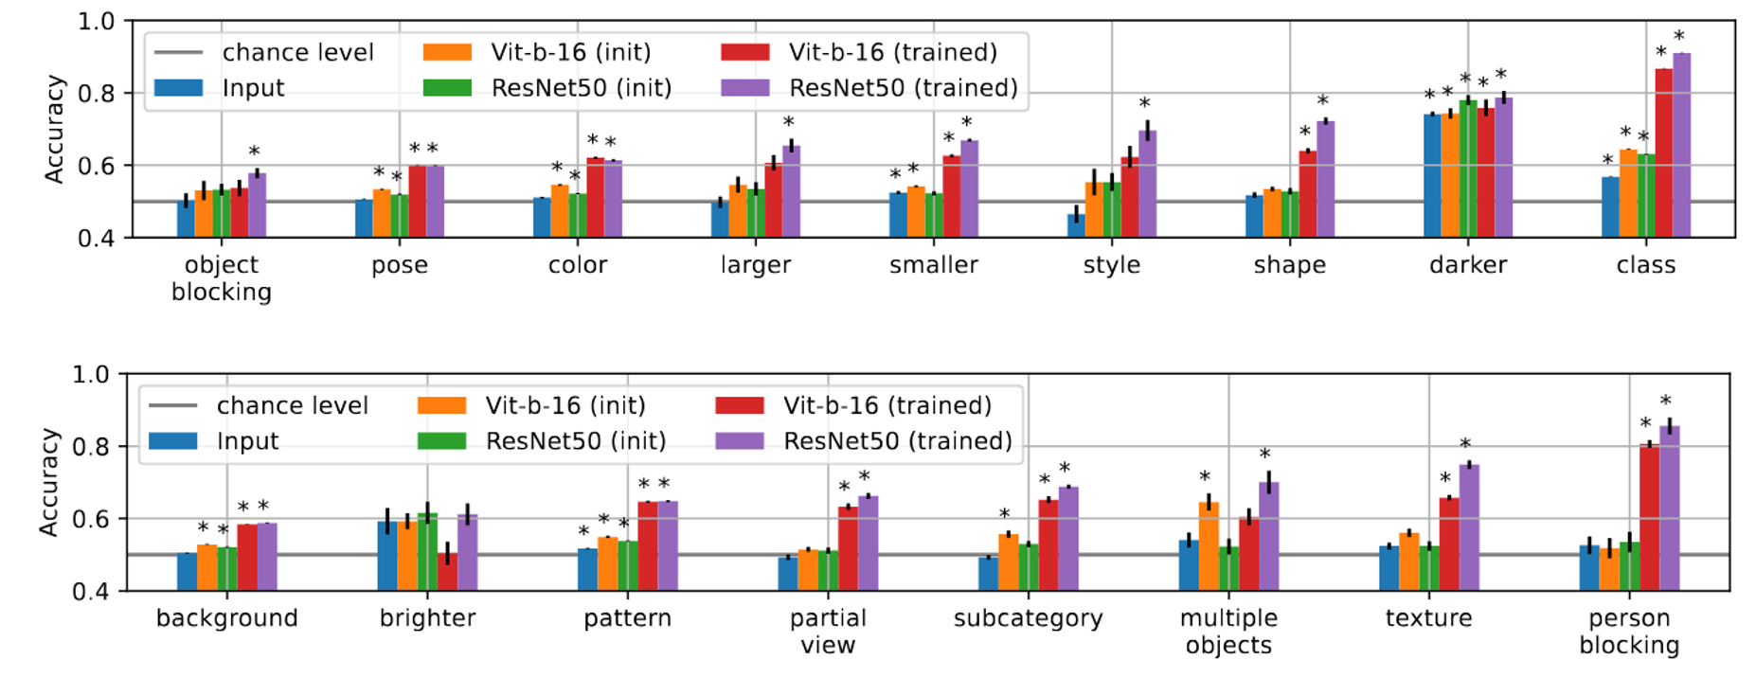
O r a l
Cross-Entropy Is All You Need To Invert the Data Generating Process Patrik Reizinger*, Alice Bizeul*, Attila Juhos*, Julia E. Vogt, Randall Balestriero, Wieland Brendel, David Klindt
Solving an arbitrary classification tasks is sufficient to linearly identify the ground-truth representations both in supervised and self-supervised learning.
What is identifiability?
Similar (Platonic) representations
Identifiability = Data + Model constraints
At the optimum of the cross entropy loss, we identify both the latent vectors and the cluster vectors up to a linear (affine) transformations
Self-Supervised Experiments
Supervised Experiments

Slide 2
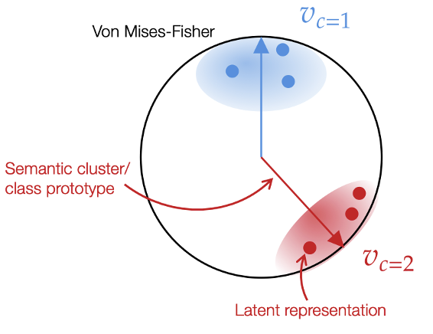





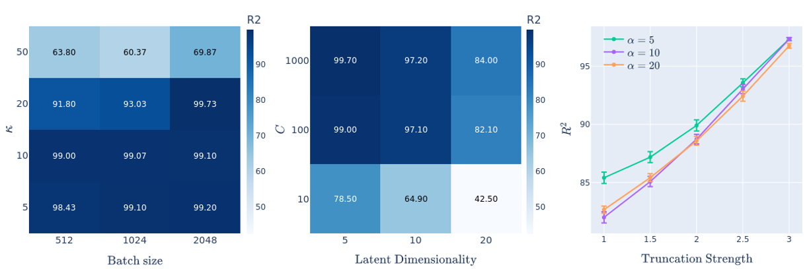
O r a l
Cross-Entropy Is All You Need To Invert the Data Generating Process Patrik Reizinger*, Alice Bizeul*, Attila Juhos*, Julia E. Vogt, Randall Balestriero, Wieland Brendel, David Klindt
Solving an arbitrary classification tasks is sufficient to linearly identify the ground-truth representations both in supervised and self-supervised learning.
What is identifiability?
What’s our data & model?
Similar (Platonic) representations
Identifiability = Data + Model constraints
At the optimum of the cross entropy loss, we identify both the latent vectors and the cluster vectors up to a linear (affine) transformations
Self-Supervised Experiments
Supervised Experiments
More concentrated clusters need larger batches
Higher-dimensional data need more clusters
Our theory is robust to assumption violations, e.g., vMF → truncated Laplace
Although trained solely with class labels, learned representations capture all ImageNet-X latent factors.
Our theory is robust to assumption violations, e.g., vMF → truncated Laplace
Intuition: the hypersphere needs to be covered well

