Slide 1

Tools to help you buy low & Survive the Bear
Kristin Vietti, Rajesh Paul, Prasanth Duvvur
This Photo by Unknown Author is licensed under CC BY

Slide 2
Motivation
Find criteria that most correlate to high stock returns.
Buy stocks so low that you minimize the chance of losing money.
Get experience using linear regression, stock data, financial charts and other technologies that we covered in class.
Validate hypothesis
Notes:
Consider talking about:
Performance of value strategies
Performance of value investors

Slide 3
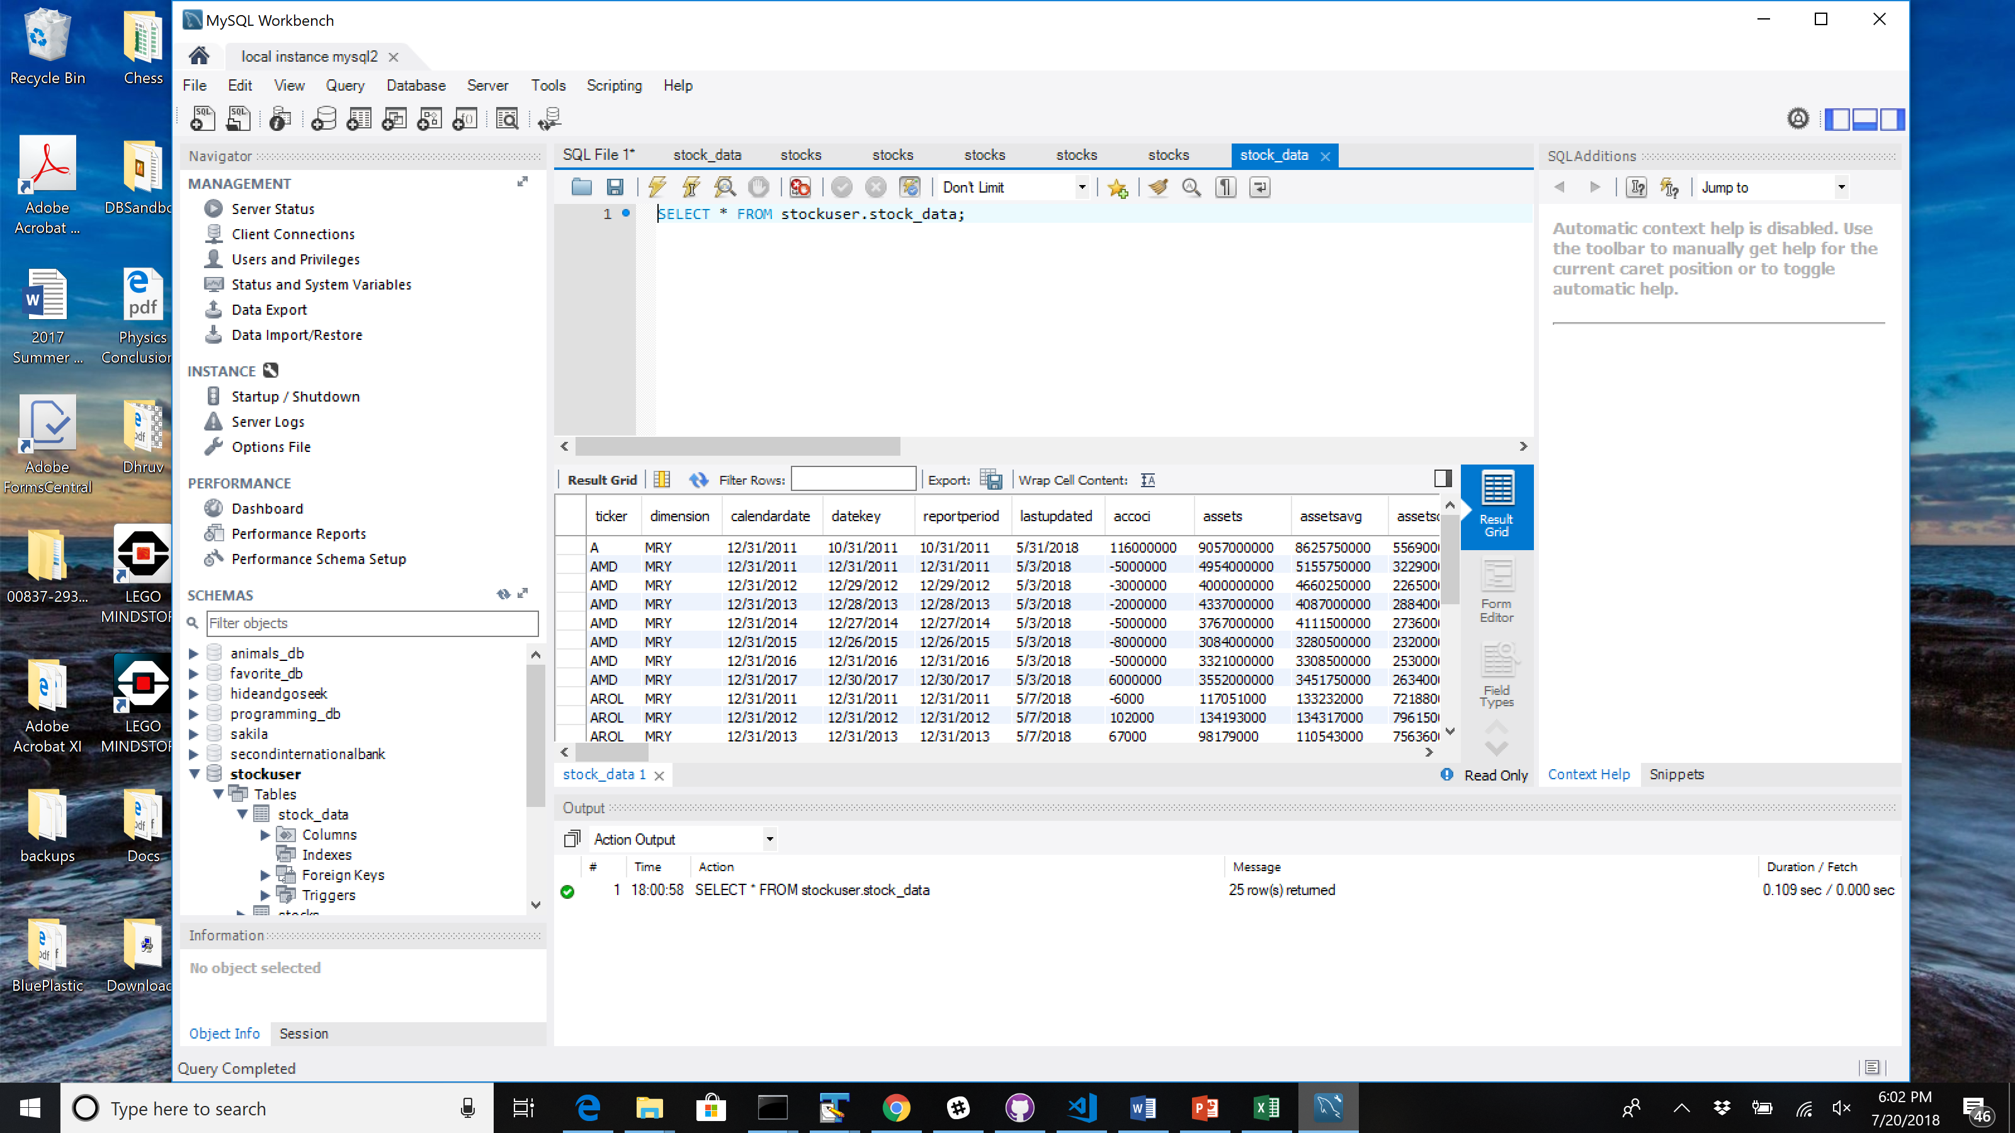
Data collection
Stock data from 2011-2017 – Quandl Core US Fundamentals Data
Load data into MySQL – 10 stocks
Calculate stock returns.
Perform linear regression using python functions from scipy
from scipy import stat
Notes:
Consider talking about:
Performance of value strategies
Performance of value investors

Slide 4
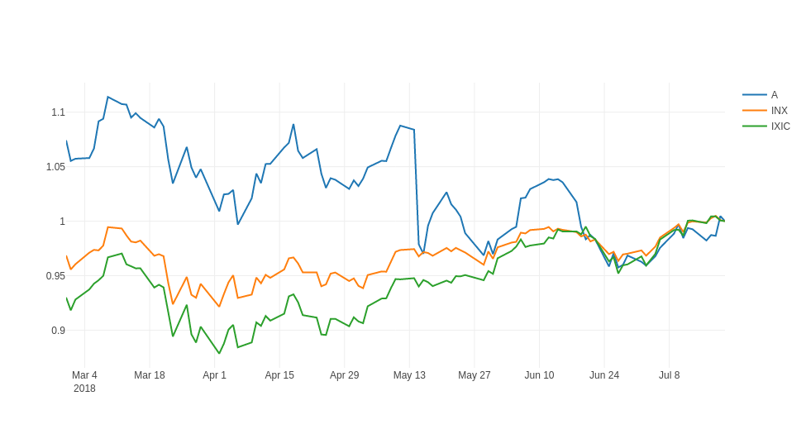
Dashboard – Stock trading plot
Provide user with current trading information and comparisons
Alphavantage API call
Timeseries daily API
100 days of history
Notes:
Consider talking about:
Performance of value strategies
Performance of value investors

Slide 5
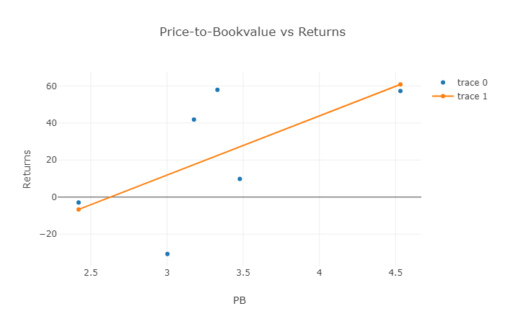
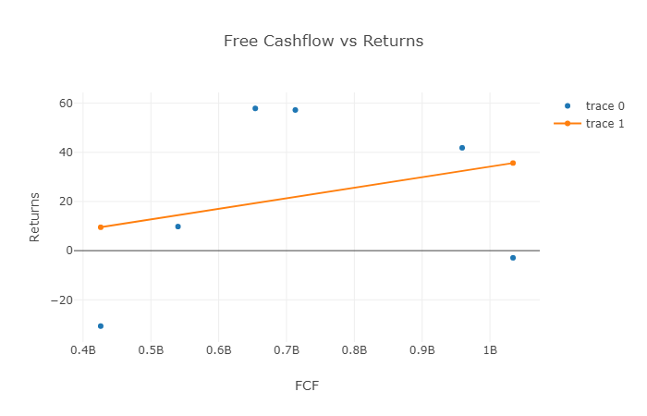
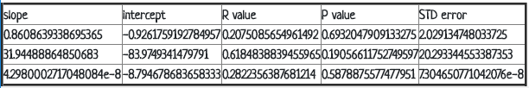
Dashboard – Analysis plots
Charts and data to do stock analysis
Charts to compare fundamentals to returns
Table summarizes statistical analysis performed
Notes:
Consider talking about:
Performance of value strategies
Performance of value investors

Slide 6
Findings/Conclusions
Some of the correlations seem to be the inverse of what stock theory would suggest. This may be due to the factors we considered.
Need more study and research into what goes into deciding if a stock is good value.
Excellent Javascript libraries and websites we can leverage for charting (stockchart.com, highchart.com).
Notes:
Consider talking about:
Performance of value strategies
Performance of value investors

Slide 7
Future
Analyze more stock performance criteria
Utilize machine learning algos to find value stocks.
More sophisticated predictive analysis and modeling
Make money
Notes:
Consider talking about:
Performance of value strategies
Performance of value investors

