Slide 1

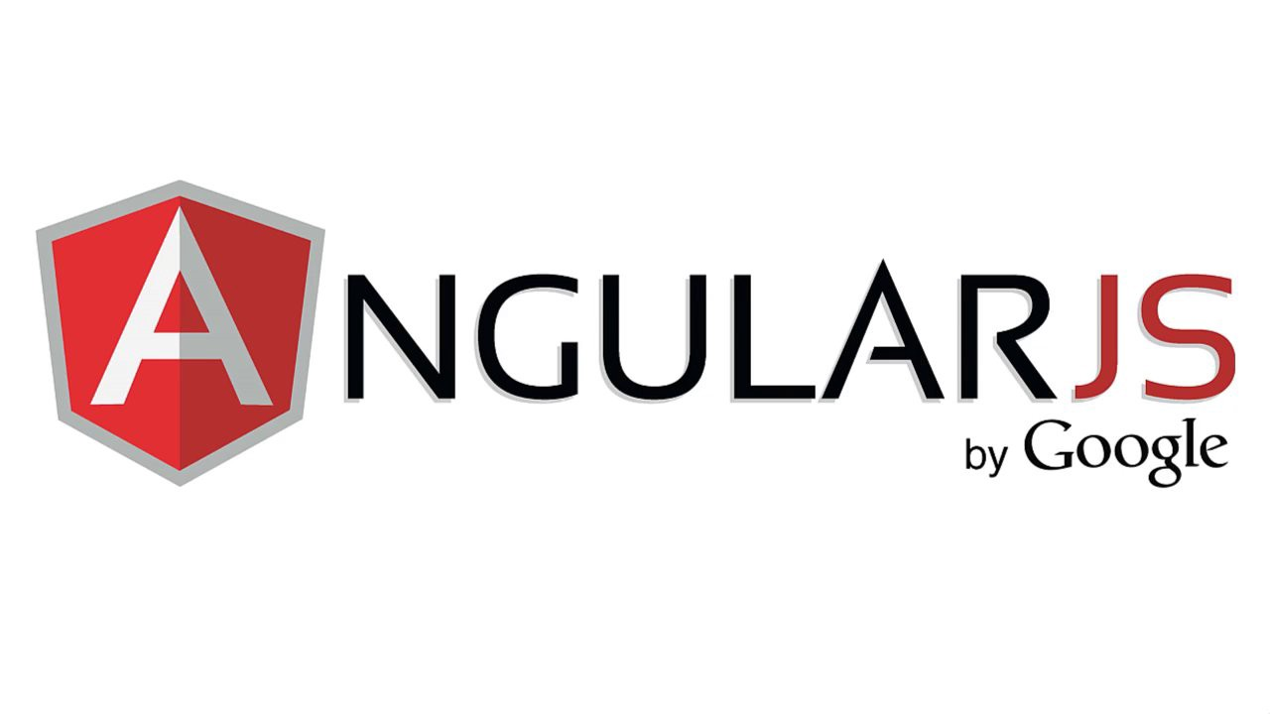
AngularJS
PAVAN SAI

Slide 2

What Is AngularJS?
It has been developed by one of the biggest technology giants Google. It is a JavaScript framework that helps you to create dynamic Web applications.
It supports to use HTML as the template language and enables the developer to create extended HTML tags that help to represent the application’s components more clearly. These tags make the code efficient by reducing the lines of code that a developer may need to write when using JavaScript.
It is open-source and licensed under the Apache License version 2.0.
It helps to develop a maintainable architecture that is easy to test at the client-end.

Slide 3
List Down The Popular AngularJS IDE Plugging/Extensions For Web Development?
Here is a list of IDE Plugging and Extensions which can enhance the way you code with AngularJS:
Sublime Text
WebStorm
Eclipse
Netbeans
Visual Studio 2012/2013 Express or higher
TextMate
Brackets
ATOM

Slide 4
What Browsers Do AngularJS Support?
AngularJS works fine with the latest versions of Safari, Chrome, Firefox, Opera 15+, and IE9+ (Internet Explorer). It also supports various mobile browsers like Android, Chrome Mobile, iOS Safari, and Opera Mobile.
( Note: Versions 1.3 and later of AngularJS dropped support for Internet Explorer 8.)

Slide 5
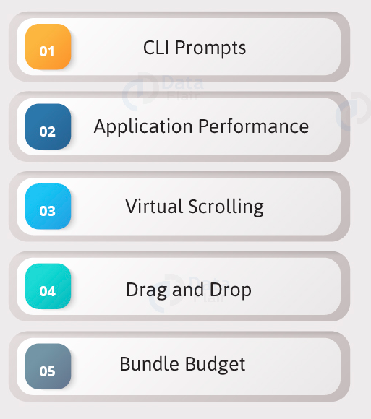
Features

Slide 6
Commands
Commands and Description
Component
ng g component new-component
Directive
ng g directive new-directive
Pipe
ng g pipe new-pipe
Service
ng g service new-service
Module
ng g module my-module
Test
ng test
Build
ng build --configuration=production // for production environment
ng build --configuration=staging // for stating environment

Slide 7
CLI Prompts
It helps users to make a decision. It asks users about “want to add routing? Y/N” and about the type of styles user want to use.

Slide 8
Application Performance
Earlier reflect-metadata is used in production but it is required at the time of development. Therefore, ployfill.ts is removed by default in angular 7.

Slide 9
Virtual Scrolling
Google accelerates the speed of Angular 7 for a huge scrollable list.
Start with a plain Angular table
We’re starting with a pretty simple example of a table using a *ngFor loop

Slide 10
How Is AngularJS Compilation Different From Other JavaScript Frameworks?
Javascript frameworks like backbone and jQuery process the template as a string and returns the result as a string. You have to dump this resulting string into the DOM where you wanted it with innerHTML().
AngularJS process the template in another way. It directly works on HTML DOM rather than strings and manipulates it as required. It uses two-way data binding between model and view to sync the data.

Slide 11
What Is Ng-View In AngularJS?
The ng-view tag creates a placeholder where an HTML or ng-template view can be placed based on the configuration.

Slide 12
What Is Ng-Template In AngularJS?
The ng-template directive is used to create an HTML view using script tag. It contains “id” attribute which is used by $routeProvider to map a view with a controller.
While defining ng-template, it is mandatory to specify the type of the <script> element as the text/ng-template. Also, assign a cache name to the template using the element’s id. Later on, this name gets used as directive’s templateUrl.
Following is the syntax of using an ng-template directive in angularJS application.

Slide 13
What Is $RouteProvider In AngularJS?
$routeProvider is the primary service which set the configuration of URLs, map them to the corresponding HTML page or ng-template, and attach a controller with the same.

Slide 14
What Is An Auto Bootstrap Process In AngularJS?
AngularJS initializes automatically upon the “DOMContentLoaded” event or when the browser downloads the angular.js script and at the same time document.readyState is set to ‘complete.’ At this point, AngularJS looks for the ng-app directive which is the root of Angular app compilation process.
If the ng-app directive is located, then AngularJS will do the following.
Load the module associated with the directive.
Create the application injector.
Compile the DOM starting from the ng-app root element.

Slide 15
What Is The Manual Bootstrap Process In AngularJS?
Sometimes we may need to manually initialize Angular app to have more control over the initialization process. We can do that by using angular.bootstrap() function
within angular.element(document).ready()function. AngularJS fires this function when the DOM is ready for manipulation.
The angular.bootstrap() function takes two parameters, the document, and module name injector.

Slide 16
What Is A Controller In AngularJS?
A Controller is a set of JavaScript functions which is bound to a specified scope, the ng-controller directive. Angular creates a new instance of the Controller object to inject the new scope as a dependency. The role of the Controller is to expose data to our view via $scope and add functions to it, which contains business logic to enhance view behaviour.
Controller Rules.
A Controller helps in setting up the initial state of the scope object and define its behaviour.
The Controller should not be used to manipulate the DOM as it contains only business logic. Instead, for managing the DOM, we should use data binding and directives.
Do not use Controllers to format input. Instead, using angular form controls is recommended for that.
Controllers should not be used to share code or states. Instead, use angular services for it.

Slide 17
How Do You Exchange Data Among Different Modules Of Your Angular JS Application?
There are a no. of ways in Angular to share data among modules. A few of them are as follows.
The most common method is to create an Angular service to hold the data and dispatch it to the modules.
Angular has a matured event system which provides $broadcast(), $emit() and $on() methods to raise events and pass data among the controllers.
We can also use $parent, $nextSibling, and $ controllerAs to directly access the controllers.
Variables defined at the root scope level ($rootScope) are available to the controller scope via prototypical inheritance. But they behave like globals and hard to maintain.

Slide 18
What Would You Do To Limit A Scope Variable To Have One-Time Binding?
By prefixing the “::” operator to the scope variable. It’ll make sure the candidate is aware of the available variable bindings in AngularJS.

Slide 19
What Is The Difference Between One-Way Binding And Two-Way Binding?
The main difference between one-way binding and two-way binding is as follows.
In one-way binding, the scope variable in the HTML gets initialized with the first value its model specifies.
In two-way binding, the scope variable will change its value whenever the model gets a different value.

Slide 20
Animation
Animations add a lot of interaction between the html elements. Animation was available with Angular 2, from Angular 4 onwards animation is no more a part of the @angular/core library, but is a separate package that needs to be imported in app.module.ts.

Slide 21

Materials
Materials offer a lot of built-in modules for your project. Features such as autocomplete, datepicker, slider, menus, grids, and toolbar are available for use with materials in Angular 7.
To use materials, we need to import the package. Angular 2 also has all the above features but they are available as part of the @angular/core module. From Angular 4, Materials module has been made available with a separate module @angular/materials. This helps the user to import only the required materials in their project.
Following is the command to add materials to your project −

Slide 22

Thank you

