Slide 1
YOUTUBE TRENDING :
CORONAVIRUS COMMENTS
By Julianna Cole and Rhea Pavithran

Slide 2


Question 1
What are the most commonly used words in the top comments on coronavirus-related videos featured on the YouTube Trending Page during the coronavirus outbreak?
Gain insights into how people reacted to the coronavirus outbreak by identifying most popular words.

Slide 3
Question 2
In what context is the word “people” used in the top comments on coronavirus-related videos featured on the YouTube Trending Page during the coronavirus outbreak?
Determine the context “people” was used to understand users’ feelings toward the outbreak.

Slide 4
Question 3
What is the most upvoted type of comment on coronavirus-related videos featured on the YouTube Trending Page during the coronavirus outbreak?
Determine which category of comments is most popular among users

Slide 5
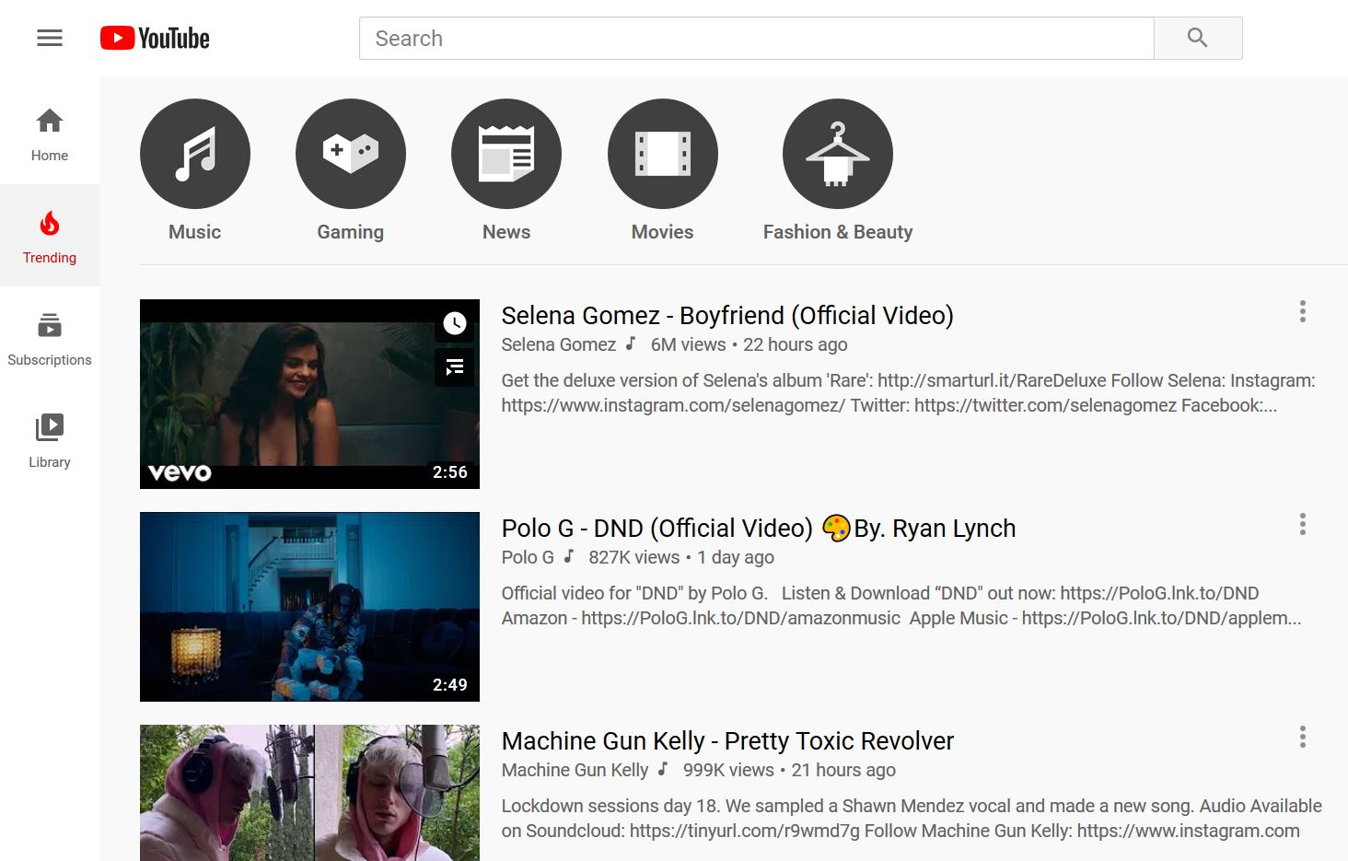
How did we gather our data?
Every day for 14 days between March 6 - March 22 at 8:00 PM, we recorded information about the top 15 videos on YouTube Trending
Title
Ranking on trending page
Category
Views

Slide 6
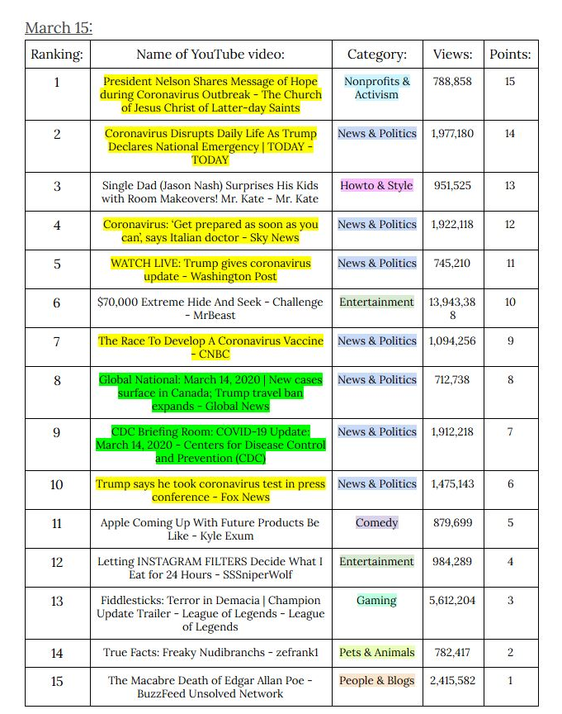
Video Data Collection
After collecting the video data, we identified the coronavirus-related videos
Yellow highlighted titles: contain the word “coronavirus”
Green highlighted titles: contain words related to coronavirus (“COVID-19”, “quarantine”, etc.)

Slide 7
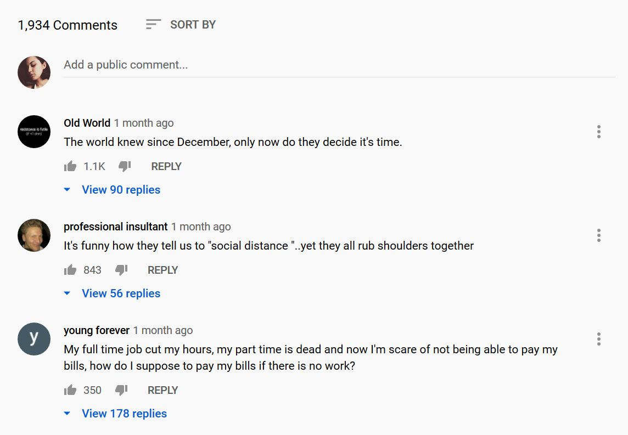
Comment Data Collection
YouTube comments are sorted by the number of “upvotes” they receive from users
Comments with the most upvotes are displayed at the top of the comment section
Descending order

Slide 8
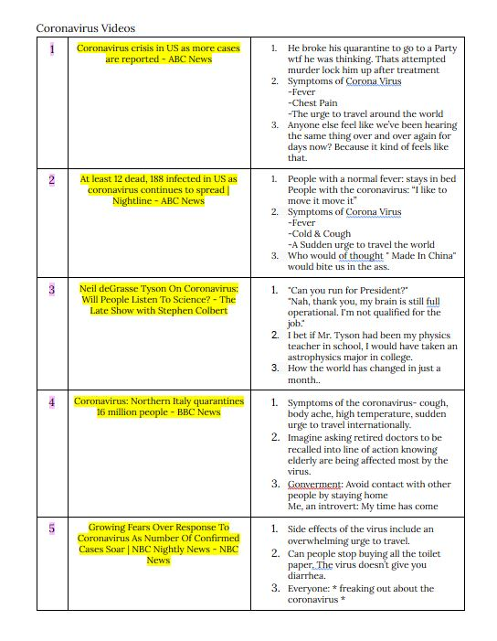
Comment Data Collection
We collected the top three comments from each coronavirus-related video
60 videos
180 total comments
Comments stored in a table with the title of the associated video

Slide 9
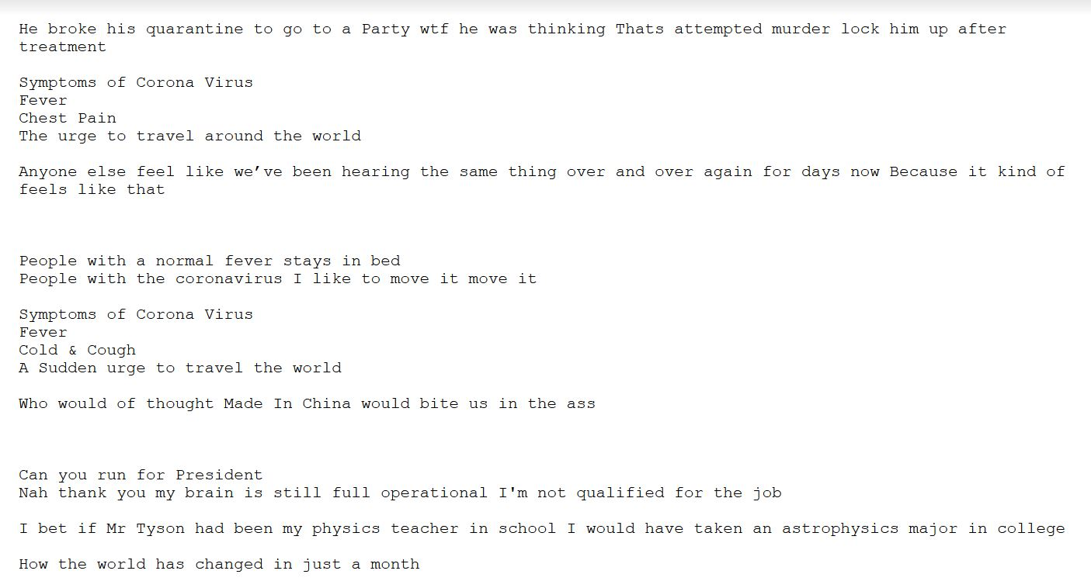
Creating a File of All Comments
We created a file containing the text from each of the 180 comments
Eliminated all punctuation to reduce redundancy of words
Text file used to generate word cloud

Slide 10
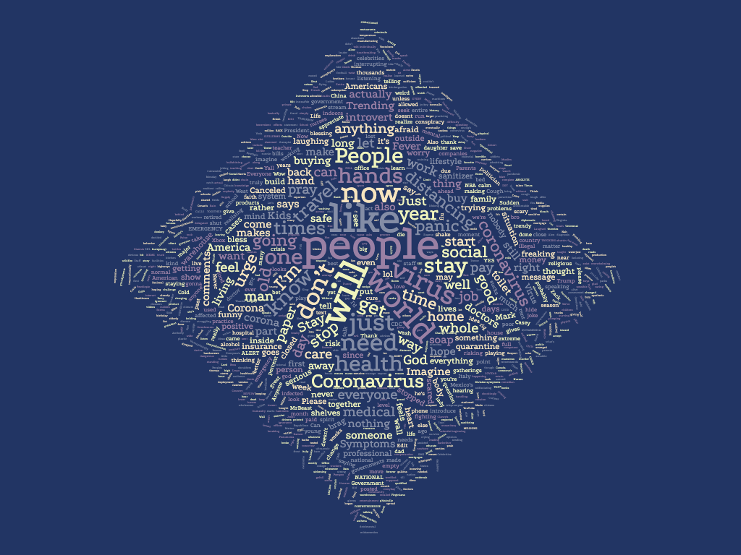
Generating a Word Cloud
Visualization of the most common words in collected comments
Words scaled based on instances of that word
Top word: “people”
Popular words:
“virus”
“coronavirus”
“stay”
“world”

Slide 11
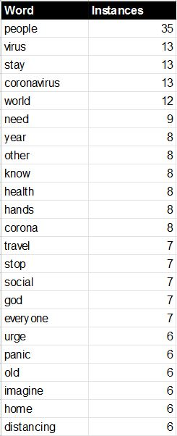
Counting Instances of Top Words
We also created a spreadsheet of the top words along with the number of times they appeared in the collected comments
“people” - 35
“virus” - 13
“stay” - 13
“coronavirus” - 13
“world” - 12

Slide 12
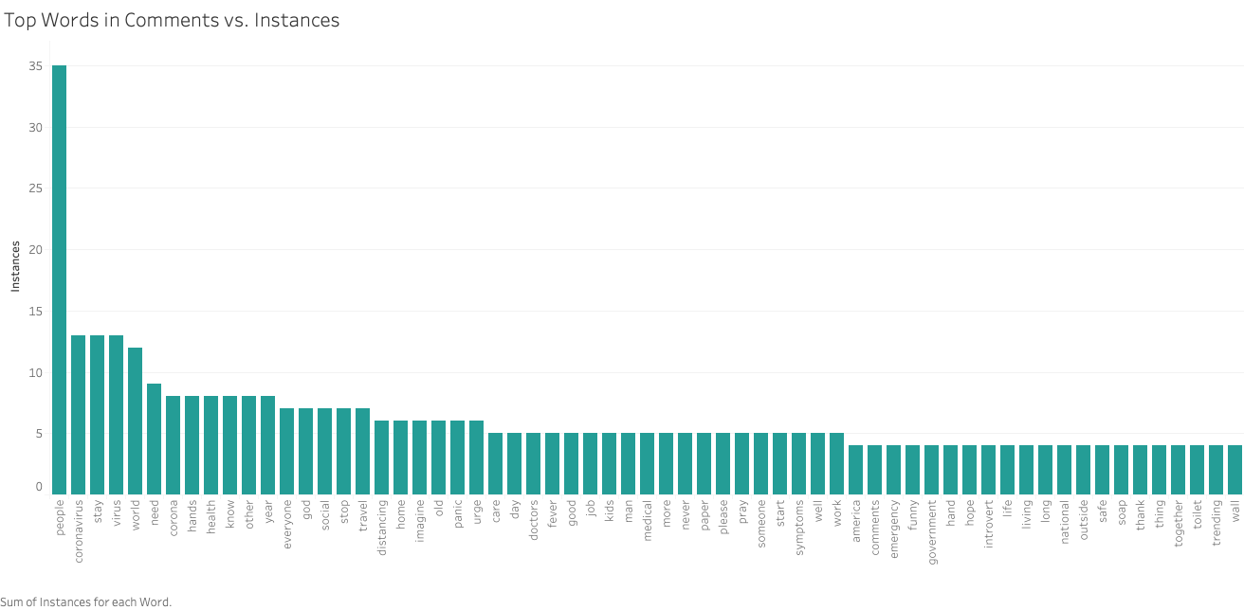
Bar Graph of Top Words & Instances
A visual representation of our top words & instances spreadsheet
“People” is used more than twice as frequently as any other word (excluding filler words)
In what context is the word “people” being used?
Notes:
Going into this research project, we had hypothesized that the word “coronavirus” would be the most popular word. However, “people” is the most popular word, even when adding up the instances of the words “coronavirus”, “corona”, and “virus”. We found this interesting, so we decided to look deeper into the context in which the word “people” was being used.

Slide 13
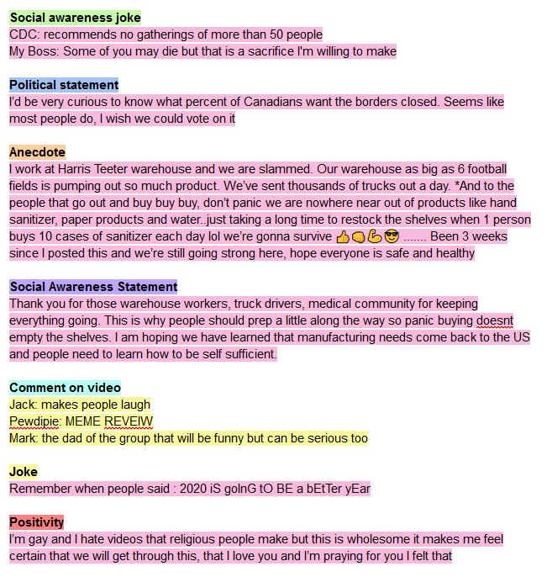
“People” Comment Categorization
We wanted to determine the context in which the word “people” was being used
35 instances of the “people”, 28 comments containing “people”
Pink highlighted comments: contain “people” and related to coronavirus
Yellow highlighted comments: contain “people” and unrelated to coronavirus
We read through all comments to find common themes
Common themes determined our 7 categories

Slide 14
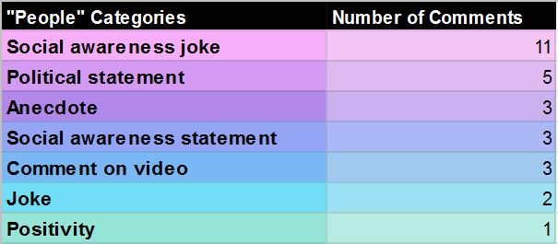
“People” Comment Categorization
25 of 28 comments are related to the coronavirus outbreak
Notes:
Social awareness jokes: social distancing, quarantine rules, supply shortages
Political statement: closing country borders, the economy, President Trump
Anecdote: essential workers sharing information about supply shortages, teenager from Italy sharing his experience during the coronavirus outbreak
Social awareness statement: washing hands, spreading the virus, and preparing for the pandemic
Comment on video: unrelated to coronavirus
Joke: the irony of staying away from “positive” people instead of “negative” people, everyone’s expectations for 2020 to be a better year than 2019
Positivity: we will get through the pandemic, praying

Slide 15
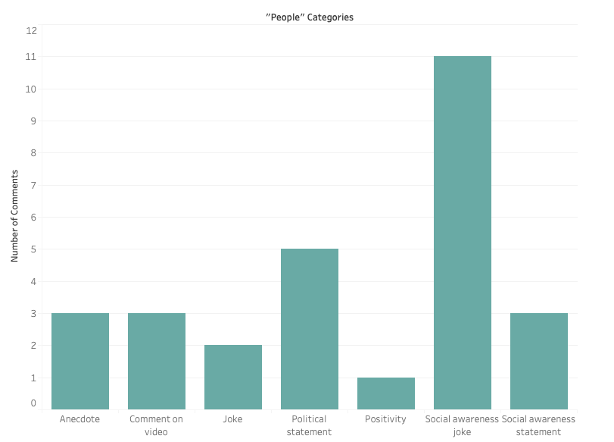
Graph of “People” Comment Categories
A visual representation of our “people” category spreadsheet
“Social awareness joke” category contains more than twice as many comments than any other category

Slide 16
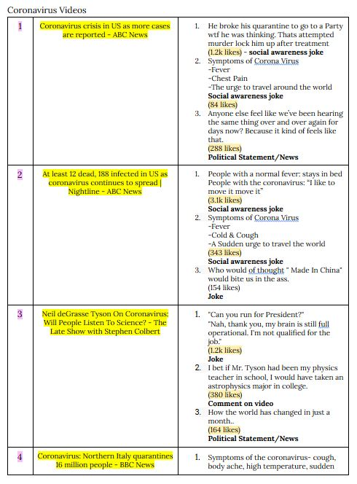
Collecting Upvote Data & Comment Categorization
Collected upvote data from each comments
Read through comments and categorized them using same process as categorizing “people” comments
New category - Religious

Slide 17
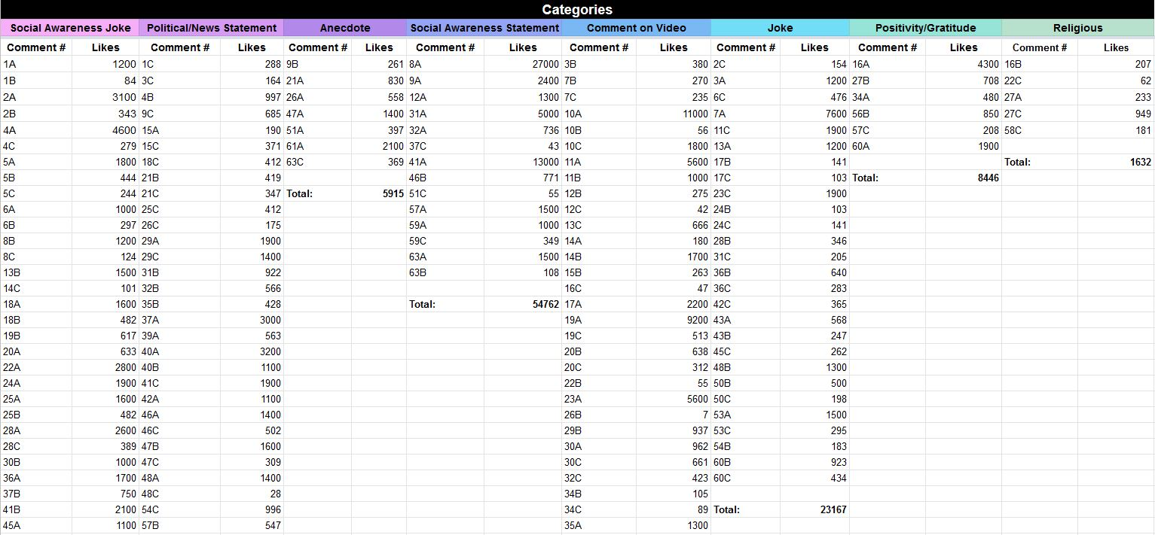
Collecting Upvote Data & Comment Categorization
Calculated total upvotes (likes) for each of the 8 comment categories

Slide 18
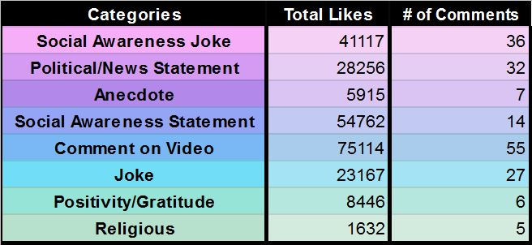
Category Totals
Most upvoted category - “Comment on Video”
Largest number of comments - “Comment on Video”

Slide 19
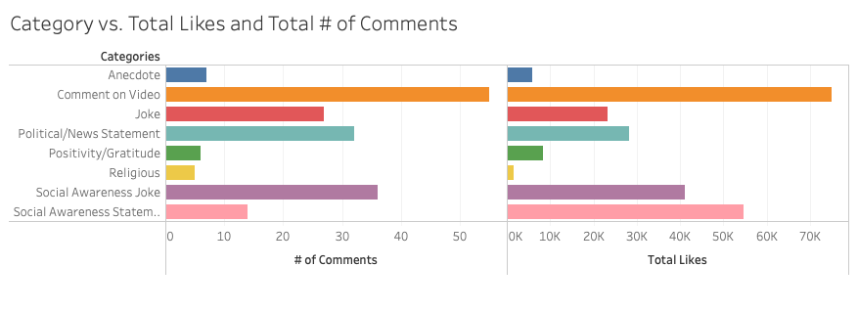
Graph of Category Totals
Visual representation of Category spreadsheet
“Comment on Video” - most comments AND most upvotes

Slide 20
Results: Question 1
What are the most commonly used words in the top comments on coronavirus-related videos featured on the YouTube Trending Page during the coronavirus outbreak?
We hypothesized that the top word would be directly coronavirus related, like “COVID-19” and “quarantine”
We found that the top word was “people”, which appeared 35 times in our comments
This was followed by “virus” (13 times), and “stay” (13 times)

Slide 21
Results: Question 2
In what context is the word ‘people’ used in the top comments on coronavirus-related videos featured on the YouTube Trending Page during the coronavirus outbreak?
28 separate comments containing the word “people”
After categorizing them, we found that the most popular categories were:
Social Awareness Joke (11 comments)
Political Statement (5 comments)
Anecdote (3 comments)

Slide 22
Results: Question 3
What is the most upvoted type of comment on coronavirus-related videos featured on the YouTube Trending Page during the coronavirus outbreak?
Most comments and most total likes: Comment on Video (55 videos, 75,114 total likes)
Shows us that many people are paying attention to what is being said in the video, regardless of relation to the coronavirus
Second most popular in terms of likes: Social Awareness Statement
Second most popular in terms of number of comments: Social Awareness Joke

Slide 23
Resources
“YouTube Trending” (2020). Retrieved from
https://www.youtube.com/feed/trending

