Slide 1

Cerios Meetup
Maart 2019: Elasticsearch

Slide 2

Agenda
Elasticsearch Meetup
Elasticsearch, when to use (architecture)
Elasticsearch, how to use (demo)

Slide 3

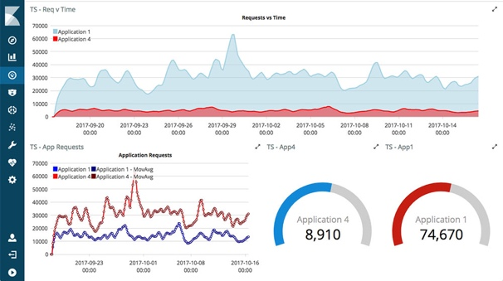


Architecture
Elasticsearch Meetup
Search and Analytics
Operations – Elastic Stack
Site Search
Query engine in CQRS architecture

Slide 4
CQRS?
Elasticsearch Meetup
Martin Fowler says:
“CQRS stands for Command Query Responsibility Segregation. It's a pattern that I first heard described by Greg Young. At its heart is the notion that you can use a different model to update information than the model you use to read information. For some situations, this separation can be valuable, but beware that for most systems CQRS adds risky complexity.”
https://martinfowler.com/bliki/CQRS.html

Slide 5
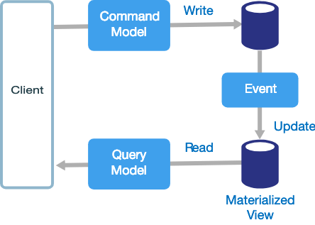
Architecture
Elasticsearch Meetup
RDBMS over here
Query engine in CQRS architecture
Maybe(!) Kafka over here
Elasticsearch over here

Slide 6

Example system
Elasticsearch Meetup
Movie plots
https://www.kaggle.com/jrobischon/wikipedia-movie-plots
35.000 detailed plot descriptions
Columns
Release Year - Year in which the movie was released
Title - Movie title
Origin/Ethnicity - Origin of movie (i.e. American, Bollywood, Tamil, etc.)
Director - Director(s)
Cast - Main actors/actresses
Genre - Movie genre(s)
Wiki Page - URL of Wikipedia page
Plot – plot scraped from the wiki page
Simple normalized data model in RDBMS
Query model in Elasticsearch

Slide 7
Example system
Elasticsearch Meetup
H2
Query engine in CQRS architecture
Not implemented
Elasticsearch

Slide 8
Example system tools
Elasticsearch Meetup
Must have
Local Elasticsearch and Kibana
Should have, you need some tooling like an IDE
Python instead of Java for the fun of it
PyCharm community edition
pandas, csv, jaydebeapi, elasticsearch, … (packages)
Optional
(H2) database
(DBeaver as) database client

Slide 9
Example system, the making of..
Elasticsearch Meetup
Download data (done)
Check the data
Install PyCharm (done)
Start PyCharm and ETL data to H2 database
Download and install DBeaver (https://dbeaver.io/download/) (done)
Start DBeaver and check H2 database
Download and install and run Elasticsearch (done)
Download and install and run Kibana (done)
First contact with Kibana and Elasticsearch…..
Notes:
check data:
cd ~/git/es-meetup/data
unzip wikipedia-movie-plots.zip
head unzip wikipedia-movie-plots.csv
create H2 database

Slide 10
Example system, the making continued..
Elasticsearch Meetup
Import csv data in Elasticsearch with model mapping
Analyse what we have by default
while True:
Improve mappings and settings and reindex
types, analyzers, (ngram) tokenizers, filters
Search and aggregate
No downtime during reindex:
aliases
Notes:
example movie Office Space, https://www.youtube.com/watch?v=cUOuUX_F_5I
jennifer aniston

Slide 11
Example system, the making continued..
Elasticsearch Meetup
High Availability
scale up and down
shards, replicas
nodes, sniffing, (software) load balancing
rack awareness
Time series
Multi index syntax
Date math
Templates
Calculate period per index
Notes:
mkdir elasticsearch-7.0.0b
tar xvf elasticsearch-7.0.0-darwin-x86_64.tar.gz -C elasticsearch-7.0.0b/ --strip-components=1
cd elasticsearch-7.0.0b
bin/elasticsearch
set replica to 1
stop 1 node, service still available (depending on client connecting to the available node!)

