Slide 1

Cerios Meetup
Maart 2019: Elasticsearch

Slide 2

Agenda
Elasticsearch Meetup
Elasticsearch, when to use (architecture)
Elasticsearch, how to use (demo)

Slide 3

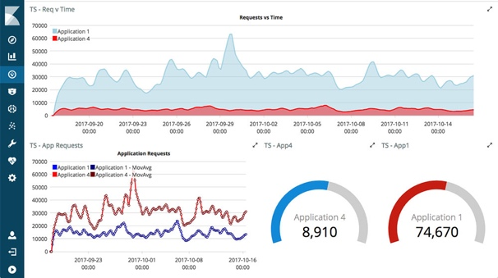


Architecture
Elasticsearch Meetup
Search and Analytics
Operations – Elastic Stack
Site Search
Query engine in CQRS architecture

Slide 4
CQRS?
Elasticsearch Meetup
Martin Fowler says:
“CQRS stands for Command Query Responsibility Segregation. It's a pattern that I first heard described by Greg Young. At its heart is the notion that you can use a different model to update information than the model you use to read information. For some situations, this separation can be valuable, but beware that for most systems CQRS adds risky complexity.”
https://martinfowler.com/bliki/CQRS.html

Slide 5
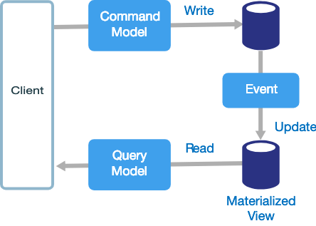
Architecture
Elasticsearch Meetup
RDBMS over here
Query engine in CQRS architecture
Maybe(!) Kafka over here
Elasticsearch over here

Slide 6

Example system
Elasticsearch Meetup
Movie plots
https://www.kaggle.com/jrobischon/wikipedia-movie-plots
35.000 detailed plot descriptions
Columns
Release Year - Year in which the movie was released
Title - Movie title
Origin/Ethnicity - Origin of movie (i.e. American, Bollywood, Tamil, etc.)
Director - Director(s)
Cast - Main actors/actresses
Genre - Movie genre(s)
Wiki Page - URL of Wikipedia page
Simple normalized data model in RDBMS
Query model in Elasticsearch

Slide 7
Example system
Elasticsearch Meetup
H2
Query engine in CQRS architecture
manual batch for now
Elasticsearch

Slide 8
Example system tools
Elasticsearch Meetup
Local Elasticsearch
H2 database
DBeaver as database client
Intellij community edition
PyCharm community edition

Slide 9
Example system, the making of..
Elasticsearch Meetup
Download data (done)
Check the data
Download and install DBeaver (https://dbeaver.io/download/) (done)
Start DBeaver and create H2 database
Install PyCharm (done)
Start PyCharm and ETL data to H2 database
Notes:
check data:
cd ~/git/es-meetup/data
unzip wikipedia-movie-plots.zip
head unzip wikipedia-movie-plots.csv
create H2 database

