Slide 1

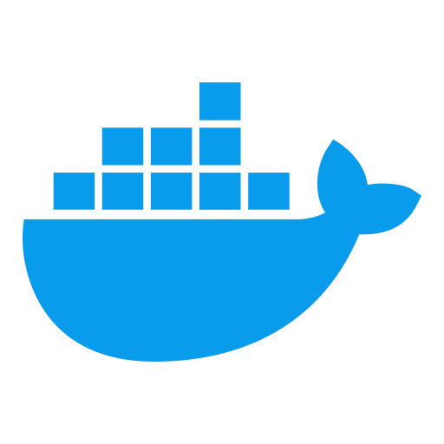


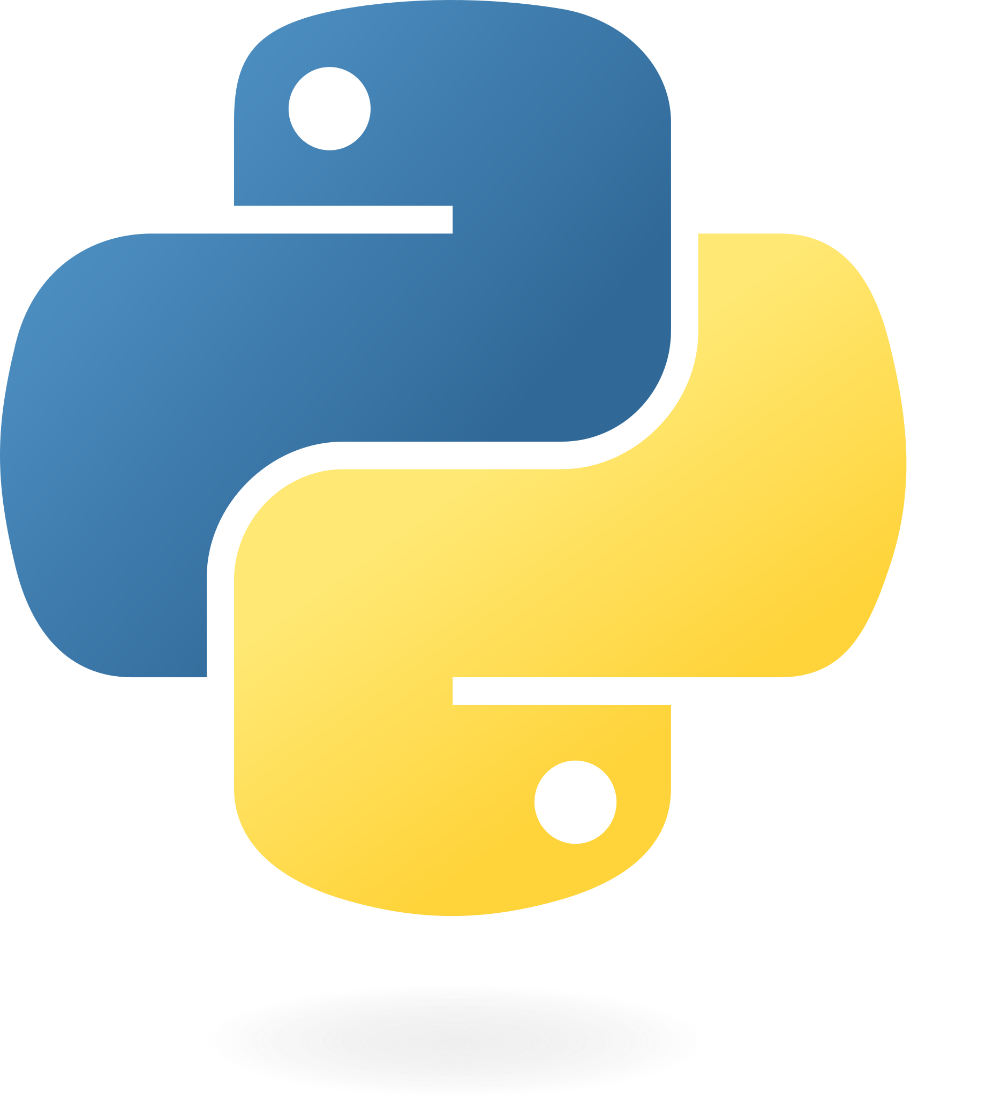

deh_nginx
deh_ui
Network reverse proxy management
Flask web-app for user interaction
Application User
Application Data Scientist
document
corpus
deh_rag_api
deh_measure
RAG doc storage & deH handling logic.
Provide hallucation assessment.
docker-compose
Docker container management and integration
ollama
ollama-webui
Ollama LLM serving environment
Web UI for Ollama configuration
Application DevOps

