Slide 1
AutOS
Analysis Presentation
Fábio Magalhães – A75030
Rui Carvalho – A76279

Slide 2
Agenda
Problem Statement
Specifications
System Overview
Use Cases
State Charts
System Stack
Fluxograms
Gantt Chart

Slide 3
Problem Statement
All recent automobiles have an on-board computer, that assist the driving and the maintenance of the vehicle. It has become an accessory more and more indispensable, however it is still very expensive for the masses. Yet possible to install on older vehicles, it brings mechanical complications, and great monetary cost.
The Project’s goal is to develop an efficient, plug-n-play, inexpensive, functionality full on-board computer for the most affordable vehicles. I will be perfect companion to every road trip.
The device should get data from the car onboard diagnostic (OBD), as well as get the road slope from the gyroscope and advise the driver by showing information to the user. The information shown must be customizable by the user through button input.

Slide 4
Specifications
Hardware Specification
Raspberry Pi 3
BCM2837 Chip 64 bit ARMv8 Cortex A53 Quad Core
1GB RAM
Wireless LAN
Bluetooth 4.1
4 USB Ports
40 GPIO Pins
HDMI Port
Ethernet Port
Micro SD Card Slot
TFT with Touchscreen
ILI9488 Display Driver
320x480 Resolution
Resistive Touchscreen
OBD module with Bluetooth
ELM327
OBDII interface
Accelerometer and Gyroscope
MPU-6050
Six Axis
I2C Communication
Tactile Buttons

Slide 5
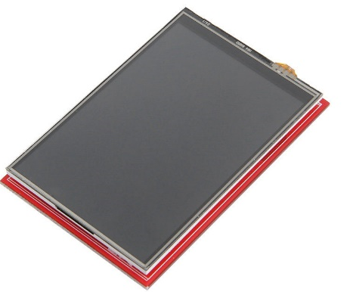
Display
ILI9488 Display Driver, SPI Compatible
Interface
Specifications
Resolution | 320x480
Frame Memory | 345 kbytes
Input Image | 24 bits
IO VCC | 1.65 – 3.3 V
Temperature | -40 ~ +85 °C
 | Pin Name | Pin Function
SCK | PA5 | SPI1_SCK
MISO | PA6 | SPI1_MISO
MOSI | PA7 | SPI1_MOSI
Interface:

Slide 6
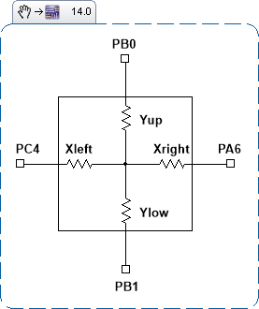
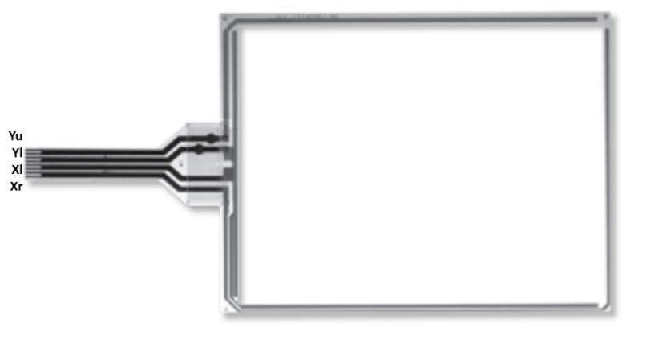
Resistive Touchscreen
Touch | Expected Output (X,Y) | Real output (X,Y)
Right Top Corner
Right Bottom Corner
Left Top Corner
Left Bottom Corner
No Touch | 0,0
 | Pin Name | Pin Function
Yup | PB0 | ADC12_IN8, GPIO IN/OUT
Ylow | PB1 | ADC12_IN9, GPIO IN/OUT
Xleft | PE7
Xright | PE8

Slide 7
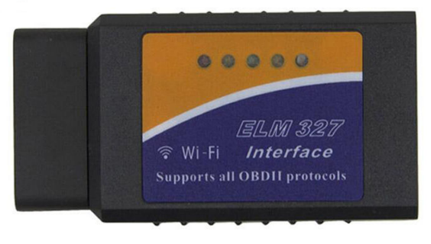
Bluetooth ELM327 OBD2 Scan Tool
Read diagnostic trouble codes, both generic and manufacturer-specific, and display their meaning. Class 2 Bluetooth transmission with Adaptive Power Control.
Suported Protocols | J1850 PWM (Ford), J1850 VPW (GM) ISO9141-2 (Asia, Europe, Chrysler) ISO14230-4 (Keyword Protocol) ISO15765-4 (CAN)
Output Protocol: | RS232 to Bluetooth
Bluetooth Range | 5 ~ 15 m
Baud Rate | 9600 / 38400
Operating Voltage | 12 / 24 V
Idle Current | 45 mA
Operating Temperature | -20º ~ 55º C
Operating Humidity | 10 ~ 85%
Send Command | Expected Output | Real output | Comment
AT Z | “ELM327 v1.x” |  | Reset Module
AT RV | “12.5V” |  | System Voltage
AT SP0 | “OK” |  | Find Protocol

Slide 8
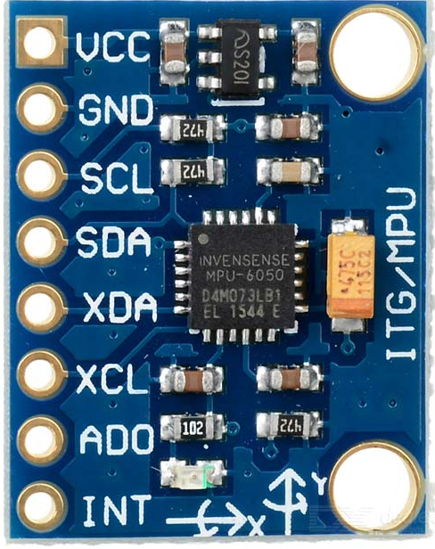
MPU-6050
Contains a MEMS accelerometer and a MEMS gyro in a single chip. It is very accurate, as it contains 16-bits analog to digital conversion hardware for each channel. Therefore it captures the x, y, and z channel at the same time. The sensor uses the I2C-bus to interface with a microcontroller.
VDD | 2.375 ~ 3.46V
VLOGIC | 1.71V ~ VDD
Serial Interface | I2C
Gyroscope | X,Y, and Z axis
Range | ±250, ±500, ±1000, ±2000 °/sec
Operating Current | 3.6 mA
Standby Current | 5µA
I2C Operating Frequency | 100 ~ 400 kHz
 | Pin Name | Pin Function
SCL | GPIO02 | SCL
SDA | GPIO03 | SDA
Send Command | Expected Output | Real output | Comment
0x75 | 0x34 |  | Device Adress

Slide 9
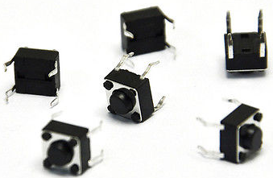
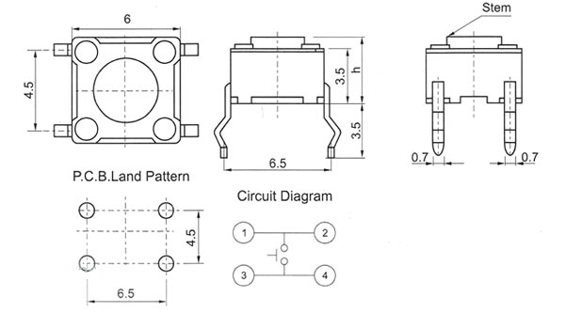
Tactile Buttons
Size (L*W*H) | 6*6*5 mm
Rated Voltage | 12 V
Rated Current | 50 mA
Contact Resistance | ≤ 0.03 Ω
Insulation Resistance | ≥ 100 MΩ
 | Pin Name | Pin Function
UP_BT | GPIO16 | Input
DOWN_BT | GPIO20 | Input
OK_BT | GPIO21 | Input

Slide 10
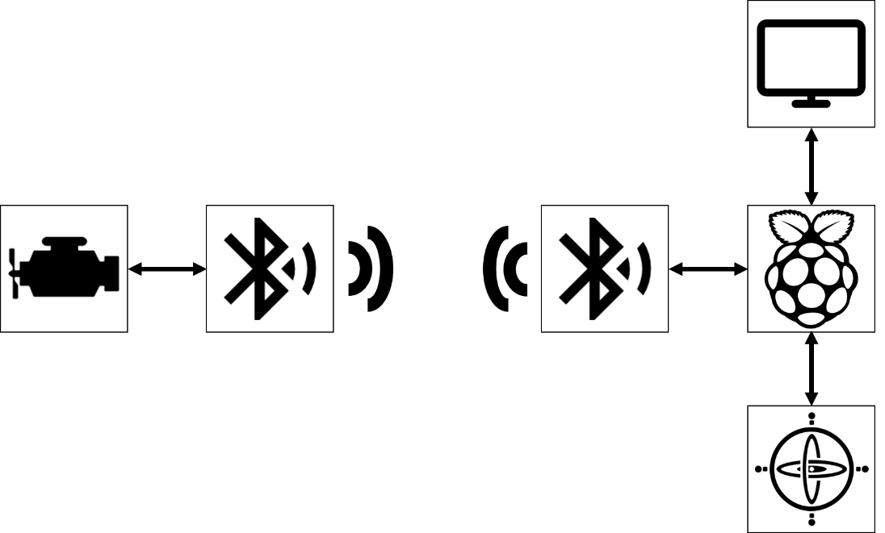
System Overview

Slide 11
EVENTS
Event | System Response | Source
On/Off | Turn System On/Off | User
Read OBD | Reads OBD data | Local Sys
Read Gyro | Reads gyroscope data | Local Sys
Display | Changes display | Local Sys
Button Click | Reads buttons states | User

Slide 12
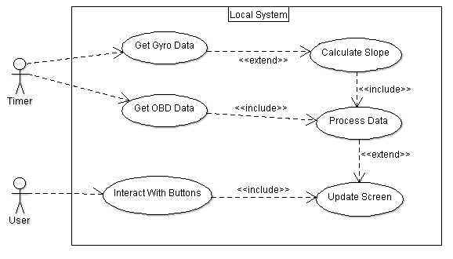
Use Cases

Slide 13
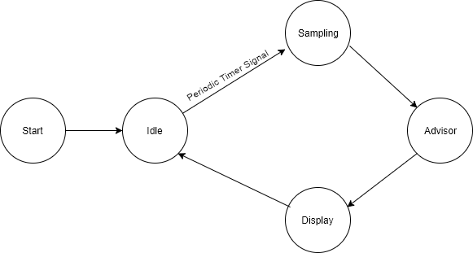
State Chart
Local and Remote System

Slide 14
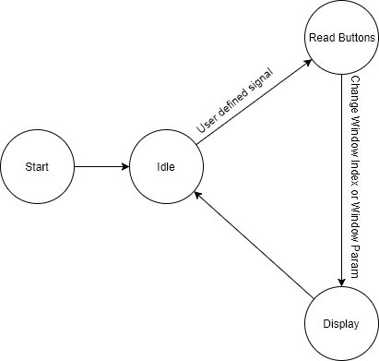
State Chart
User Interface

Slide 15
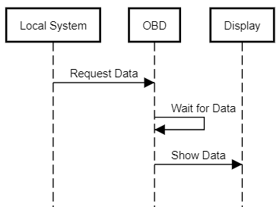
Sequence Diagram

Slide 16
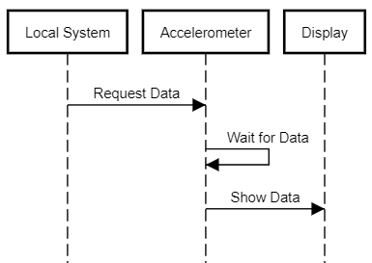

Slide 17
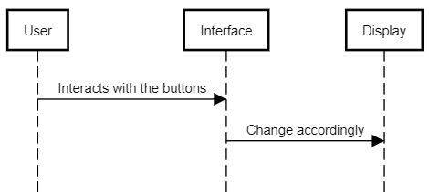

Slide 18
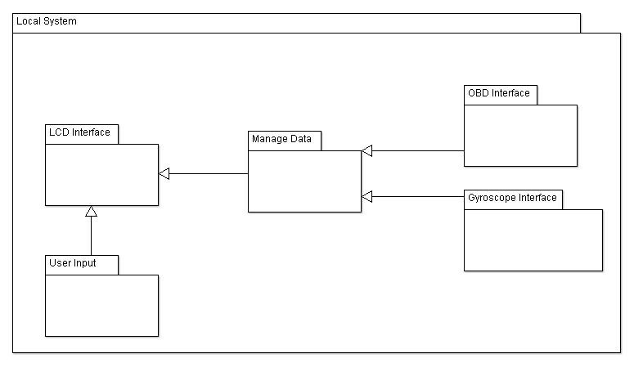
Software System Overview

Slide 19
Software System Overview

Slide 20
Data acquisition Subsystem
This subsystem is responsible for acquiring the sensors data. The subsystem is composed by a periodic timer and its
handler, configured to a sampling frequency, a task for verifiyng the OBD values , and another to verify the slope value.
The sensors handlers use the function setSysParam, to refresh the current system's data.

Slide 21
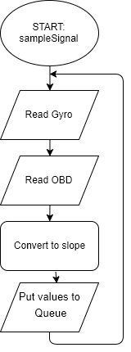
sampleSignal
Reads the values from the sensors and send them to their handlers.

Slide 22
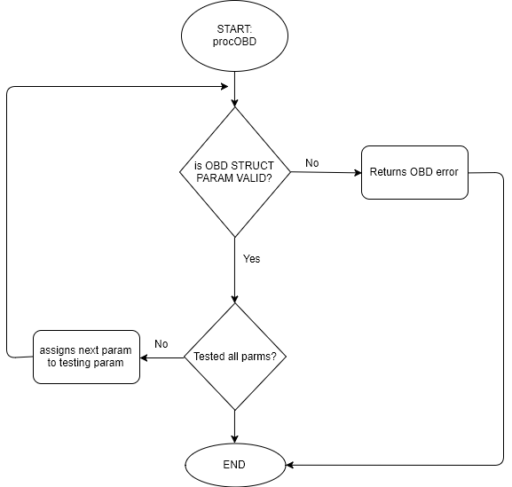
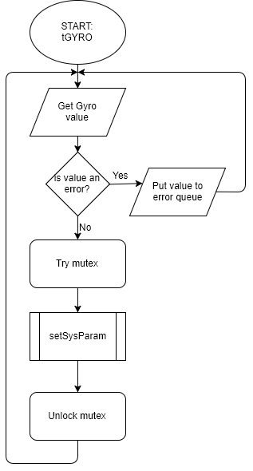
tOBD
This task verifies the OBD values and ,in case of invalid values, send an error queue to the error handler.
If no error occured set the values as system params.

Slide 23
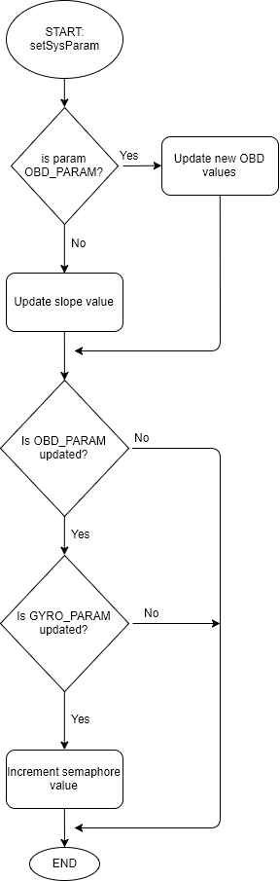
tGYRO
This task verifies the slope value and, in case of invalid value, send an error queue to the error handler.
If no error occured set the value as system param.

Slide 24
setSysParam

Slide 25
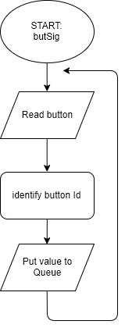
User interface subsystem
This subsystem is responsible for identifying the user input, i.e. the button id, and display information for the user. The system is composed by a periodic
Timer an its handler, and task that identifies the button pressed and actuates on the system, by changing the focused window
or the param displayed.
butSignal:
Reads the user input, buttons, and send it to its respective handler.

Slide 26
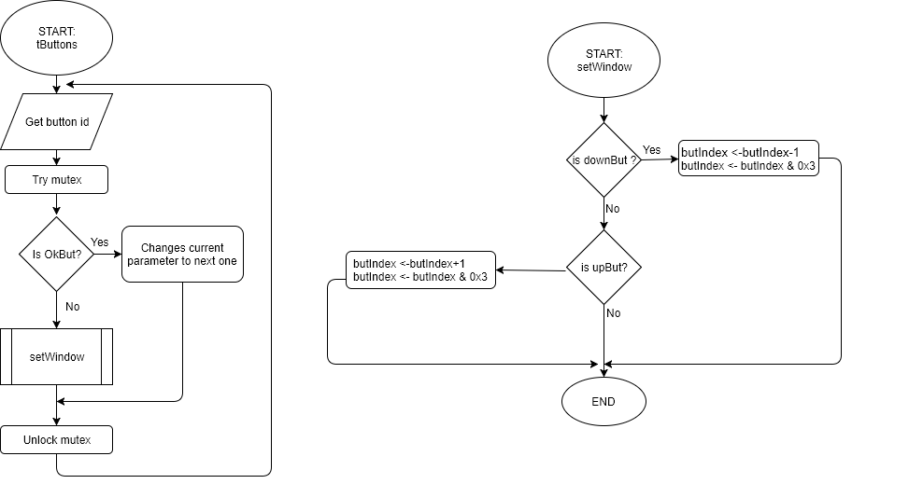
tButtons
Identifies the button pressed, and updates either the param either the window pointer, depending on the user input.

Slide 27
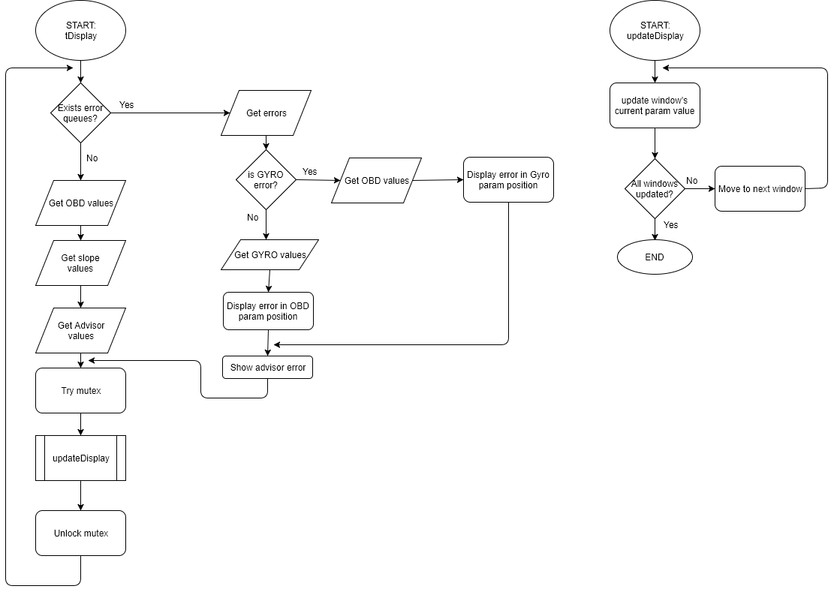
tDisplay

Slide 28
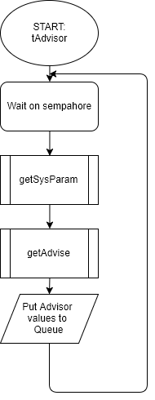
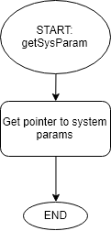
Advising subsystem
This system receives the sensor information, and based on it, give the user a warn relatively to speed, rpm, car's
temperature, battery or/and slope. The system is composed by a task that receives the gyroscope slope and the OBD values, and
verify if any value is out of the recomended range. In case a value is off that range, it display in the bottom of the display
a warn.

Slide 29
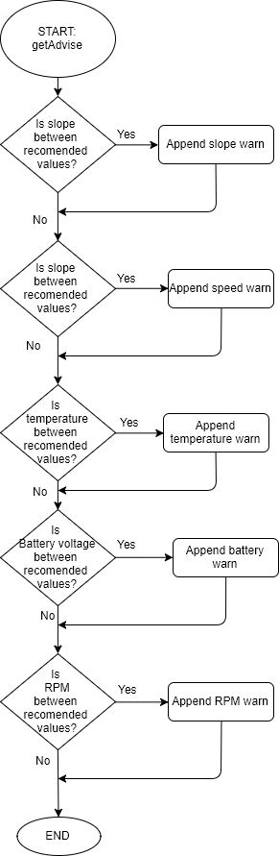
getAdvise

Slide 30
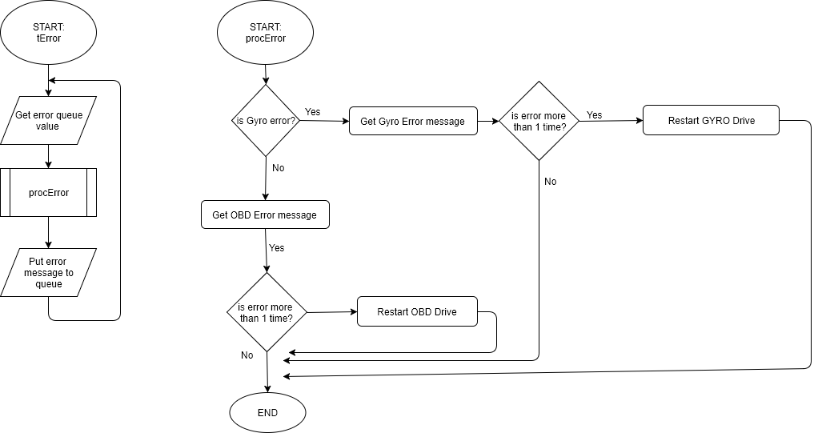
Error handling subsystem
This subsystem is responsible to report malfunction in the data acquisition subsystem through the display. This system is composed by a task that
identify the error and send it to Display, and restart the associated drive.
tError:
Reads the queue received and identify it relatively to Gyro error and OBD error, then send it to the display
handler and proceed to restart the drive.

Slide 31
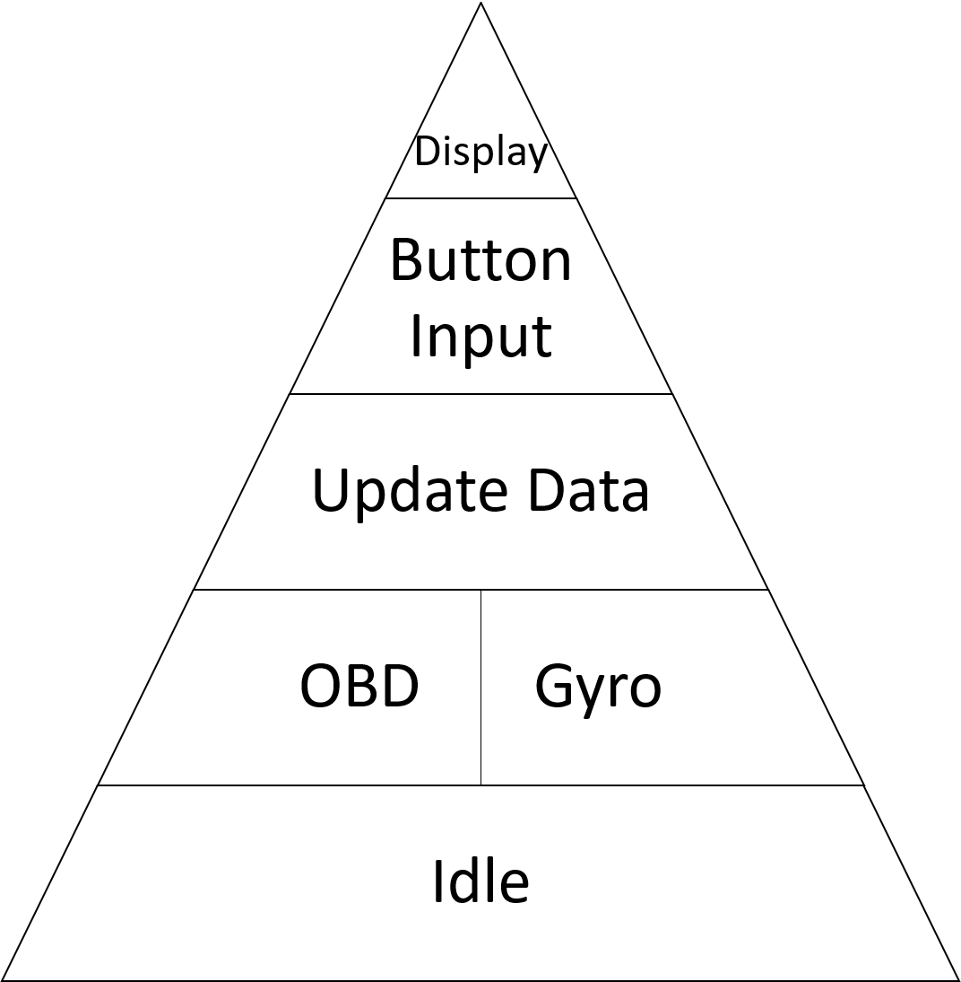
Task Priority

Slide 32
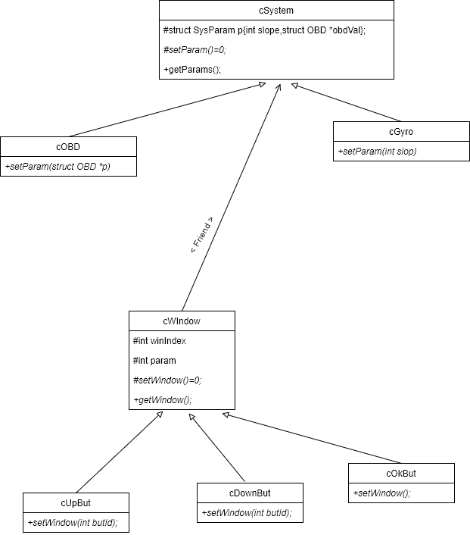
Class Diagram

Slide 33
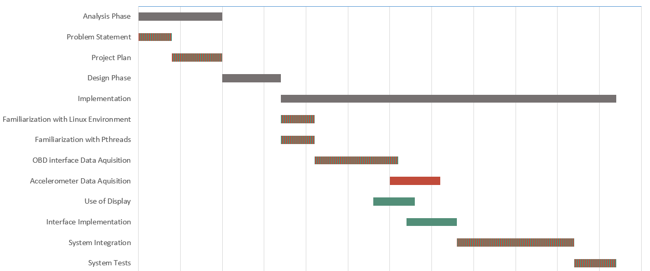
Gantt Chart
 | Fábio Magalhães
 | Rui Carvalho

