Slide 1
AutOS
Analysis Presentation
Fábio Magalhães – A75030
Rui Carvalho – A76279

Slide 2
Agenda
Problem Statement
Constrains
Technical Constrains
Functional Requirements
Non-Functional Requirements
Specifications
System Overview
Use Cases
State Charts
System Stack
Gantt Chart

Slide 3
Problem Statement
All recent automobiles have an on-board computer, that assist the driving and the maintenance of the vehicle. It has become an accessory more and more indispensable, however it is still very expensive for the masses. Yet possible to install on older vehicles, it brings mechanical complications, and great monetary cost.
The Project’s goal is to develop an efficient, plug-n-play, inexpensive, functionality full on-board computer. I will be perfect companion to every road trip.
Apart from giving every basic information, the system will be able to report to the user every malfunction in the car.

Slide 4
Market Study
There are few similar products in the market, since most care more with audio and video display than to monitor the car and advise the driver.

Slide 5
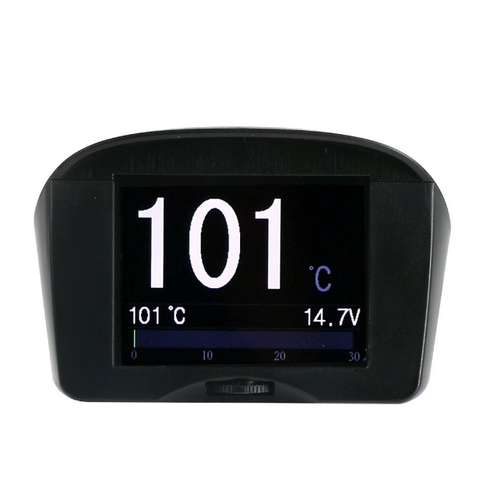
Market Study
X50 Plus OBD mini car trip computer is a small car instrument with powerful functions, which is especially suitable for vehicles without a tachometer, an engine temperature gauge and fuel consumption display functions.
X50 Plus can also display and monitor vehicle battery voltage, generator charging voltage, offering vehicle over speed alarm, high engine temperature alarm and monitoring and other functions. It even can read vehicle data streams, scan engine fault codes and offer fault code clearing functions. Available at a reasonable price.

Slide 6
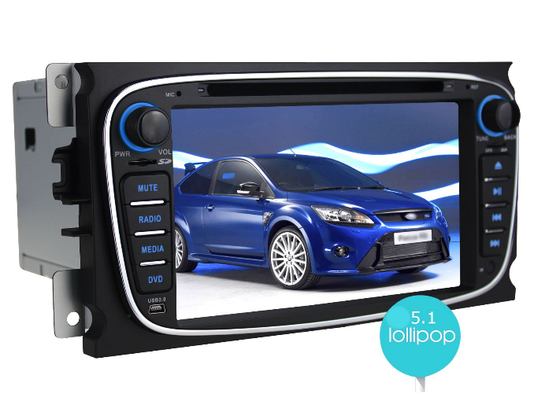
Market Study
Joying is a Professional high quality Android auto radio Head Unit In dash car GPS navigation supplier, which focus on entertainment while on trip, with network, audio, video, Bluetooth and GPS capability, instead of focusing on car monitor. Which inflates the price above a reasonable value.

Slide 7
Constraints
Constraints
Budget must be minimal.
Project developed by a team of two.
Technical Constraints
Raspberry Pi
Buildroot
Pthread
C/C++
User Implemented Device Driver

Slide 8
Requirements
Functional Requirements
Get car information through OBD port
Show data on screen
Alert the user for malfunctions
Calculate road slope
Warn bad driver behaviour
Functional Requirements
Low Cost and low power.
User-friendly interface.
Plug’n’play
The system must have low latency.

Slide 9
Specifications
Hardware Specification
Raspberry Pi 3
BCM2837 Chip 64 bit ARMv8 Cortex A53 Quad Core
1GB RAM
Wireless LAN
Bluetooth 4.1
4 USB Ports
40 GPIO Pins
HDMI Port
Ethernet Port
Micro SD Card Slot
TFT with Touchscreen
ILI9488 Display Driver
320x480 Resolution
Resistive Touchscreen
OBD module with Bluetooth
ELM327
OBDII interface
Accelerometer and Gyroscope
MPU-6050
Six Axis
I2C Communication
Tactile Buttons

Slide 10
Specifications
Software Specification
Embedded Linux
C/C++ Language
Buildroot
Pthreads Library
Implement Device Drivers

Slide 11
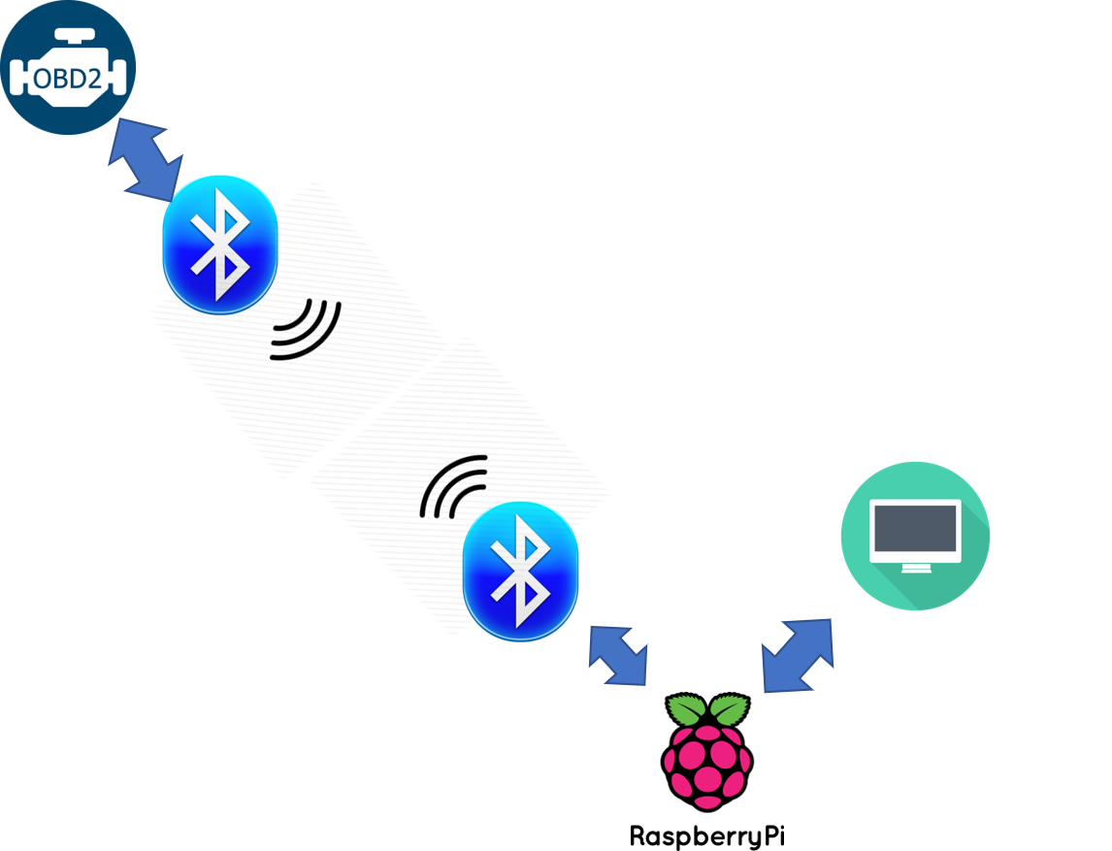

System Overview

Slide 12
Events
Event | System Response | Source
On/Off | Turn System On/Off | User
Read OBD | Reads OBD data | Local Sys
Read Accelerometer | Reads accelerometer data | Local Sys
Display | Changes display | Local Sys
Button Click | Reads buttons states | User

Slide 13
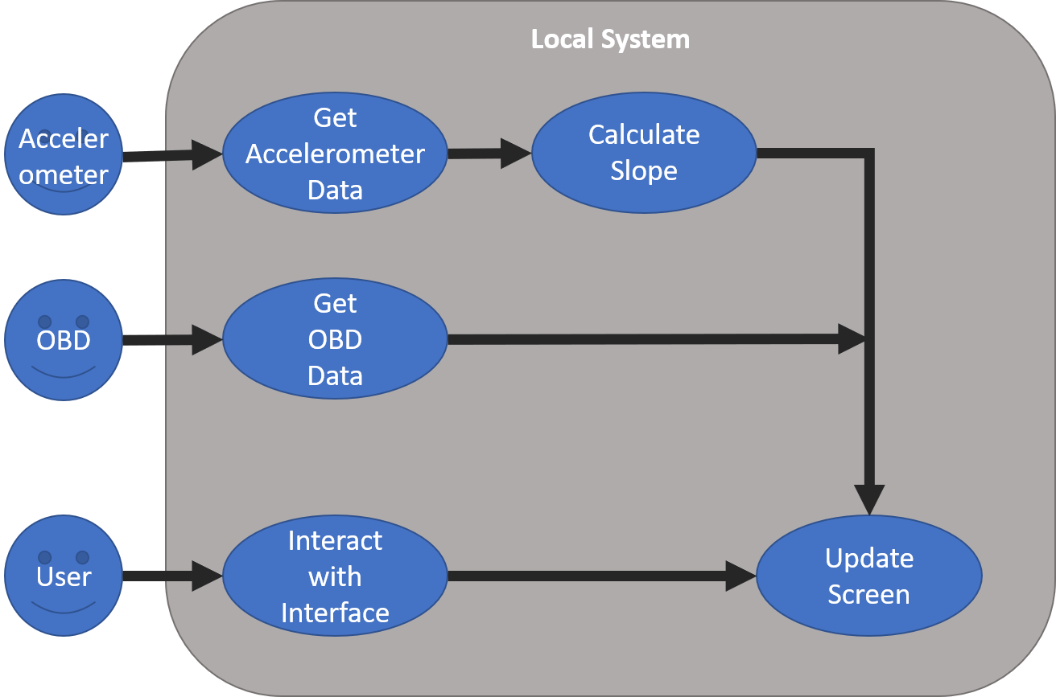
Use Cases

Slide 14
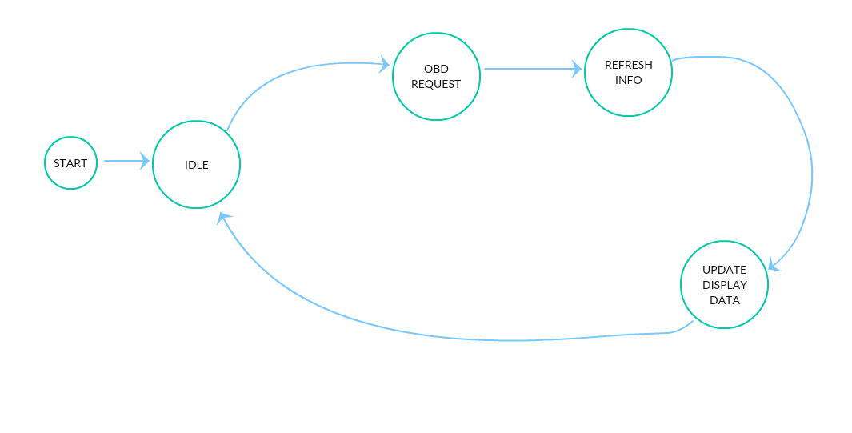
State Chart

Slide 15
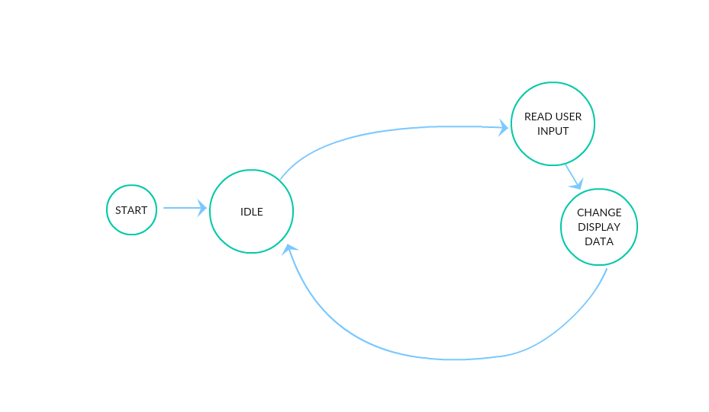
State Chart

Slide 16
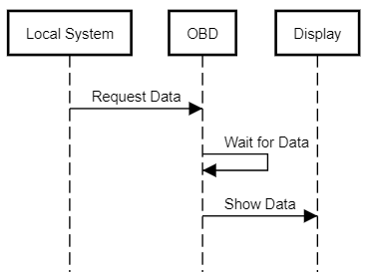
Sequence Diagram

Slide 17
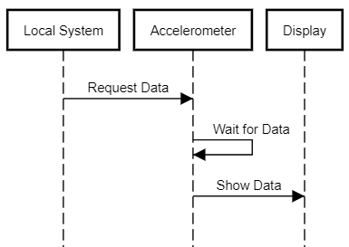
Sequence Diagram

Slide 18
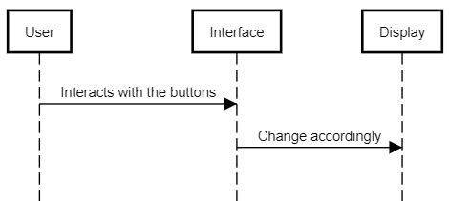
Sequence Diagram

Slide 19
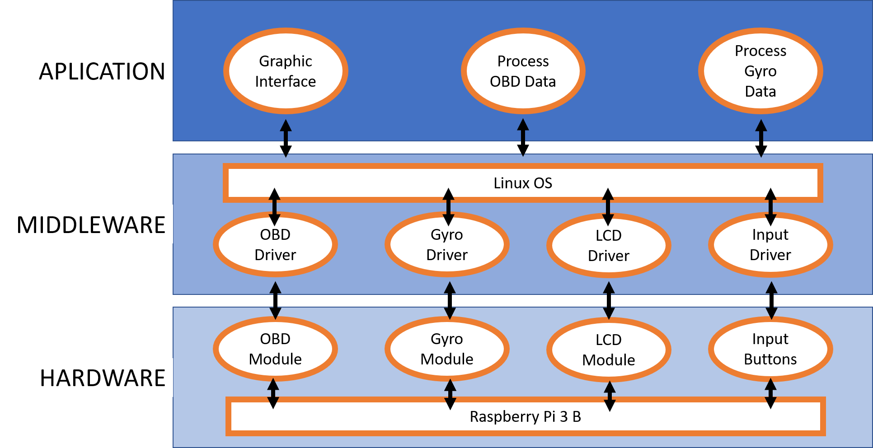
System Stack

Slide 20
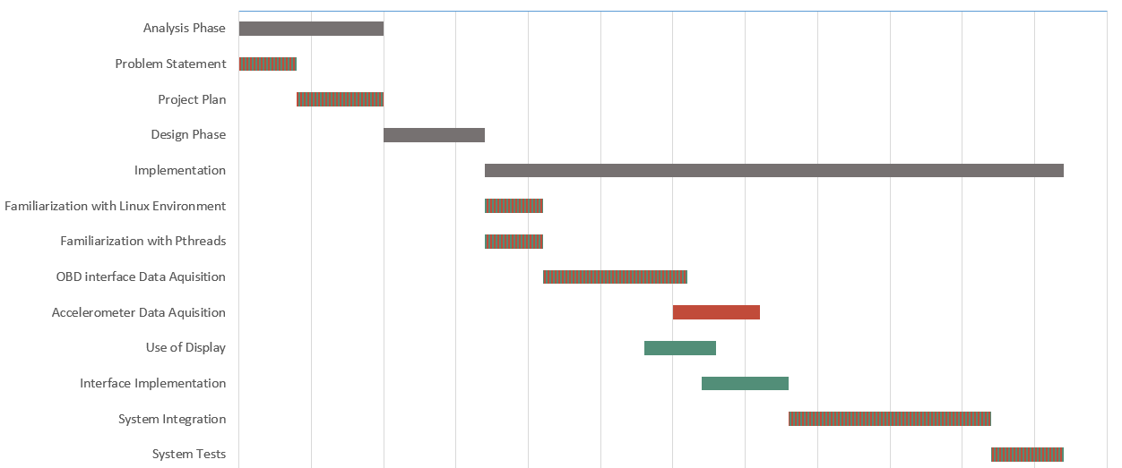
Gantt Chart
 | Fábio Magalhães
 | Rui Carvalho

