Slide 1

Opening a pastry shop in toronto

Slide 2
Where to open a pastry shop in Toronto?
Ontario has the strongest economy in Canada, contributing the highest GDP per capita in the country.
Toronto, its capital, has one of the top food scenes in Ontario. As aspiring pastry chefs based in Toronto, we want to open our first Pastry shop here.
Our Pastry shop concept focuses on products that go well with either coffee or tea.
The product selection, for now, will focus on pastry products only.

Slide 3
Data acquisition and preparation
Postal codes, boroughs, and neighborhoods data for Toronto scraped from https://en.wikipedia.org/wiki/List_of_postal_codes_of_Canada:_M
Coordinates per postal code from https://cocl.us/Geospatial_data
Neighborhood coordinates from the Geopy library. Postal code data refined into neighborhood-level coordinates. <include the number of neighborhoods>
Establishment categorization and counts per neighborhood from FourSquare, focusing only on competitor or complementary industries including the following establishments: Bakery, Café, Coffee Shop, Donut Shop, Pastry Shop, Tea Room

Slide 4
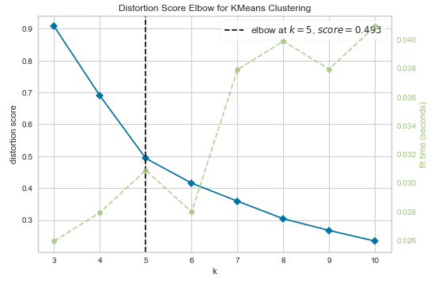
Choosing the best k for clustering
Use K Elbow Visualizer
Use K = 5

Slide 5
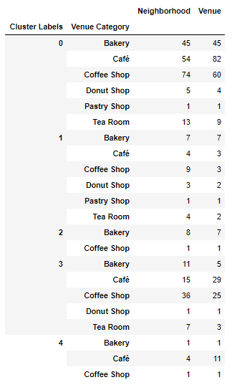
Zero in on clusters with dense coffee shop or café presence
As we are looking to enter areas packed with Coffee Shops, Cafés, or Tea Rooms, as they complement our products, and with minimal competition, Cluster 3 is of interest

Slide 6
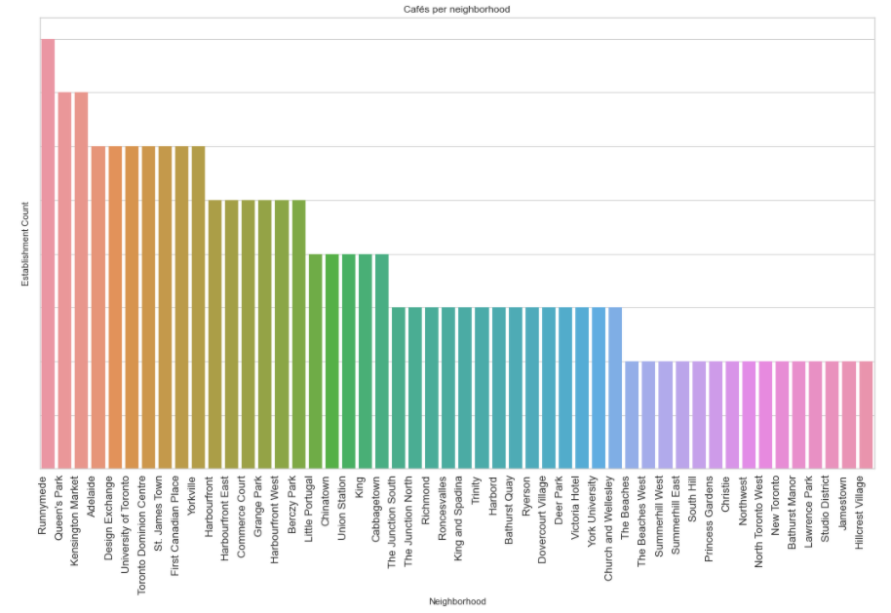
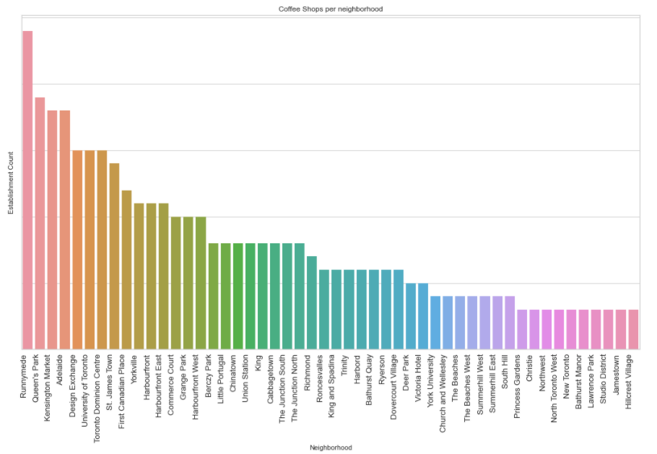
Keep an eye on competition from Runnymede
Other supporting points and figures here

Slide 7
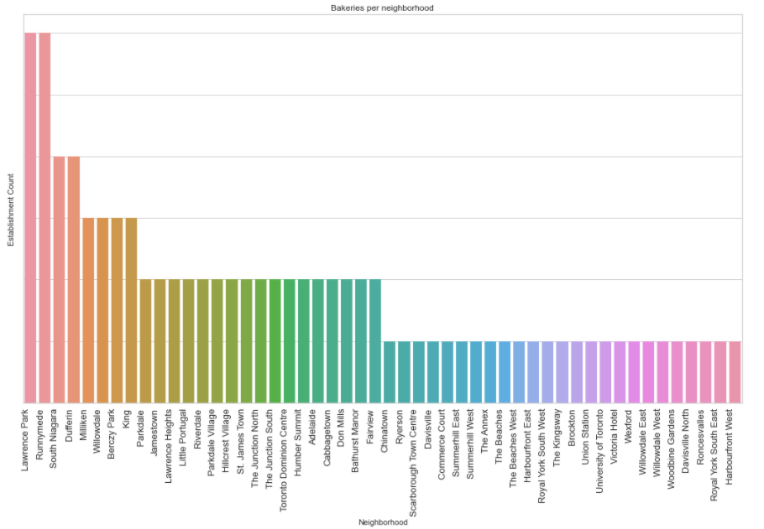
Keep an eye on competition from Runnymede
Dense presence of coffee shops, cafes, bakeries in Runnymede

Slide 8
Recommendation and future directions
Conducted an analysis through K-Means clustering to find a suitable location to open a pastry shop in Toronto:
Explore Cluster 3 neighborhoods, specifically: Oriole, Queen's Park, East Toronto, Mount Dennis, North Park, St Phillips, Martin Grove Gardens, Scarborough Village, Scarborough Village West, The Queensway East, Jamestown
Further validate the situation in the neighborhoods above
Accuracy of the models has room for improvement. Consider augmenting with more data from other sources, such as:
Ratings
Richer list of establishments and locations
Foot traffic or population density

