Slide 1
How Stars Respond to Mass Loss and Mass-Transferring Binaries in MESA
Lars Bildsten
TA: Bill Wolf

Slide 2
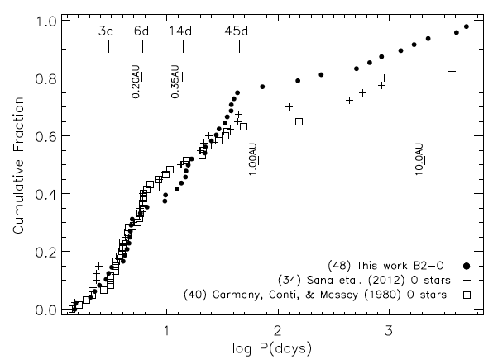
70% of Massive Stars in Binaries
Kobulnicky et al. ‘14

Slide 3
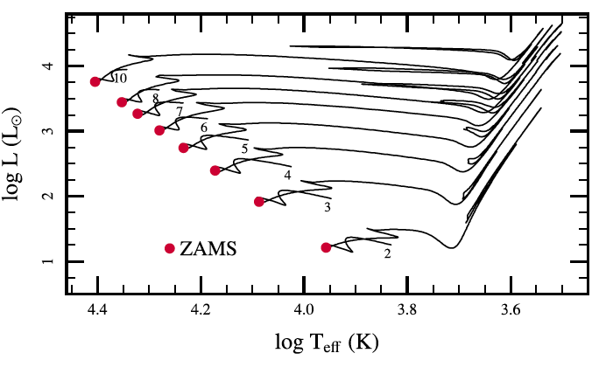
Stars get Bigger as they Evolve
Paxton et al ‘11

Slide 4
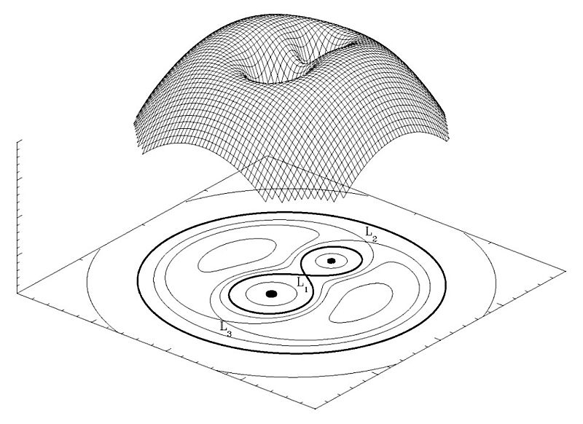

Eventually exceeding the Roche Radius
Best fitting formula for Roche Lobe radius is that of Eggleton:

Slide 5
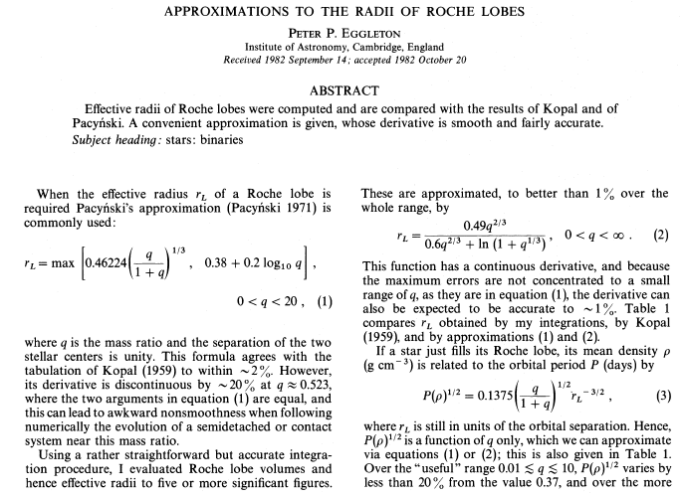
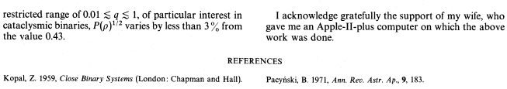
> 1000 citations !!!

Slide 6
Motivation for Massive Stars
Many massive stars are in tight binaries, leading, during evolution, to Roche Lobe Overflow
We need to know how the radius changes as mass is lost, or gained,
Two cases defined long, long ago. . . Brilliantly named case A and case B!

Slide 7
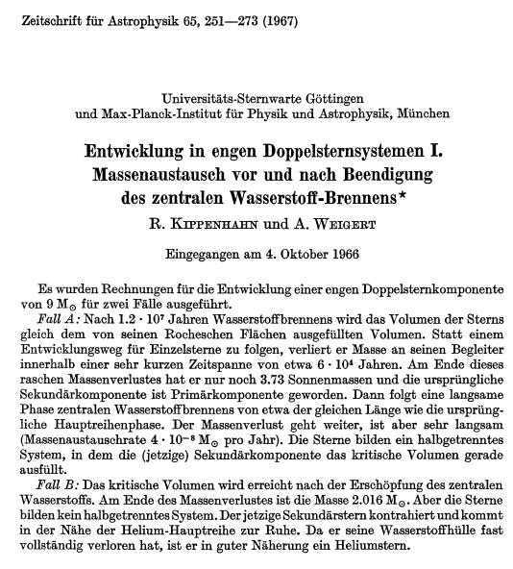
Case A =>
Case B =>

Slide 8
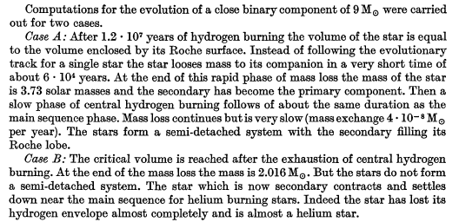
Translation
Why such rapid mass transfer?
What happens to the accretor?

Slide 9
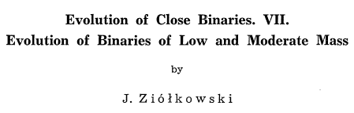
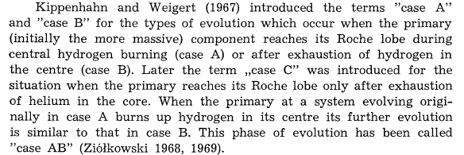
Case A and Case B (Sorry!)

Slide 10
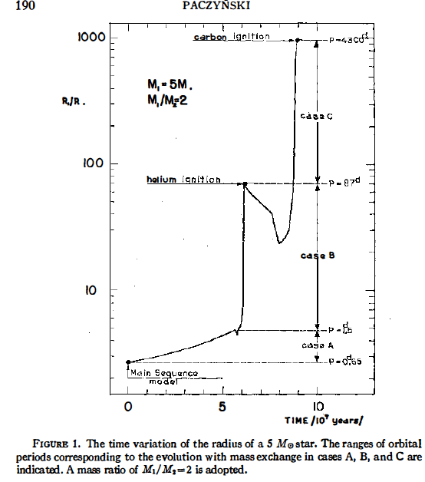

Slide 11
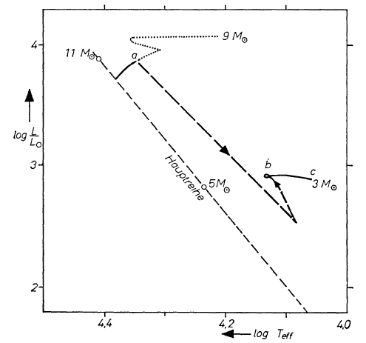

Slide 12
Stellar Response vs. Roche Radius
Since the more massive star evolves first, it will almost always be the one to first fill the Roche Radius
The resulting transfer is thus from massive to less massive star (e.g. a 9 to a, say, 2).
Secular stability requires that the donor star stay within the Roche radius as mass is lost.
If not stable, then likely a merger event ensues

Slide 13

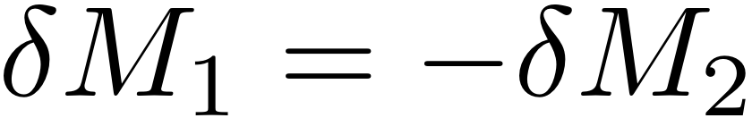
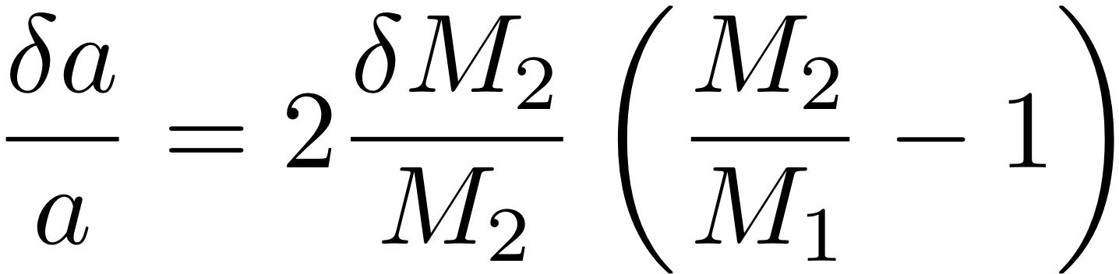
Changes in Orbital Parameters
Presume that mass and angular momentum are preserved during mass transfer. Ignoring spin, the total angular momentum is:
This leads to a simple change in separation due to mass transfer of, from 2=> 1 , and
So, since M₂>M₁ and M₂ decreases, orbit shrinks!

Slide 14
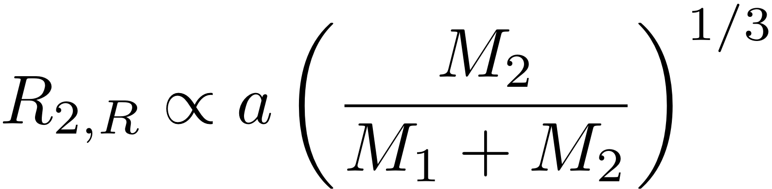
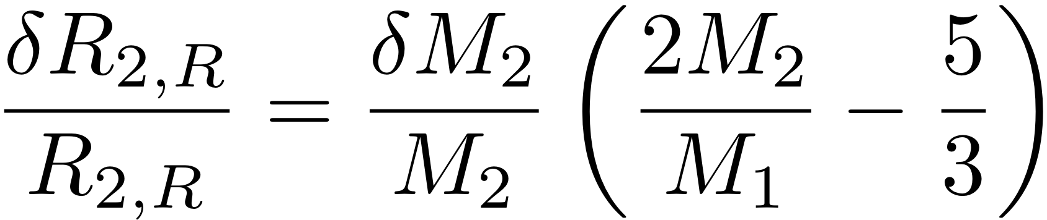
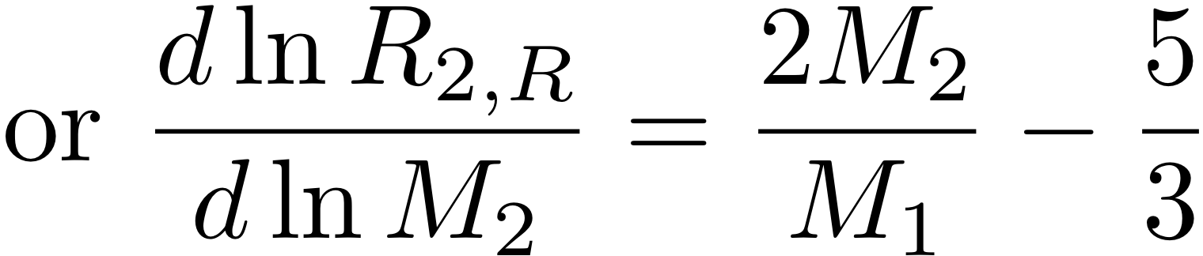
Changes in Roche Radius
Using the simpler form for the Roche Radius, we get:
The resulting change in the Roche Radius around donor star (2), is then
When M₂>5M₁/6 and M₂ decreases, Roche Lobe shrinks. . . Star MUST shrink even more, otherwise a runaway situation occurs ! !

Slide 15
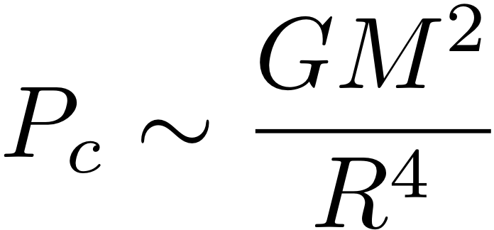
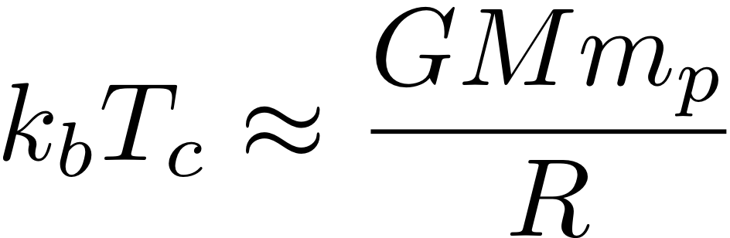
How Does a star Adjust to Mass Loss?
Let’s pull a piece of fluid off the star over a timescale long compared to the dynamical time.
The star is always in Hydrostatic balance, so
Pressure is matched by ideal gas, so
So, what is T_{c} is same as what is R?

Slide 16
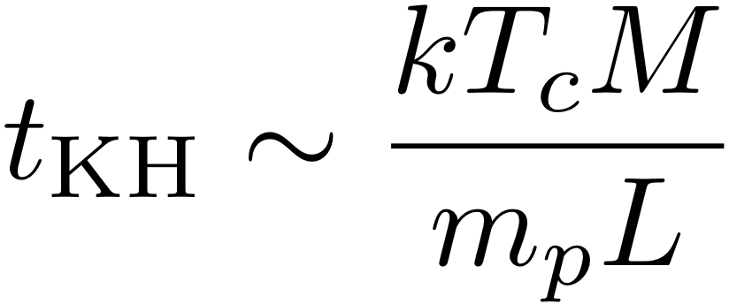
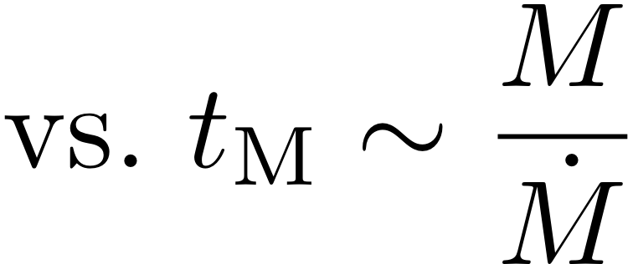
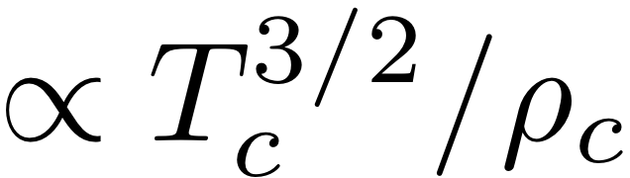
What Determines the Temperature Response?
Heat moves around in a star on the Kelvin-Helmholtz time, which we compare to the mass changing timescale
If the mass loss is rapid, then the deep fluid elements should respond adiabatically, otherwise the temperature would adjust due to changing the entropy, which is

Slide 17
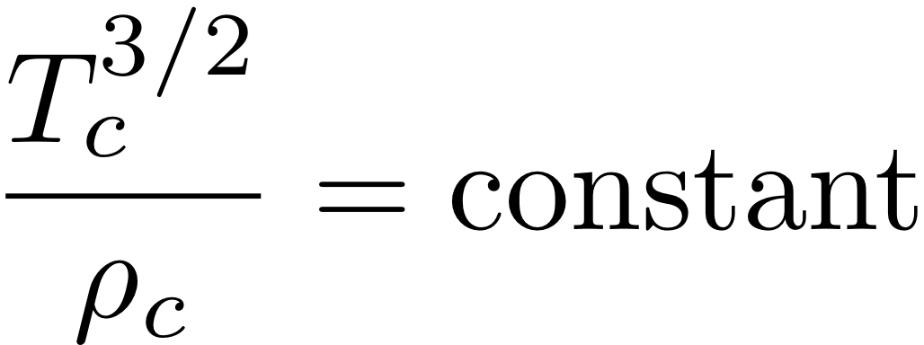
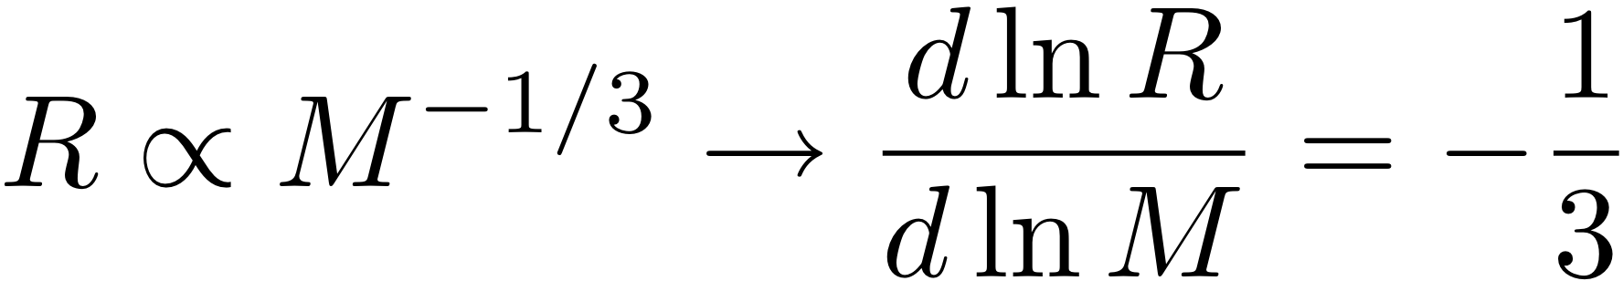
Adiabatic Response
If rapid, then the fluid elements within the star respond adiabatically. IF we treat the star as one-zone, with one entropy, then since
Hydrostatic balance + adiabatic response then implies a radius expansion, clearly unstable when massive => light

Slide 18

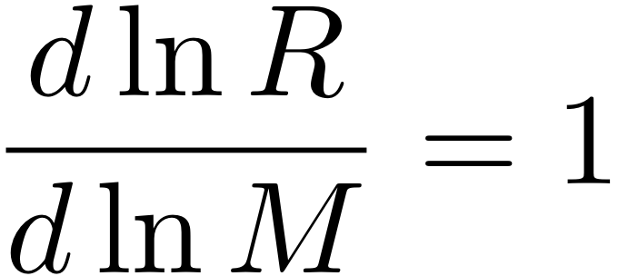
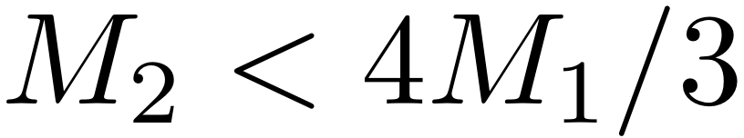
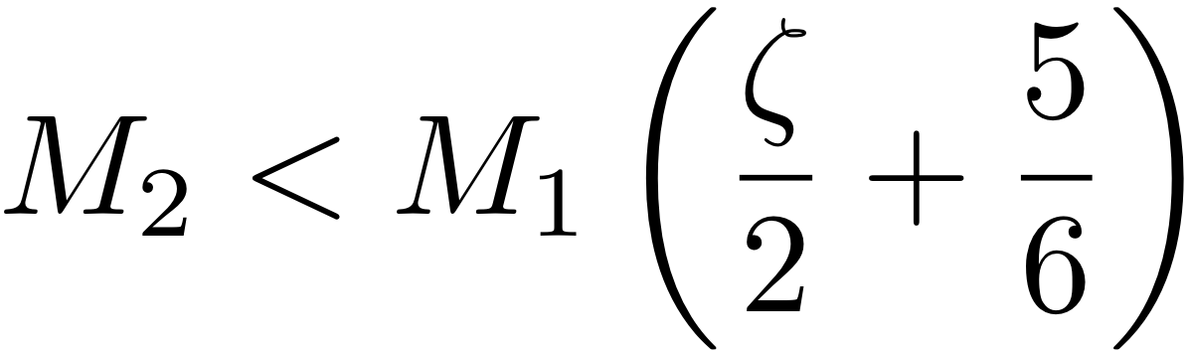
“Equilibrium” Response
Maybe, instead, the star has time to find it’s new main sequence mass. If so, then
If the star responds this way, then it’s shrinkage as mass is lost would lead to a critical mass ratio defined by having the star stay inside the Roche radius after mass lost, requiring

Slide 19
Minilab
Download work directory from mesastar.org (bildsten_minilab.tar.gz)
Task: Evolve 5 Msun MS star with mass change on
Pick log(mdot) between -3 and -7
Fill in inlist_bildsten_minilab (follow comments and/or guide)
Run with mass loss (negative mass_change), then mass gain (positive mass_change)
Observe how entropy structure changes relative to original model
Calculate zeta (d log R / d log M; log M in history.data as log_star_mass)

Slide 20

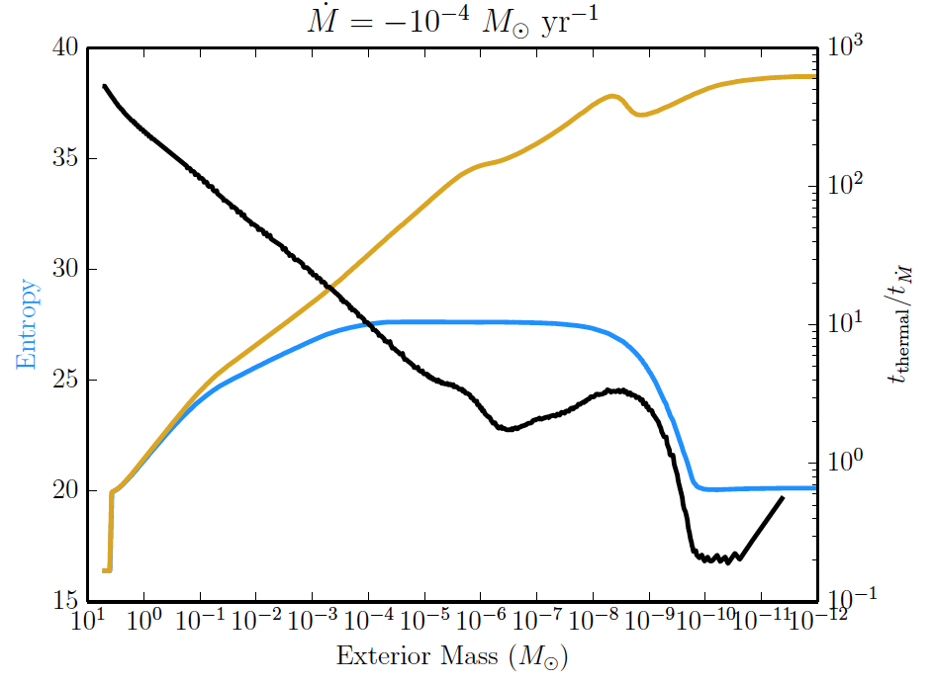

Slide 21
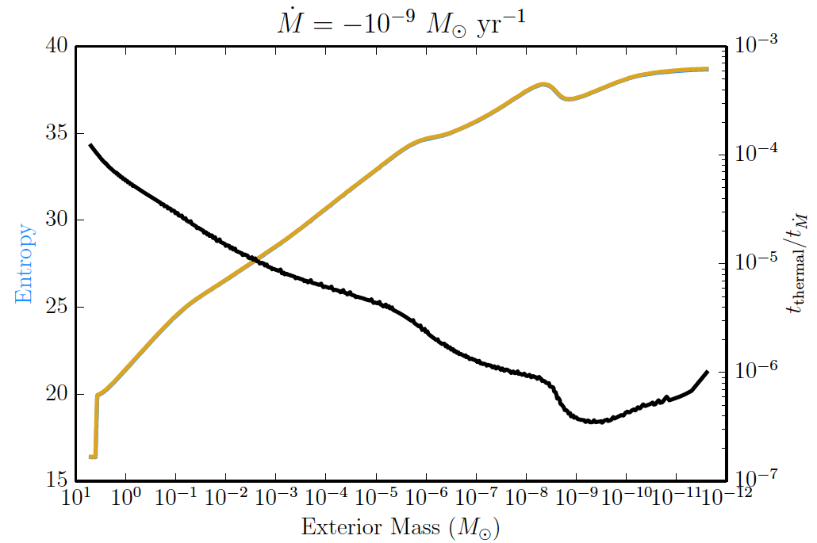
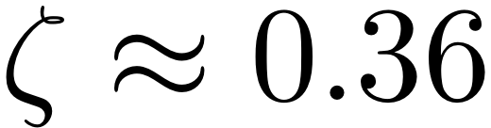

Slide 22
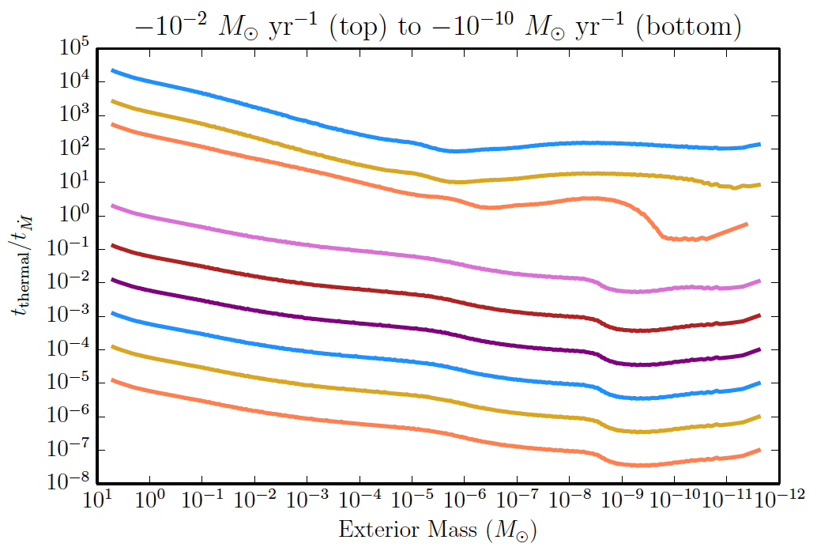

Slide 23
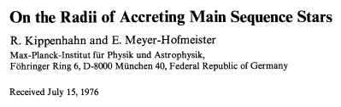
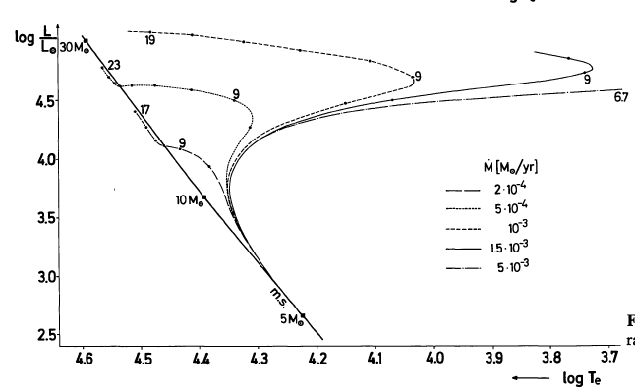

Slide 24
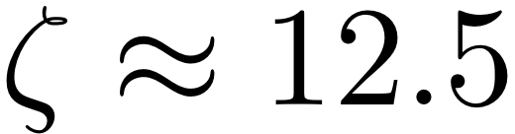
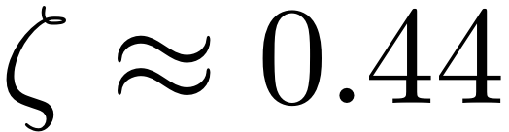
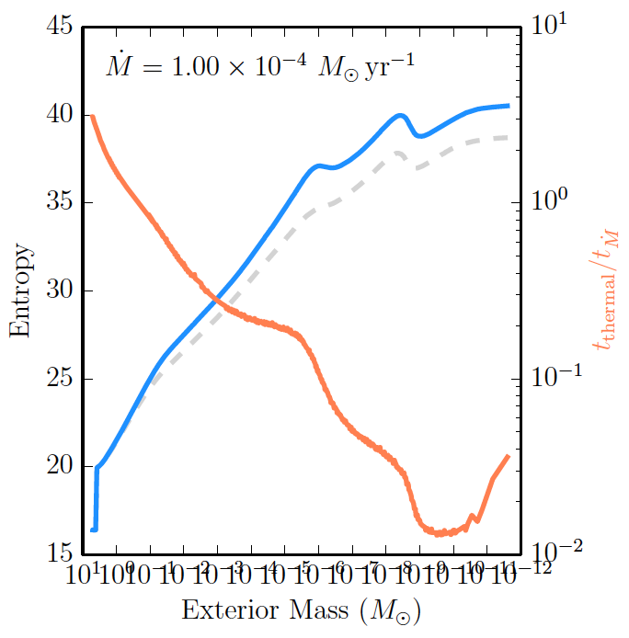
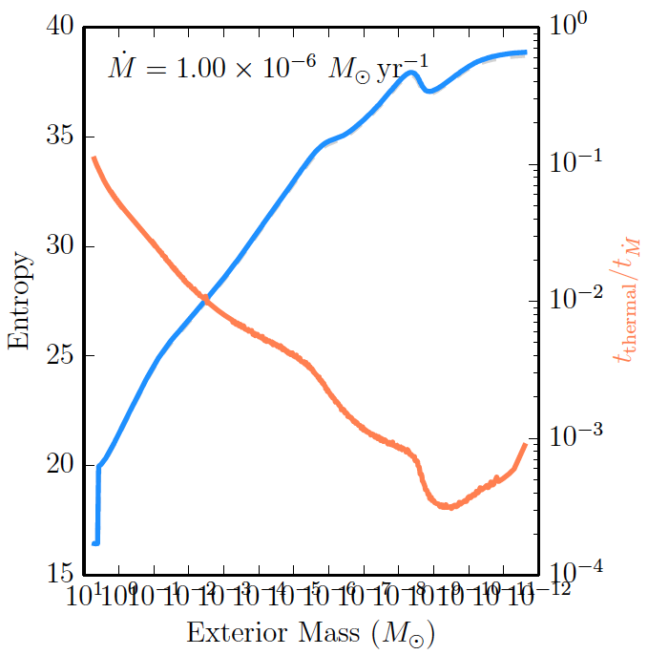
MESA Results for Mass Gainers

Slide 25
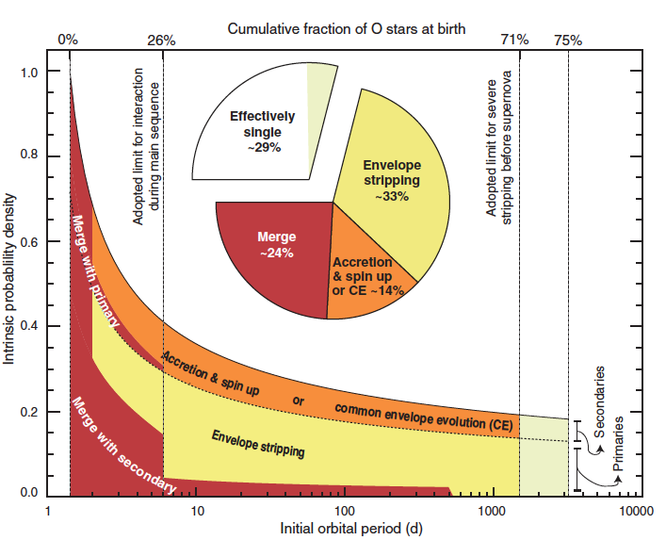
Massive Stars tend to Interact
Sana et al. ‘13

Slide 26
Low Mass Stars Interact as Well
Some come into contact due to gravitational wave driving, leading to mass transfer that is stable and driven by loss of angular momentum
Cataclysmic variables are the best such example, talked about already by Dean.

Slide 27
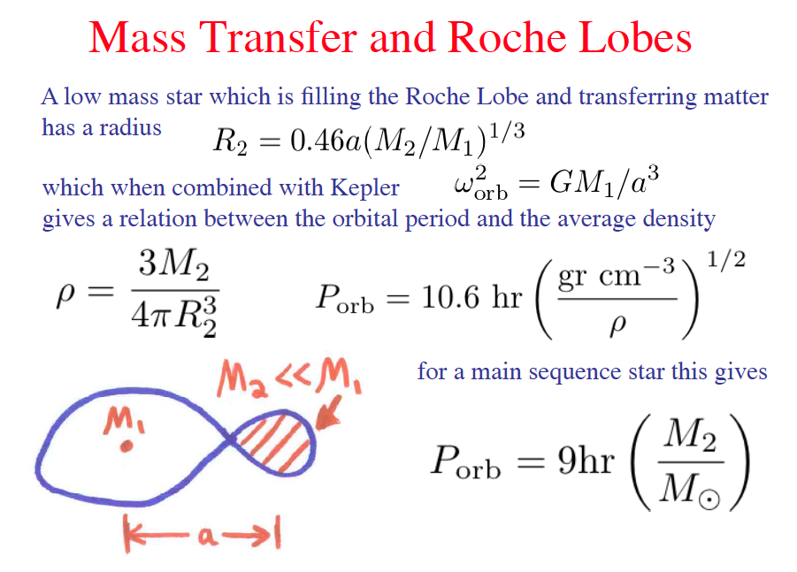

Slide 28



Mass Transfer Basics
Start with the total orbital angular momentum (ignoring spin), and
assume that object 2 always fills the Roche lobe,
And conserve mass in the binary during the mass transfer, then
Assuming that the donor mass changes as then gives
Notes:
This always seems to be a figure I sort of skip over.. Maybe either state it more clearly or
Spread it over two ?

Slide 29
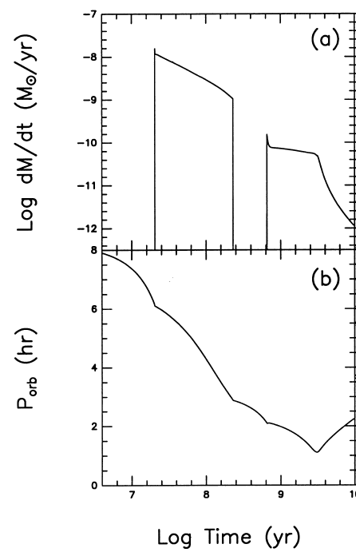

Slide 30
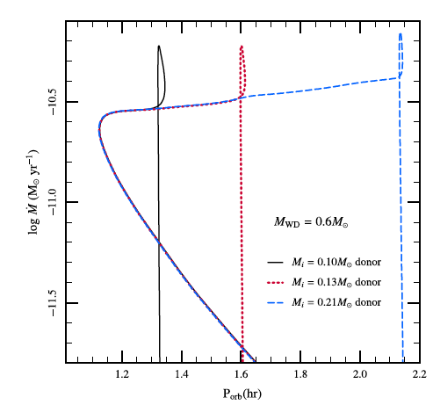
Very low mass donors onto a WD..

Slide 31
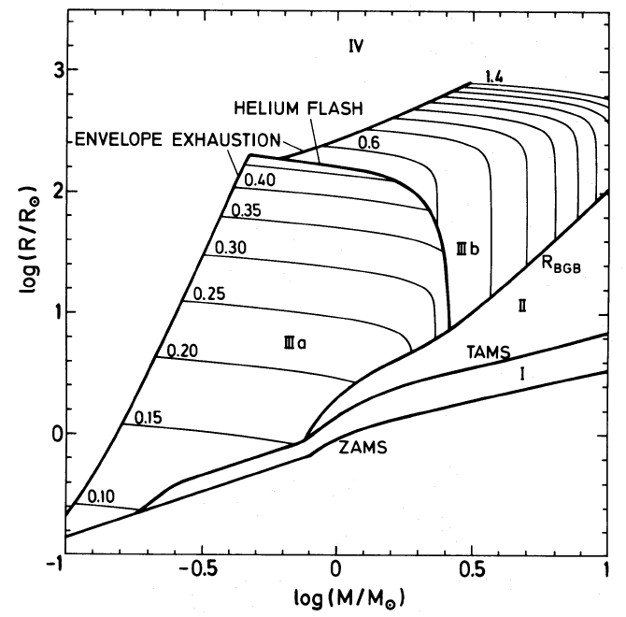
Binary Evolution for Low Mass Stars
de Kool ‘92; de Kool & Ritter ‘93; Iben & Tutukov ’93. Politano ‘96
Helium Core
Mass

Slide 32
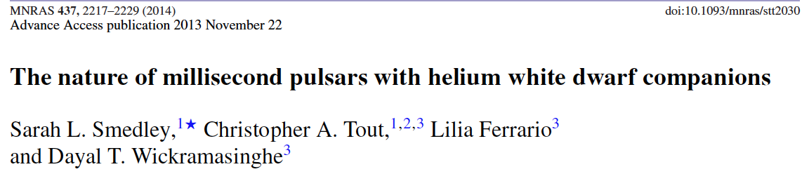
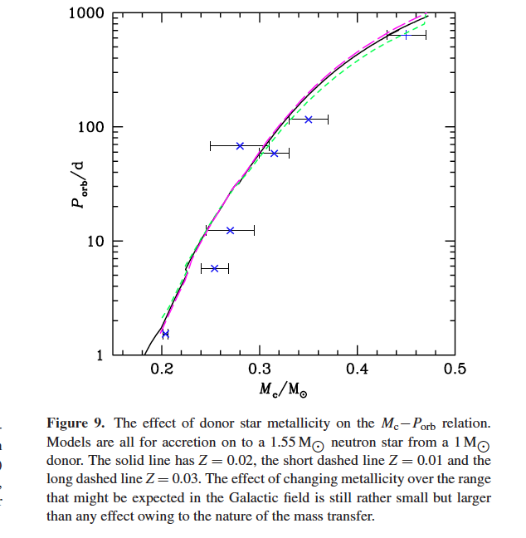

Slide 33
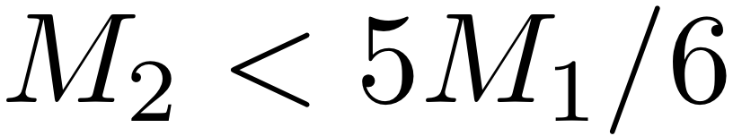
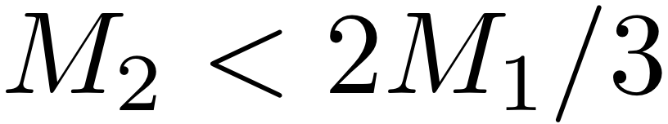
What’s the Story?
Neutron star is formed, and, somehow, stays bound in a wide orbit
Low-mass star evolves to become a red giant, and fills the Roche Lobe
To diagnose the stability of this mass transfer, we need to know how the RGB responds relative to Roche Radius
IF RGB is ‘in equilibrium’ during mass transfer, then the radius is nearly constant and
IF RGB star expands like the adiabat, then the constraint is stricter

Slide 34
Maxilab Overview
Use mesa/binary to evolve red giants in binaries
Determine what companion masses cause stable/unstable mass transfer through Roche lobe overflow
Do this for six starting models (three masses, two luminosities; provided)
Report stability (1), instability(-1) or uncertain (0) to Google sheet
Will the critical ratio Mdonor/Maccretor between stability/instability remain constant?

Slide 35
Maxilab Details
Download models/guide from mesastar.org (bildsten_maxilab.tar.gz)
Learn about binary module (see guide)
Copy mesa/binary/test_suite/binary_donor_only_implicit_mdot as work directory
Adjust inlist_project with binary parameters, inlist1 to load each model and add pgstar plot for mdot history
Determine stability/instability for randomly chosen companion mass (1x - 3x donor mass) for each RGB model using Mdot history and/or mass history; report to spreadsheet

Slide 36
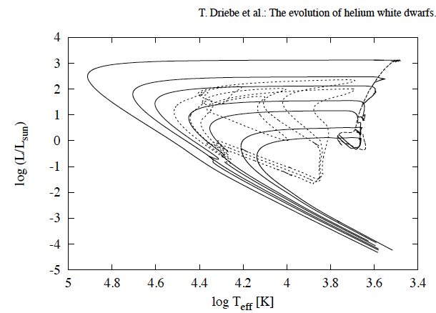
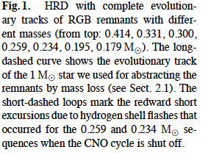
Outcomes
For mass transfer from an RGB star to, say, a low mass MS star, it is unstable, leading to a common envelope and spiral-in, result is a He core WD

Slide 37
Outcomes
IF Roche Lobe filling happens very close to the tip of the RGB, then the He core can still flash and you make an sdB star!
Stable cases we know about are mass-transferring systems that contain NSs and some that contain WDs, but must be massive.

