Slide 1
CAP V-SAR
Civil Air Patrol Virtual Search and Rescue Trainer
A desktop simulator for electronic search: aircrew, mission base, live ATC
California Wing Conference | [date]
[Rank] Ron Craighead, CAP | [unit / duty position]
CONCEPT BRIEF - DRAFT - not an approved CAP program
Notes:
Open with the Palomar sortie: a 121.5 ELT on the ground at ESCON on the ILS; SoCal protected 3,300 and gave us blocks above and below. That sortie is now Scenario C-1 in this trainer. Nothing here is built yet; this is a concept and a plan I want hard questions on.

Slide 2
Electronic search is a perishable, expensive skill
And a real sortie gives you whatever signal conditions exist that day
• A practice sortie needs an aircraft, fuel, a crew, a practice beacon and cooperative weather
• You get one set of signal conditions per flight, chosen by chance, not by the instructor
• Crews too often meet the hard cases for the first time on a real mission:
  – a reciprocal bearing they chase for twenty minutes
  – a signal masked by a ridge that they read as 'no beacon'
  – a needle swinging wildly on close approach
  – a 406 needle that only moves every 50 seconds
  – a search that cannot be flown without negotiating with a busy approach controller
• Those are the moments a trained response matters most, and the ones we practise least
CAP V-SAR | Concept Brief | DRAFT v0.1 | 6 Sep 2026
2
Notes:
The point is not that we don't train. It's that the failure modes are random in the real world and we can't schedule them.

Slide 3
What CAP V-SAR is
Four layers, all software, running on members' own PCs
Layer | What it is | What it does
1 Simulation | X-Plane 12 + a small scripted plugin | Flight, terrain, and a synthesized beacon signal with instructor-controlled effects
2 Instruments | Air Manager panels | Becker SAR-DF 517 and RHOTHETA RT-600 heads; a second COM panel at the Observer seat
3 Radios | PilotEdge + a CAP mission net | Live human ATC on one radio, mission base on the other - two PTTs, as in the aircraft
4 Mission base | Web client + CalTopo training map | Live aircraft tracking, bearing plotting, retasking, and a debrief replay against beacon truth
Windows, Mac or Linux. No aircraft, no fuel, no weather. Repeat the hard scenario until the crew gets it right.
CAP V-SAR | Concept Brief | DRAFT v0.1 | 6 Sep 2026
3
Notes:
Emphasise 'members' own PCs'. The hardware bar is a mid-range gaming PC. The sim already runs on my Linux workstation.

Slide 4
X-Plane does not simulate distress beacons. That is the advantage.
Because the entire signal chain is synthesized, the instructor controls every effect that makes electronic search hard - individually, repeatably, on demand.
Effect | What the crew experiences | What it trains
Radio horizon | Nothing until you climb | Deliberate altitude selection
Terrain masking | Signal vanishes in a valley | Reposition, don't conclude 'no beacon'
406 burst cadence | Needle updates every ~50 s, then holds | Patience; plan turns around the next burst
121.5 homer | Continuous needle at short range | The 406-to-121.5 transition on final
Cone of confusion | Bearing indeterminate overhead | Confirming station passage
Multipath | A confident, wrong bearing off a ridge | The single most valuable lesson
Wrong 406 channel | Becker 517 hears nothing | Why the RT-600 is replacing it
CAP V-SAR | Concept Brief | DRAFT v0.1 | 6 Sep 2026
4
Notes:
No real airplane can be told to produce a textbook multipath error on demand. This one can. This catalogue is effectively the syllabus.

Slide 5
Concept of Operations: three modes, each usable on its own
Training value arrives early; the network comes later
Mode | Who | What it looks like | Available
A Solo | One trainee, instructor over the shoulder | One PC. Trainee flies and works the DF; instructor places the beacon and injects effects. | End of Phase 2
B Crew | MP, MO, MS at separate stations | One sim drives several Air Player panels. Crew coordinates on intercom; instructor runs the scenario. | Phase 3
C Networked exercise | Several aircrews + remote mission base staff | Multiple sims, live ATC, mission voice net, shared CalTopo map. Base staff participate from home. Approximates a full exercise. | Phase 4-5
Stop after Phase 2 and you still have a worthwhile single-seat DF trainer.
CAP V-SAR | Concept Brief | DRAFT v0.1 | 6 Sep 2026
5
Notes:
Phase gating is deliberate. The network layers are the fun part to design and the wrong place to start.

Slide 6
Crew and staff stations
Each role sits where it does in the aircraft and at mission base
Role | Station | Function in the trainer
Mission Pilot | Sim, primary display, yoke and rudder | Flies the pattern; works ATC
Mission Observer | Air Player panel + second COM panel | Operates the DF; logs bearings; works the mission net
Mission Scanner | Air Player panel + external view | Scan discipline; clock-position reports
Instructor / Controller | Scenario web UI + instructor panel | Places beacons; injects effects and faults; adjudicates
Mission Base (IC, AOBD, MRO) | Browser client, remote | Tracks aircraft; plots cuts; retasks; runs the debrief
CAP V-SAR | Concept Brief | DRAFT v0.1 | 6 Sep 2026
6
Notes:
Base staff need install nothing - it's a browser. Everyone joins an overlay VPN so nothing is exposed to the public internet.

Slide 7
Scenario C-1: the ELT we worked at ESCON on the Palomar ILS
121.5 MHz beacon on the ground at a fix where the plate says 3,300 ft - SoCal Approach live on frequency
• 121.5 only - no satellite alert; tasking from reports of a signal in the CRQ approach area
• The source sits directly beneath the ILS final approach course
• SoCal protected the 3,300 ft approach altitude and issued block altitudes above and below it
• Crew searches the upper block, then the lower, while IFR arrivals pass between them
• Continuous 121.5 needle; multipath off terrain to the east; cone of confusion over the fix
• Debrief replays the track against the blocks issued and the timing of ILS traffic
The training value is not the beacon. It is that this search cannot be flown at all without continuous negotiation with a live controller - on the final approach course, with the ideal altitude occupied by traffic.
CAP V-SAR | Concept Brief | DRAFT v0.1 | 6 Sep 2026
7
Notes:
As flown - Ross will recognise it. Variants: ramp false alert at the field; two aircraft deconflicted by ATC; same geometry with a 406 beacon to add burst cadence; running it unannounced as a routine flight-following request; a genuine target in terrain east of the field.

Slide 8
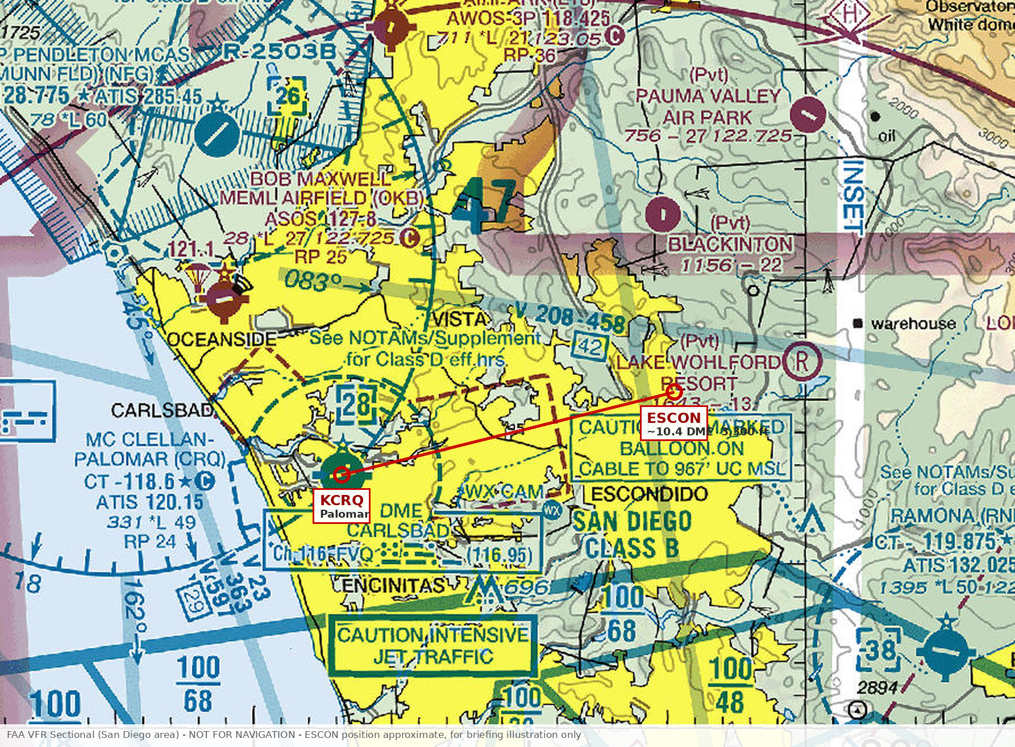
Scenario C-1: where the search happens
ESCON sits on the ILS final approach course, inside SoCal Approach's airspace
• The beacon was on the ground at ESCON
• Directly beneath the final approach course into Palomar
• Class D below, San Diego Class B shelves to the south, Camp Pendleton to the north
• Terrain rises to the east - the source of the multipath in the scenario
• No satellite alert. 121.5 only. Position came from reports, not from Doppler.
This is not open terrain. Every turn has to be bought from a controller.
CAP V-SAR | Concept Brief | DRAFT v0.1 | 6 Sep 2026
8
Notes:
Point at the red line: that is the approach course. The beacon is under it. Anywhere you want to fly to take a cut is somewhere an arrival wants to be.

Slide 9
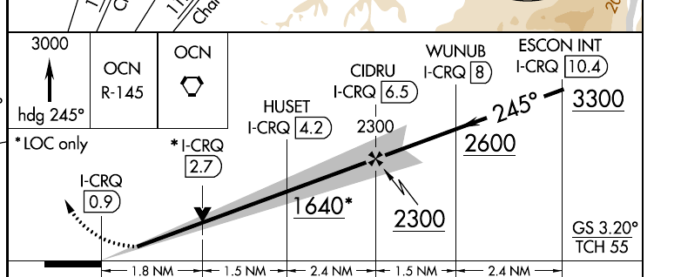
Scenario C-1: why altitude was the constraint
The plate puts arriving IFR traffic at 3,300 ft over ESCON - exactly where the search wanted to be
ILS or LOC RWY 24
MC CLELLAN-PALOMAR (CRQ)
ESCON INT - I-CRQ 10.4
3,300 ft on the plate
SOCAL APP CON 127.3 / 323.0
Approach course 245 degrees
BLOCK ABOVE
search here, clear of the approach
3,300 ft - PROTECTED
ILS arrivals to Palomar - stay out
BLOCK BELOW
search here once traffic is clear
FAA ILS or LOC RWY 24, KCRQ - cycle 2609, eff 03 SEP - 01 OCT 2026 - NOT FOR NAVIGATION
CAP V-SAR | Concept Brief | DRAFT v0.1 | 6 Sep 2026
9
Notes:
SoCal gave us a block above and a block below, so we could work around the 3,300 approach altitude rather than through it. That is the whole scenario: the crew never gets the altitude it actually wants, and has to build a fix from the altitudes it can have.

Slide 10
Live ATC: PilotEdge
Real human controllers working to the 7110.65, on the western US
• Supports X-Plane 12 on Windows, Mac and Linux
• ZLA coverage: Los Angeles ARTCC - half of California, much of Nevada, parts of AZ/UT. Western US package adds Oakland, Seattle, Salt Lake, Denver, Albuquerque
• Guaranteed coverage 8am-11pm Pacific, 7 days a week. Five-hour free trial.
• Coordinated SAR ops and declared emergencies are established practice on the network; controllers welcome them
• All connected aircraft see each other, so two CAP aircraft can be deconflicted by ATC as in reality
• Cost: $19.95/mo per pilot. Shared-cockpit tiers put an MO at $9.95 and an MS at $5.95 - about $36/mo for a three-person crew
• Mission traffic - bearings, beacon reports, base coordination - stays on the CAP mission net, never on ATC frequencies
CAP V-SAR | Concept Brief | DRAFT v0.1 | 6 Sep 2026
10
Notes:
I know Keith Smith at PilotEdge; he has been receptive before. A coordinated exercise slot with briefed controllers is very achievable.

Slide 11
Mission base and CalTopo
The debrief is the product
• Each sim posts position every few seconds to a tracking service; aircraft appear on a CalTopo map exactly as an inReach or ADS-B track would
• CalTopo's supported Team API adds markers, search assignments and the alert position
• Exercise traffic runs on a separate CalTopo training team or self-hosted Desktop instance - never an operational map
• Base staff see live aircraft, plot bearing cuts, retask crews, and open the search from a simulated AFRCC alert
• Everything is recorded: track, bearings, radio calls, reports
• Debrief: the crew's track replayed against the true beacon position. A real sortie gives you that only partially and at far greater cost.
CAP V-SAR | Concept Brief | DRAFT v0.1 | 6 Sep 2026
11
Notes:
The one place this system touches a tool also used for real missions is CalTopo. Separate account, separate credentials, SIM callsigns. That's the whole isolation story.

Slide 12
What it trains, and how we would know
Written as observable behaviours so they can map to task requirements later
Role | Representative objectives
Mission Pilot | Mode selection in the power-up window; homing intercept to overhead; recognising reciprocal and multipath bearings; altitude for radio horizon; working a 406 then transitioning to 121.5; negotiating a search in controlled airspace
Mission Observer / Scanner | DF as a crew resource; bearing log and position estimate; formatted reports to base; aural acquisition and squelch; scan and clock-position discipline
Mission Base | Live situational awareness; plotting cuts; refining the area from negative information; retasking; opening from an AFRCC alert with uncertainty
Measure | Method
Time from first signal to overhead | Recorded per sortie; trend per crew
Track efficiency | Distance flown after acquisition vs. straight line
False-bearing recovery | Time spent on a wrong bearing before correction
SME acceptance | Experienced MPs rate each effect against the real thing before any trainee flies it
CAP V-SAR | Concept Brief | DRAFT v0.1 | 6 Sep 2026
12
Notes:
A trainer with no measure of effect gets judged on how impressive it looks. These are the measures I propose.

Slide 13
Architecture
Beacon truth lives on a server; the sim computes what the DF would see; Air Manager only displays it
COMMAND
Mission base web client | CalTopo training map | Debrief replay
SERVICES
Scenario service (beacon truth) | Tracking service | Mumble mission net | PilotEdge (external)
INSTRUMENTS
Air Manager: Becker 517 head | RT-600 head | MO COM panel | Air Player crew stations
SIMULATION
X-Plane 12 + DF engine plugin (bearing, LOS via terrain probe, signal, cadence) -> cap/df/* datarefs
Position flows up: sim -> bridge -> tracking -> map. Beacon truth flows down: scenario service -> bridge -> sim datarefs -> DF engine -> panel.
CAP V-SAR | Concept Brief | DRAFT v0.1 | 6 Sep 2026
13
Notes:
Why the engine is in the sim and not in Air Manager: terrain masking needs a terrain probe and scenario delivery needs networking, and Air Manager's Lua has neither. X-Plane gives plugins both. Trainees can't find the answer on their own disk - truth arrives only as runtime values.

Slide 14
Roadmap: five gated phases
Solo trainer at the end of Phase 2 - about 20 developer-days in
Phase | Scope | Exit criterion | Effort
0 | Foundation | Our own plugin moves a needle in Air Manager | 3-5 d
1 | Propagation engine | Bearings within 1 degree; a valley null where the map says | 6-10 d
2 | Becker 517 head, solo mode | A trainee flies a complete homing intercept alone | 8-12 d + art
3 | Effects, RT-600, crew mode, SME validation | Multipath on demand; a 3-person crew runs a sortie; MPs sign off the effects | 9-13 d + art
4 | Tracking and CalTopo | A remote observer watches a sortie live on a training map | 9-15 d
5 | Radio net, mission base client, debrief | A full networked exercise with remote base staff, then track-vs-truth debrief | 10-18 d
P | Parallel: vendor engagement | Written answer from Laminar on split-COM datarefs; not blocking | 2-4 d
Total: 45-73 developer-days plus 6-12 days of artwork. Volunteer time is the dominant cost.
CAP V-SAR | Concept Brief | DRAFT v0.1 | 6 Sep 2026
14
Notes:
Use the product after Phase 2 before committing to the rest. If it stops after Phase 3 it is still a worthwhile aircrew trainer.

Slide 15
What it costs
Per-seat software, mostly one-time or modest; hardware is members' own PCs
Item | Basis | Order of magnitude
X-Plane 12 | Per pilot PC, one-time | Tens of dollars; free demo for development
Air Manager 5 | Per instrument PC | Per-seat licence; Air Player seats separate
PilotEdge | Per person, monthly or annual | $19.95/mo pilot; $9.95 MO; $5.95 MS
CalTopo team account | Annual, per team | Wing may already hold one; a training sub-team may suffice
Flight controls | Per pilot station | Yoke and pedals - the largest hardware item after the PC
Server hosting | Existing or small cloud VM | Negligible
Mumble, WireGuard, XPPython3, Python | - | Free, open source
Developer and artist time | Phases 0-5 | The real cost. Volunteer.
CAP V-SAR | Concept Brief | DRAFT v0.1 | 6 Sep 2026
15
Notes:
Figures are order-of-magnitude and must be confirmed against current vendor pricing before any approval request.

Slide 16
Partners and relationships
None of this is built on strangers
Partner | Role in V-SAR | Status
PilotEdge (Keith Smith) | Live ATC; coordinated exercise slots; shared-cockpit tiers | Existing relationship; receptive to SAR ops
Laminar Research (Austin Meyer) | X-Plane; a small dataref request to complete the copilot transmit path for split COM | Existing relationship; receptive previously
Sim Innovations | Air Manager instrument platform | Commercial product; documented API; community store
CalTopo | Training map, supported Team API, Desktop instance | Team account required
CA Wing Stan/Eval and NHQ | Path to training credit, if any | Not yet engaged - this brief is the first step
CAP V-SAR | Concept Brief | DRAFT v0.1 | 6 Sep 2026
16
Notes:
The Laminar ask is deliberately small: X-Plane already models a full copilot audio panel; what's missing is a copilot transmit path for plugins. We test what exists first, then send a one-page spec.

Slide 17
Who builds it
Phases 0-2 need four people. The rest is recruited as each phase approaches.
Tier | Roles | When
Governance | Executive Sponsor | Project Officer | Steering Group (gates only) | From day one
Team A - Sim and instruments | Technical Lead | DF Engine Developer | Instrument Developer | Graphic Artist | Phases 1-3
Team B - Network and infrastructure | Services Developer | Mission Base Client Developer | Infrastructure and Comms Officer | Phases 4-5
Team C - Content and training | Scenario Author / Curriculum Lead | Exercise Instructors | Skills Evaluation Trainers (SETs) | Documentation Lead | Phase 3 onward
Assurance and liaison | SME Validation Panel | Stan/Eval | Safety | CPP (if cadets) | Vendor Liaison | Sustainment Owner | As required
Starting team: Sponsor (occasional), Project Officer who is also Technical Lead, DF Engine Developer, and an artist working in bursts.
Three positions would actually stop the project if vacated: DF Engine Developer, Project Officer, and Vendor Liaison. Each needs a named deputy.
CAP V-SAR | Concept Brief | DRAFT v0.1 | 6 Sep 2026
17
Notes:
A SET is a Skills Evaluation Trainer - they can sign off tasks for qualification, so they are the mechanism by which any training credit reaches a record. Engage one from Phase 3, before the recording design is fixed. Resist standing up the whole chart now. The classic volunteer failure is a steering group meeting monthly about a product that does not exist. Recruit against the phase column. Also: the demonstration at the end of Phase 2 is the highest-value governance event in the plan - put a Wing leader in the left seat and the project sells itself.

Slide 18
Decisions I need from Wing leadership
Each one changes what gets built
• Which aircraft and avionics do our crews actually fly? 172/182, G1000 or conventional - sets the panel layout
• Is the RT-600 in scope, and can we get its operating documentation?
• Is any training credit being sought? Built as a procedures trainer, it earns nothing unless Stan/Eval and NHQ say it does
• Can a CalTopo training team or sub-team be provisioned?
• Are cadets in scope? Remote participation engages Cadet Protection requirements for the online environment
• Who does the artwork? Faceplates are a graphics job, not a coding job
• Which PilotEdge coverage area - ZLA, Western US, or both?
• Who owns this after delivery? A trainer nobody maintains decays within two sim updates
CAP V-SAR | Concept Brief | DRAFT v0.1 | 6 Sep 2026
18
Notes:
The credit question is the one I most want an early answer to. I'd rather know now than build for a credit that never comes.

Slide 19
The ask
1
Endorsement to proceed with Phases 0-2 on my own equipment
No Wing funds required. Deliverable: a working single-seat DF trainer anyone can fly.
2
Two or three experienced Mission Pilots as validators
To rate each signal effect against their own experience before any trainee sees it.
3
An early conversation with Stan/Eval and NHQ on training credit
So fidelity and documentation are built to the right standard from the start.
4
A CalTopo training team and a PilotEdge exercise slot
Both are cheap and both need someone with authority to ask.
5
Hard questions on the plan
It has been red-teamed once. It needs to be red-teamed by people who fly these sorties.
CAP V-SAR | Concept Brief | DRAFT v0.1 | 6 Sep 2026
19
Notes:
Close on item 1. Everything else can follow once there is something to fly.

Slide 20
Backup: the split-COM question
Why the Observer's second COM panel needs one small favour from Laminar
• The real GMA 1347 lets the pilot transmit on COM1 while the right seat transmits on COM2
• X-Plane already models a complete copilot audio panel - about thirty datarefs - including a copilot COM transmit selector
• What is missing is the transmit path to plugins: sim/atc/com1_tx and com2_tx are 'the pilot's voice'; the plugin overrides have no copilot equivalent
• Proposed: com1/com2_tx_copilot, com1/com2_tx_override_copilot, audio_com_selection_copilot, and make radios_are_copilot writable
• Sequence: test what already works, confirm what PilotEdge reads, then send a one-page spec. We are not blocked either way - the MO can work the CAP FM mission radio, which is how crews actually divide radios
CAP V-SAR | Concept Brief | DRAFT v0.1 | 6 Sep 2026
20
Notes:
Only if asked. The headline is that it completes a subsystem Laminar already built rather than asking for new capability.

Slide 21
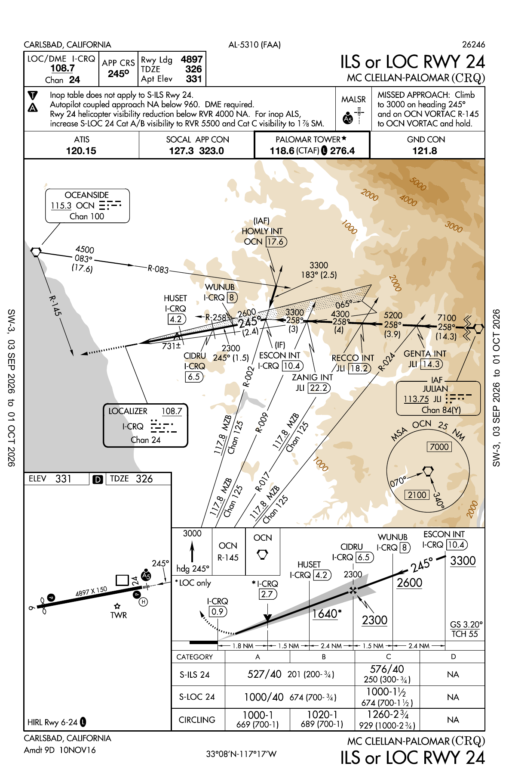
Backup: ILS or LOC RWY 24, McClellan-Palomar (KCRQ)
• ESCON INT is the intermediate fix, I-CRQ 10.4 DME, at 3,300 ft
• Approach course 245 degrees; step-down through WUNUB 2,600 and CIDRU 2,300
• SOCAL APP CON 127.3 / 323.0; Palomar Tower 118.6
• The beacon lay on the ground beneath the fix
FAA chart, cycle 2609, eff 03 SEP - 01 OCT 2026.
NOT FOR NAVIGATION.
CAP V-SAR | Concept Brief | DRAFT v0.1 | 6 Sep 2026
21
Notes:
Only if someone wants the full plate. ESCON is the IF, not the FAF - CIDRU at 2,300 is where the glideslope is intercepted.

