Slide 1
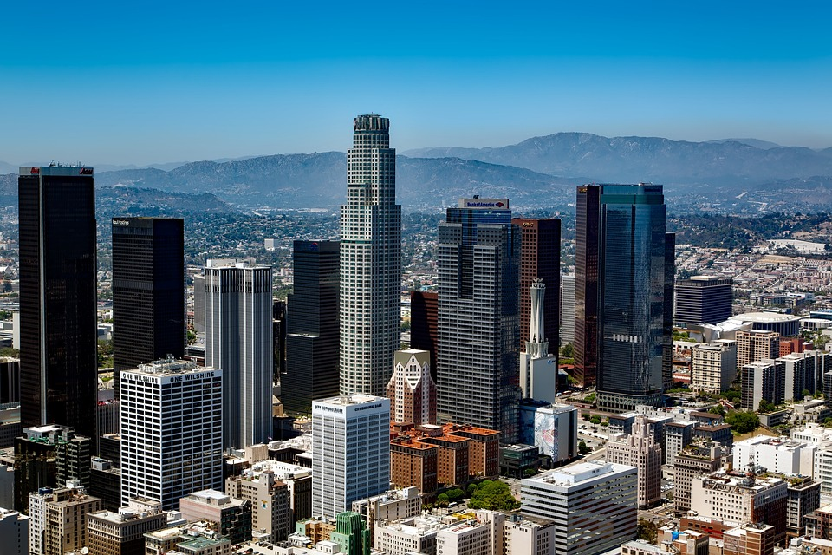
Los Angeles
Robert Pearce, Julianne Lo, Hannah Burgess, Akhil Karandikar
Crime Data 2020 - Present
Credit: CC0 Public Domain

Slide 2
Project Overview
Los Angeles Crime Data from 2020-Present
We will be discussing data trends in crime over time and location to determine where and when crimes are more likely to take place.
We will be showing analyses of:
total crimes committed across varying dates, times, and locations
We are interested in determining who is most at risk for particular types of crime.
We will be showing analyses of:
the number of crime types across differing gender and age.

Slide 3
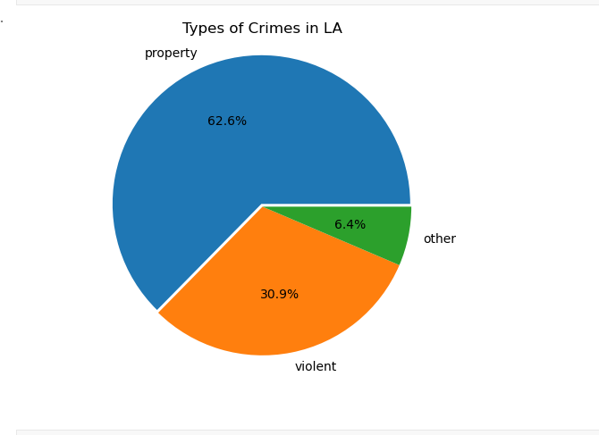
Types of Crimes Committed
Out of 138 different types of crime listed, we have narrowed down the categories.
761,583 crimes committed in Los Angeles since January 2020

Slide 4
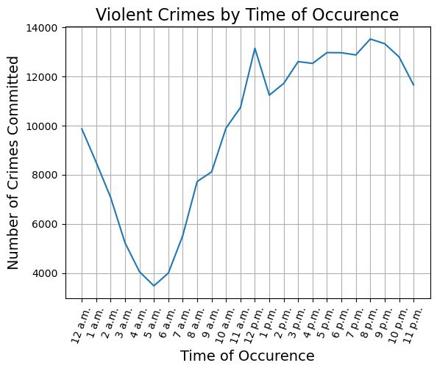
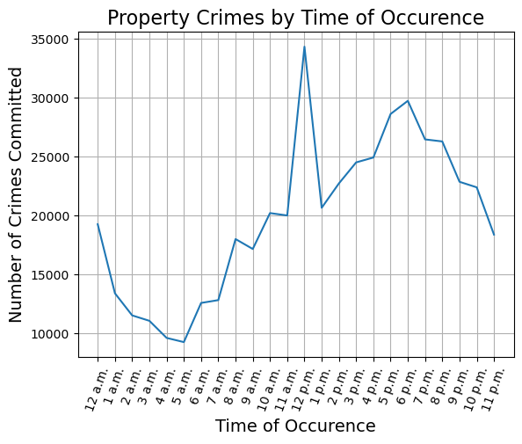
Time of the Day

Slide 5
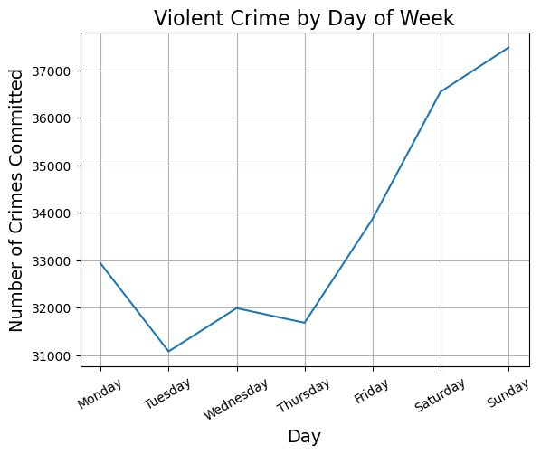
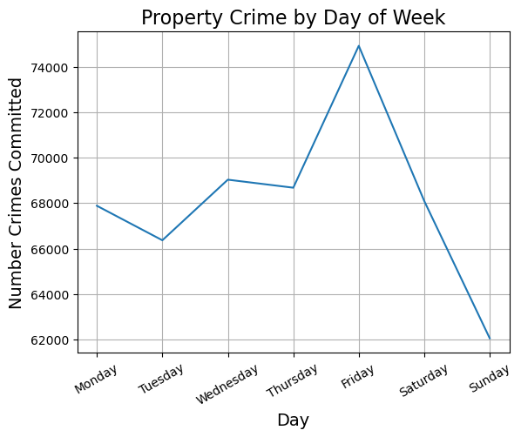
Day of the Week

Slide 6
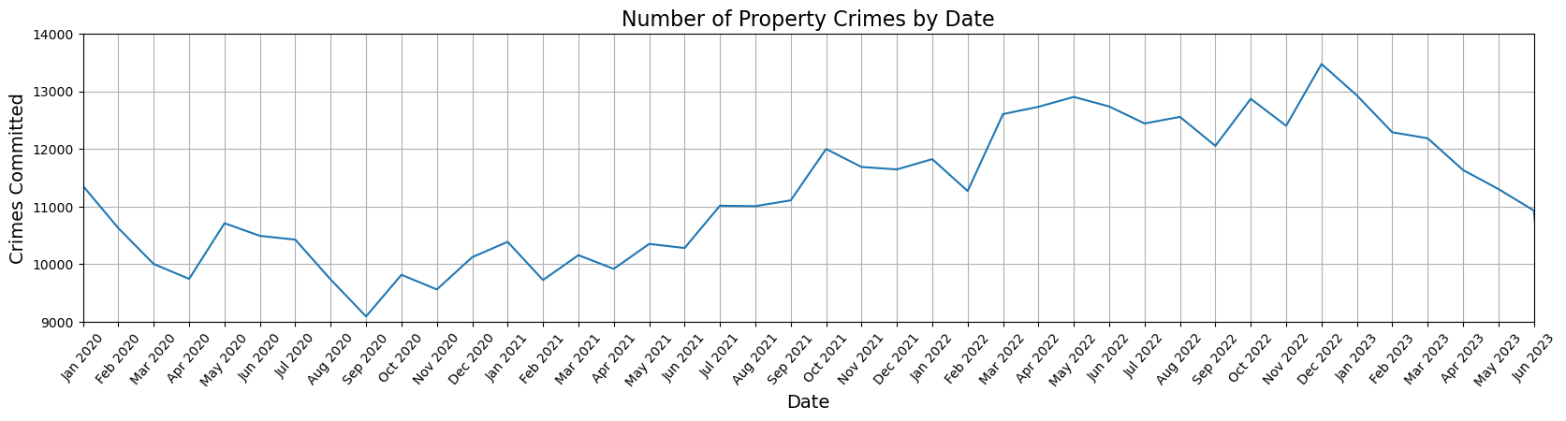
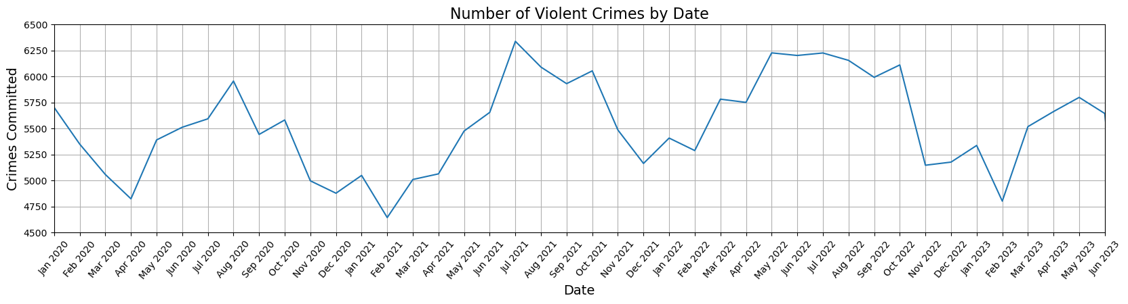
Month and Year

Slide 7
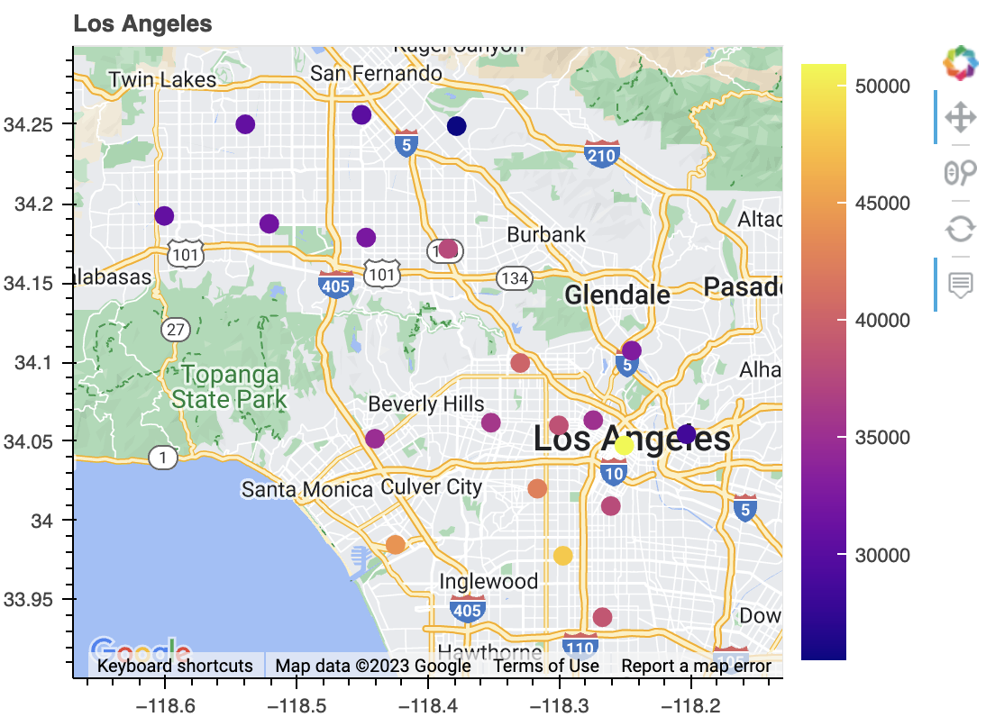
Location of Crime
Mission
Foothill
Devonshire
Topanga
West Valley
Van Nuys
N Hollywood
Hollywood
Northeast
Olympic
Rampart
Hollenbeck
West LA
Willshire
Central
Southwest
Newton
Pacific
Southeast

Slide 8
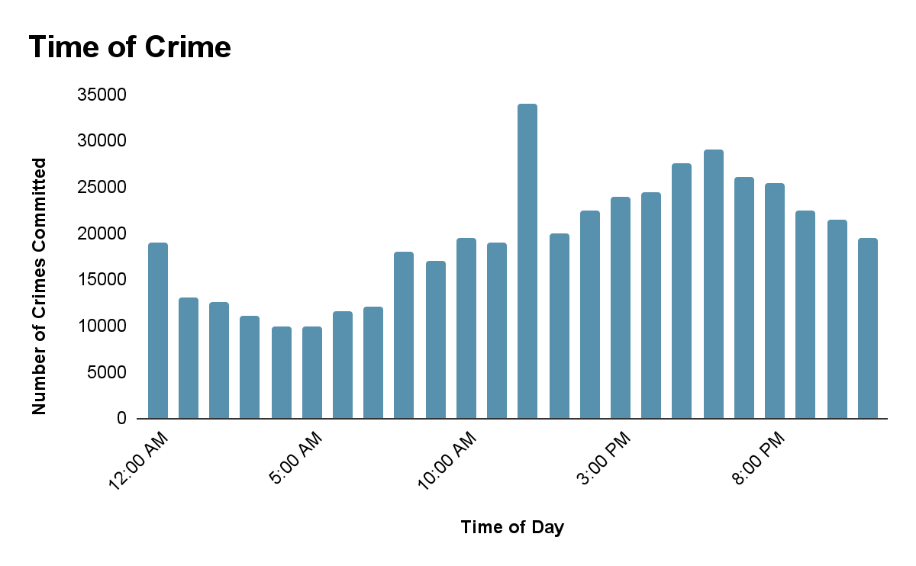
What time of day are criminals most active?
Around lunch time. 12-1pm

Slide 9
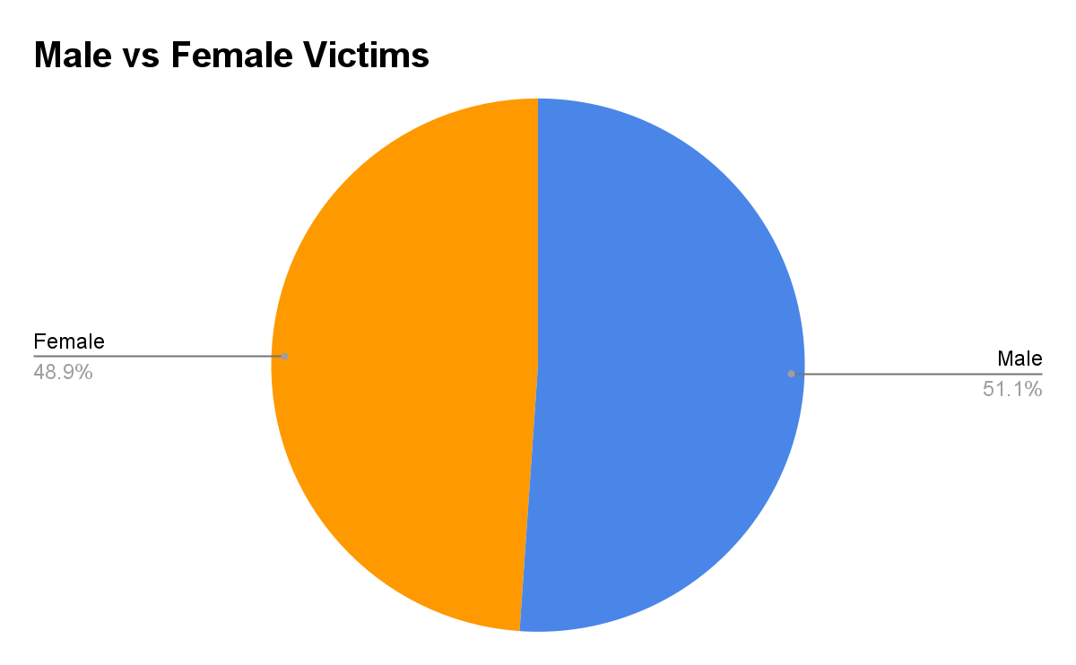
Who is more susceptible at becoming a victim of a crime?
Male vs Female
Men are slightly more likely to be targeted during acts of crime in Los Angeles.

Slide 10
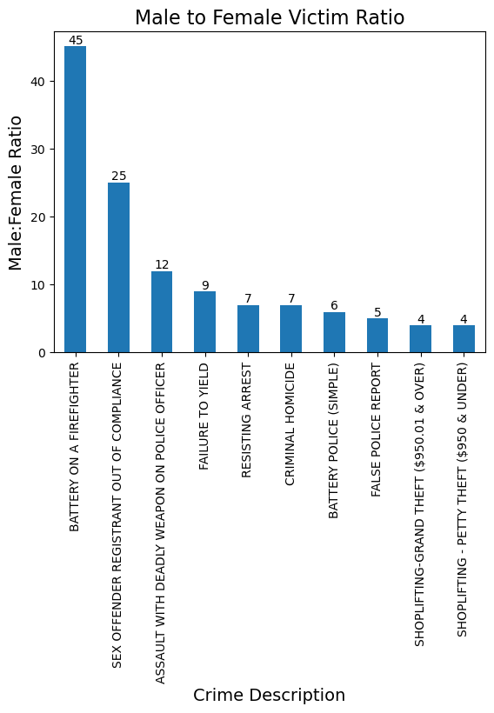
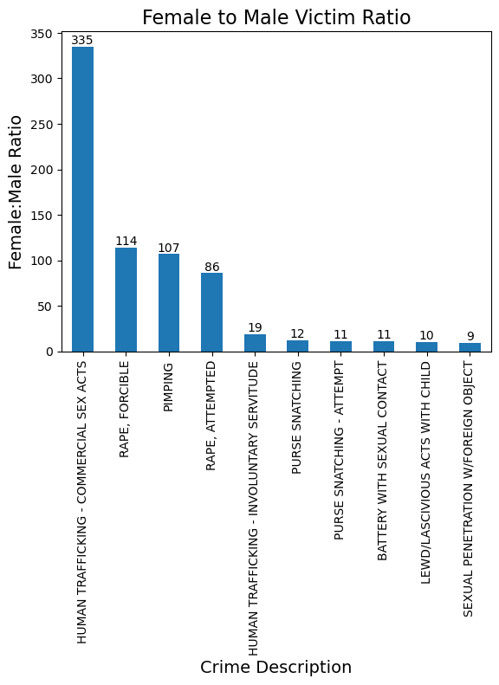
Male vs Female

Slide 11
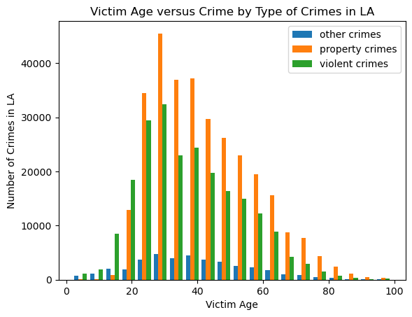
Who is more susceptible at becoming a victim of a crime?
Age

Slide 12
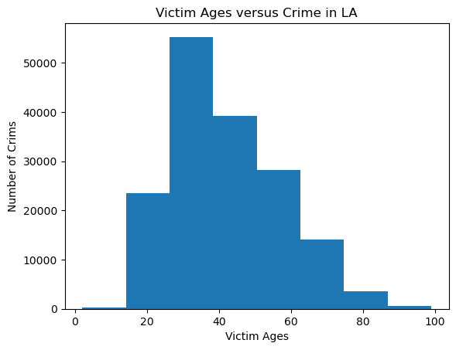
Age

Slide 13
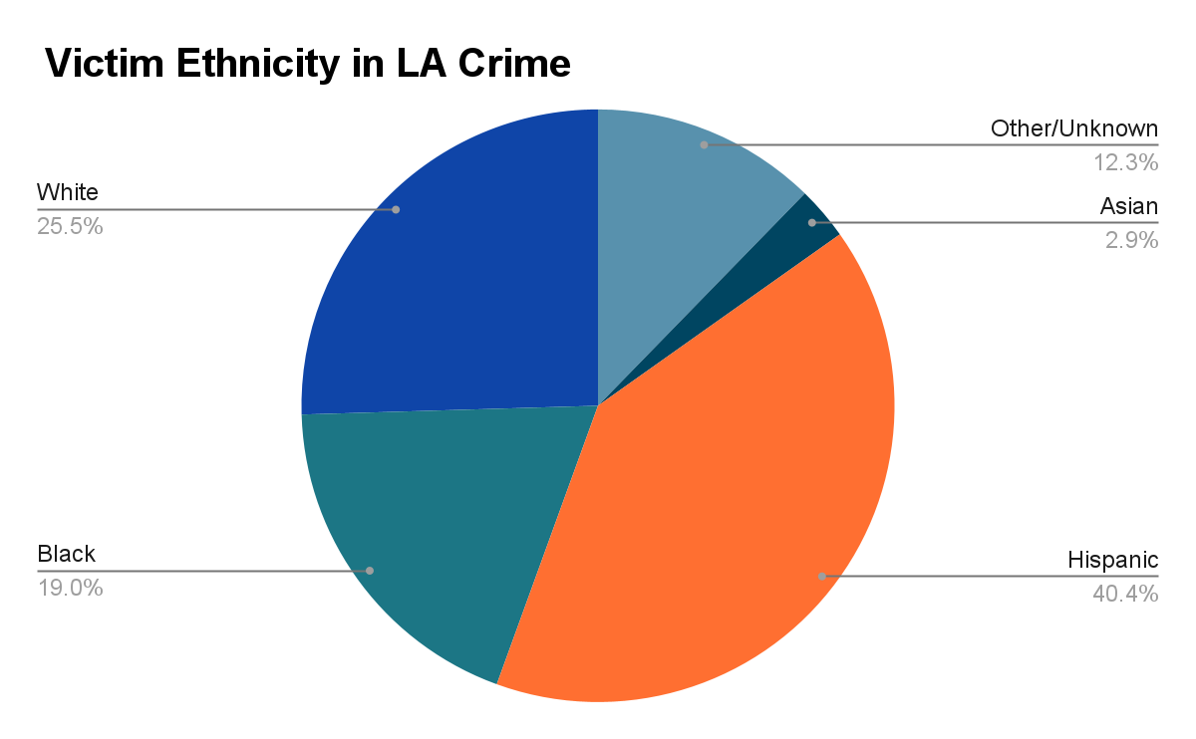
Who is more susceptible at becoming a victim of a crime?
Ethnicity
People of Hispanic descent are more likely to be targeted during acts of crime in Los Angeles.

Slide 14

Conclusions
In conclusion, the project found that crimes changed according to multiple patterns
Some of the patterns that were influential were seasonal or time
The rates of property crime fell during covid lockdowns but other types of crimes were not impacted by lockdowns
There was also major differences between property and violent crime
The project also found that women were more likely to be victims of sex crimes

