Slide 1
Airline Customer Satisfaction ~ Logistic Regression
By: Robert Pearson

Slide 2
Introduction
Dataset is Customer Satisfaction in Airline
Survey data taken from an undisclosed airline company.
Focused on measuring an airline’s passenger satisfaction with their flight.
Passengers responded by ranking a number of variables on a scale of 1-5 or responding to certain flight related questions.

Slide 3
Introduction
Why is this important?
Measuring customer satisfaction with a service is a key component of any business.
Airline could have collected the data due to wanting to them wanting to improve the customer’s experience.
In an industry, like the airline industry, customer satisfaction plays a big role in customer retention. Airlines want to make customers into lifetime customers and that happens from customers having a good experience on their flight.

Slide 4
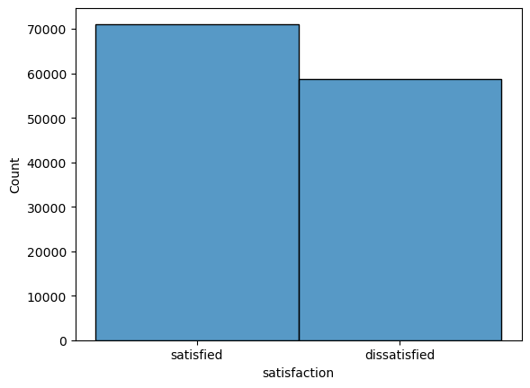
Initial Analysis
129,880 samples of an airline’s customer ratings
22 columns of data with a mix of categorical and numerical
The dependent variable in this study is satisfaction, this variable’s output is either “satisfied” or “dissatisfied.”
Some missing values for the variable “Arrival Delay in Minutes” but was only 393 out of 129,880.

Slide 5
Data Preparation
Data appeared to be mostly cleaned up already.
Missing values were imputed with mean value.
Most of the data was numerical, but the variables “Customer Type”, “Age”, and “Class” required one-hot encoding.

Slide 6
Models
The selected variables are “Seat comfort”, “Departure/Arrival time convenient”, “Food and drink”, “Gate location”, “Inflight wifi service”, “Inflight entertainment”, “Online support”, “Ease of Online booking”, “On-board service”, “Leg room service”, “Baggage handling”, “Check-in service”, “Cleanliness”, and “Online boarding”.
Experiment Number | Parameters
1 | All twenty-one (21) variables with 80/20 split for train, and test
2 | All twenty-one (21) variables with 70/30 split for train, and test
3 | Selected variables with 80/20 split for train, and test
4 | Selected variables with 70/30 split for train, and test

Slide 7
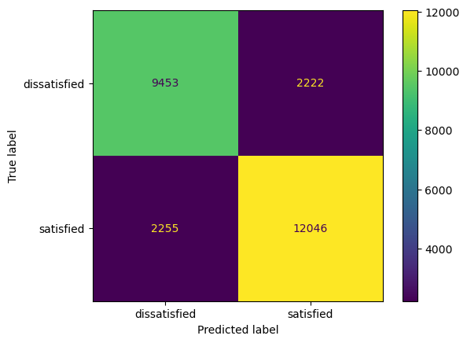
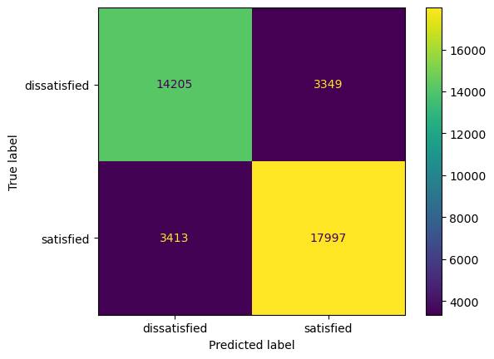
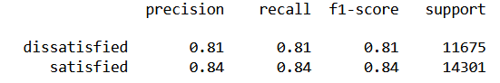
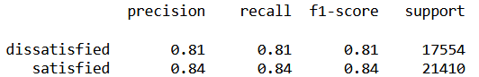
Results - All 21 variables with 80/20 split and 70/30 split
80/20
70/30
Model with twenty-one features and a 70/30 split has the highest true positives. Showing that the model correctly identifies the most satisfied customers.
The model with twenty-one features and an 80/20 split has the lowest false negatives, showing that it incorrectly predicts the fewest dissatisfied customers as satisfied.
Notes:
Accuracy: 60% of customers correclty correctly classified. 40% of messages misclassified, Precision: 85% of flagged messages were actually spam. 15% of flagged messages weren't spam, Recall: 46% of spam messages were flagged. 54% of spam messages were missed.
the model with twenty-one features and a 70/30 split for train/test has the highest true positives, showing that the model correctly identifies the most satisfied customers. While the model with twenty-one features and an 80/20 split for train/test has the lowest false negatives, showing that it incorrectly predicts the fewest dissatisfied customers as satisfied. Considering these factors, if we were to prioritize correctly identifying satisfied customers (true positives), the model with a 70/30 split is better. But, if we prioritize minimizing the number of dissatisfied customers that are incorrectly reported as satisfied (false negatives), the model with an 80/20 split is better.

Slide 8
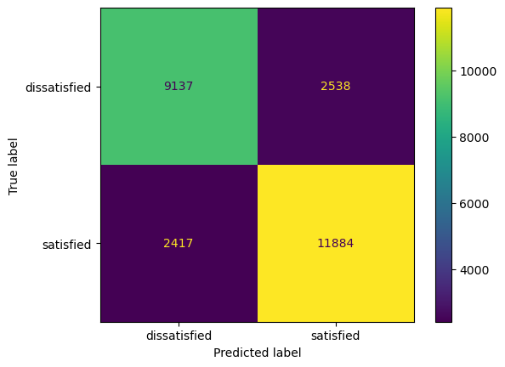
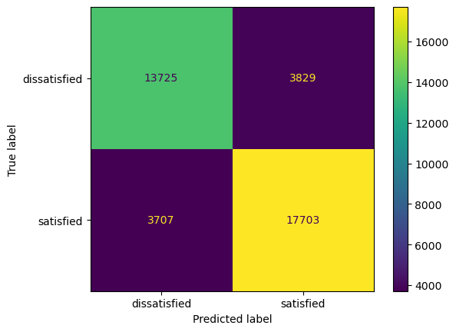
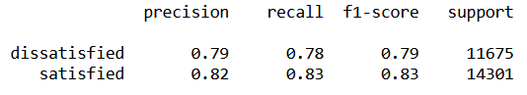
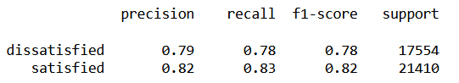
Results - Selected variables with 80/20 split and 70/30 split
80/20
70/30
Both models had a higher false positive count and false negative count compared to their counterparts.
It misclassified satisfied customers as dissatisfied and vice versa more often compared to the other models.

Slide 9
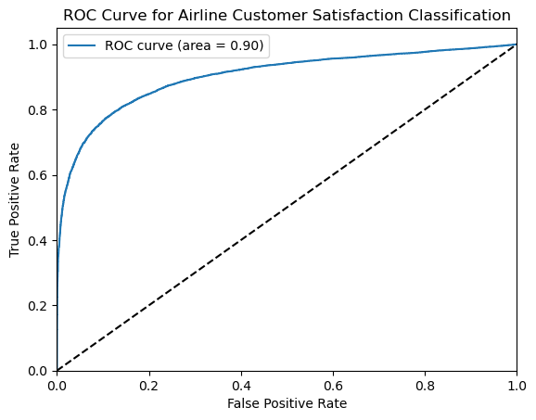
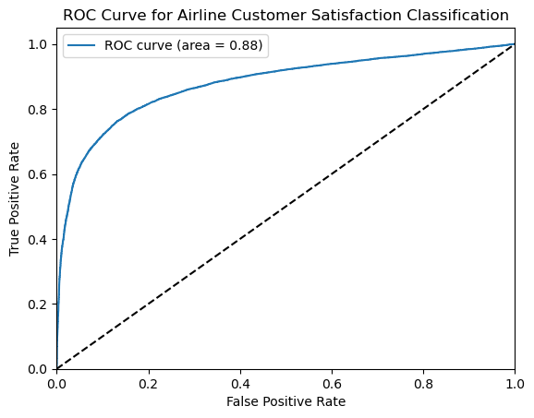
Results
ROC curve created by plotting the true positive rate against the false positive rate.
The AUC is the probability that the model will rank a randomly chosen positive example more highly than a randomly chosen negative example.
Ranges from 0 to 1, 0.5 = random guessing, and 1 = perfect performance.
All models can achieve a high true positive rate while keeping the false positive rate relatively low.
Selected variables
21 variables

Slide 10
Problems Encountered
Obtaining the data / choosing dataset
Creating a ROC curve (receiver operating characteristic curve)
Interpretating the ROC curve and AUC

Slide 11
Future Improvements
Run more experimenters with different variables selected.
More in-depth analysis into the relationship between each variables and how it affects a customer being satisfied.
Test different models

Slide 12
Conclusion
The models with all twenty-one features only slightly outperformed those with fourteen features
The models with twenty-one variables, 70/30 split model excelled in identifying satisfied customers, the 80/20 split model minimized misclassification of dissatisfied customers.
The model with all fourteen features and an 80/20 split was the least favorable performer due to higher false positive and false negative counts.

