Slide 1

Cyclistic Case Study
Using Excel, SQL, PowerPoint

Slide 2
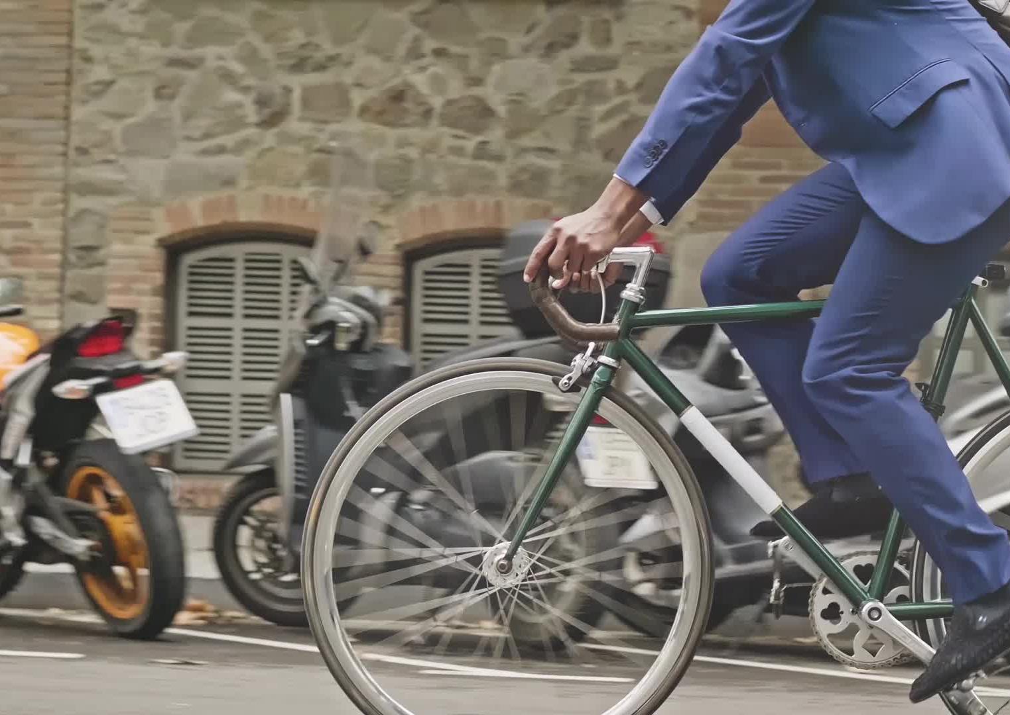
Project Purpose:
Support the decision-making process to the Marketing Analytics Team that attempts to understand casuals and members behaviors and convert casuals into members.

Slide 3
Data Cleaning Process
Data were cleaned and organized using SQL and Excel.
The dataset is too big for excel. Data samples were chosen using SQL and prepared for the cleaning process.
Cleaned blanks and irrelevant data cells using Excel formulas.
Data were cleaned following rules found at Case Study 1_How does a bike-shared navigate speedy success_-2.pdf

Slide 4
Data Manipulation
Added ride length and day of the week column in excel.
United and combined all datasets in SQL.
United and combined the datasets depending on seasons.

Slide 5
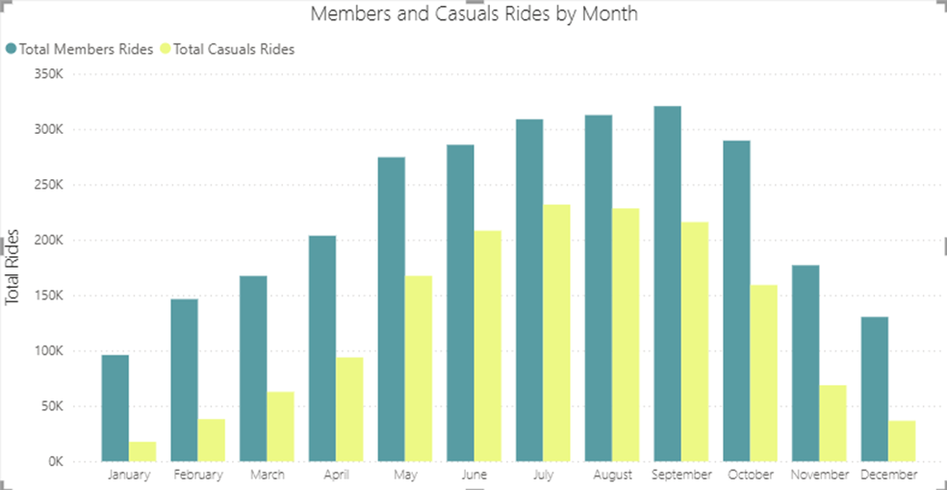
Members vs Casuals by Month
Members have more rides all year long.
There is a massive increase in rides in May and a huge decrease in November for casuals.
Members have a steadier increase and drop off.

Slide 6
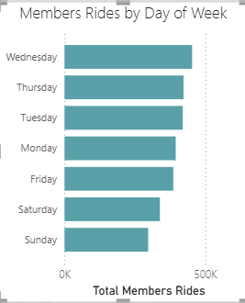
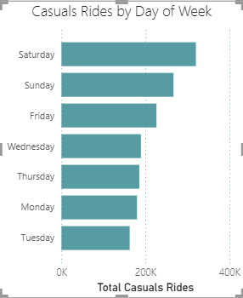
Members vs Casuals by the Day of the Week
Casuals prefer riding on weekends, especially Saturday.
Members prefer riding on weekdays.

Slide 7
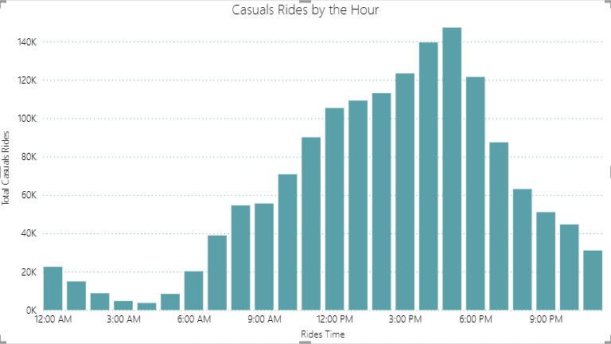
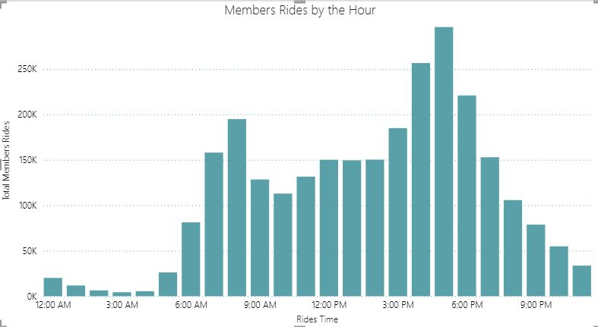
Members vs Casuals by the Hour
Members tend to ride in the more in the mornings around 8 AM and in the evening.
Casuals tend to mostly ride in the afternoon and evenings.

Slide 8
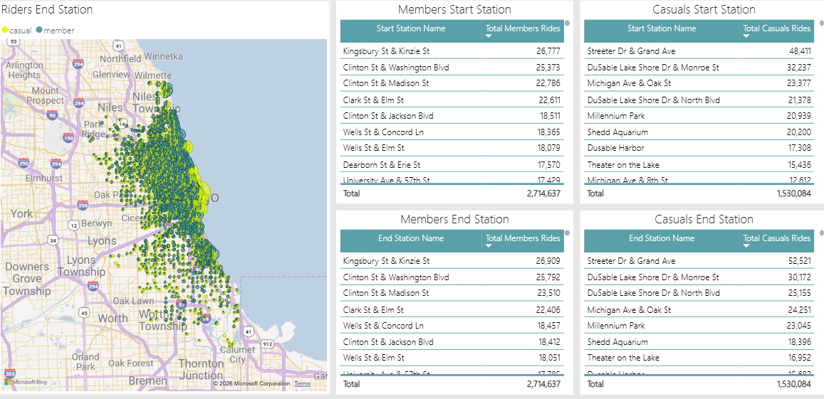
Rides Start and End Destination
Members and Casuals start and end stations are different.
A lot more casuals tend to ride along the coast.
With Streeter Dr & Grand Ave being the most popular start and end station.

Slide 9
Recommendation
Target Casual Riders on Weekends.
  Casual riders tend to ride bikes for more on weekends. Therefore, marketing campaigns can target casual riders on weekends by offering discounts and promotions for annual memberships..

Slide 10
Recommendation
2. Target the Coastal Stations.
  Casual riders tend to ride more around the coast than in any other area. Put out more signs, fliers and posters by those stations to help increase annual membership.

Slide 11
Recommendation
3. Highlight the Benefits of Annual Membership.
  Both casuals and members like riding their bikes in the evening. Marketing strategy should highlight the benefits of annual memberships to casual riders. For instance, campaign can emphasize that annual members get discounts on rides and can reserve bikes in advance. This can help to incentivize casual riders to become annual members by showcasing these benefits.

Slide 12
Source
Data were obtained directly from company records available at:
https://divvy-tripdata.s3.amazonaws.com/index.html
License to use data is available at :
https://www.divvybikes.com/data-license-agreement
Data is from December 2023 – November 2024

