Slide 1
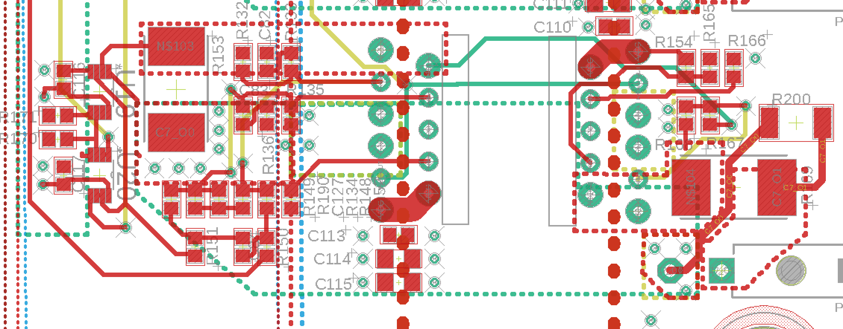
One example output channel’s analog stage:
To adjust the compensation to make amplifier stable for a desired load, change C82 and C83 (0805 size surface mount components)
Optional (if circuit still is not stable): Short circuit across the parallel RC circuit formed by R190 and C127
If more than 3.5 amps output current is needed, replaced R152 and R166 with a smaller current limiter resistor. To get full 8 amp output, use 0 ohms. See OPA549 datasheet for details.
If you want to slow down or speed up the rise time of the output current, you can change C84.

Slide 2
