Slide 1
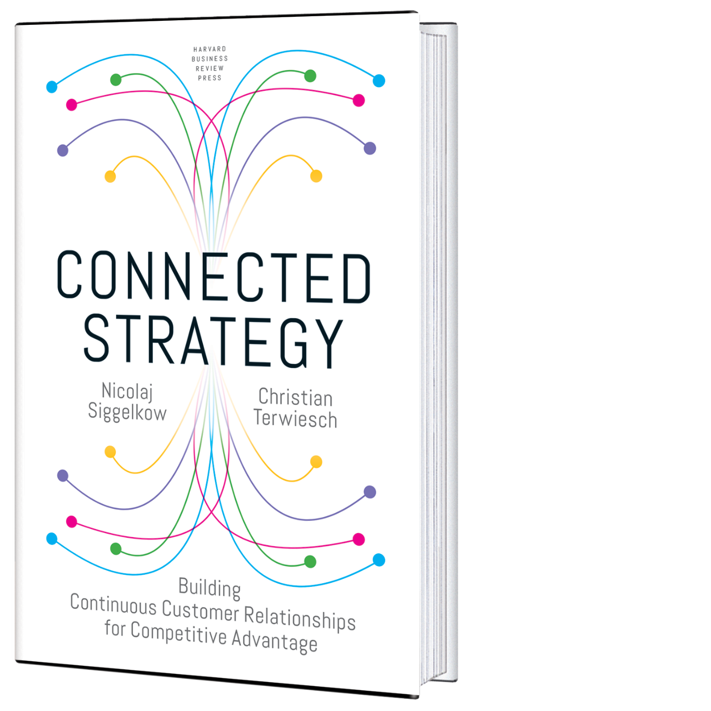
Worksheets from Siggelkow & Terwiesch Connected Strategy (HBR Press, 2019)

Slide 2
Chapter 3
(Rewards of Connected Strategies)

Slide 3
Step 1: Diagnostic questions concerning your current connections with customers
Questions | Answers
How often do you currently connect to your customers?
What kind of information do you receive about your customers’ needs?
How does information flow from the customer to you? For instance, does the information flow rely on the customer taking the initiative, or does the information flow happen in more a continuous and autonomous manner
How long does it take for a customer need to reach you?
How long does it take for you to react once you have a customer need?
What do you learn each time a customer connects to your firm? How are you integrating these episodic interactions into a single connected experience for your customers?

Slide 4
Step 2: Brainstorm the effects of a Connected Strategy could have for your organization
Imagine a world in which customers could instantaneously communicate their needs to you. You are by their side as they go through life, anytime and anywhere. How would this increase in connectivity allow you to improve how you serve your customers? More specifically:
Questions | Answers
How could you use this information to increase the willingness-to-pay of your customers?
How could you use this information to decrease your fulfilment costs?
Next, imagine a world in which you know a customer need even before the customer knows this need itself.
Questions | Answers
How could you use this information to increase the willingness-to-pay of your customers?
How could you use this information to decrease your fulfilment costs?

Slide 5
Step 3: Start identifying drivers of willingness-to-pay
Willingness to Pay
Consumption Utility: How happy is the customer with the product or service?
Accessibility: How easy is it for the customer to get the product or service?
Cost of Ownership: How much does it cost for the customer to use and maintain the product?
Performance
Fit
Location
Timing
Usage cost over product life
Maintenance cost over product life

Slide 6
Step 4a: Sketch the efficiency frontier for your industry that reflects the trade-off between willingness-to-pay and fulfillment costs
High
Willingness to pay
Low
High
Fulfillment costs
Low

Slide 7
Step 4b: Follow-up questions after sketching the efficiency frontier
Questions | Answers
Where are you relative to the efficiency frontier?
If you are not on the efficiency frontier, what efficiency improvements do you plan to pursue in order to reduce your fulfilment costs?
Assuming you are on the efficiency frontier, do you feel that you are in the right spot on the frontier?
What are the trends in your industry? Is there pressure on lowering costs or do you see your firm win over its rivals by providing products and services with a higher willingness-to-pay?
Are there new technologies that have allowed some of the firms already in the industry or potentially new entrants to push out the frontier? Do you see new business models breaking the trade-off between willingness-to-pay and fulfillment costs?

Slide 8
Chapter 6
(Creating Connected Customer Relationships)

Slide 9
Step 1: Map the current customer journey of one customer experience
Customer Journey
Why does the customer engage in the interaction?
How does the customer go about identifying, ordering, and paying for the desired product?
What products and services are provided to the customer?
Latent need
Awareness of need
Search for options
Decide on options
Order & pay
Receive
Experience good/
service
Post-purchase experience

Slide 10
Step 2: Identify customer willingness-to-pay drivers and pain points
Willingness-to-Pay Drivers and Pain Points
Why does the customer engage in the interaction?
How does the customer go about identifying, ordering, and paying for the desired product?
What products and services are provided to the customer?
Latent need
Awareness of need
Search for options
Decide on options
Order & pay
Receive
Experience good/
service
Post-purchase experience

Slide 11
Step 3: Capture the information flows for this customer experience
Information Flows
Why does the customer engage in the interaction?
How does the customer go about identifying, ordering, and paying for the desired product?
What products and services are provided to the customer?
Latent need
Awareness of need
Search for options
Decide on options
Order & pay
Receive
Experience good/
service
Post-purchase experience
Description of
Information
Trigger
Frequency
Richness
Customer effort
Action by
Improvement
Ideas

Slide 12
Step 4: Identify the deeper needs of the customer
In the eyes of the customer, the purpose of the relationship with our firm is to…
Why
How

Slide 13
Step 5: Understand the current relationship with your customer across separate (repeated) customer experiences
A) Identify the customer and retrieve data
Questions | Answers
How do you identify the customer and connect him or her to prior customer experiences?
Is this identification requiring time and effort form the customer?
Is this identification costly to your firm?
What organizational incentives are in place (or what disincentives need to be removed) so that various parts of your organization share the information they have about a particular customer?
B) Customization
Questions | Answers
How do we improve customization for a particular customer based on information that we have gathered about this customer?
What feedback do we gather from the customer to understand whether a particular solution worked well?
Can the customer make direct suggestions to us of how to improve our product or service?

Slide 14
Step 5: Understand the current relationship with your customer across separate (repeated) customer experiences
C) Population-level insights
Questions | Answers
How do we currently use population (or market-segment) level data to improve our product assortment?
How do we currently use population (or market-segment level data to refine features of existing products?
How do we currently use population (or market-segment level data to create entirely new products?
D) Why-How ladder questions
Questions | Answers
At what level in the Why-How ladder are most of our transactions currently taking place?
What would be alternative value propositions to the customer that are either more focused (HOW) or broader (WHY)?

Slide 15
Step 6: Identify new opportunities associated with connected relationships
Automatic Execution
Coach Behavior
Curated Offering
Respond-to-Desire
Latent need
Awareness of need
Search for options
Decide on options
Order & pay
Receive
Experience good/
service
Post-purchase experience
Responses to Pain Points
Required Information

Slide 16
Step 7: Find ways to utilize information gathered from repeated interactions to improve the Recognize-Request-Respond cycle
Experience 1
Experience 2
Experience 3
Experience 4
Customization Improvements
Fulfillment of deeper customer needs
Optimization of Product and Service Offering
Creation of New Products and Services
Efficiency Improvements

Slide 17
Step 8: Assess your data-protection policies to maintain trust with your customers
Questions | Answers
What procedures do we have in place to stay informed about data protection and privacy regulations in all the geographies in which we are active?
How do we keep up with how public opinion is changing with respect to these issues?
How do we currently obtain customer consent? How transparent is it to our customers what happens to their data?
What do we do to keep the data current and accurate?
What are our activities to keep the data safe and under what conditions do we notify customers of any breaches?

Slide 18
Chapter 10
(Creating Connected Delivery Models)

Slide 19
Step 1: Use the Connected Strategy Matrix to map your own activities and the activities of your competitors
 | Connected Producer | Connected Retailer | Connected Market Maker | Crowd Orchestrator | P2P Network Creator
Respond-to-Desire
Curated Offering
Coach Behavior
Automatic Execution

Slide 20
Step 2: Use the empty cells in the Connected Strategy Matrix to create new ideas
 | Connected Producer | Connected Retailer | Connected Market Maker | Crowd Orchestrator | P2P Network Creator
Respond-to-Desire
Curated Offering
Coach Behavior
Automatic Execution

Slide 21
Step 3: Understand your existing revenue model, identify its main limitations and consider alternatives for your current activities as well as for the ideas created above
Questions | Answers
What does the customer pay for?
What are your different revenue streams?
Who is paying?
When does payment occur?
Questions | Answers
Next, look for inefficiencies in your revenue model. Do you use this revenue model because you believe it is the right one, or are you constrained by connectivity to the customer?
Now that you understand the current revenue model, consider ways for considering these inefficiencies

Slide 22
Step 4: Deconstruct your Connected Strategy into technological sub-functions and then catalogue currently used technological solutions for each sub-function
 | Recognize | Request |  |  | Respond |  |  | Repeat | Connection Architecture | Revenue Model
 | Become aware of the need | Search and decide on option | Order | Pay | Receive | Experience | After sale | Learn and improve | Connect parties in ecosystem | Monetize customer relationship
Sense
Transmit
Analyze
React

Slide 23
Step 5: Identify new technological solutions and how those might enable further innovations in your Connected Strategy not identified so far
 | Recognize | Request |  |  | Respond |  |  | Repeat | Connection Architecture | Revenue Model
 | Become aware of the need | Search and decide on option | Order | Pay | Receive | Experience | After sale | Learn and improve | Connect parties in ecosystem | Monetize customer relationship
Sense
Transmit
Analyze
React

