Slide 1
OpenSSH: Tips & Tricks
Robert Petranović, 2014

Slide 2
OpenSSH: Tips & Tricks
ssh-agent
Client config
Proxying
NAT (aka port forwarding)
Reverse tunneling
VPN

Slide 3
ssh-agent
Pokretanje agenta
  Ubično se pokreće tijekom pokretanja X sessiona.
  Ispisuje važne varijable, koje treba učitati u evironment.
Dodavanje ključa
  ssh-add
  TTL kao parametar

Slide 4
Client config
User: $HOME/.ssh/ssh_config
System: /etc/ssh/ssh_config
Umjesto pisanja dugačkih naredbi:
  ssh -p 2222 -i ~/.ssh/id_rsa robi@…
  ssh public

Slide 5
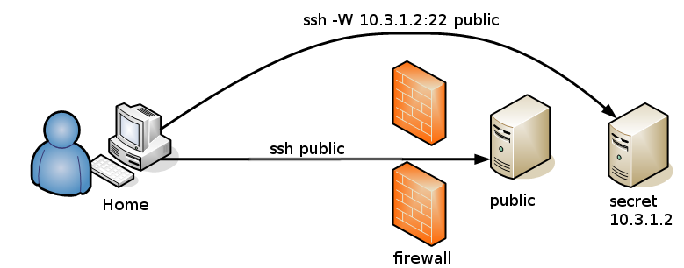
Proxying

Slide 6
NAT (Port forwarding)
Local
  ssh -L lport:host:tport
ssh -L 65432:10.3.1.2:5432
psql -h localhost -p 65432
Remote
  ssh -R lport:host:tport
Reverse ssh tunnel

Slide 7
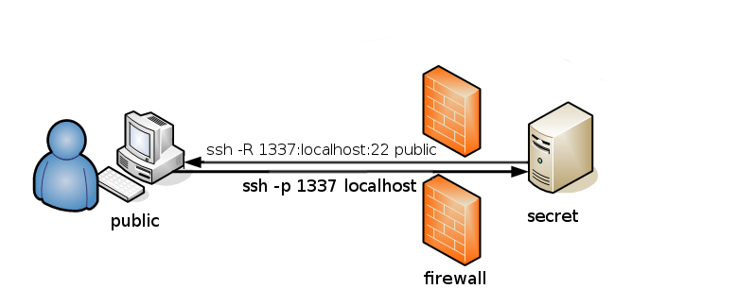
Reverse tunneling

Slide 8
VPN
TUN/TAP
TCP tunnel, loše performanse!
Opcije:
  TunnelDevice (-w)
      Uzima parametar: local_intf:host_intf
      To su brojevi TUN/TAP adaptera
  Tunnel – vrsta tunnela

Slide 9
VPN
Point to point
  OSI layer 3
  Zahtjeva IP router
  -o Tunnel=point-to-point
Ethernet
  OSI layer 2
  Zahtjeva bridge
  -o Tunnel=ethernet

Slide 10
Hvala!
Pitanja?
http://github.com/rpetrano/talk-ssh

