Slide 1
The Non-Uniform
Fast Fourier Transform
Group Meeting
Friday, October 3rd, 2008

Slide 2
Overview
Intuitive Descriptions
Formulation of Equations for NUDFT
NUFFT Development
Inverse Techniques
Generalizations
Basic Examples
Applications to Research

Slide 3
NUDFT Description
NUDFT: essentially the DFT without limitations to equally spaced frequency nodes
  Useful for applications in which samples must be taken at irregular intervals in frequency, time, or both (NNDFT)
  Allows for more “selectively concentrated” frequency (or time) information
Fast implementation: NUFFT:NUDFT::FFT:DFT
Notes:
NUDFT – Non-Uniformly Spaced or Non-Equispaced Discrete Fourier Transform
The DFT and FFT are limited to obtaining frequency information at regular intervals in the frequency domain when given samples taken at regular intervals in the time/space domain
In many applications, the data will be collected on a non-uniform grid, or it is desirable to have the frequency information for non-uniformly spaced points in the frequency domain
In these cases, we can use a generalization of the DFT known as the non-uniform DFT
The non-uniform DFT will assume equispacing in time/space but will allow spacing in the frequency domain to be variable.
A further generalization of the NUDFT is the NNDFT, which doesn’t assume equispacing in either domain.
The mathematics are a little tricker, but essentially the problem is exactly the same.
The fast version of the NUDFT is the NUFFT, as you might expect.

Slide 4
Interpretation as Interpolation
Can be thought of as two sequential processes
  FFT taken to get frequency information at uniformly-spaced nodes
  Results used to interpolate to desired nodes
Approximation
  Interpolation only produces approximation of values at desired nodes
  Quality of approximation dependent on node spacing, nature of function
Notes:
A good way to think of the NUDFT is in terms of interpolation.
While the NUDFT computes the Fourier coefficients in one fell swoop, it’s instructive to think of it as two processes that occur in serial.
First, the input data is used to perform a standard FFT and get Fourier coefficients on a regularly spaced grid.
Using these, the frequency representation of the signal can be interpolated to find the values at the desired frequency nodes
Because this process uses interpolation, it only produces an approximation of the coefficients at these nodes
The quality of that approximation will depend on the specific behavior of the function being transformed and the spacing of the nodes

Slide 5

Deriving the NUDFT: Setup
Set of d-dimensional frequencies
Index set specifying sample locations:
Space of all d-variate one-period functions expressed as:
Notes:
Now we’ll take a few minutes to derive the NUDFT
We start with a subset (called T^d but it’s not shown on the slide) of R^d where we’ll get our frequencies from. We’ll assume during the transform that we have M elements from this space that we’re working with, which will give us M Fourier coefficients
Each vector from T^d has every one of its frequency components between -1/2 and ½
The index set I_N essentially serves as a way of indexing the samples of the source signal that we’re provided with
That allows us to set up a basis for the space of all d-variate one-periodic functions, which is the space where the NUDFT of the function will reside

Slide 6

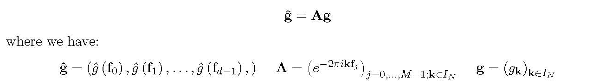
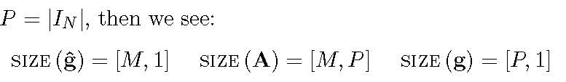
Deriving the NUDFT: Expression
A 1-periodic function can be written as a basis expansion:
In matrix notation:
Dimensionality (M: # of Fourier coefficients):
Notes:
Using that basis, any one periodic function can be written as a basis expansion with certain coefficients
That lets us write an expression that should look pretty familiar; it’s essentially the same as the DFT, but the values of f don’t have to be evenly spaced
As a sanity check for the matrix notation, we can look at the dimensions of each of the matrices involved in that calculation
The ghat matrix has M entries for each of the Fourier coefficients. The notation for P means that P is the cardinality of the index set, which is the total number of samples in time/space that we have of the original function.

Slide 7
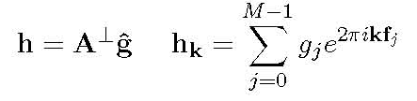
Deriving the NUDFT: The Adjoint
Adjoint – something like an “inverse” transform
Expressed as:
Adjoint behavior
  When frequency nodes equally spaced, NUDFT collapses to DFT, and A⊥ A=MI_{M}
  Without equal spacing, equality does not hold
    Transform cannot be “undone” just by applying the adjoint
Notes:
In the standard DFT, the adjoint of the Fourier matrix can be used as an inverse transform to perfectly recover the samples
The adjoint in the NUDFT doesn’t have this property because of the non-uniform spacing of frequencies.
As a result, you can’t just apply the adjoint to the transformed data to get the samples back like you can in the DFT.
Obviously, if the nodes are equally spaced, the NUDFT just collapses to the DFT, and the inverse will work.
There are a few approaches that can be taken to find the inverse depending on the situation, but they all require iterative methods, which is our forte

Slide 8
Developing the NUFFT: Introduction
Computationally fast
  Does not require full computation of A
  Uses approximations in both frequency and time/space – not a perfect representation of the transform
Makes use of standard FFT techniques and window operations
Notes:
The NUFFT is similar to the FFT in the sense that it’s a fast algorithm for the NUDFT transform, but there’s a key difference to it – it doesn’t give a perfect representation of the NUDFT
Just as with the DFT, it’s impractical and computationally expensive to construct the entire NUDFT matrix.
However, if some approximations are made during the process (notably by using window functions), known FFT methods like the FFTW can be used and the calculation time is reduced.
The key to producing a more accurate NUFFT is in good selection of the window functions, which may depend on the application and the nature of the data itself.

Slide 9

Developing the NUFFT: 1-D
In 1-D, want frequency information for certain frequencies
Goal: find a linear combination of 1-periodic shifted window functions to approximate the NUDFT
General equation to satisfy:
Notes:
To simplify the development, we can just look at how the NUFFT is done in 1 dimension.
Our goal is to find weights for a linear combination of 1-periodic shifted window functions that we can use to approximate the NUDFT well.
We want to select the window function and the window function weights in such a way that we can get our approximated signal as close as possible to the NUDFT
In the equation on the slide, little n = sigma * N.
This is just meant to indicate that we have oversampled the function by a factor sigma, but it’s important because it’ll be used in our approximations.

Slide 10
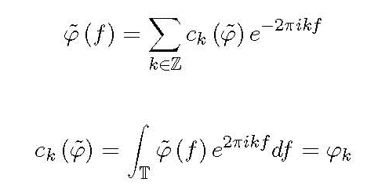
Developing the NUFFT: Window Fcns.
Essentially used as method of frequency interpolation
Start with a standard window function ', extend to 1-periodic version
Periodic version expressed as Fourier Series:
Notes:
The window functions essentially serve as methods of frequency interpolation
By coming up with a general expression for the transform of our data, we can evaluate it at specific frequencies, as we said before
The shifted window functions, then, are linearly combined to give us a continuous function we can evaluate at certain points
If we start with some window function phi, we can extend it to a 1-periodic version and then express it as a Fourier Series with coefficients as on the slide

Slide 11
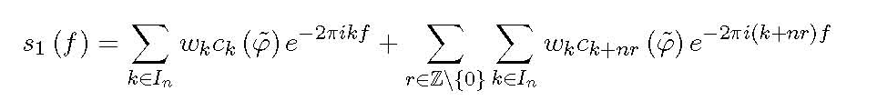
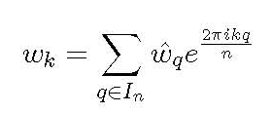


Developing the NUFFT: 1st Approx.
Then the approximation function can be expressed in a Fourier Series representation:
Approximation: compactness in time domain
  Assume window function has decaying Fourier coeff.
  Choose w_{k}’s to match NUDFT coefficients:
Notes:
Since we originally expressed our approximation S as a linear combination of window functions, we can use the Fourier Series representation to expand S further.
The document I sent out has the intermediate steps in this – when I was reading the derivation, these didn’t jump out at me and it took me a little bit to figure out how to work through it, so if you’re curious as to where that specific expression comes from, you can take a look at the document.
The first approximation we make is compactness in the time/space domain.
What we have in the equation on the slide is a Fourier Series representation of a function in frequency – the Fourier coefficients then represent time/space information.
We want to assume that the Fourier coefficients for our window function decay toward the ends of In, to ensure that the window function has smoothness in the frequency domain.
As a result, the assumption we make is that the window function is chosen in such a way that its Fourier series coefficients ck (which represent time/space) are concentrated between –N/2 and N/2, so we set the wk’s that are in In but not in IN to 0, and select the wk’s that are in both In and IN in such a way as to make them as close to the NUDFT coefficients as possible

Slide 12
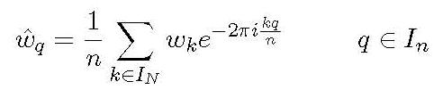
Developing the NUFFT: 1st Approx.
Approximation yields an expression for the weights in the original s₁ expansion:
  This is a standard DFT, since k and q are both integers and are distributed uniformly
  Can be evaluated with standard FFT algorithms (notably FFTW)
Results in truncation in the time/space domain
Notes:
This gives us an expression for the weights of the window functions, which is simply a standard DFT
The advantage of this is that we can use regular FFT techniques to solve this equation, which we already know to be efficient
However, by setting some of the coefficients wk to 0, we essentially perform a truncation in time, which introduces an approximation

Slide 13
Developing the NUFFT: 2nd Approx.
Want to truncate window function
  Give compact support in frequency domain
  Achieved by multiplying against function with compact support (Â)
Approximate s₁ by:
Define a new multi-index set:
Notes:
The 2nd approximation is to give the window function compact support in the frequency domain, which is achieved by multiplying it against a truncation function chi that will ensure compact support between f = -m/n and f = m/n
This gives the approximation to S that is on the slide
Next, define a new multi-index set, which is essentially just serving a similar role to In but it has a dependence on m

Slide 14

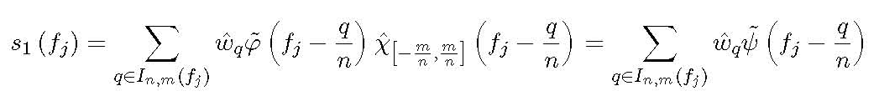
Developing the NUFFT: 2nd Approx.
Define a function Ã by:
Then we can write s₁ as:
Results in frequency truncation
Notes:
And then define a function psi as the product of the window and the truncation, then S can be written in a single sum
The new index-set is just to remove the 0 terms from the sum on the previous slide; it doesn’t further develop the NUFFT anymore, it just allows it to be expressed in a simpler way
We’re using the window functions for interpolation, so it makes sense that we would want to keep them relatively concentrated in frequency

Slide 15

Developing the NUFFT: Generalization
Same approach applied
Vector, matrix notation used
s₁ expressed as:
Notes:
The approximation function S we developed in 1-D is easily generalized to multiple dimension. The circled dot indicates component-wise product, and the inverse on the vector n is a component wise index
In this sum, the multi-index set is now also multidimensional

Slide 16
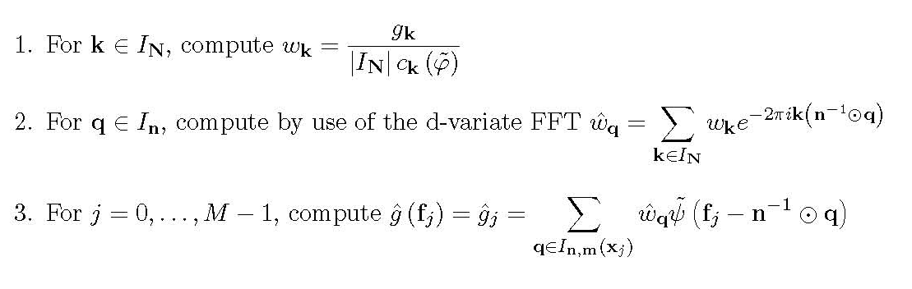
NUFFT: Algorithm
Inputs: M, N, frequency locations, and sample values
Algorithm:
Outputs: Fourier coefficients at given frequency locations
Notes:
Using these approximations, if we’re given the number of Fourier coefficients M, the vector N of data points in each dimension, the frequency locations, and the data values themselves, we can compute the NUFFT
First, we determine the time/space weights by diving them by the known Fourier coefficients for our chosen window function and by the cardinality of the set IN.
We only do this for k in IN; we set the time/space weights for k in In but not IN to 0
Then, for each vector in In, we determine the frequency weight by performing a d-variate FFT on the weights wk that we computed
Finally, we can write our approximation as a linear sum of the shifted window functions and evaluate this at the frequency nodes fj to get our Fourier coefficients at the desired locations

Slide 17
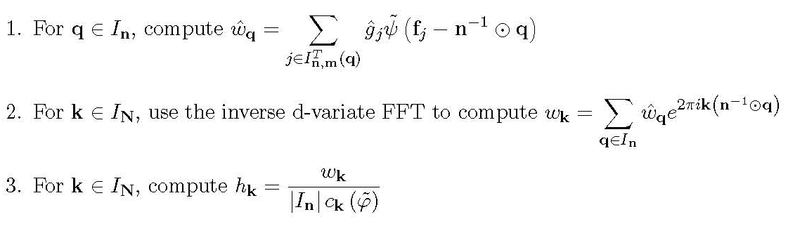
Adjoint NUFFT: Algorithm
Inputs: M, N, frequency locations, and Fourier coefficients
Algorithm:
Outputs: Sample values over uniform grid
Notes:
The development of the adjoint is similar, and yields a similar algorithm. Given the frequency locations, the Fourier coefficients, the number of coefficients M, and the number of sample points, we first compute the frequency weights using a new multi-index set
Then, we use the inverse d-variate FFT to find the time/space weights
Finally, we divide the time/space weights by the cardinality of the sample set and the Fourier coefficients of the window function to obtain sample values over the uniform grid

Slide 18


Inverse Techniques
No simple inverses exist
Over-determined case:
  More frequency locations than time/space points
  Problem can be formulated as weighted least-squares problem:
Under-determined case:
  Fewer frequency locations than time/space points
  Problem can be formulated as damped minimization problem:
Notes:
As was mentioned earlier, the adjoint does not serve as an inverse, and in fact, no simple inverses exist to the NUDFT matrix
In practice, inverse problems are solved with iterative algorithms such as conjugate gradients
There are two main cases that arise: in the first, there are more frequency locations than time/space points, meaning the problem is overdetermined
In this case, the problem takes the form of a weighted least-squares problem where the weights may be used to compensate for clustering of the frequency locations
The second case is when there are fewer frequency locations than time/space points, in which case there are multiple solutions and the problem can be considered a damped minimization problem in which some regularization is involved to control the norm of the signal

Slide 19
Inverse Techniques
Both systems can be solved using Conjugate Gradients
Under-determined case requires some form of regularization
  Included in the damped minimization approach
  Smooth time/space functions preferred; sample values decay at edges

Slide 20
Generalizations of NUFFT
NNFFT – NU in both time/space and frequency version of Fast Fourier Transform
NUFCT/NUFST – NU version of Fast Cosine/Sine Transform
NUSFFT – NU version of Sparse Fast Fourier Transform
NUFPT – NU version of Fast Polynomial Transform
NUSFT – NU version of Spherical Fourier Transform
Notes:
The NUDFT can be generalized to other transforms, as well
The NNFFT, already mentioned, is an extension of the NUFFT where the time/space nodes are also not equally spaced. In this case, an extra interpolation is required
Non-uniformly spaced versions of the fast cosine or fast sine transform, the sparse fft, the fast polynomial transform, and the spherical fourier transform

Slide 21
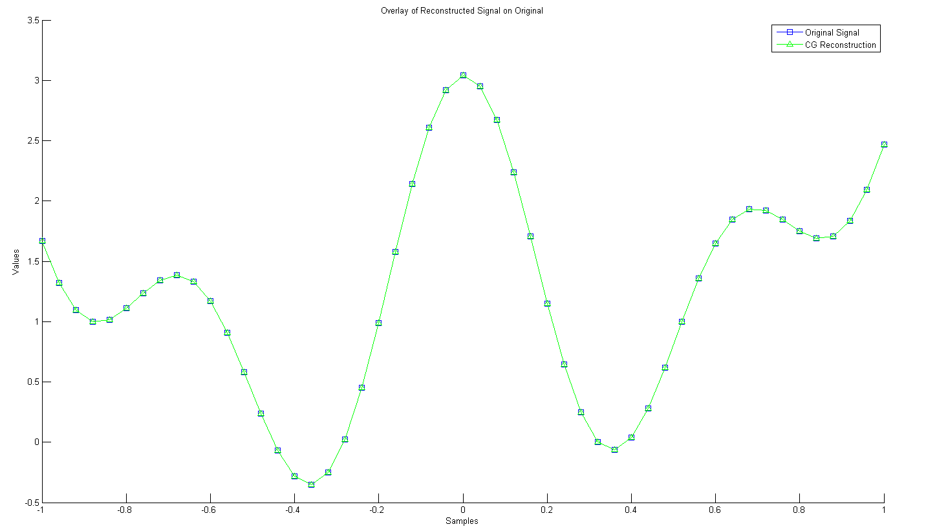
Basic Example: 1-D Reconstruction
MATLAB Example with irregularly spaced data
Conjugate Gradients used in reconstruction

Slide 22
Applications to Research
Unevenly spaced frequency data arises in MRI
Given Fourier coefficient values at frequencies lying on 3-dimensional spirals
  Under-determined case
  Want to reconstruct a 3-dimensional image from Fourier coefficients

