Slide 1
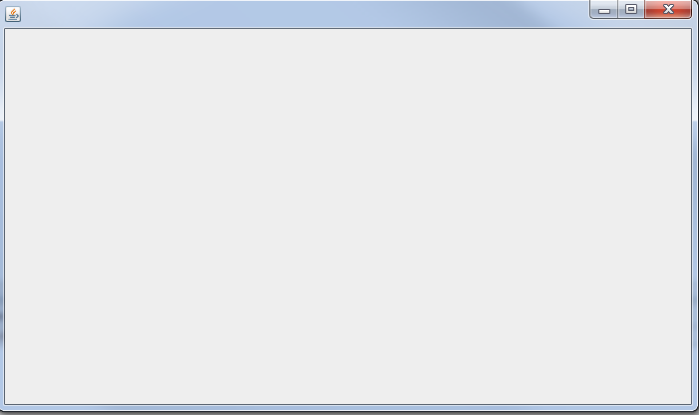






P2P Chat – Mock Up
Send a friend request
Visible only for private message
Contact List
Remo online
Messages
Notary Service
Remo
HSR
Messages are shown here (asc):
Time
Message
Left: Friend’s message
Right: My message
08:10
Hello
08:11
Hi
Send

Slide 2



P2P Chat – Mock Up
Send a friend request
Visible only for private message
Contact List
Remo online
Messages
Notary Service
Remo
Message is received and accepted
HSR
08:10
Hello
Message is received but rejected
08:11
Hello
pending
08:12
Hello
08:11
Hi
You have to accept/reject the message
Send

