Slide 1







FINANCIAL FRAUD DETECTION VIA DATA MINING
Group Id - 1
07. Pranjal P. Arote
53. Rutuja P. Gholap
55. Chaitanya A. Gore
Guided by-
59. Dewanshi L. Gupta
Prof. A. S. Bodhe

Slide 2

Problem Statement
03
Table of Content
Introduction
02
Dataset
03
Algorithms Used
04
GUI
05
Conclusion
06

Slide 3


Problem Statement
To develop financial fraud detection system using data mining techniques, which can accurately and efficiently identify suspicious transactions within large datasets. The system should be capable of minimizing false positives while maximizing the detection of actual fraudulent activities.

Slide 4
Introduction
In this Financial fraud detection systems we have used different classification algorithms which fall under the category of supervised algorithms to identify patterns in transaction data that may indicate fraudulent activities.
This system enhance accuracy, scalability, and adaptability in detecting fraud.

Slide 5
Dataset Info
Sr.No. | Attributes | Description
1. | step | represents a unit of time where 1 step equals 1 hour.
2. | type | type of online transaction
3. | amount | the amount of the transaction
4. | nameOrig | customer starting the transaction
5. | oldbalanceOrg | balance before the transaction
6. | newbalanceOrig | balance after the transaction
7. | nameDest | recipient of the transaction
8. | oldbalanceDest | initial balance of recipient before the transaction
9. | newbalanceDest | The new balance of recipient after the transaction
10. | isFraud | fraud transaction

Slide 6
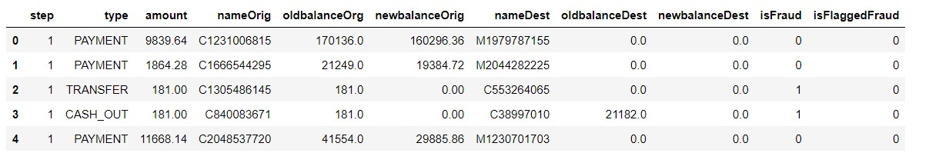
Dataset Info

Slide 7
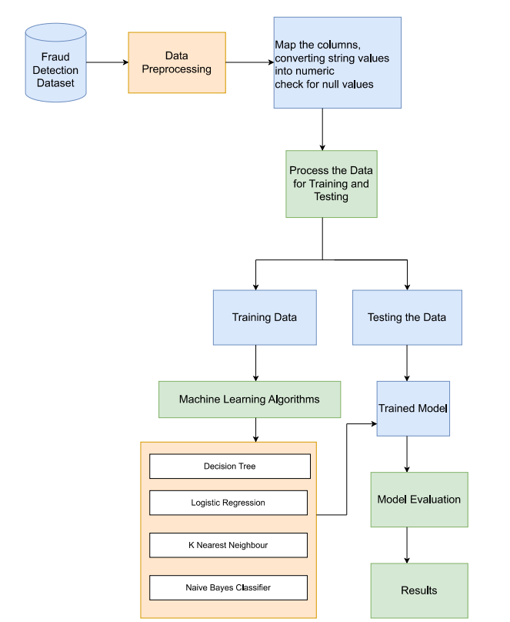

System Architecture

Slide 8

Algorithms Used
1.Decision Tree Algorithm
Decision tree algorithm falls under the category of supervised algorithm.
It can be used for solving regression and classification problems.
It creates a tree like structure, where each node represents a decision, the branch represents the result of the decision and the leaf node specifies the class label.
2.KNN Algorithm
KNN(K- Nearest Neighbor) ,a type of supervised algorithm, is one of the most important type of classification algorithm.
The most important task in KNN is to choose the value of k based on the given inputs.
After that we calculate the Euclidean distance.
After that we find the nearest neighbors by arranging the distance in ascending order and choosing the k smallest suitable data points.
At last, we apply the label to the most frequent among the nearest K neighbors.

Slide 9
3. Logistic Regression
Logistic regression falls under the category of supervised algorithm.
It is used for binary classification.
We give independent variables as a input and it gives output in form of probability value.
Logistic regression is of three types namely binomial, Multinomial and ordinal
4. Naive Bayes Algorithm
Naive Bayes is a classification algorithm that uses Bayes' theorem to determine class labels from input features. The model's assumption is that features are independent of each other when considering the class label, making calculations straightforward.
Variants of Naive Bayes include Gaussian (for continuous data), Multinomial (for discrete data such as word counts), and Bernoulli (for binary data)

Slide 10
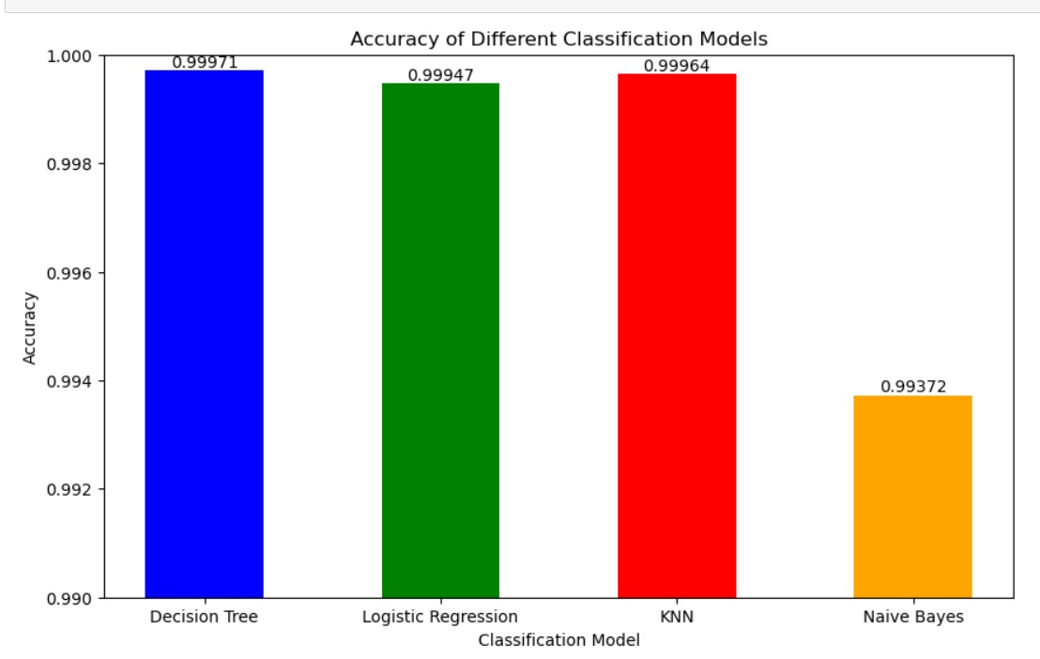
Comparative Analysis
Algorithms | Precision | Recall | Accuracy
Decision Tree Algorithm | 88.6 | 86.33 | 99.97
KNN Algorithm | 80.33 | 88.60 | 99.96
Logistic Regression Algorithm | 70.33 | 94.66 | 99.94
Naïve Bayes Algorithm | 40 | 16.33 | 99.37

Slide 11
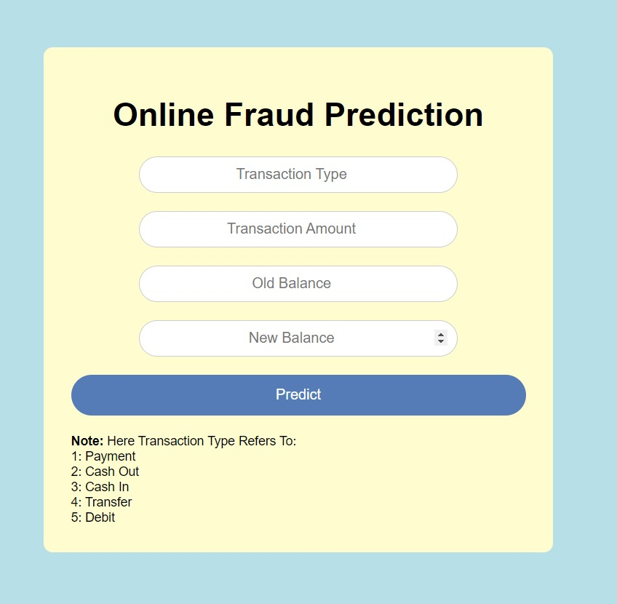
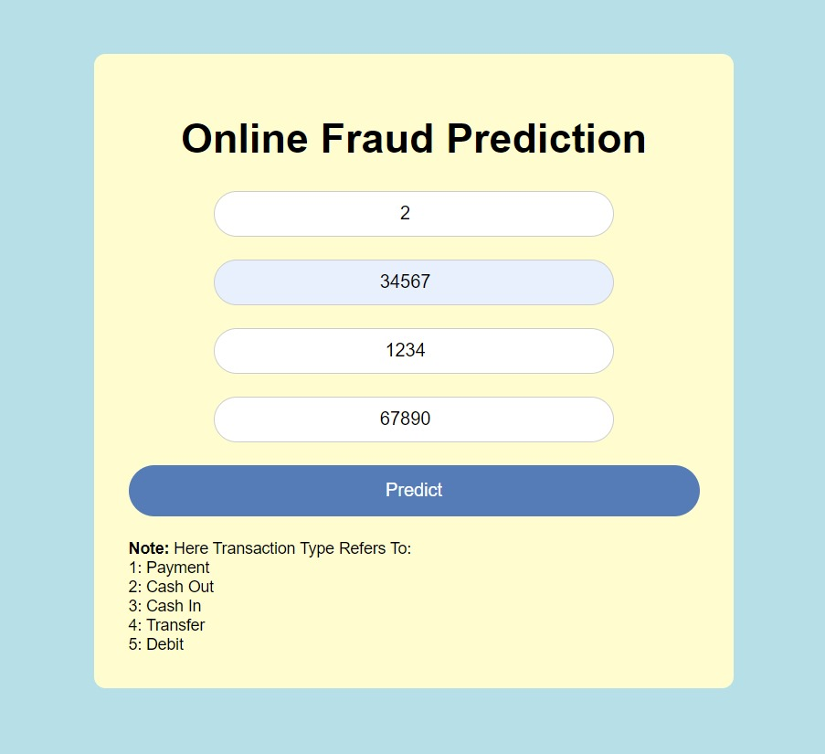
Graphical User Interface

Slide 12
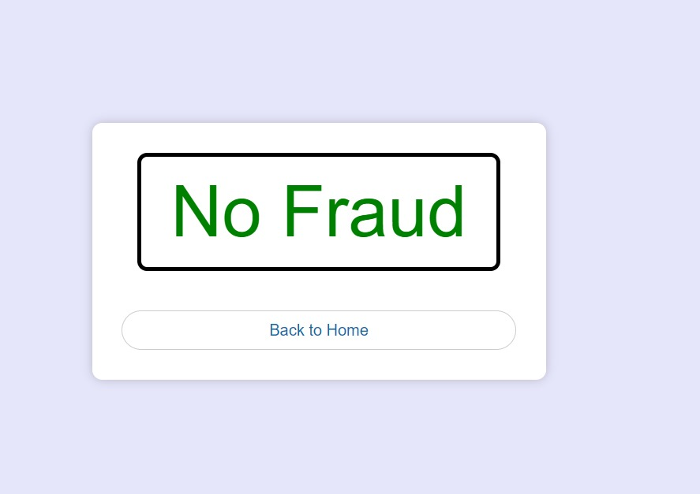
Graphical User Interface

Slide 13
Conclusion
We can see that the accuracy of Decision Tree Algorithm is highest amongst all the four algorithms.
Hence, we can conclude that Decision Tree Algorithm is best suited for fraud detection in accordance to the dataset which we used.
Through the integration of advanced technologies such as artificial intelligence, machine learning, and big data analytics, financial institutions are continuously enhancing their capabilities to detect and prevent fraud in real-time.
The comparison of Navie Bayes, Random Forest, Decision Tree, Logistic Regression, K- Nearest Neighbor is done for finding accuracy of classification models.
Through the integration of advanced technologies such as artificial intelligence, machine learning, and big data analytics, financial institutions are continuously enhancing their capabilities to detect and prevent fraud in real-time.

Slide 14
References
M. N. Ashtiani and B. Raahemi, "Intelligent fraud detection in finan- cial statements using machine learning and data mining: A systematic literature review," IEEE Access, vol. 10, pp. 72504-72525, 2022.
K. Randhawa, C. K. Loo, M. Seera, C. P. Lim, and A. K. Nandi, "Credit card fraud detection using adaboost and majority voting," IEEE Access, vol. 6, pp. 14277-14284, 2018.
A. A. Almazroi and N. Ayub, "Online payment fraud detection model using machine learning techniques," IEEE Access, vol. 11, pp. 137 188- 137 203, 2023. D. Huang, D. Mu, L. Yang, and X. Cai, "Codetect: Financial fraud detection with anomaly feature detection," IEEE Access, vol. 6, pp. 19 161-19 174, 2018.
J. Shah, 2021, “Online Payments Fraud Detection with Machine Learning” [online] Available: https://www.kaggle.com/datasets/jainilcoder/online-payment-fraud-detection

Slide 15

THANK YOU!!!!

