Slide 1
ClassiFace
Demographic Classification by Facial Recognition
CS 334
Damien Lo, Danny Ambrose, Robert Jarman, Will Kohn
April 22, 2025
Notes:
Slides 1-4 (RJ), Slide 5-6 (Damien), Slides 7 (Danny), Slides 8-9 (RJ), Slides 10-13 (Danny), Slides 14-22 (Damien), Slides 23-28 (Will), Slides 29-30 (Danny), Slides 31-32 (Will)

Slide 2
Motivation and Deployment
Identifying Business Clientele and Marketing Strategies
Instead of using pre-cropped images from a dataset, extract client’s faces using YOLO from live cameras
Run the faces through our suite of models to identify the age and gender of patrons
Use the results as analytics to better inform marketing and service-based decisions

Slide 3
The Dataset
IMDB-WIKI – 500k+ face images with age and gender labels

Slide 4
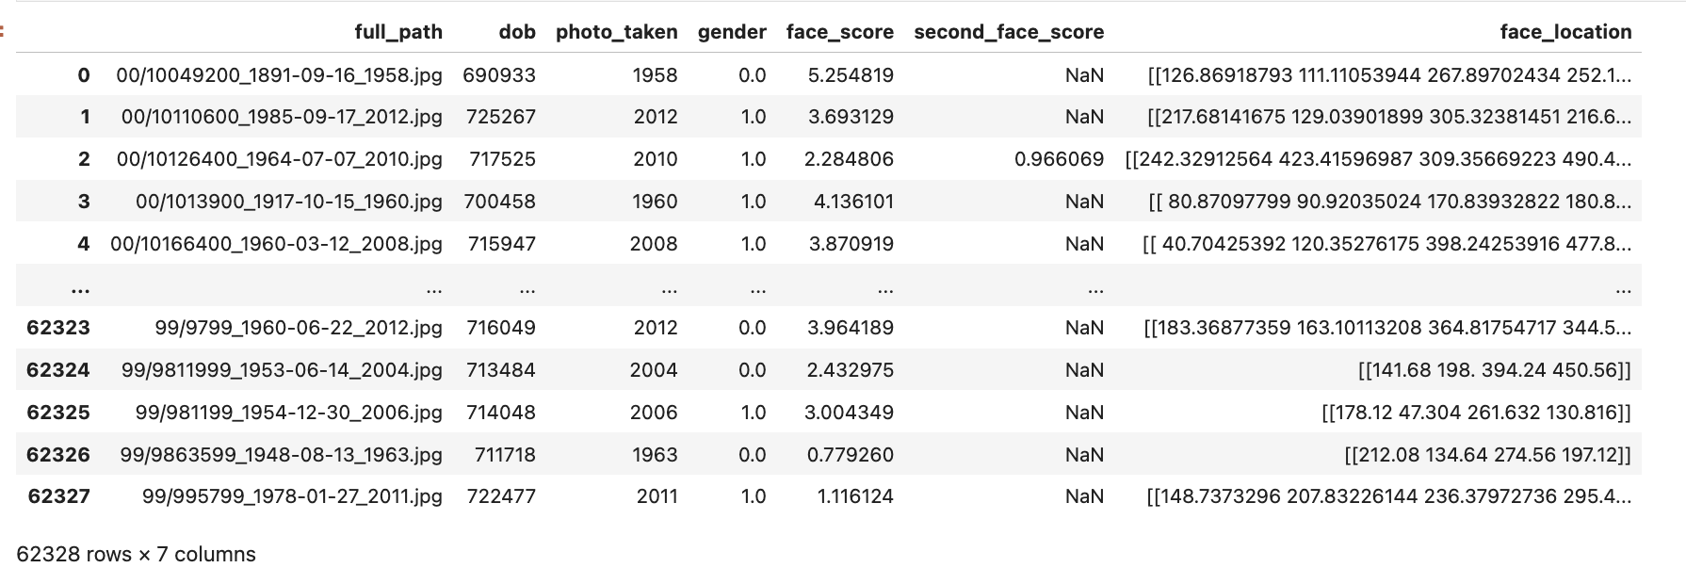

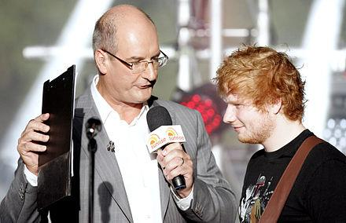
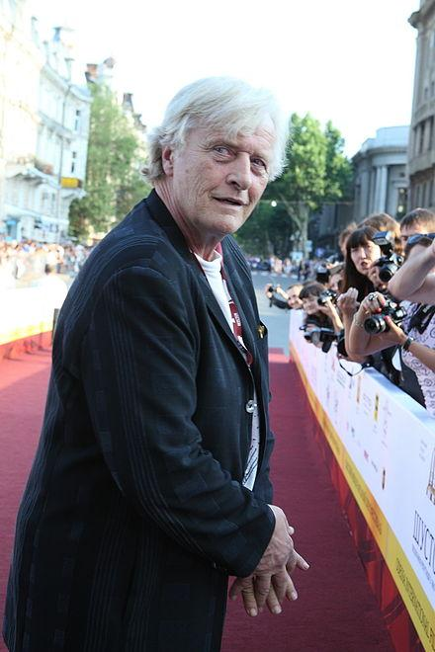
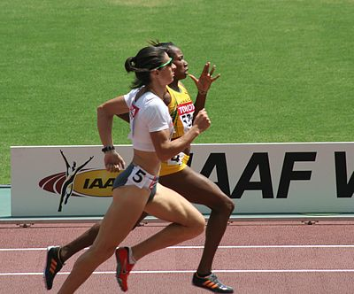
Metadata
dob: date of birth (Matlab serial date number)
photo_taken: year when the photo was taken
full_path: path to file
gender: 0 for female and 1 for male, NaN if unknown
face_location: location of the face. To crop the face in Matlab run
Image Data
(Wiki Face Data)
Notes:
Many retail businesses lack demographic data on their customers such as age and gender, we collect the data through store data

Slide 5
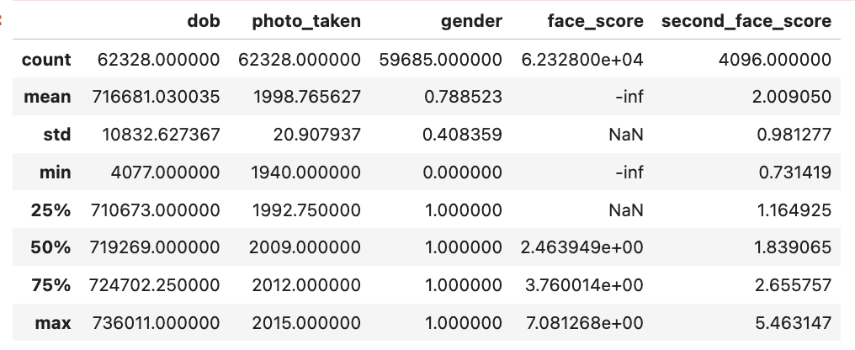
Summary Statistics
Notes:
Refer to some studies hard to read female, bias is some

Slide 6
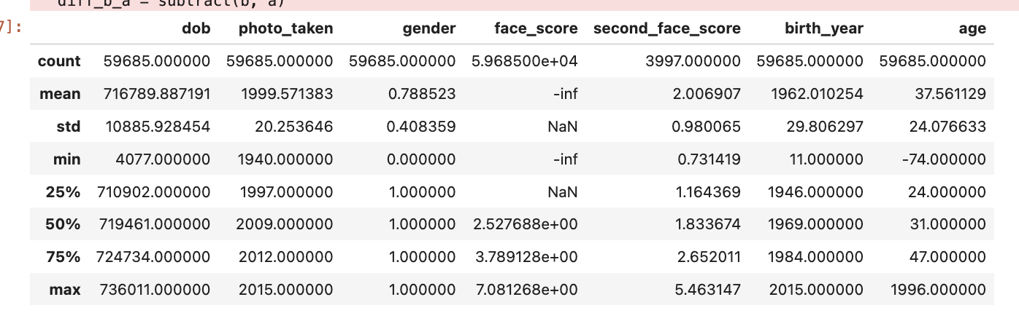
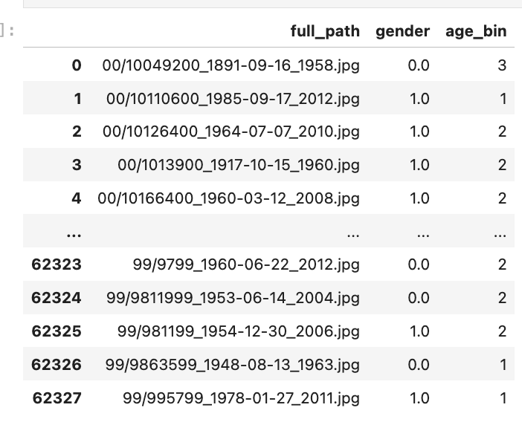
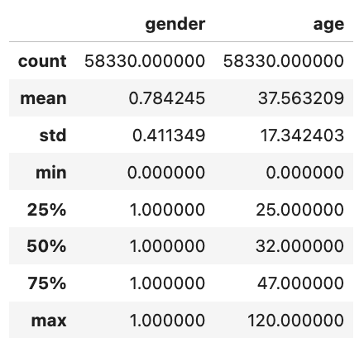
Variable Engineering
1. Age Conversion
2. Missing Data
Age: Fill With Mean
Gender: Dropped
3. Drop Irrelevant Variables
Notes:
Mention there are 2 tasks, binary classification for gender and regression for age

Slide 7
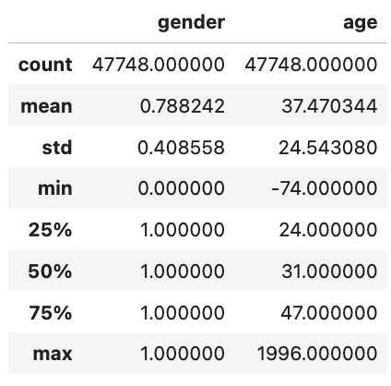
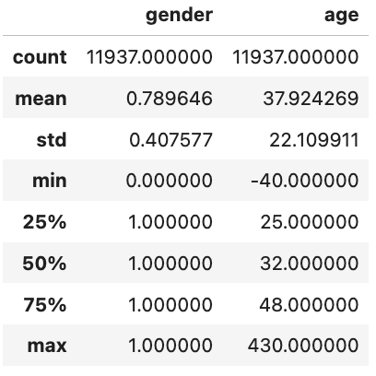
Train & Test Split - 80:20
Split in ascending order of file_path sorted (split is exact)
The mean & standard deviation turned out to be very similar also

Slide 8
KNN

Slide 9
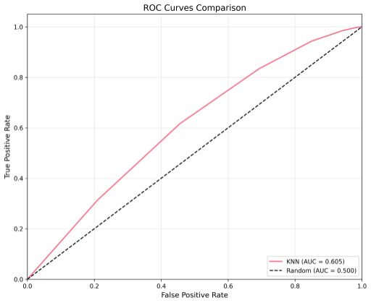
KNN
Best results with k = 8
KNN Gender accuracy: 0.78
KNN Age MAE: 15.82 years
Off by 15 years on average based on the measure error distance
KNN Age RMSE: 25.75 years
Penalizes larger errors
Age R²: -0.13
Model is poor representation
Notes:
It being a negative value represents that it is further from the actual values than if you were to use the average random mean
MAE: Mean Average Error
RMSE: Root Mean Squared Error

Slide 10
Regressions

Slide 11
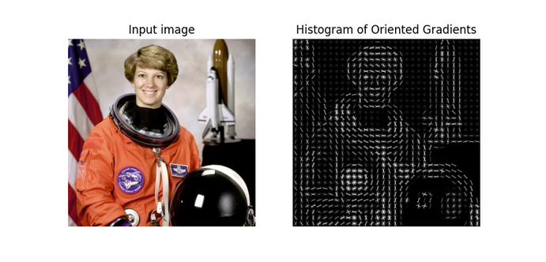
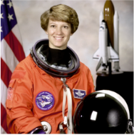

Feature Extraction
Histogram of Oriented Gradients (HOG)
Preprocessing
Crop to face
Resize (128, 128)
Detects edges
Finds gradient magnitude and orientation for each pixel
HOG for each block (16 px)
Works well for lightweight models
128
128

Slide 12
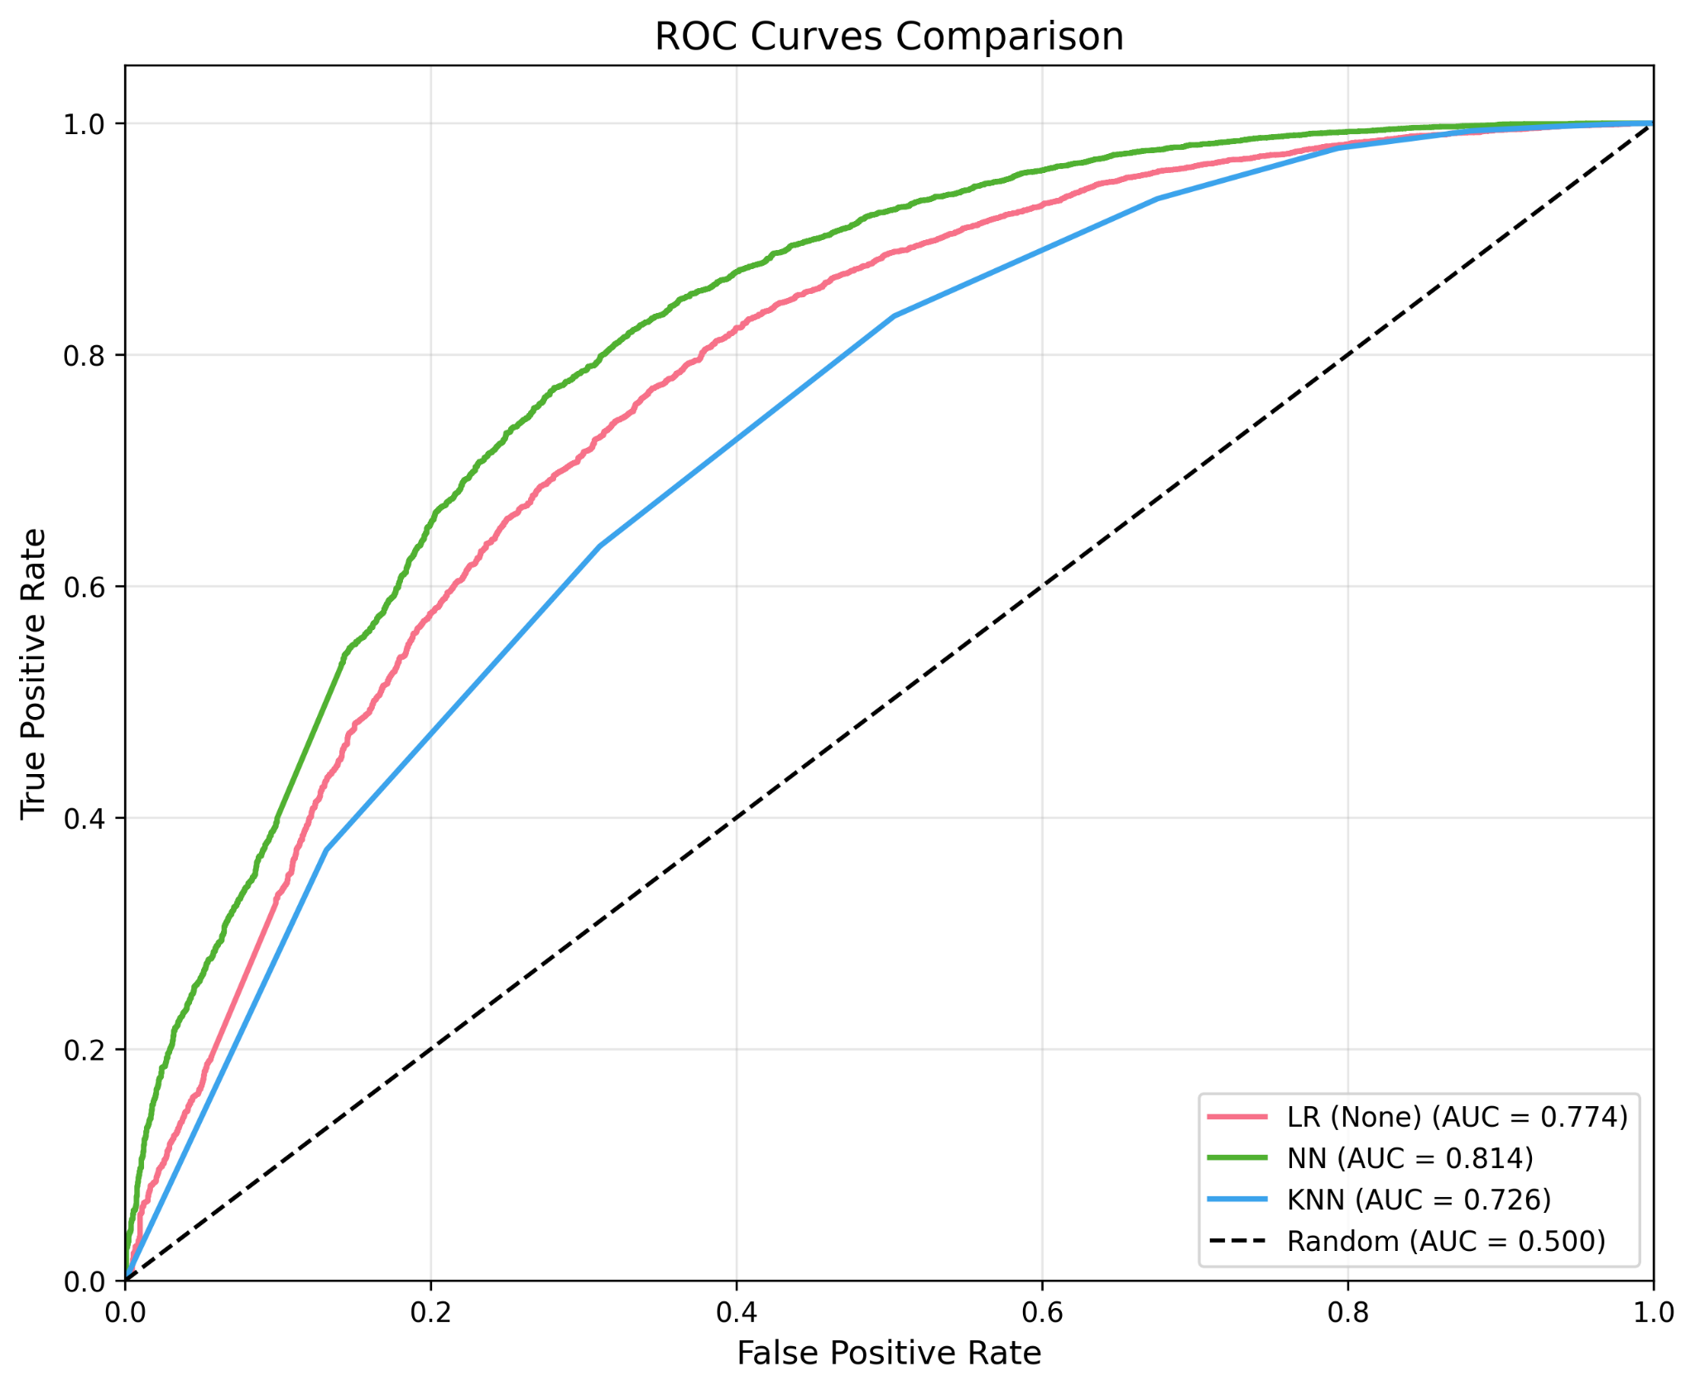
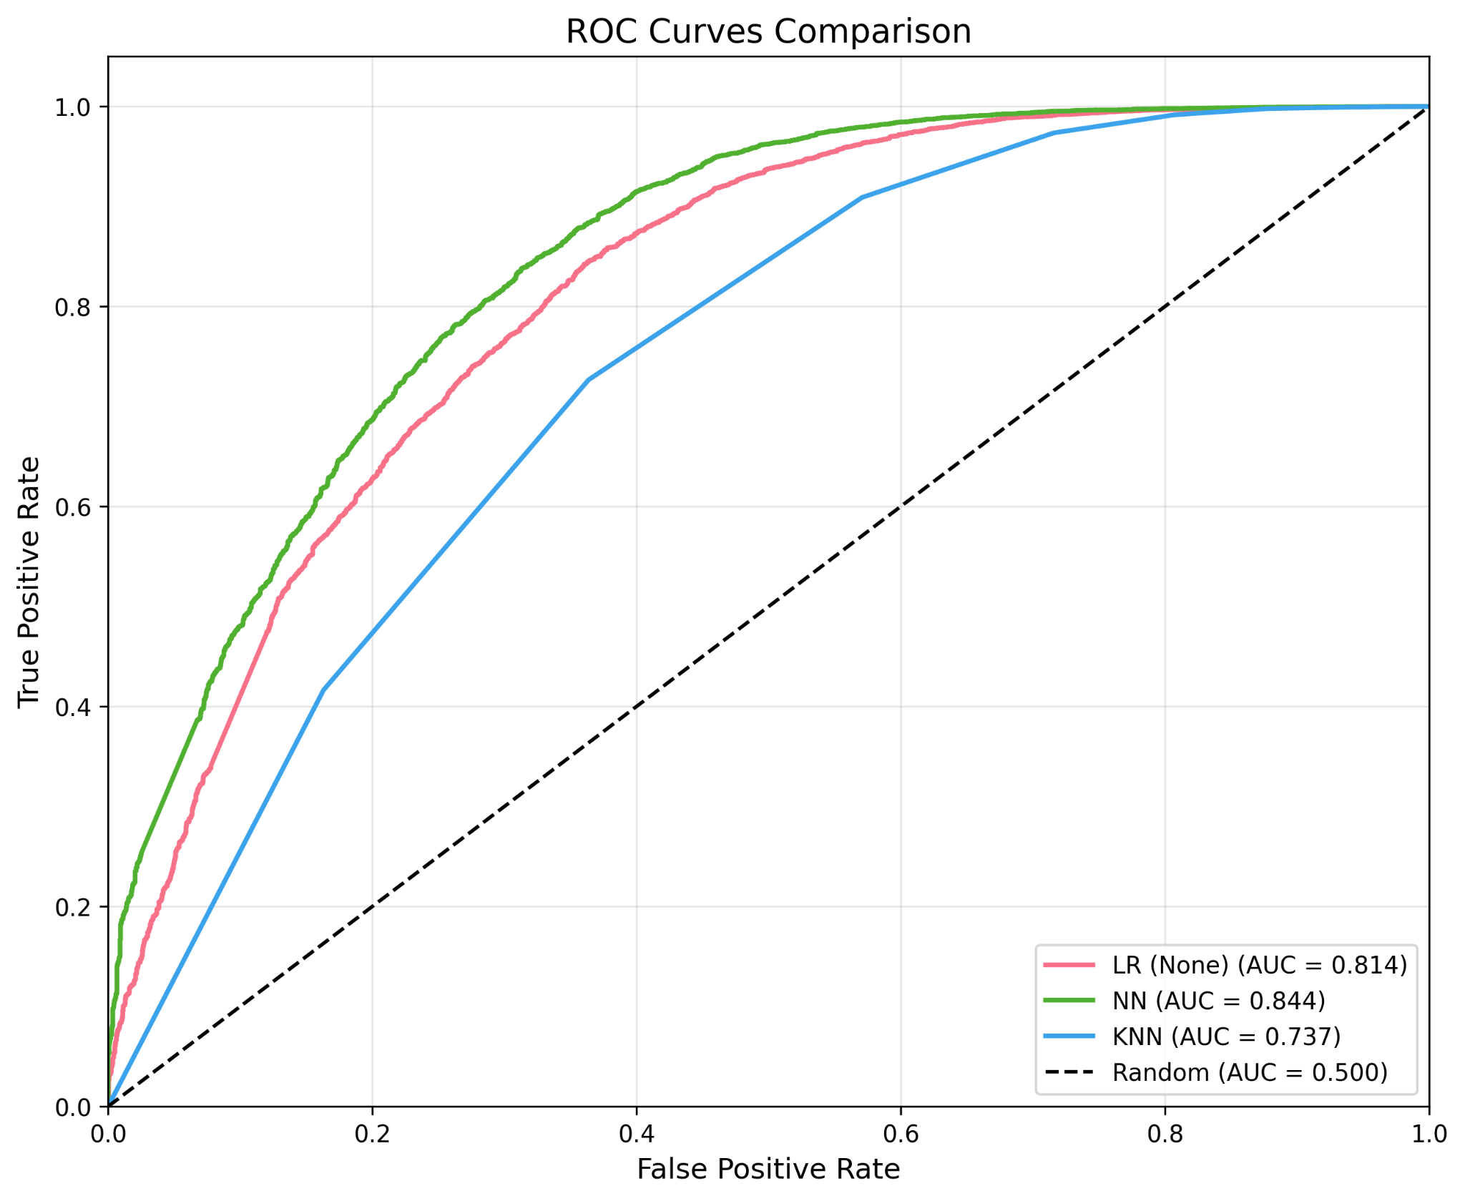
Comparison
HOG feature extraction worked slightly better for lightweight sklearn models than pixel by pixel feature extraction
(Faded lines are px by px with PCA)

Slide 13
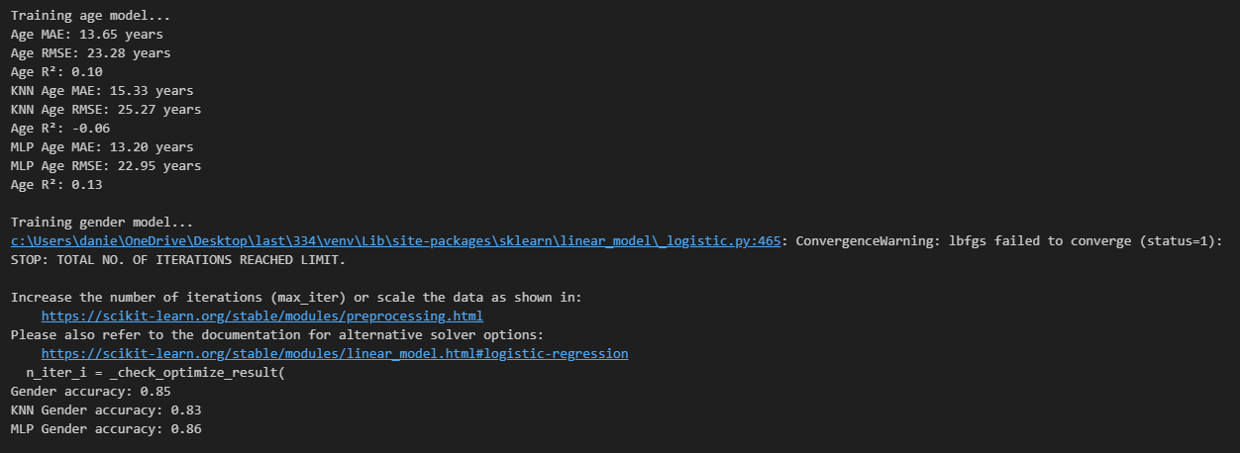
Linear Regression (Age Prediction)
The Linear regression has a MAE of 13.65 years, a RMSE of 23.28 years, and an R² of 0.10.
with HOG feature extraction
80% training and 20% test
No hyperparameter training needed
Logistic Regression (Gender Prediction)
The Logistic regression has a gender predictive accuracy of 85%.
with HOG feature extraction
80% training and 20% test
max_iter = 100 had the best accuracy using Grid Search

Slide 14
FCNN & ResFCNN

Slide 15
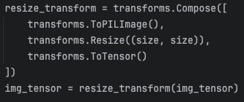
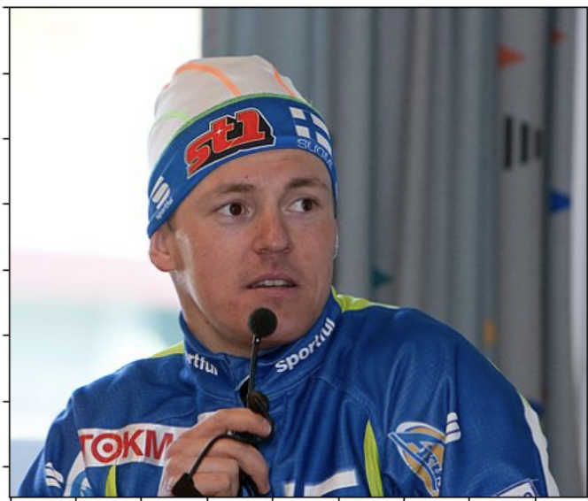
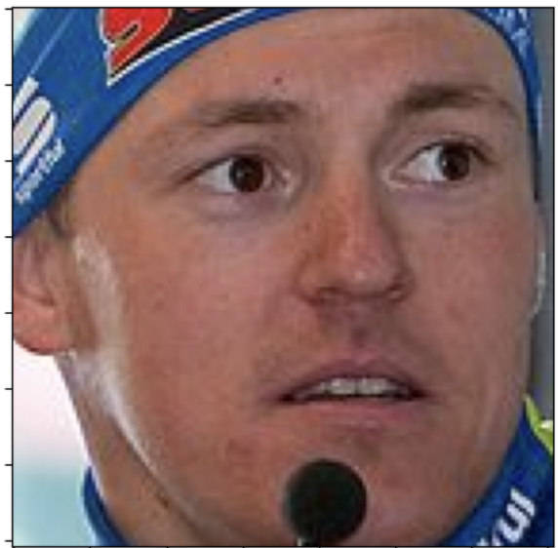



Feature Preprocessing
Resize {128, 224}
Faces can be stretched and squeezed
Face Crop
FCNN
ResFCNN
FCNN
ResFCNN
Flatten [C,H,W] -> C * H * W
New format: [Pixel1C1, Pixel1C2, Pixel1C3, Pixel2C1…..]
*Loose information about the spatial position of pixels, now just a linear order built in from (R,0,0) -> (B,128,128)
Scaling (Colour & Pixel Wise)
FCNN
(255, 255, 255) -> (1,1,1)
Notes:
Note that resize will stretch and squeeze some faces, but necessary for equal features and stacking

Slide 16
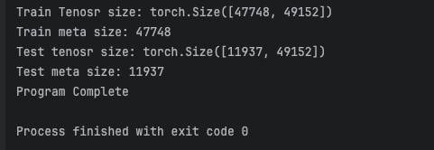
Final Feature Tensor

Slide 17
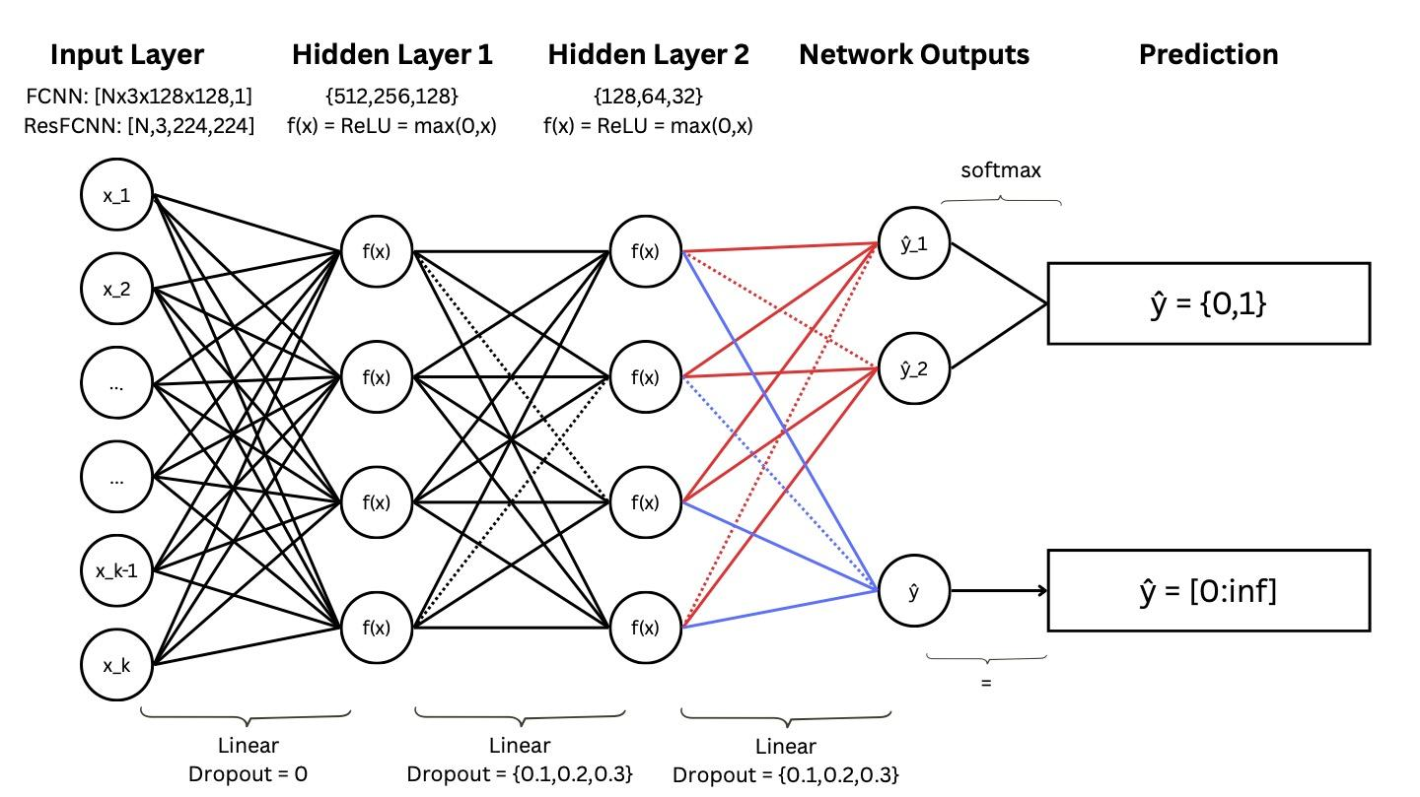
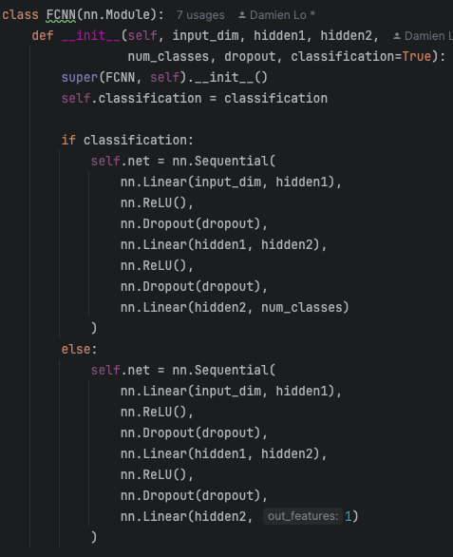
Model Architecture: 3-layered FCNN
Red: Path for Classification Task (Gender)
Blue: Path for Regression Task (Age)

Slide 18
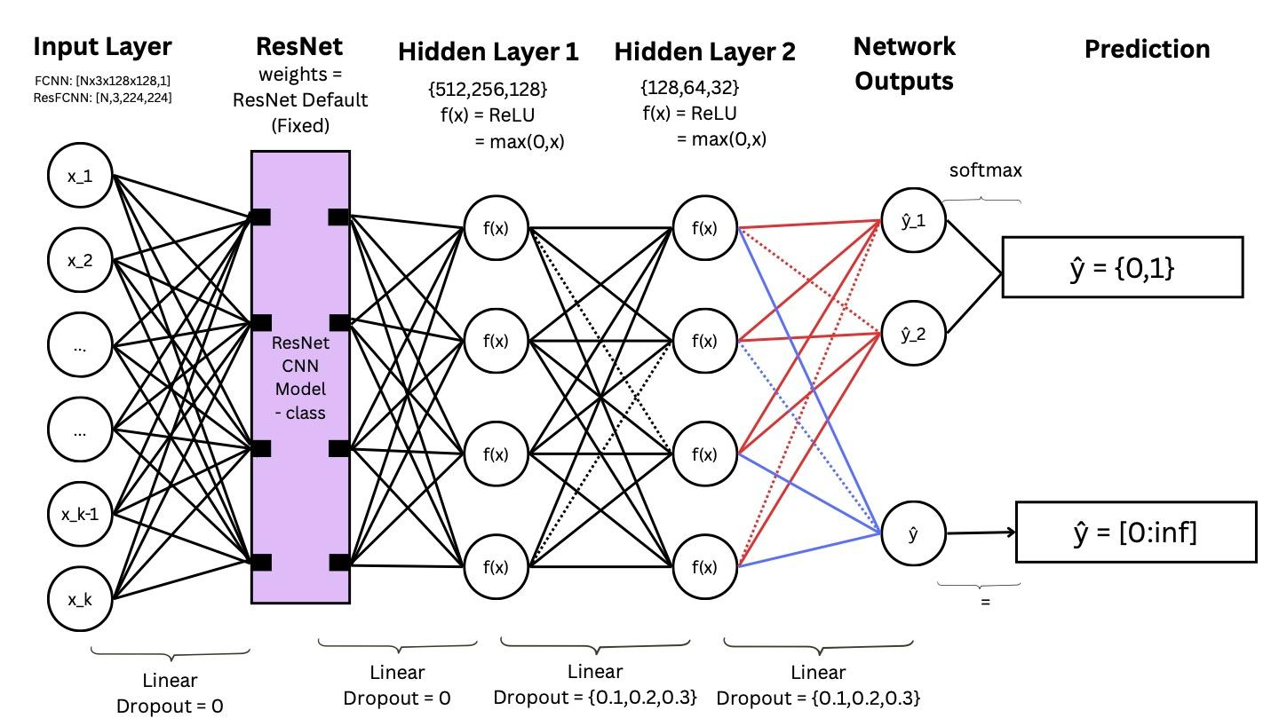
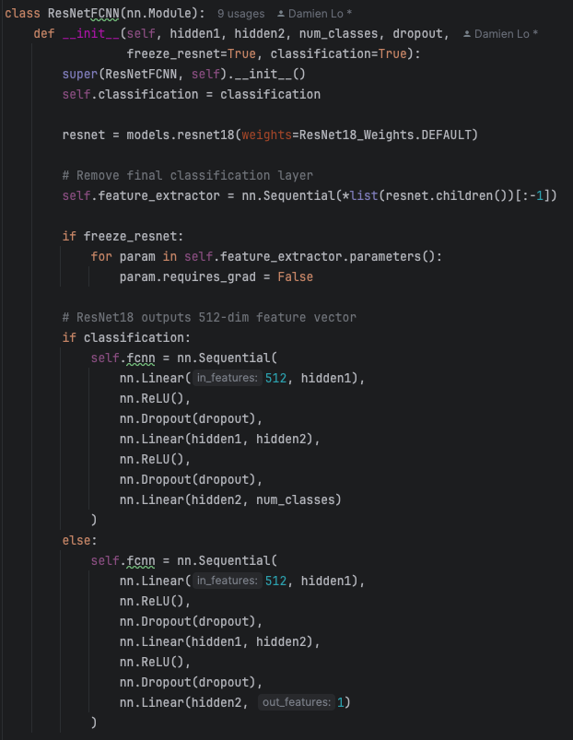
Model Architecture: ResNet + 3-layered FCNN
Red: Path for Classification Task (Gender)
Blue: Path for Regression Task (Age)

Slide 19
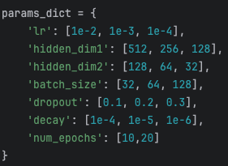
Training and Hyperparameter Tuning
Hyperparameter Method: 5 KFold + Cross Validation (RandomSearch)
Complexity: complexity = hidden_dim1 + hidden_dim2
Returns: best_model, simple_model (within 1 std of best_model.best_epoch)
Loss Metric: (Gender, Age) : (CrossEntropy, MSE)
Optimiser: Adaptive Moment Estimation (ADAM)
Adapts Learning Rate while training
Accounts for both first and second moment
of gradient
Notes:
decay is L2 regulasation

Slide 20
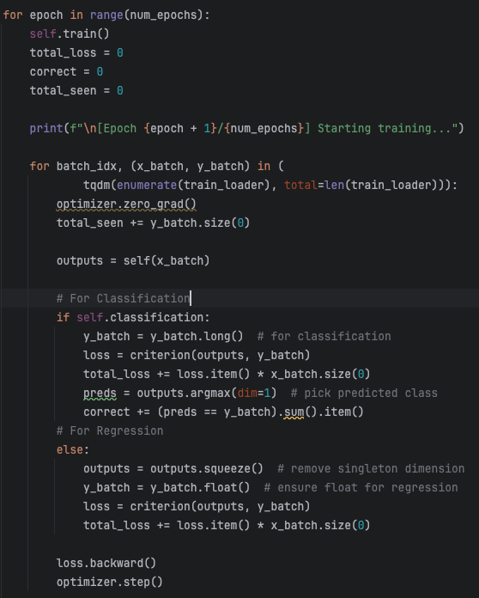
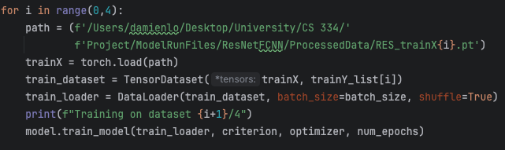
Considerations on Training and Validation
Batch Training
ResNet Model Training
Train dataset had to be split into 4 splits (too large)
For each epoch -> Train on all Datasets
For each dataset -> Train on all epochs
(Average the results per epoch)
Model never sees the whole dataset (interconnections between dataset can not be learnt)
Given splits are random -> train should still converge and be generalisable

Slide 21
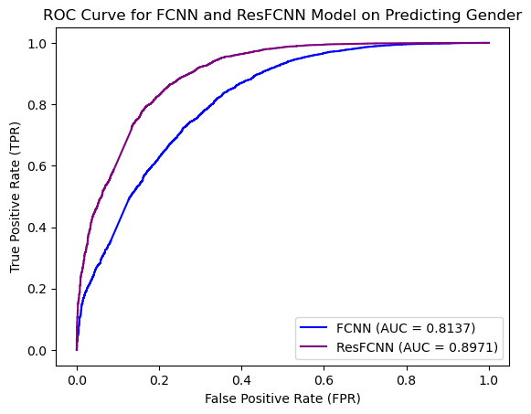
Results: (Gender)
FCNN = {'lr': 1e-04, 'h1': 512, 'h2': 256, 'batch_size': 64, 'num_epochs': 23, 'decay': 1e-04, 'dropout': 0.1, 'complexity': 768}
ResFCNN = {'lr': 1e-03, 'h1': 128, 'h2': 32, 'batch_size': 128, 'num_epochs': 12, 'decay': 1e-06, 'dropout': 0.1, ‘complexity’: 160}

Slide 22
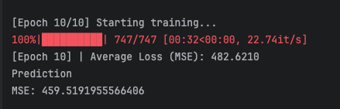
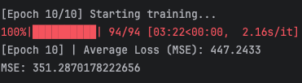
Results: (Age)
FCNN = {'lr': 1e-04, 'h1': 256, 'h2': 128, 'batch_size': 64, 'num_epochs': 15, 'decay': 1e-04, 'dropout': 0.1, 'complexity': 256}
ResFCNN ={'lr': 1e-03, 'h1': 256, 'h2': 64, 'batch_size': 64, 'num_epochs': 14, 'decay': 1e-06, 'dropout': 0.1, ‘complexity’: 160}
FCNN
RMSE = ± 21yr
ResFCNN
RMSE = ± 18yr

Slide 23
Convolutional Neural Networks

Slide 24
Feature Preprocessing
Age and gender extracted from metadata (wiki.mat)
Either age or gender used, not both
Images were kept as RGB and not grayscaled
Each image kept as a 3d matrix
Converted PIL image (H × W × C) → PyTorch tensor: (C, H, W)
Used an 80/20 Train-test split sorted by image path
AlexNet
Resize (227, 227)
Normalize([0.5]*3, [0.5]*3)
Face Crop
ResNet18
Resize (224, 224)
Normalize([0.485, 0.456, 0.406], [0.229, 0.224, 0.225])
Notes:
Note that resize will stretch and squeeze some faces, but necessary for equal features and stacking

Slide 25
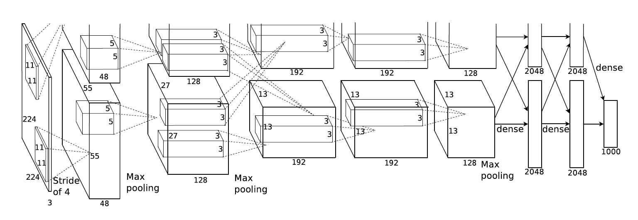
Model Architecture: AlexNet
Trained for 90 epochs with a batch size of 128 (same as original AlexNet). Learning rate was 0.005.
Used Mean Squared Error (MSE) for age loss function and Binary Cross Entropy (BCE) for gender.

Slide 26
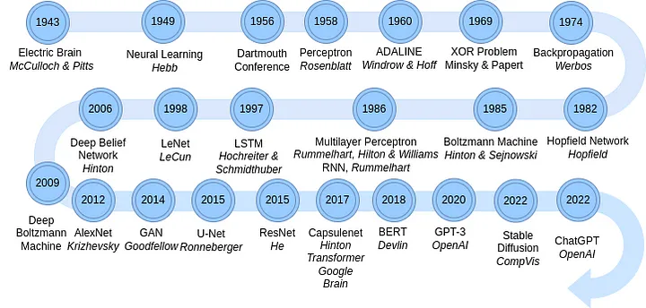
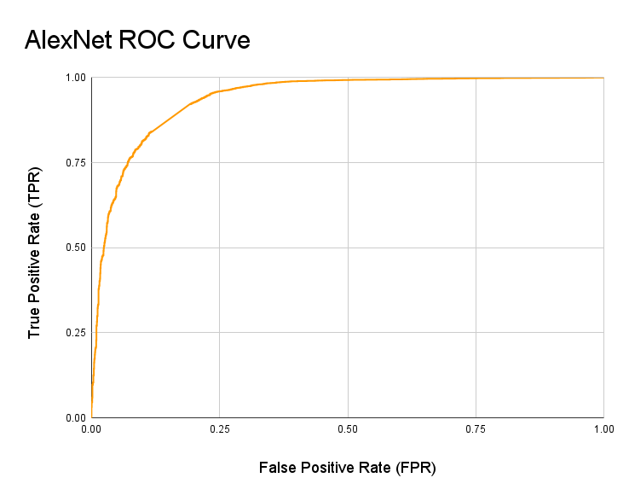
Results: AlexNet
Age Results
Mean Absolute Error (MAE): 10.92 years
Root Mean Squared Error (RMSE): 14.34 years
R²: 0.28031087
Gender Results
Accuracy: 0.9055
Area Under ROC Curve (AUC): 0.9396
Area Under PRC Curve (AUPRC): 0.9680

Slide 27
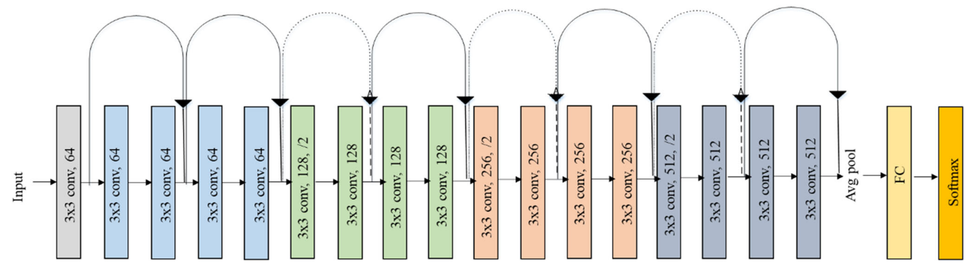
Model Architecture: ResNet18
The same hyperparameters and loss functions were kept from AlexNet. Therefore, no hyperparameter tuning was conducted.

Slide 28
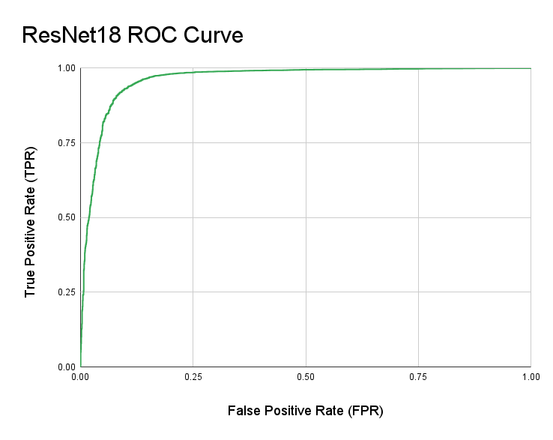
Results: ResNet18
Age Results
Mean Absolute Error (MAE): 7.77 years
Root Mean Squared Error (RMSE): 10.80 years
R²: 0.58654964
Gender Results
Accuracy: 0.9387
Area Under ROC Curve (AUC): 0.9631
Area Under PRC Curve (AUPRC): 0.9830

Slide 29
Model Comparison

Slide 30
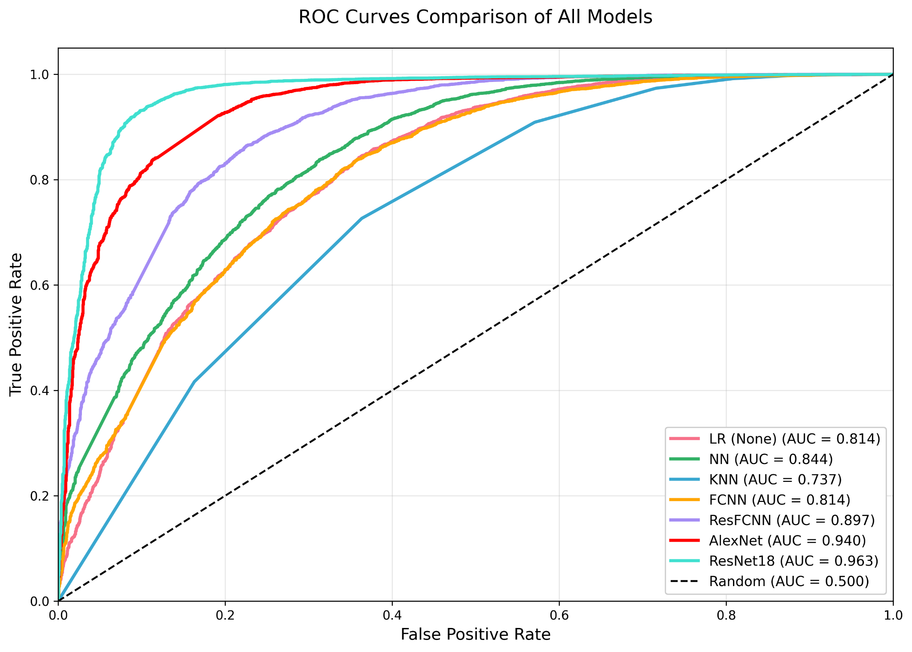
ROC For Gender Prediction

Slide 31
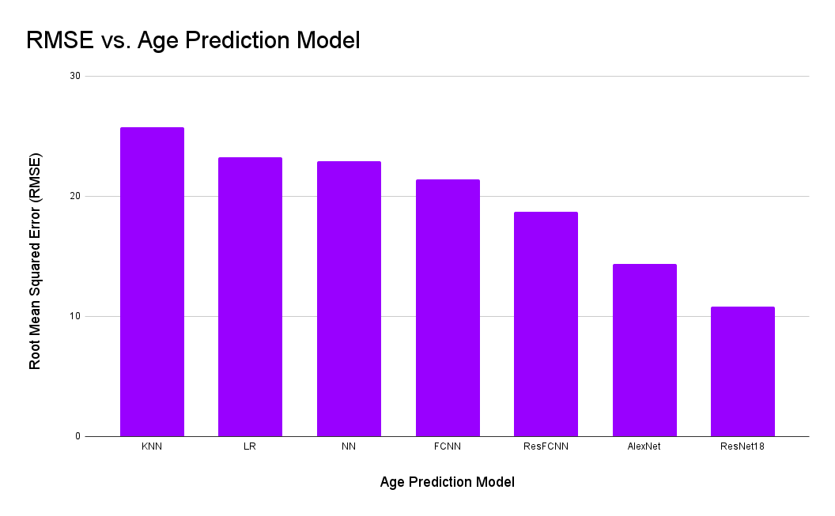
ROC For Gender Prediction
Age Prediction Model | RMSE
KNN | 25.75
LR | 23.28
NN | 22.95
FCNN | 21.42
ResFCNN | 18.73
AlexNet | 14.34
ResNet18 | 10.80

Slide 32
Thank You

